Slide 1
Sustainable Data Curation and Dissemination for Thermodynamics
Ken Kroenlein
Director
Thermodynamics Research Center
Nano WG
November 13, 2014

Slide 2
Our mission…
Provide critically evaluated thermophysical and thermochemical property values of chemicals (and mixtures) for use by industry, academia, and other government agencies for purposes such as…
  Chemical process development & optimization (including essentially all separation processes; distillation, crystallization, extraction)
  Fundamental research into molecular properties (e.g., benchmark values for computational chemistry)
  Regulatory decisions

Slide 3














Slide 4
Experimental data captured from 5 journals
J. Chem. Eng. Data, J. Chem. Thermodyn., Fluid Phase Equilib., Thermochim. Acta, Int. J. Thermophys.

Slide 5
Experimental data captured from 5 journals
J. Chem. Eng. Data, J. Chem. Thermodyn., Fluid Phase Equilib., Thermochim. Acta, Int. J. Thermophys.

Slide 6
Experimental data captured from all literature

Slide 7
Data growth is exponential
Annual growth of data in thermophysical properties of small molecular organics has been near 6 % per year for 200 years
  Doubles every 12 years
Shorter term has been trending upward, with 7 % growth for the last 20 years
  Doubles every 10 years
Across all data collection in science, 4.7 % per year
  Doubles every 15 years
  Larsen and von Ins Scientometrics 2010, 84, 575-603

Slide 8
New compound types appear e.g. ionic liquids, biofuels, pharmaceuticals
1-hexyl-3-methylimidazolium
bis[(trifluoromethyl)sulfonyl]imide
CAS is adding new substances at the rate of more than 15,000 per day.
http://www.cas.org/about-cas/cas-fact-sheets/registry-fact-sheet

Slide 9
Historical Data Evaluation Rate
Hydrocarbons
Non-hydrocarbons
Hydrocarbons
Non-hydrocarbons
14 %
(34% hydrocarbons only)
48 %
Number of Compounds
█ Experimental
█ Evaluated
1952 (Rossini, API 44)
2010 (TRC Tables)
Properties: c_{p}, p_{vap}, ρ, Δ_{c}H, μ

Slide 10
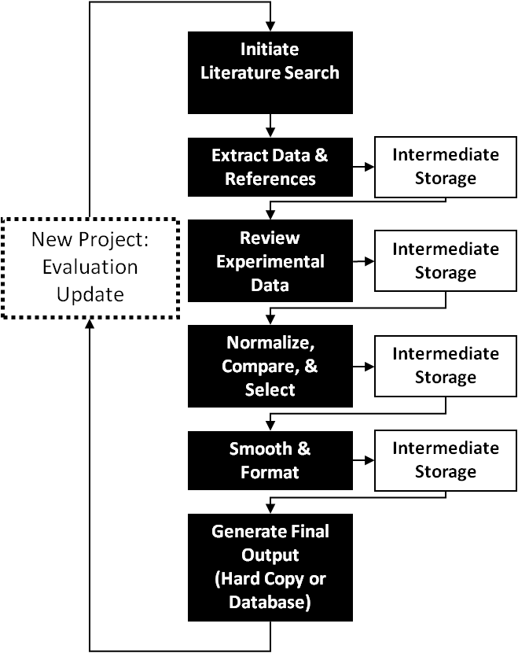
Traditional data evaluation cycle
Very long turn-around times
  Minimum = months or more
Who chooses what to evaluate?
Short “shelf life”
  If new data are published, then what?
Historically, most critically evaluated data have never been used.

Slide 11
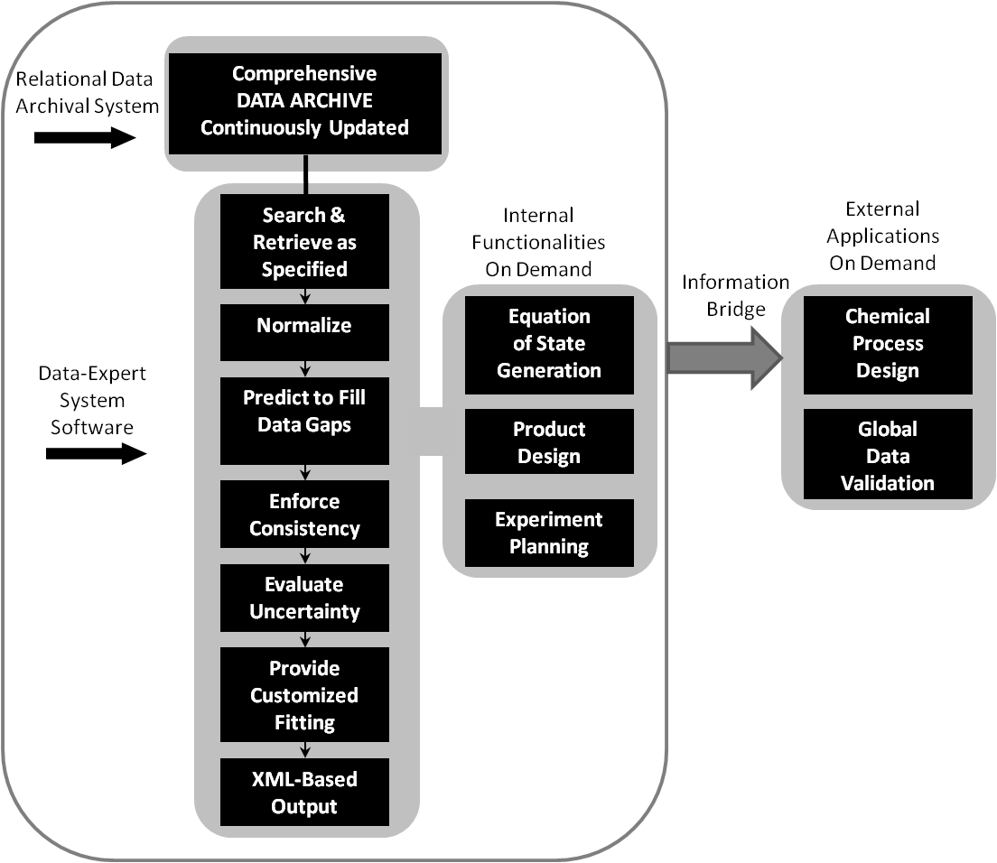
Dynamic data evaluation cycle
Requires
  A trusted data archive with full, machine-interpretable metadata
  Data-Expert System Software: software developed via systematic, test-driven analysis of real data systems
Delivers
  A data expert backed by a well-curated library at the beck and call of engineers
Schematic representation of dynamic data evaluation performed by a user on demand as implemented in the NIST ThermoData Engine (TDE) (NIST SRD 103a and 103b)

Slide 12
Our solution:
NIST Journal Cooperation and
ThermoLit
Since 2003, TRC has been cooperating with journals
in the field with editorial support for data validation:
  J. Chem. Eng. Data (2003)
  J. Chem. Thermodyn. (2004)
  Fluid Phase Equilib. (2005)
  Thermochim. Acta (2005)
  Int. J. Thermophys. (2005)
More details: Chirico et al., J. Chem. Eng. Data 2013, 58, 2699−2716

Slide 13
Facts leading to NIST-Journal cooperation
Many published articles (~ 20 %) reporting experimental thermodynamic and transport property data contained significant numerical errors.
  Reporting of nonsensical uncertainties is not included in this number.
The rate of publication of property data continues to increase rapidly.
  ~2-fold increase of data every 12 years.
Percentage of errors is increasing over time. (Computers are great, but not always…)
Result…
There are a lot of erroneous data in the literature… and the situation is getting worse.
Underlying problems…
Problem 1: Reviewers do not have the time or resources to check reported numerical data against available literature data.
Problem 2: Reviewers do not have the time or resources to check the quality of literature searches by authors.
Problem 3: Tabulated data are very rarely plotted at any time in the review process.
  This would reveal many problems.
The implemented procedures are designed to help with all of these problems.

Slide 14
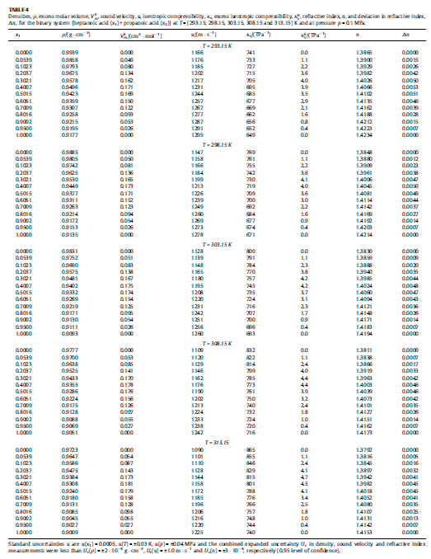
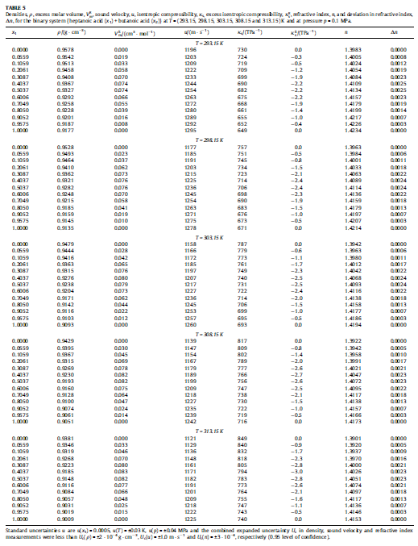
Experimental data look like this…
Reviewers look at it,
and turn to the next page.

Slide 15

1. Experiment Planning
(Article Authors)
Start of
process
ThermoLit
Journal Support
Websites
A
2. Article Preparation and Submission (Article Authors)
NIST Literature Report
End
Reject
3. Journals (Editors)
4. Traditional Peer Review
End
Reject
5. Decision
Approve (not “Accept”)
6a. In-House Data Capture
(Student Associates)
6b. Guided
Data Capture
6c. ThermoData
Engine
B
NIST/TRC
SOURCE Database
NIST Data Report
7. Journals (Editors)
7a. Revisions (Authors)
End
Reject
8. Final
Decision
Accept
Publish
After publication
C
9. ThermoML Archive of
published experimental data
10. Data Users
End of
process

Slide 16
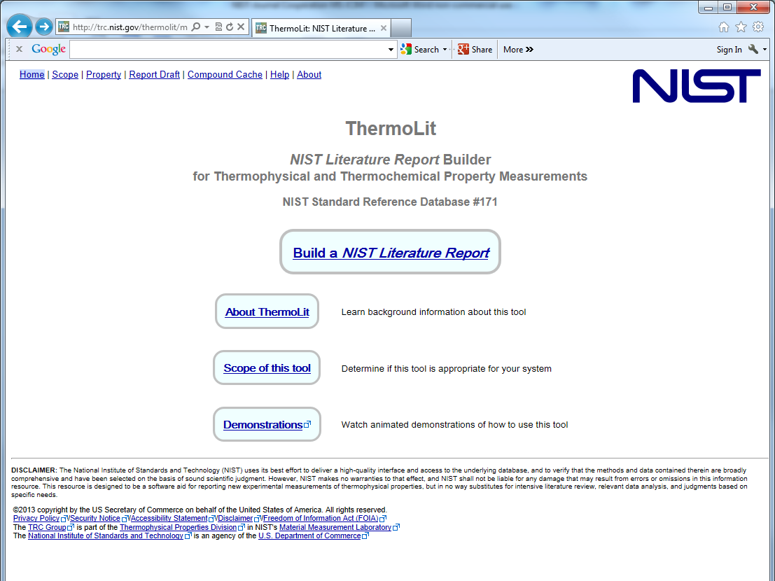
The NIST SOURCE Archive:
5.4 million experimental
property values for
Pure compounds: 22,000
Binary Mixtures: 46,000
Ternary Mixtures: 13,000
Reactions: 6400
This web application provides free and open access to literature information contained in the NIST SOURCE Data Archive of Experimental Data, and provides an easy-to-use tool for generation of a NIST Literature Report in PDF format

Slide 17
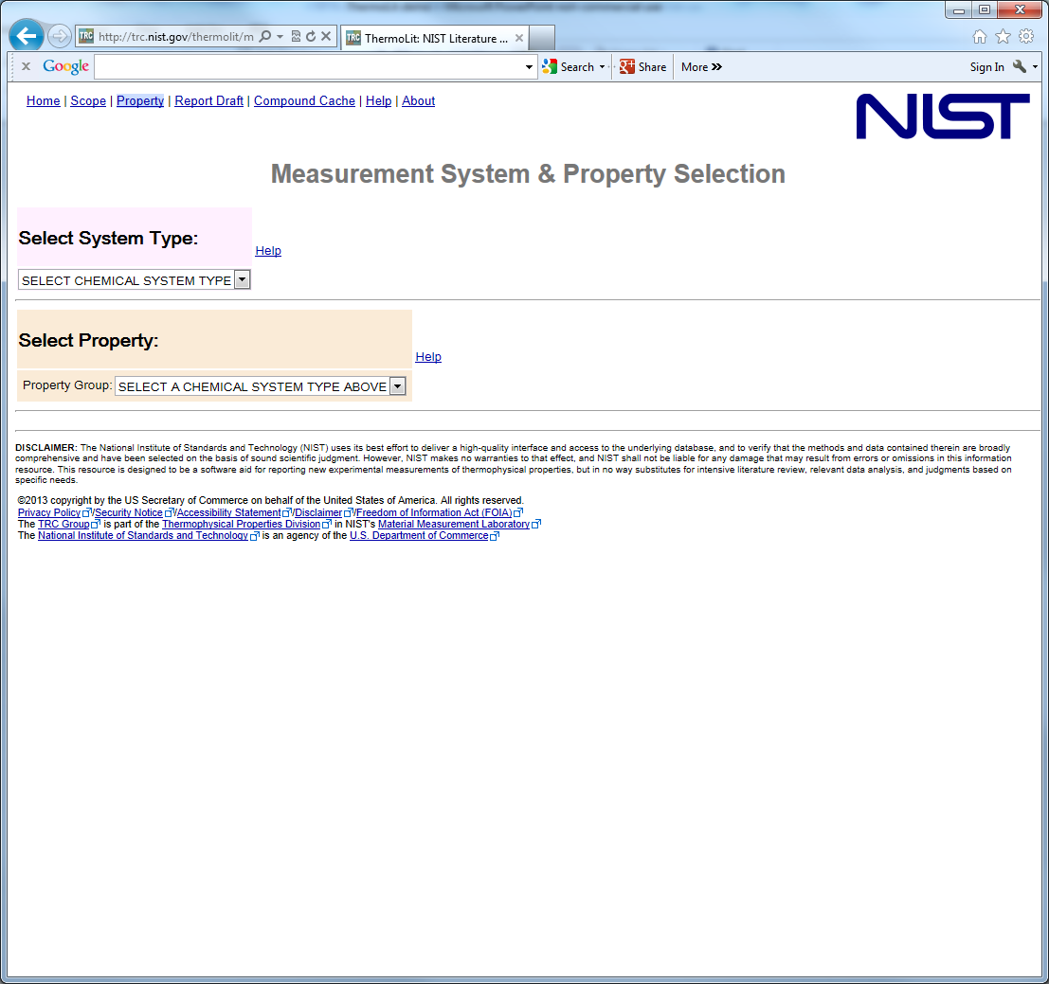
Select the system type:
(i.e. the number of chemicals in your mixtures – 3 max)

Slide 18
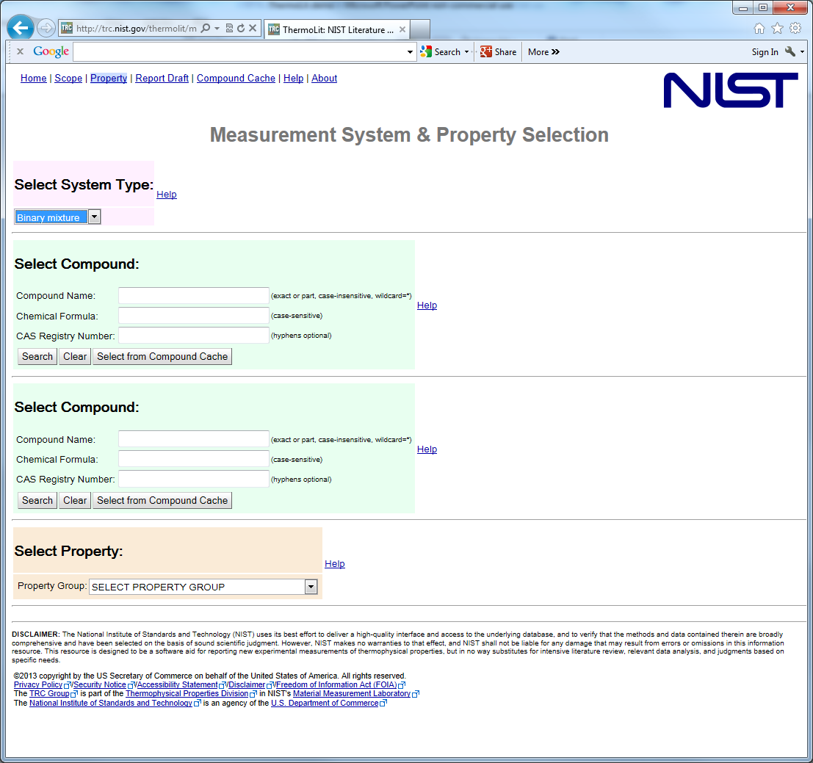
Select chemicals:
Many thousands to choose from
Search by name, formula, CASRN

Slide 19
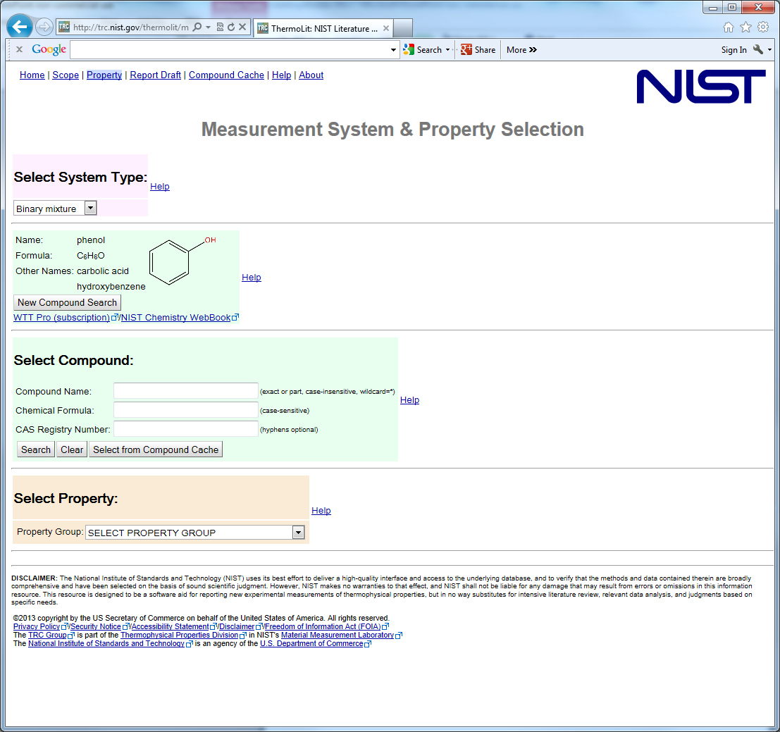
Find first compound: phenol
Enter compound name, formula, CASRN, or combination…
Here, name = toluene

Slide 20
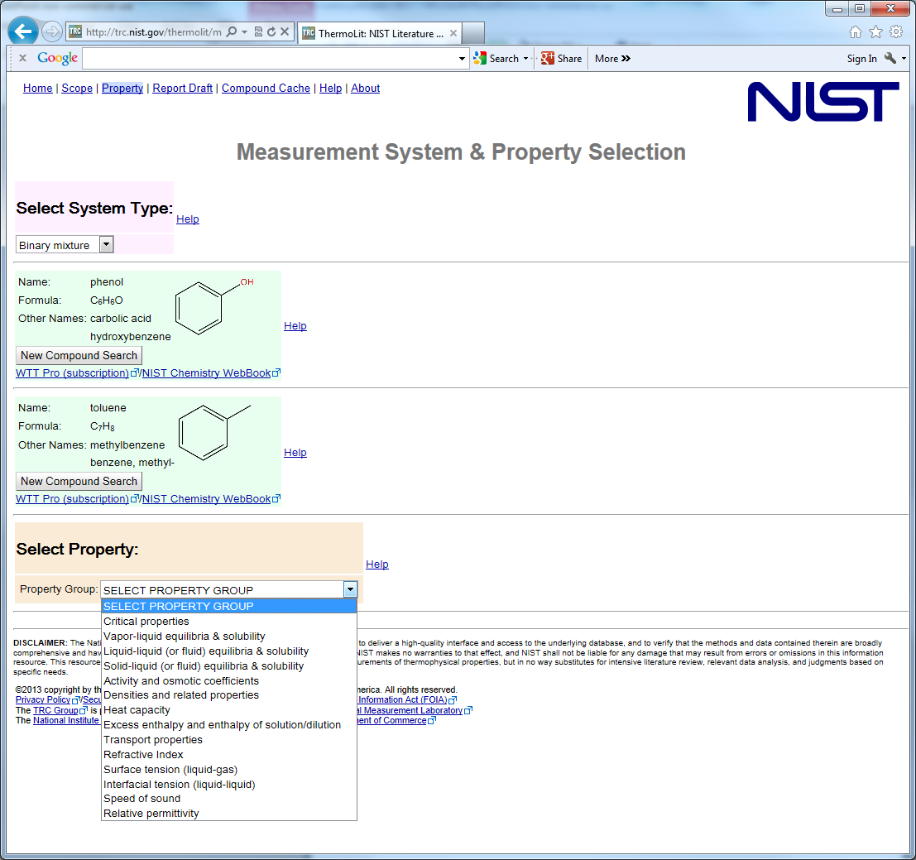
Select the Property Group:
Some have 2 or 3 sub-properties to choose from, but for most, there are none

Slide 21
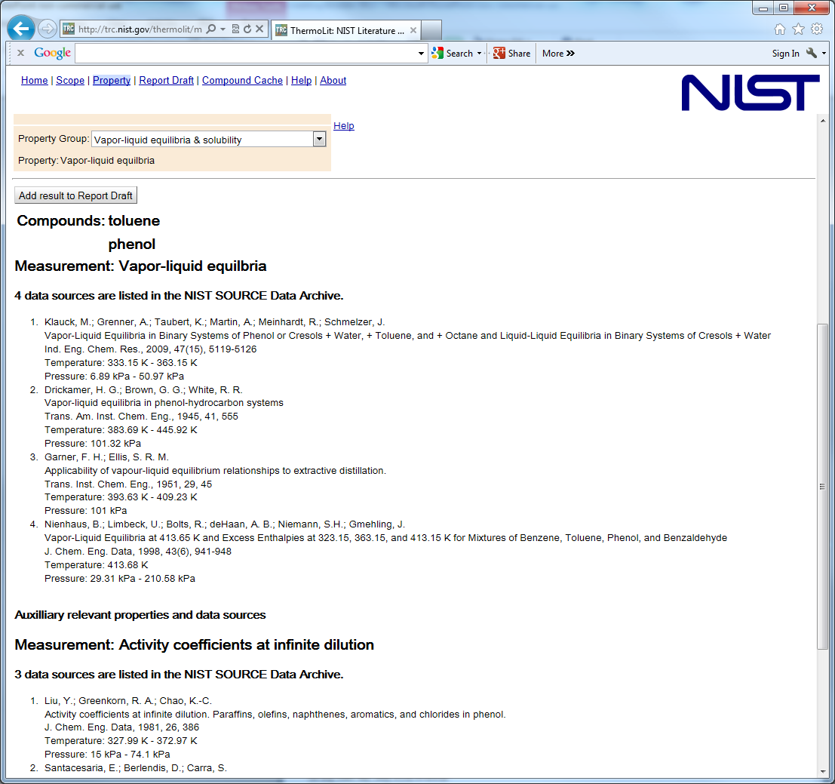
Scroll down to see all results
Results for closely related properties are provided automatically
Results mimic a traditional literature search…
  Bibliographic information
  Variable ranges (not numerical data)

Slide 22
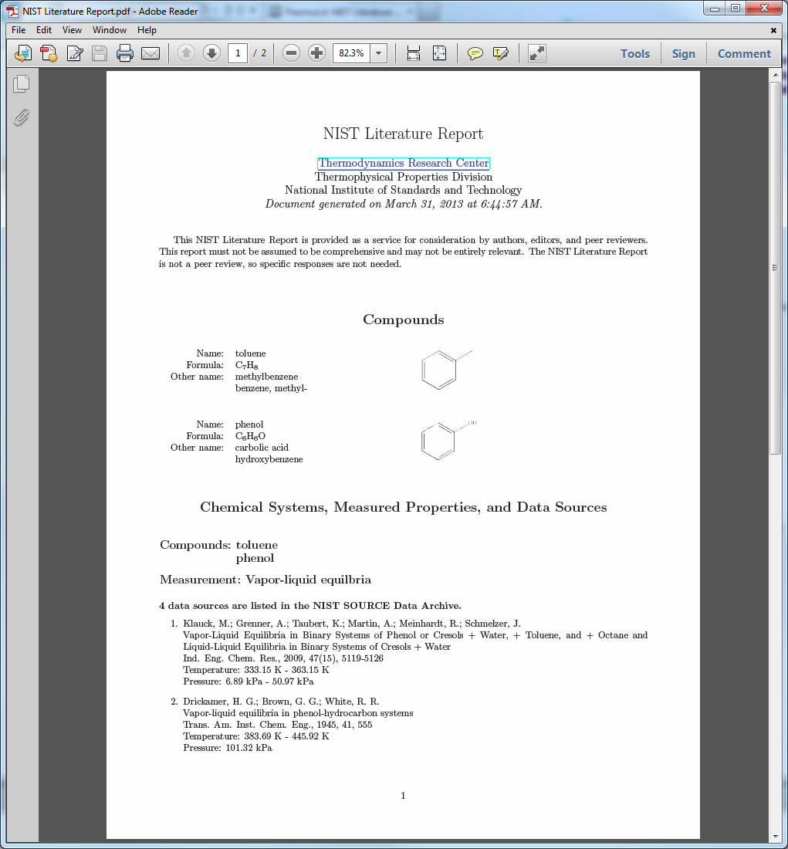

Slide 23
1. Experiment Planning
(Article Authors)
Start of
process
ThermoLit
Journal Support
Websites
A
2. Article Preparation and Submission (Article Authors)
NIST Literature Report
End
Reject
3. Journals (Editors)
4. Traditional Peer Review
End
Reject
5. Decision
Approve (not “Accept”)
6a. In-House Data Capture
(Student Associates)
6b. Guided
Data Capture
6c. ThermoData
Engine
B
NIST/TRC
SOURCE Database
NIST Data Report
7. Journals (Editors)
7a. Revisions (Authors)
End
Reject
8. Final
Decision
Accept
Publish
After publication
C
9. ThermoML Archive of
published experimental data
10. Data Users
End of
process

Slide 24
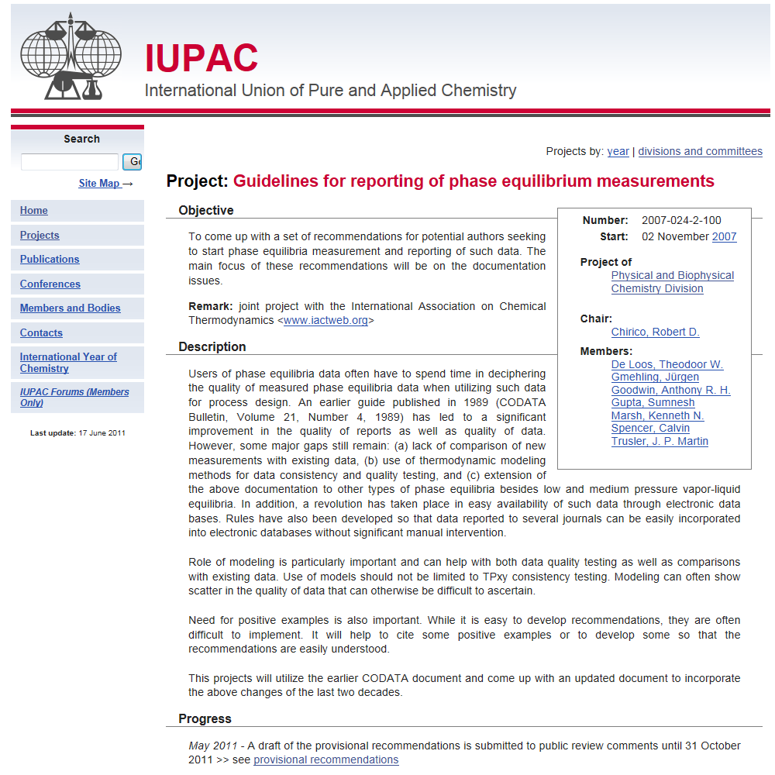
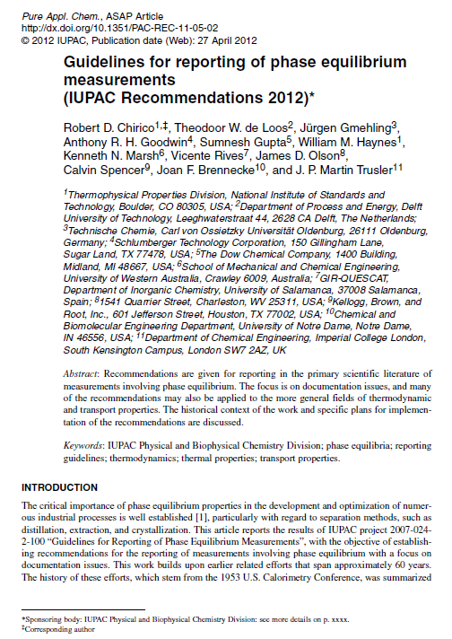
2007 IUPAC Project:
Guidelines for Reporting of Phase Equilibrium Measurements
Journal Editors plus
Data Analysts &
Process Engineers on the team
Right team to ensure:
dissemination
implementation
consistent enforcement
Guidelines can be applied to all thermophysical property measurements of all kinds
(Focus: Documentation Issues)

Slide 25
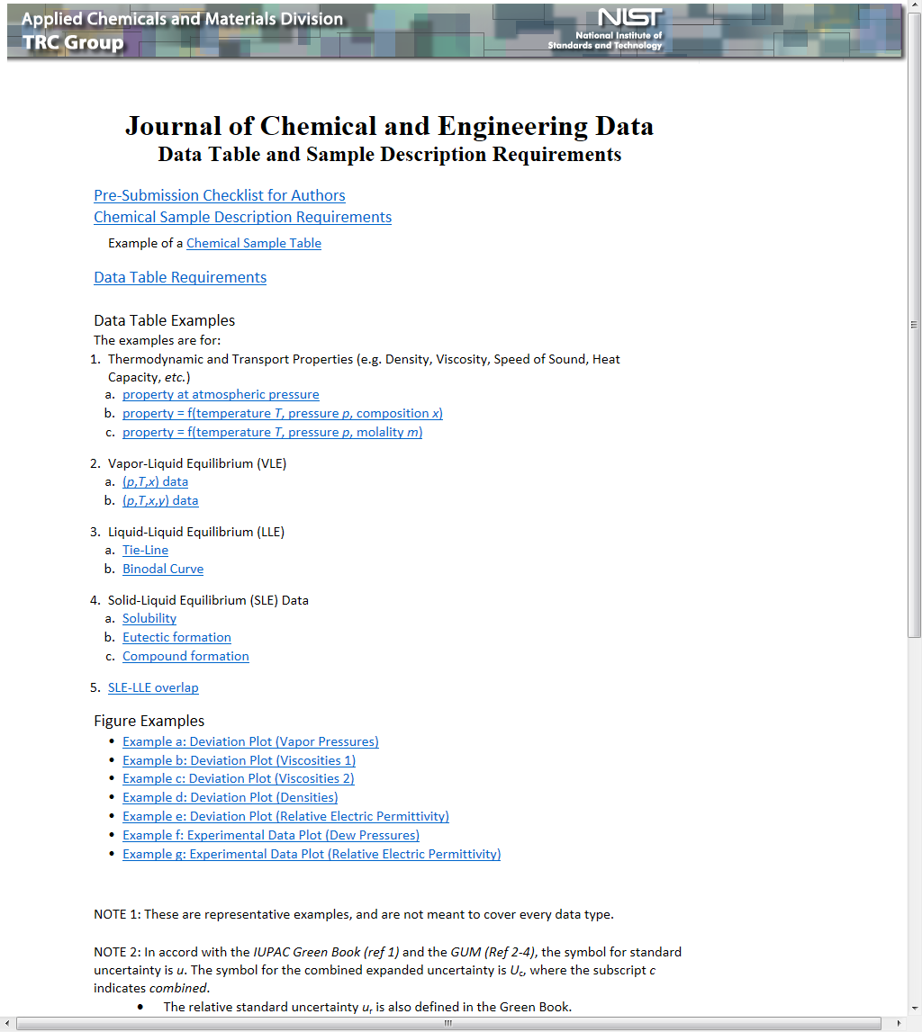
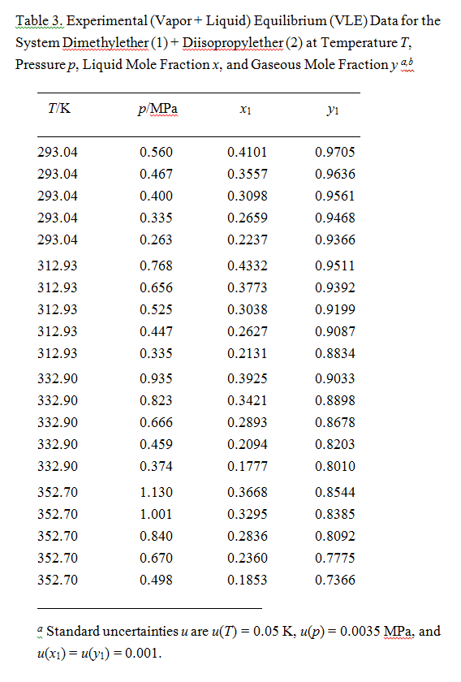
Pre-submission checklist for authors (and reviewers)
Customized support for each journal
(style & format)
Examples
Note 1: Tables are “stand alone”, and should include well defined
compounds
variables
constraints
compositions
properties
data types
(experimental vs derived data)
Journal Support Websites were developed to disseminate the recommendations through examples
Note 2: Uncertainties must be included in the table

Slide 26
1. Experiment Planning
(Article Authors)
Start of
process
ThermoLit
Journal Support
Websites
A
2. Article Preparation and Submission (Article Authors)
NIST Literature Report
End
Reject
3. Journals (Editors)
4. Traditional Peer Review
End
Reject
5. Decision
Approve (not “Accept”)
6a. In-House Data Capture
(Student Associates)
6b. Guided
Data Capture
6c. ThermoData
Engine
B
NIST/TRC
SOURCE Database
NIST Data Report
7. Journals (Editors)
7a. Revisions (Authors)
End
Reject
8. Final
Decision
Accept
Publish
After publication
C
9. ThermoML Archive of
published experimental data
10. Data Users
End of
process

Slide 27
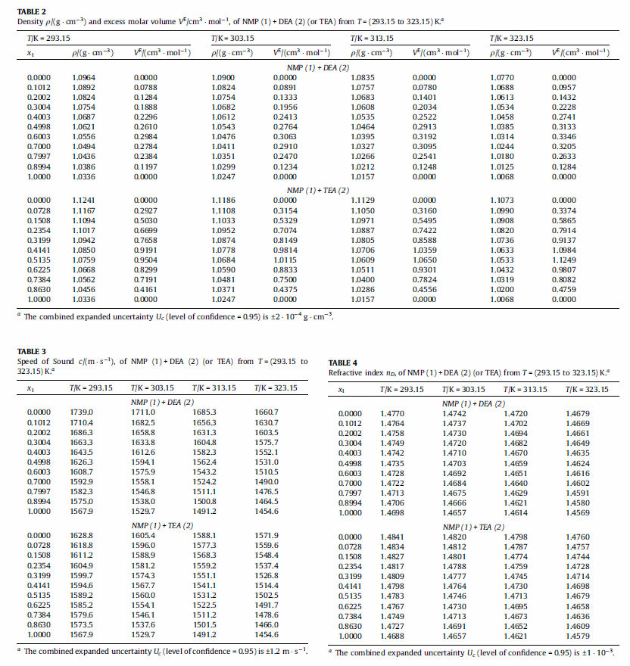
Many tables of experimental data look like this...(or worse)
Reviewers will not carefully plot or review this data
What do we see at the “Approve” stage?
(In traditional peer review, these data are already accepted)

Slide 28
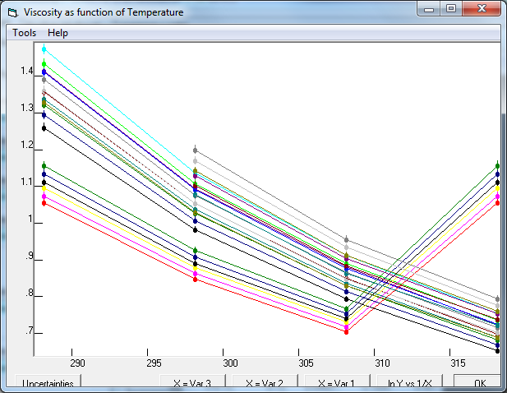
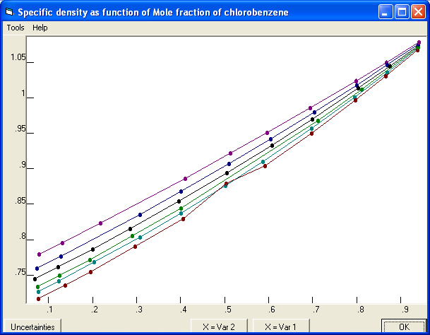
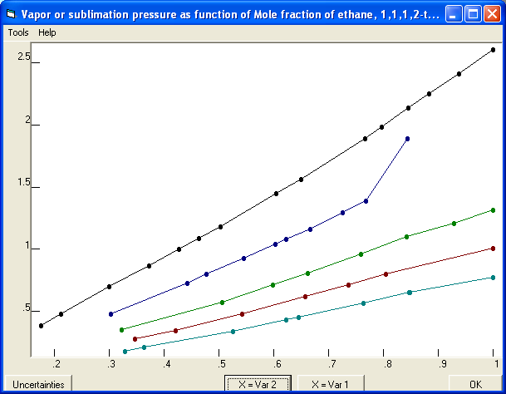
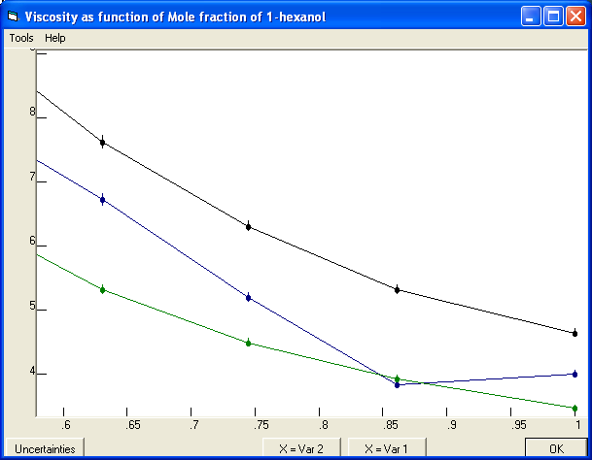
Typographical Errors…
Erroneous column duplication
Fill-down error
Viscosities for a ternary mixture plotted as a function of temperature. Lines represent data of constant composition (isopleths).
Densities for a binary system are shown as a function of temperature for twelve isopleths (compositions).
Random typing errors still happen…

Slide 29
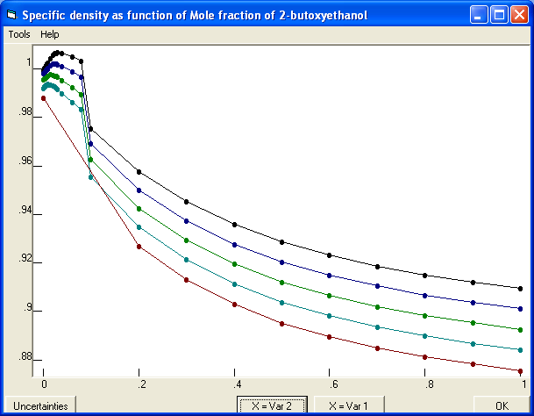
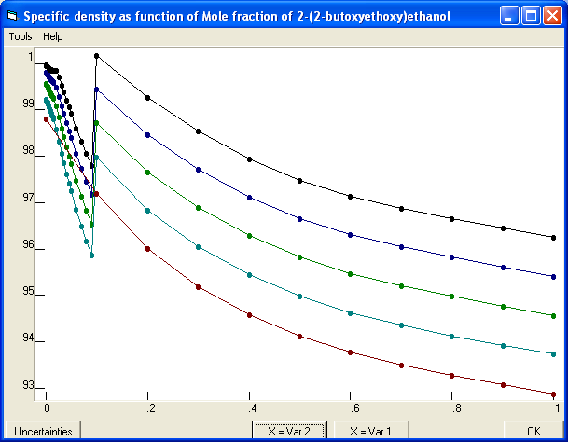
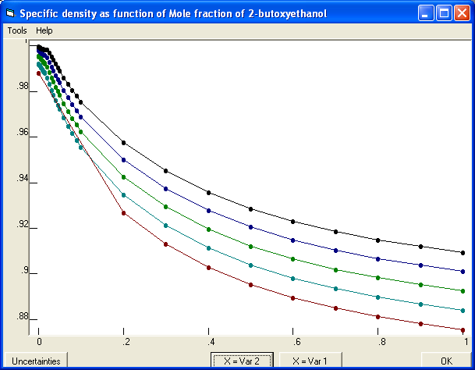
Compound names were switched between low and high concentration data tables
Density as a function of mole fraction for a binary mixture
After repair

Slide 30
1. Experiment Planning
(Article Authors)
Start of
process
ThermoLit
Journal Support
Websites
A
2. Article Preparation and Submission (Article Authors)
NIST Literature Report
End
Reject
3. Journals (Editors)
4. Traditional Peer Review
End
Reject
5. Decision
Approve (not “Accept”)
6a. In-House Data Capture
(Student Associates)
6b. Guided
Data Capture
6c. ThermoData
Engine
B
NIST/TRC
SOURCE Database
NIST Data Report
7. Journals (Editors)
7a. Revisions (Authors)
End
Reject
8. Final
Decision
Accept
Publish
After publication
C
9. ThermoML Archive of
published experimental data
10. Data Users
End of
process

Slide 31
Examples of problems found with TDE...
We are looking for data consistency with…
  Critically evaluated property data
  Literature values
  The laws of science
Next few slides show figures generated by the NIST ThermoData Engine (TDE) software
These are generated automatically when an inconsistency is detected
Inconsistencies are reviewed by NIST professionals (like me) and verified problems are included in a NIST Data Report provided to the Journals

Slide 32
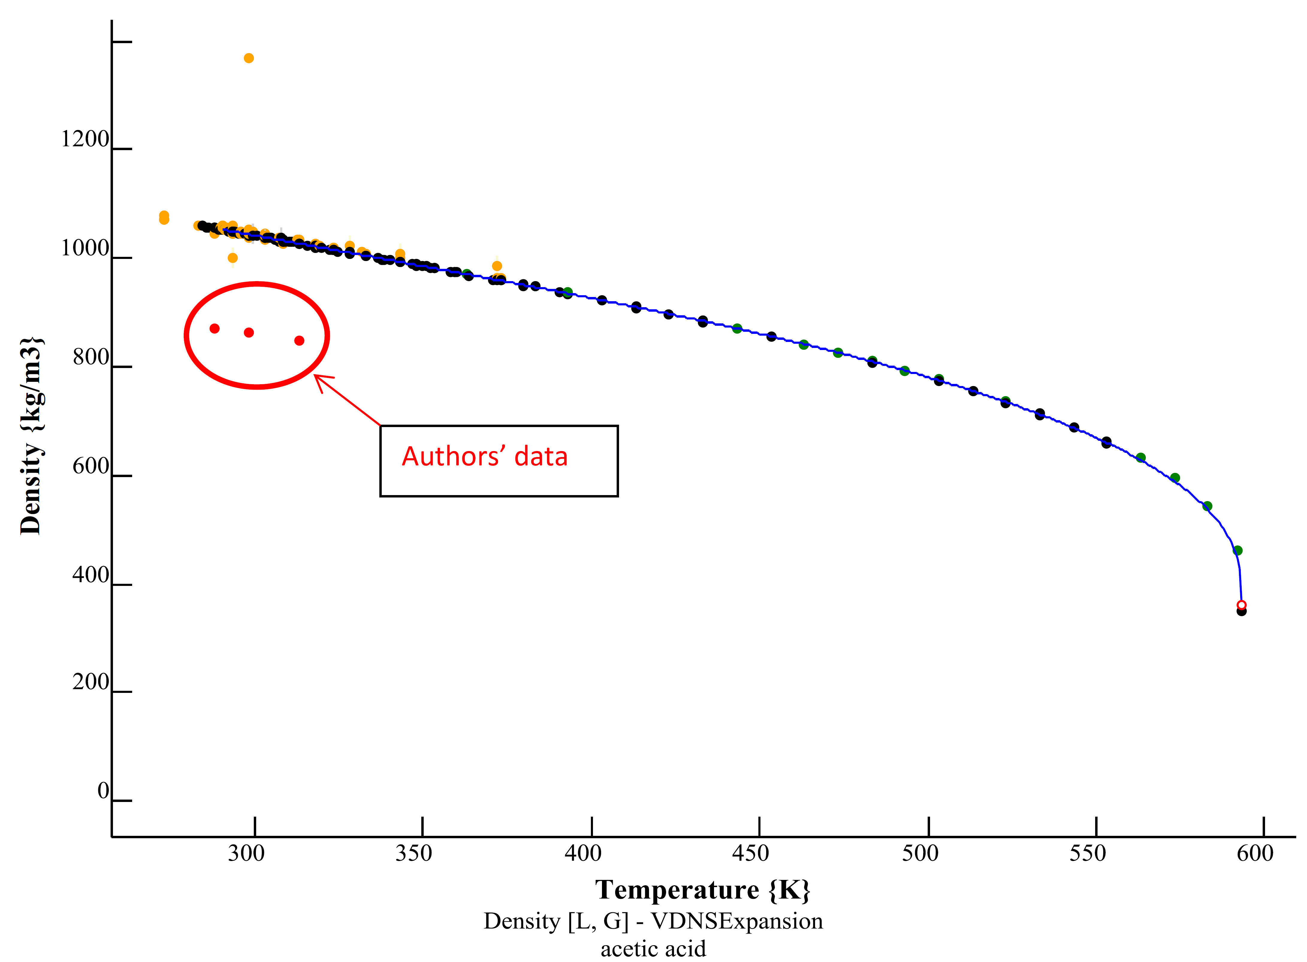
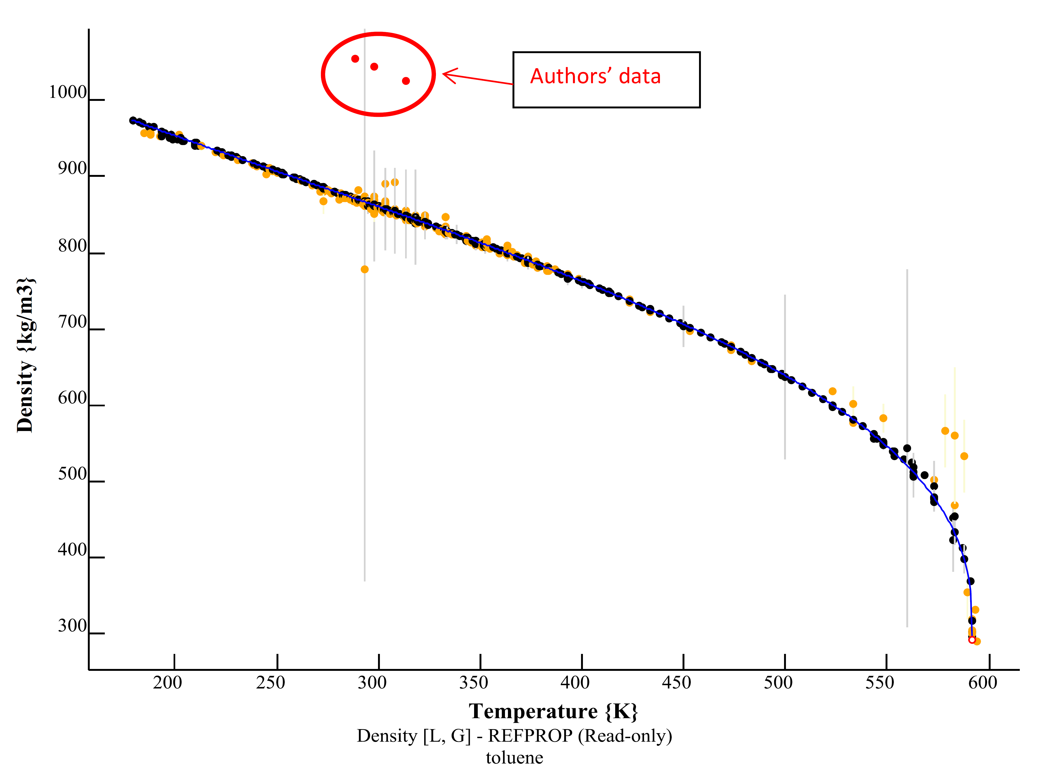
Data were accidentally swapped between toluene and acetic acid
The manuscript was correct before publication

Slide 33
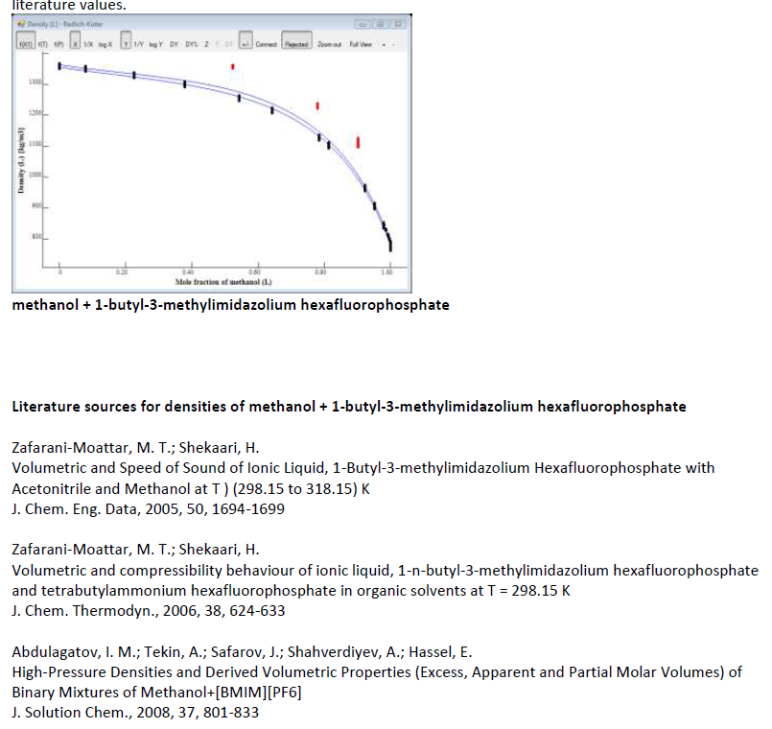
Submitted densities
Densities for an ionic liquid plus methanol as a function of composition near room temperature
Literature values
References (not cited)

Slide 34
Deviation plots (A, percentage; B, absolute)
Vapor pressures of diisopropyl ether reported as part of vapor-liquid equilibrium (VLE) studies for a series of binary mixtures
Note: If the endpoints (i.e. pure components) are wrong, the mixture data are certainly wrong…

Slide 35
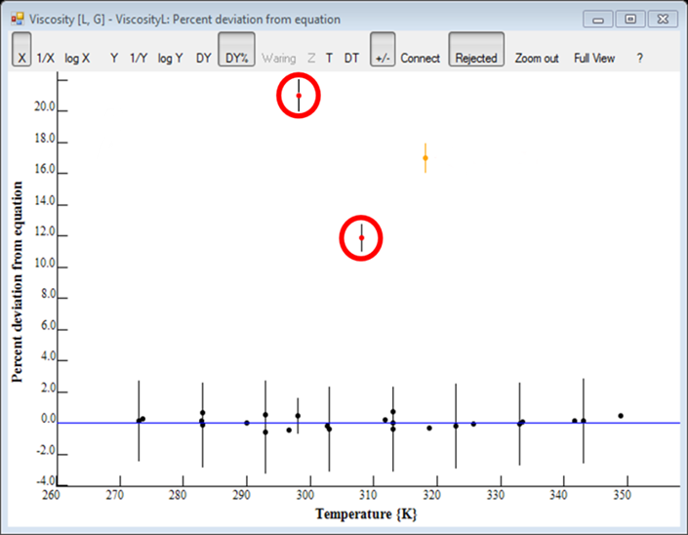
Submitted viscosities for methyl propanoate (circled) relative to literature values reported by multiple researchers (black dots).
Only literature value* cited in the manuscript
Article was rejected at the Approve stage
Literature data
* It was earlier work by the same author.

Slide 36
Vapor-liquid equilibrium (VLE) quality assessment in TDE
System: pyrrolidine + water
Data type: pressure, temperature, composition of
gas & liquid (“pTxy”)
Liquid-phase compositions
Gas-phase compositions
Compositions for the liquid and gas phase were erroneously switched in the submitted data
Problem was fixed at the Approve stage before publication
A VLE quality assessment algorithm was developed and implemented in TDE*
Five thermodynamic consistency tests are applied (Gibbs-Duhem equation requirements + vapor pressure consistency at endpoints)
Plots of test results are output automatically by TDE for all reported VLE data
* J.-W. Kang, V. Diky, R.D. Chirico, J.W. Magee, C.D. Muzny, I. Abdulagatov, A.F. Kazakov, M. Frenkel
J. Chem. Eng. Data 2010, 55, 3631–3640

Slide 37
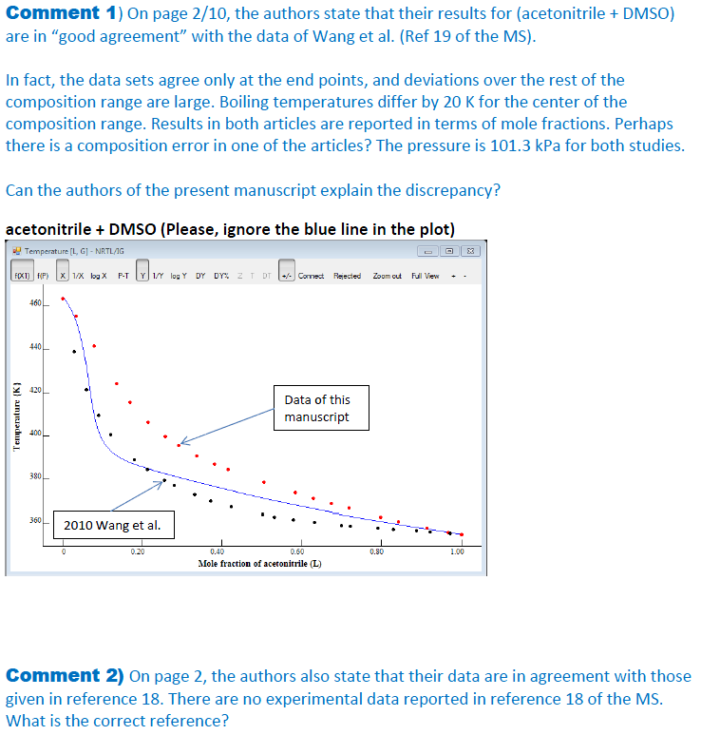
Bubble-point temperatures differ by 20 K in the middle of the composition range.
They also declared good agreement with an article that had no experimental data at all.

Slide 38
Approximately ⅓ of articles that reach the “approve” stage are found to contain significant problems that require further revision
This is the distribution of problems within that one third...
Problems found and corrected every year: ≈ 500
(often more than 1 problem/manuscript)

Slide 39
1. Experiment Planning
(Article Authors)
Start of
process
ThermoLit
Journal Support
Websites
A
2. Article Preparation and Submission (Article Authors)
NIST Literature Report
End
Reject
3. Journals (Editors)
4. Traditional Peer Review
End
Reject
5. Decision
Approve (not “Accept”)
6a. In-House Data Capture
(Student Associates)
6b. Guided
Data Capture
6c. ThermoData
Engine
B
NIST/TRC
SOURCE Database
NIST Data Report
7. Journals (Editors)
7a. Revisions (Authors)
End
Reject
8. Final
Decision
Accept
Publish
After publication
C
9. ThermoML Archive of
published experimental data
10. Data Users
End of
process

Slide 40
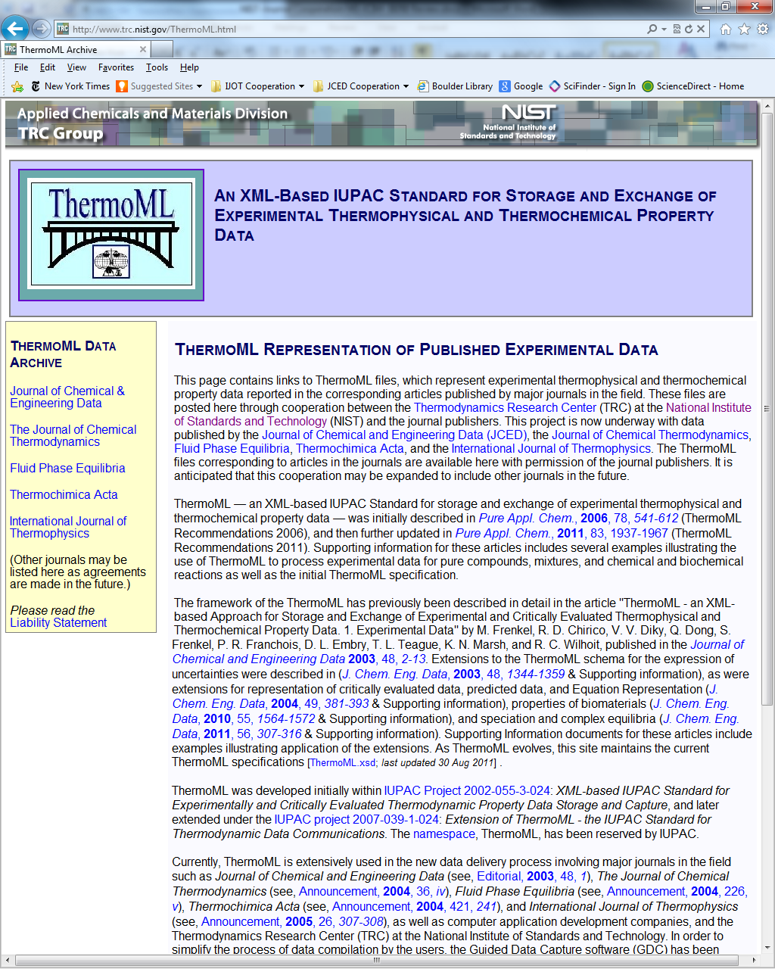
All data within the scope of the cooperation are posted
for free downloading in ThermoML format
(IUPAC standard for machine-to-machine data communications)
Popular with process-simulation companies, such as....
AspenTech, Burlington, MA
Virtual Materials Group, Calgary, Canada
SimSci-Esscor Invensys, Lake Forest, CA
and others...

Slide 41
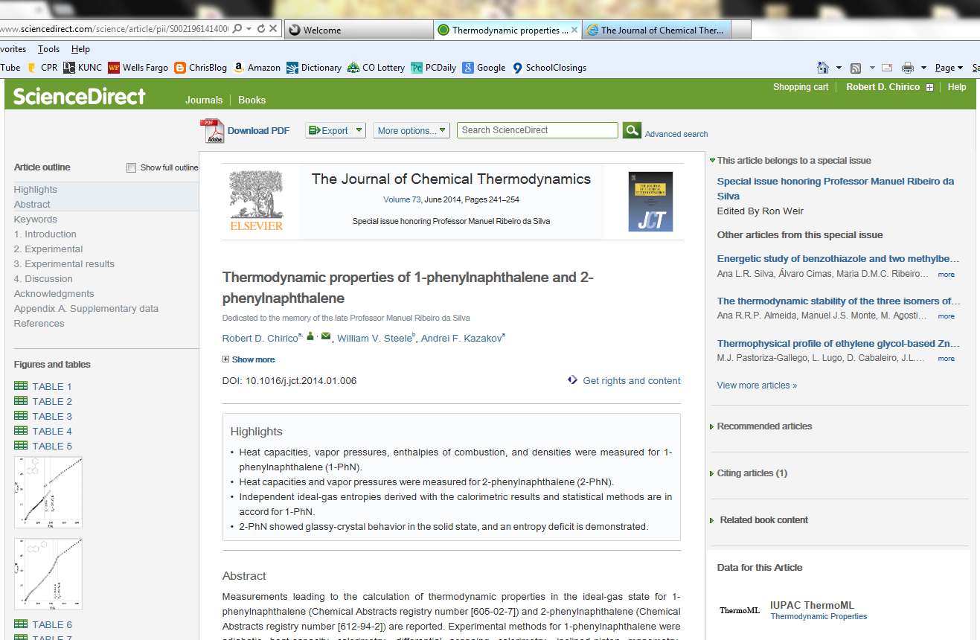

Slide 42
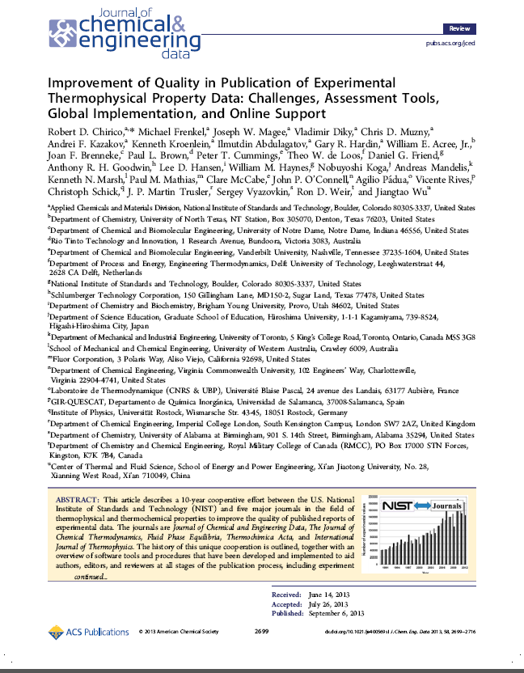
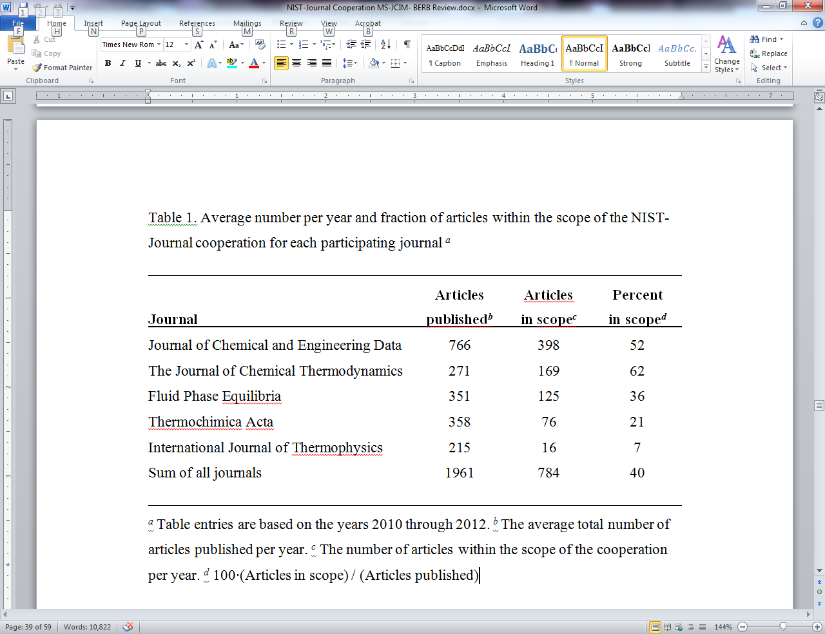
Journal article on the NIST-Journal cooperation…
Authors: NIST personnel + all editors (past and present) of the cooperating journals

Slide 43
Number and Fraction of Articles Considered
Total number of articles published per year by these journals: ~2000
Number of articles published within the scope of the NIST-Journal Cooperation: ~800
Number of articles processed at NIST:
800 + rejections +
re-reviews ≈ 1500

Slide 44
Additional avenues of attack:
Prediction method development
  Reoptimization and development of UNIFAC derivatives
  Updated group contribution methods for enthalpies of reaction (Benson method)
  QSPR with Symbolic Regression for viscosity correlation
  QSPR with Support Vector Machine Regression for critical properties
  Natural Language Processing for data identification
Industrial engagement
  Licensing and redistribution agreements with process simulation companies
  Industrial consortium with annual workshop (CRADA)
Direct distribution through SRD
  ThermoLit: Online literature search (Free)
  Web Thermo Tables: Online critically evaluated data (Subscription)
  ThermoData Engine: Desktop application for data curation (For purchase)

Slide 45


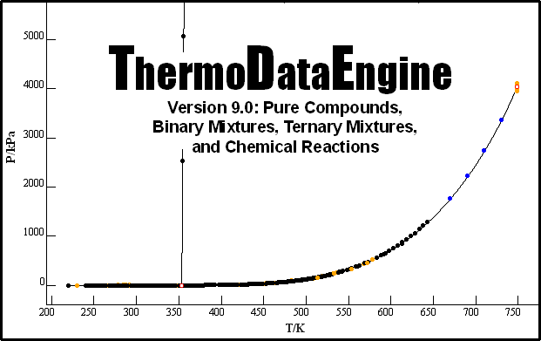


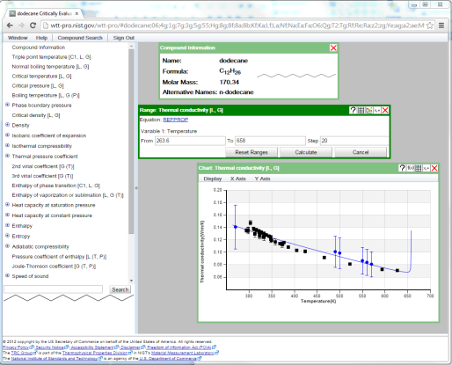
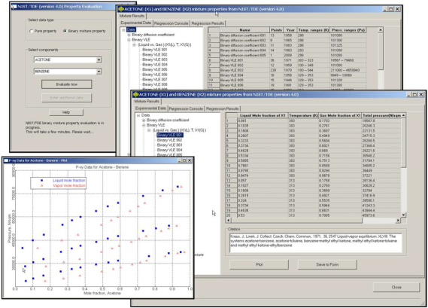
TRC Data Ecosystem
Model
Development
Data Capture
Molecular Modeling
&
Property Prediction
Open
Literature
Algorithmic
Enhancement
Quality Checks in
Peer Review
ThermoData Engine (SRD 103b)
Licensing
Web-based
Dissemination
Web Thermo Tables (SRD 203)
ThermoLit (SRD 171)

Slide 46
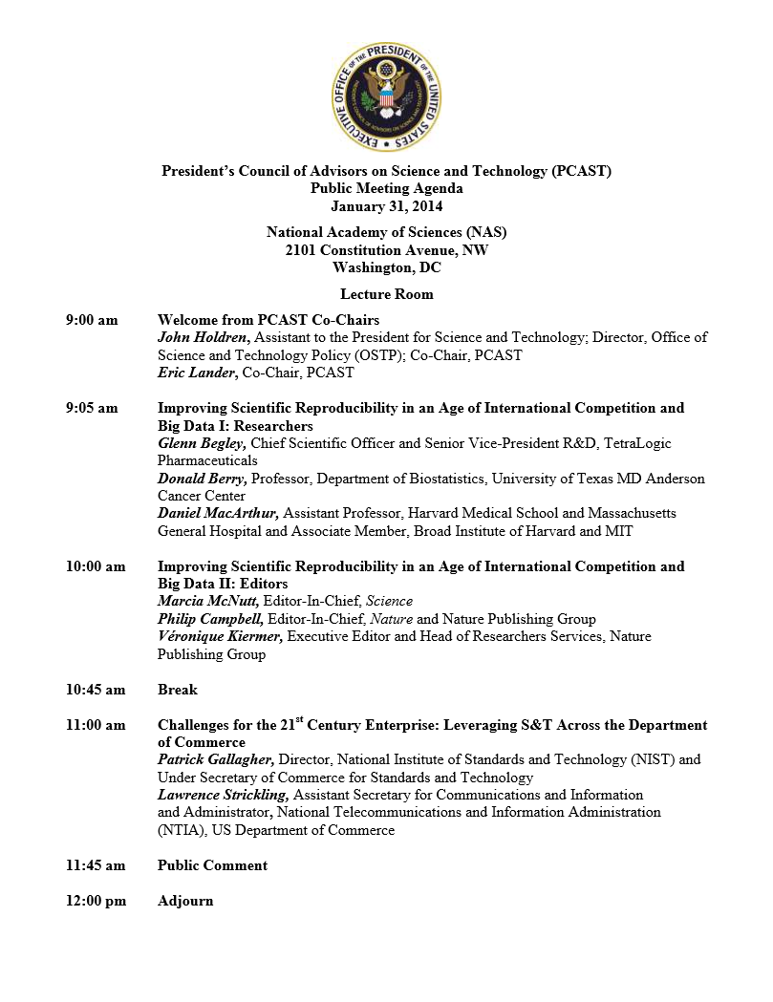
“the greatest likelihood of change is going to come from the journals and granting agencies.”
“We no longer start with hypotheses: we sift results from large, noisy data sets… any process extracting ‘interesting’ results will also enrich for biases and artifacts”

Slide 47

The Future…
The data wave will continue to grow…
If nothing changes, it will carry a lot of “data pollution”

Slide 48
?

