Slide 1
Considerations of relevance vs reliability and know vs show for CLEAR communication and how they relate to issues for nanotechnology, including the data-readiness levels
Some ideas for discussion
Nano WG webmeeting
April 24, 2014
Please direct comments to:
Mark D. Hoover (304-285-6374, mhoover1@cdc.gov) and
Stacey L. Harper (541-737-2791, harpers@science.oregonstate.edu
The findings and conclusions in this presentation are those of the authors and do not necessarily represent the views of their respective organizations.

Slide 2
Some references
de la Iglesia, D., S. Harper, M.D. Hoover, F. Klaessig, P. Lippell, B. Maddux, J. Morse, A. Nel, K. Rajan, R. Reznik-Zellen, M.T. Tuominen. Nanoinformatics 2020 Roadmap, 2011. Available at: http://eprints.internano.org/607/.
Hoover, M.D., L.J. Cash, S.M. Mathews, I.L. Feitshans, J. Iskander, and S.L. Harper: ‘Toxic’ and ‘Nontoxic’: Confirming Critical Terminology Concepts and Context for Clear Communication, in Encyclopedia of Toxicology, 3rd edition (P. Wexler, ed), Elsevier, Oxford, 2014.
Data Readiness Levels (DRL) – Draft Discussion Document
http://www.nano.gov/node/1015

Slide 3
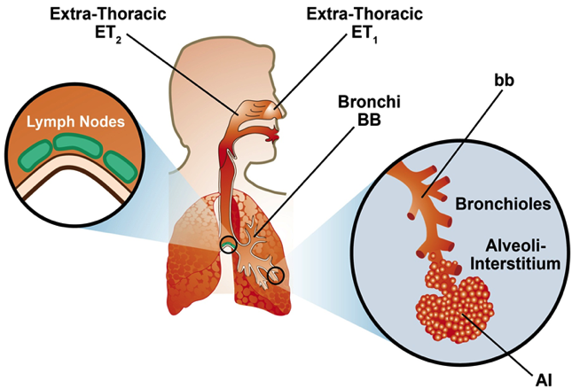
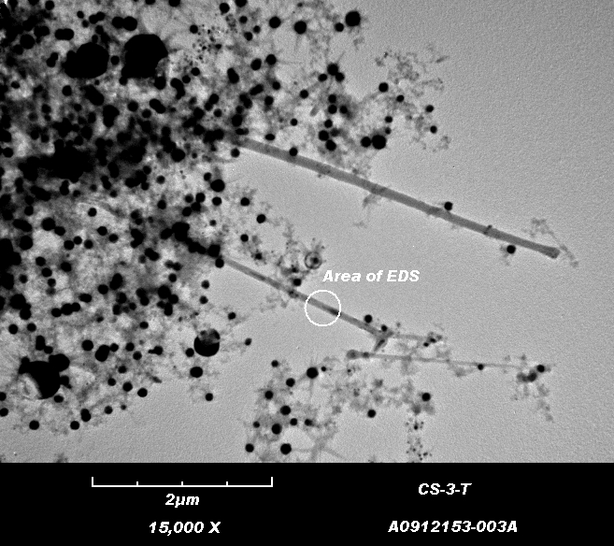
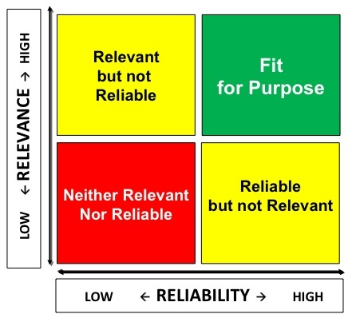
A context for our work
Public Health
Emerging Technology
Risk Management
Adapted from L. J. Cash (2014)

Slide 4
Relevance-versus-Reliability Assignment
Relevant
but not Reliable
Fit
for Purpose
LOW ← RELEVANCE → HIGH
Neither Relevant
Nor Reliable
Reliable
but not Relevant
LOW ← RELIABILITY → HIGH
Hoover, Cash, Mathews, Feitshans, Iskander, and Harper (2014)
4
Notes:
Hoover, M.D., L.J. Cash, S.M. Mathews, I.L. Feitshans, J. Iskander, and S.L. Harper: ‘Toxic’ and ‘Nontoxic’: Confirming Critical Terminology Concepts and Context for Clear Communication, in Encyclopedia of Toxicology,3rd edition (P. Wexler, ed), Elsevier, Oxford, 2014.

Slide 5
Know-versus-Show Alignment
Can guide prioritization of relevant
work
Ideal
knowledge
space
NO ← Can we Show? → YES
Poorly understood mission risks
Documentation may be needed
NO ← Do we Know? → YES
Hoover, Cash, Mathews, Feitshans, Iskander, and Harper (2014)
Notes:
Hoover, M.D., L.J. Cash, S.M. Mathews, I.L. Feitshans, J. Iskander, and S.L. Harper: ‘Toxic’ and ‘Nontoxic’: Confirming Critical Terminology Concepts and Context for Clear Communication, in Encyclopedia of Toxicology,3rd edition (P. Wexler, ed), Elsevier, Oxford, 2014.

Slide 6
CLEAR Communication Assessment Criteria
Concise
Logical.
Ethical...
Ethical, legal, and societal issues
Accurate
Relevant
Hoover, Cash, Mathews, Feitshans, Iskander, and Harper (2014)
Notes:
This graphic was inspired by a stimulating discussion I had in the Spring of 2012 with Dr. John Iskander of the CDC Office of the Associate Director for Science, in which he described his idea for selecting five key principles as an anagram of the word “CLEAR” to convey an instructive set of goals for use in the scientific review process.
I was impressed with how John’s idea supports the concepts of this slide set. If “good processes make good products,” then a CLEAR concept process for writing can surely contribute to good written products.
After some deliberation, and noting that he was adapting his principles from a scientific leadership curriculum, John settled on a formulation that encourages authors and reviewers to ensure that science communications achieve the following five principles: Clarity, Logic, Ethics, “Agency”, and Relevance.
Given the overarching message in this slide set that “the determination to make robust decisions” can achieve success through any number of processes, I worked on some alternate formulations, including the current pyramid version shown above which states that “CLEAR communication is Concise, Logical, Ethical, Accurate, and Relevant.”
In both cases, relevance is the foundation. In the alternate formulation, “Agency” is a component of relevance. Both formulations invoke ethics and logic. Clarity is explicitly stated in the first and implied to be the product of a logical presentation in the second . The concept of “Concise” in the alternate version helps to focus the intent of an individual piece of writing, while still enabling a potentially unlimited suite of useable written products to be assembled in encyclopedic form.
Also see:
Hoover, M.D., L.J. Cash, S.M. Mathews, I.L. Feitshans, J. Iskander, and S.L. Harper: ‘Toxic’ and ‘Nontoxic’: Confirming Critical Terminology Concepts and Context for Clear Communication, in Encyclopedia of Toxicology,3rd edition (P. Wexler, ed), Elsevier, Oxford, 2014.

Slide 7
Perception-versus-Reality Refinement
The “snake oil” quadrant
Inappropriate outcomes are likely
The “seat belt” quadrant
Appropriate outcomes are likely
It’s Bad ←PERCEPTION→ It’s Good
The “smoking is bad for us” quadrant
Inappropriate outcomes can be avoided
The “childhood immunization”
quadrant
Beneficial opportunities may be missed
It’s Bad ← REALITY → It’s Good
Hoover, Cash, Mathews, Feitshans, Iskander, and Harper (2014)
7
Notes:
Hoover, M.D., L.J. Cash, S.M. Mathews, I.L. Feitshans, J. Iskander, and S.L. Harper: ‘Toxic’ and ‘Nontoxic’: Confirming Critical Terminology Concepts and Context for Clear Communication, in Encyclopedia of Toxicology,3rd edition (P. Wexler, ed), Elsevier, Oxford, 2014.

Slide 8
Data Readiness Levels For Community Discussion
Seven graded definitions (0-6) are defined:
0. Invalid data
Raw or unscaled data
Scaled data
Scaled data with defined precision or noise level
Scaled data with defined precision and noise levels, but not related to the larger body of scientific knowledge
DRL 4 data related to the larger body of scientific knowledge, but with measurement uncertainty too large for data standard
Standards-quality data of X % measurement uncertainty
http://www.nano.gov/node/1015
Notes:
Quality of data → DRL’s
Existing community resources – how can they work together? Mark’s Data Translator
8

Slide 9
Associated Metadata Classifications
For Community Discussion
Three metadata qualifiers:
Poor Metadata: Failure to include critical information so that the data cannot be reproduced by others, or so that there is ambiguity in interpreting the data, or so that acceptable measurement uncertainty estimates cannot be made; for example, failure to adequately describe the measurement/computational methods used, or failure to provide complete and unambiguous descriptions of data format.
Acceptable Metadata: Inclusion of all key parameters so that others can reproduce the data, and so that there is little/no ambiguity in interpreting the data, and so that acceptable measurement uncertainty estimates can be made, including adequate descriptions of measurement/computational methods used, boundary and initial conditions, and complete and unambiguous descriptions of data format, curation, and provenance (history).
Excellent Metadata: Inclusion of all key parameters so that others can reproduce the data and unambiguously interpret the data, and so that acceptable measurement uncertainty estimates can be made, as well as other information to judge the data such as names and pedigree of the data creators; data format, curation, and provenance; and validation of the measurement/computational methods. DRL 6(X), by its nature, can only be data that have excellent metadata.
http://www.nano.gov/node/1015
Notes:
Quality of data → DRL’s
Existing community resources – how can they work together? Mark’s Data Translator
9

Slide 10
Tabular Version of DRL Attributes
For Community Discussion
Attribute | DRL 0 | DRL 1 | DRL 2 | DRL 3 | DRL 4 | DRL 5 | DRL 6
Units |  | maybe | yes | yes | yes | yes | yes
Precision and Noise |  |  |  | either | both | both | both
Independent Confirmation |  |  |  | possibly | yes | yes | yes
Related to Larger Body of Scientific Knowledge |  |  |  |  | no | yes | yes
Measurement Uncertainty |  |  |  |  | speculative | high | low
Example or use | little to none | unscaled sensor data | scaled sensor data | scaled data; noise levels defined | major scientific advances | coarse validation of theory | theory refinement and methods validation
http://www.nano.gov/node/1015
Notes:
Quality of data → DRL’s
Existing community resources – how can they work together? Mark’s Data Translator
10

Slide 11
OVERALL OBJECTIVE
Build and sustain a total culture of safety, health, well-being, and productivity
Notes:
Our overall objective is to build and sustain a total culture of safety, health, and well-being. And we have added “productivity” as an essential part of total mission success. Earlier versions of the slides focused on traditional themes in safety and health; and the current slides recognize and attempt to address and convey the total breadth of our NIOSH mission. The concept of a total culture rightly transcends the workplace to address all aspects of our lives. Thus, we want to advance and ensure both health protection and health promotion; in conjunction with total mission success.

Slide 12
A Key Concept
The method is not the message; [the message] is in the managerial frame of mind determined to make robust decisions.
Zebroski, E.L. (1991) Lessons Learned from Man-Made Catastrophes. In Risk Management: Expanding Horizons in Nuclear Power and Other Industries. R.A. Knief, V.B. Briant, R.B. Lee, R.L. Long, and J.A. Mahn, eds., Hemisphere Publishing, New York.

Slide 13
Nanoinformatics (a working definition)
The science and practice of determining which information is relevant to meeting objectives of the nanoscale science and engineering community,
and then developing and implementing effective mechanisms
to collect, validate, store, share, analyze, model, and apply the information, and then to confirm achievement of the intended outcome from use of that information.
http://www.internano.org/nanoinformatics/
Notes:
Note that this version of the definition now concludes with a step to “confirm” that the information enabled achievement of the intended outcome.

Slide 14
Communication and Education Message and Audience-Planning Matrix for (insert the current project name)
 | Workers | Health and safety practitioners | Managers | Policy makers and regulators | Equipment and facility providers | Materials suppliers | Financiers | Insurers | Legal community | Researchers | Educators | Students | Emergency Responders | Media | Consumers | Society
Literacy and Critical Thinking Skills
Real Life Examples
Understanding (not rote application)
Continuous Improvement
Modeling and Sharing
Assessment
Specific messaging and actions in each element of the matrix must be based on (a) what knowledge and understanding each stakeholder needs and (b) what knowledge and understanding each stakeholder can provide.
Notes:
Included in the Nanoinformatics 2020 Roadmap, available at http://eprints.internano.org/607/1/Roadmap_FINAL041311.pdf.
Citation:
de la Iglesia, D., S. Harper, M.D. Hoover, F. Klaessig, P. Lippell, B. Maddux, J. Morse, A. Nel, K. Rajan, R. Reznik-Zellen, M.T. Tuominen. Nanoinformatics 2020 Roadmap, 2011. Available at: http://eprints.internano.org/607/.
Also described in Hoover, M.D., L.J. Cash, S.M. Mathews, I.L. Feitshans, J. Iskander, and S.L. Harper: ‘Toxic’ and ‘Nontoxic’: Confirming Critical Terminology Concepts and Context for Clear Communication, in Encyclopedia of Toxicology,3rd edition (P. Wexler, ed), Elsevier, Oxford, 2014.
The concept was illustrated in the following presentation from the Nanoinformatics 2010 Workshop:
Pilot of the Communication and Education Message and Audience Planning Tool for the Nanoinformatics 2020 Roadmap and Plan: Illustration of Findings Related to Public Perception Stephanie Mathews, MPH, CHES, Doctoral student, Department of Epidemiology and Biostatistics, University of Georgia, College of Public Health, Athens, GA
The Nanoinformatics 2010 Workshop is designed as a community-wide, public forum to survey the current nanoinformatics landscape, to stimulate collaborative activities and pilot projects, and to craft a broad-reaching Nanoinformatics 2020 Roadmap and Plan for the development and implementation of informatics in the nanotechnology domain. The draft roadmap that will be discussed at the workshop includes a table illustrating the concept of “A Communication and Education Message and Audience Planning Tool for the Nanoinformatics 2020 Roadmap and Plan”. The table recognizes a diversity of stakeholders and community roles that can make informatics contributions and have informatics needs, including workers, health and safety practitioners, management, policy makers and regulators, equipment and system vendors, consumers, the legal community, researchers, educators, the media, and society in general. The table further recognizes the common and potentially unique needs of each stakeholder and partner to (1) Emphasize literacy and develop critical thinking; (2) Develop and use real-life data examples; (3) Stress conceptual understanding rather than mere application of procedures; (4) Foster continuous improvement and active discussions; (5) Use technology for developing conceptual understanding and for analyzing and sharing information (e.g., modeling and simulation, databases, etc.); and (6) Use assessments to improve and evaluate the efficacy and impact of these activities.
Success of the Nanoinformatics 2020 Roadmap and Plan will require detailed considerations of how the vision of a communication and education message and audience planning tool can be specifically and effectively refined and applied across the many disciplines and many aspects (both scientific and societal) of nanotechnology research, development, and application. In this pilot illustration an example table was prepared to stimulate discussion of possible Pilot Project ideas for application of the Communication and Education Message and Audience Planning Tool proposed in the Nanoinformatics 2020 Roadmap and Plan. Current entries represent portions of a first layer of evidence-based communication considerations for the perception of nanotechnology. Subsequent dimensions of the matrix could include parallel information related to other areas of interest such as health and safety, technical feasibility, economics, and population disparities. (The invaluable contributions of Dr. Mark D. Hoover of the National Institute for Occupational Safety and Health to this work are gratefully acknowledged.)

Slide 15
Informatics lifecycle roles and responsibilities
 | Set Mission Objectives | Determine Relevance | Collect | Validate | Store | Share | Analyze and Model | Apply | Confirm Effectiveness
Customers | X | X |  |  |  |  |  | X | X
Creators |  | X | X | X |  |  |  |  | X
Curators |  | X |  | X | X | X |  |  | X
Analysts |  | X |  | X |  |  | X |  | X
Draft for discussion

Slide 16
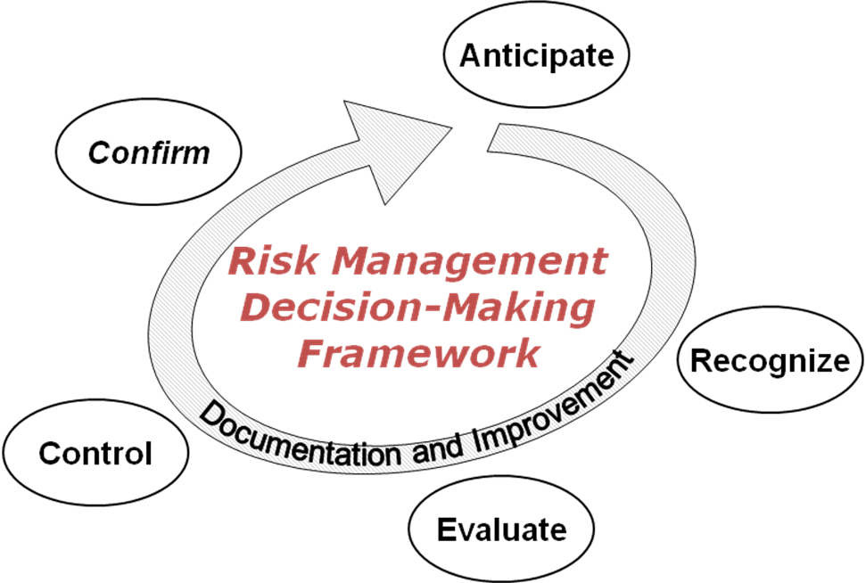
We can partner to develop and apply a comprehensive decision-making framework to:
Anticipate,
Recognize,
Evaluate,
Control, and
Confirm
Training
Hoover et al., Synergist, 22(1): 10, 2011
success in proactive understanding and management of potential hazards, exposures, and resulting risks to safety, health, well-being, and productivity
by applying a science- and practice-based approach to build and sustain leaders, cultures, and systems that are relevant and reliable and over which we have influence.
Use ARECC. PREVENT a wreck.
Notes:
Citation:
Hoover, M.D., T. Armstrong, T. Blodgett, A.K. Fleeger, P.W. Logan, B. McArthur, and P.J. Middendorf: Confirming Our IH Decision-Making Framework, The Synergist, 22(1): 10, 2011.
Hoover, M.D., L.J. Cash, S.M. Mathews, I.L. Feitshans, J. Iskander, and S.L. Harper: ‘Toxic’ and ‘Nontoxic’: Confirming Critical Terminology Concepts and Context for Clear Communication, in Encyclopedia of Toxicology,3rd edition (P. Wexler, ed), Elsevier, Oxford, 2014.

Slide 17
Proposed Graphical Representations of the US-EU Communities of Research: An Information-to-Action Continuum
The following graphics are intended to illustrate how the CoRs can ideally link and feed one another through an idealized information-to-action continuum.
Although a number of simplifications are in play, notably the role of "ontologies and databases" as the supporting and unifying foundation of an "information pyramid”, it is hoped that these images of the proposed continuum will help clarify and guide the cohesive development and implementation of comprehensive and effective CoR activities.
The proposed graphics were created, in particular, to help define the role of the Risk Assessment CoR. Using the concept that “exposure x hazard = risk”, the Risk Assessment CoR is working to determine the best ways to organize and analyze exposure and hazard data to create meaningful risk forecasts that will support sound decision-making.
Draft for discussion
17

Slide 18
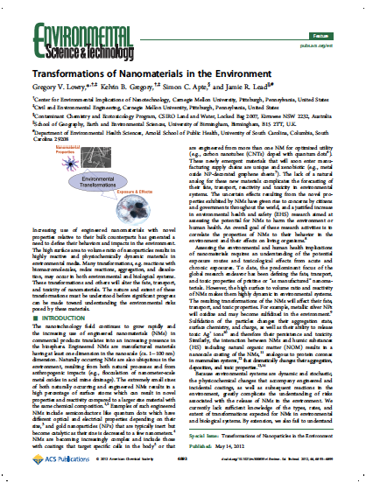
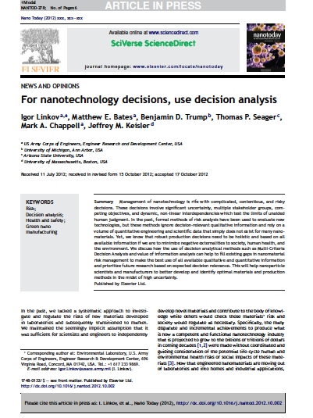
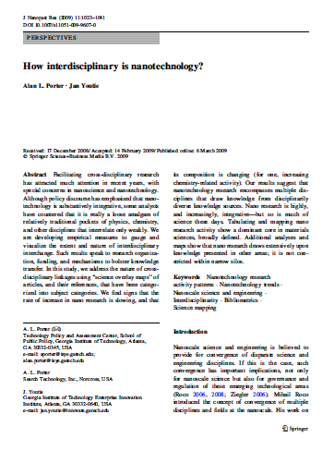
Idealized Information-to-Action Continuum
Action
Use risk assessment input to weigh trade-offs in context of alternatives and take action to minimize risks.
Risk Management CoR
Synthesize hazard and exposure research, filter and interpret to arrive at risk forecasts of ENMs.
Risk Assessment CoR
Draw on emerging and increasingly organized data sources to model potential exposure, transformation, biouptake, and ecological and human health impacts.
Exposure CoR
Ecotox Testing and Modeling CoR
Human Health Modeling
CoR
Subsume and organize all emerging nanomaterial data and metadata to provide hazard and exposure modelers with rich, integrated data sets.
Ontologies and Databases CoR
Information
Open Literature

Slide 19
Idealized Information-to-Action Continuum: exposure x hazard = risk
Action
Use risk assessment input to weigh trade-offs in context of alternatives and take action to minimize risks.
Risk Management CoR
Synthesize hazard and exposure research, filter and interpret to arrive at risk forecasts of ENMs.
Risk Assessment CoR
Risk
=
Draw on emerging and increasingly organized data sources to model potential exposure, transformation, biouptake, and ecological and human health impacts.
Exposure CoR
Ecotox Testing and Modeling CoR
Human Health Modeling
CoR
Exposure
X
Hazard
Subsume and organize all emerging nanomaterial data and metadata to provide hazard and exposure modelers with rich, integrated data sets.
Ontologies and Databases CoR
Information
Open Literature
19

Slide 20
Idealized Information-to-Action Continuum: property x incorporation = performance
Action
Use performance input to weigh trade-offs in context of alternatives and take action to minimize risks.
Products and Applications
Synthesize property and incorporation research to interpret to arrive at performance of ENMs.
Performance
=
Draw on emerging and increasingly organized data sources to model potential properties and how to incorporate them to provide desired perfomance
Property
X
Incorporation
Subsume and organize all emerging nanomaterial data and metadata to provide hazard and exposure modelers with rich, integrated data sets.
Ontologies and Databases
Information
Open Literature
20

Slide 21
Current Information-to-Action Continuum
Action
The current horizontal information-to-action continuum fails to efficiently organize and deliver emerging nanotechnology data and information among the CoRs.
Implementation of the idealized information-to- action continuum will optimize CoR roles and communication pathways to :
support the development of relevant models of exposure and hazard potential ,
synthesize exposure and hazard potentials into assessments of risk, and
translate the results of assessments into effective decision-making for risk management .
Risk Management CoR
Risk Assessment CoR
Exposure CoR
Ecotox Testing and Modeling CoR
Human Health Modeling
CoR
Information
Ontologies and Databases CoR
Open Literature
21

Slide 22
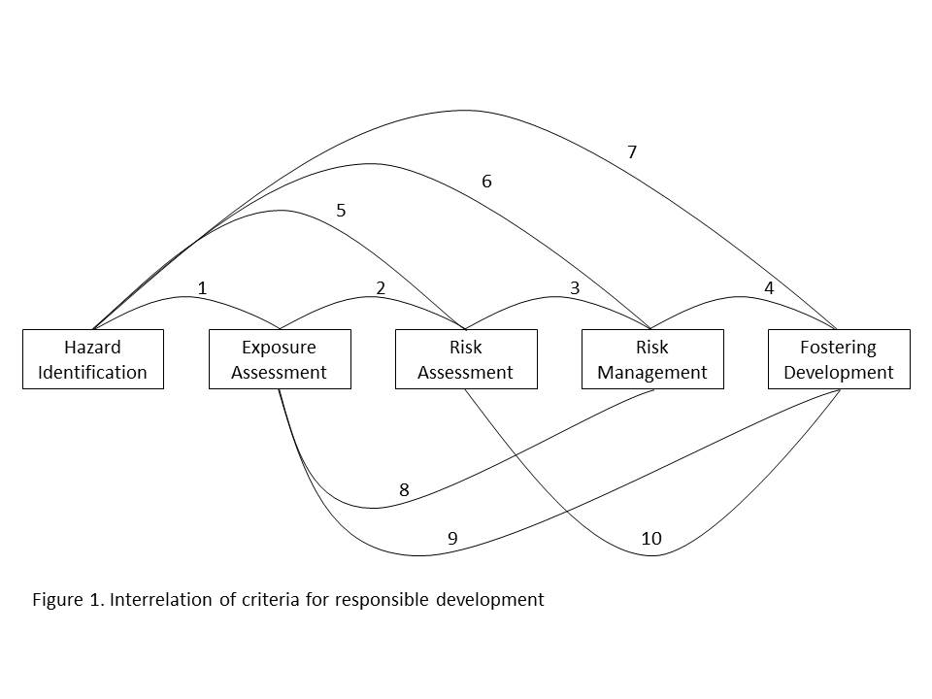
Interrelationships of criteria for responsible development of nanotechnology
Schulte et al. 2013, OSH Criteria for Responsible Development of Nanotechnology
In press for Journal of Nanoparticle Research

Slide 23
Essential factors to build and sustain safety, health, well-being, and productivity
Leaders
Cultures
Systems
A management view for possible application in our mission

Slide 24
Systems are essential to building and sustaining safety, health, well-being, and productivity
Cultures
Leaders
Systems
Our mission will collapse and fail without them.

Slide 25
Leaders are essential to building and sustaining safety, health, well-being, and productivity
Cultures
Leaders
Systems
Our mission will collapse and fail without them.

Slide 26
Cultures are essential to building and sustaining safety, health, well-being, and productivity
Leaders
Cultures
Systems
Our mission will collapse and fail without them.

Slide 27
Four Steps for Community Action to build and sustain a total culture of safety, health, well-being, and productivity
Engage the community
Inform the interested
Reward the responsive
Understand and incentivize the reluctant
Adapted from our Nanoinformatics 2020 Roadmap
Notes:
Our approach to achieve community action to build and sustain a total culture of safety, health, and well-being, is our simplified version of the “early adapters, late adapters, etc. concept” in which we endeavor to engage the community, inform the interested, reward the responsive, and understand and incentivize the reluctant.
We are grateful that you are interested enough to invest some time and we hope that the ideas and connections you can make from this presentation will be useful to you (and thereby provide some sort of “reward” for your involvement). If you feel reluctant to embrace these ideas, we would like to understand any barriers or issues that need to be overcome.
Source:
Hoover, M.D.: Informatics in Relation to Nanomaterials and Worker Health, Workshop on Nanomaterials and Worker Health: Medical Surveillance, Exposure Registries, And Epidemiologic Research, Keystone, Colorado, July 21-23, 2010.
And incorporated into the Nanoinformatics 2020 Roadmap and Plan:
de la Iglesia, D., S. Harper, M.D. Hoover, F. Klaessig, P. Lippell, B. Maddux, J. Morse, A. Nel, K. Rajan, R. Reznik-Zellen, M.T. Tuominen. Nanoinformatics 2020 Roadmap, 2011. Available at: http://eprints.internano.org/607/.

Slide 28
Four Steps for Community Action to build and sustain a total culture of safety, health, well-being, and productivity
Understand and incentivize the reluctant
Reward the responsive
Inform the interested
Engage the community
Leaders Systems Cultures
Adapted from our Nanoinformatics 2020 Roadmap
Notes:
Our approach to achieve community action to build and sustain a total culture of safety, health, and well-being, is our simplified version of the “early adapters, late adapters, etc. concept” in which we endeavor to engage the community, inform the interested, reward the responsive, and understand and incentivize the reluctant.
We are grateful that you are interested enough to invest some time and we hope that the ideas and connections you can make from this presentation will be useful to you (and thereby provide some sort of “reward” for your involvement). If you feel reluctant to embrace these ideas, we would like to understand any barriers or issues that need to be overcome.
Source:
Hoover, M.D.: Informatics in Relation to Nanomaterials and Worker Health, Workshop on Nanomaterials and Worker Health: Medical Surveillance, Exposure Registries, And Epidemiologic Research, Keystone, Colorado, July 21-23, 2010.
And incorporated into the Nanoinformatics 2020 Roadmap and Plan:
de la Iglesia, D., S. Harper, M.D. Hoover, F. Klaessig, P. Lippell, B. Maddux, J. Morse, A. Nel, K. Rajan, R. Reznik-Zellen, M.T. Tuominen. Nanoinformatics 2020 Roadmap, 2011. Available at: http://eprints.internano.org/607/.

Slide 29
Questions and Discussion
Understand and incentivize the reluctant
Reward the responsive
Inform the interested
Engage the community
Leaders Systems Cultures
Adapted from our Nanoinformatics 2020 Roadmap
Notes:
Our approach to achieve community action to build and sustain a total culture of safety, health, and well-being, is our simplified version of the “early adapters, late adapters, etc. concept” in which we endeavor to engage the community, inform the interested, reward the responsive, and understand and incentivize the reluctant.
We are grateful that you are interested enough to invest some time and we hope that the ideas and connections you can make from this presentation will be useful to you (and thereby provide some sort of “reward” for your involvement). If you feel reluctant to embrace these ideas, we would like to understand any barriers or issues that need to be overcome.
Source:
Hoover, M.D.: Informatics in Relation to Nanomaterials and Worker Health, Workshop on Nanomaterials and Worker Health: Medical Surveillance, Exposure Registries, And Epidemiologic Research, Keystone, Colorado, July 21-23, 2010.
And incorporated into the Nanoinformatics 2020 Roadmap and Plan:
de la Iglesia, D., S. Harper, M.D. Hoover, F. Klaessig, P. Lippell, B. Maddux, J. Morse, A. Nel, K. Rajan, R. Reznik-Zellen, M.T. Tuominen. Nanoinformatics 2020 Roadmap, 2011. Available at: http://eprints.internano.org/607/.

