Slide 1
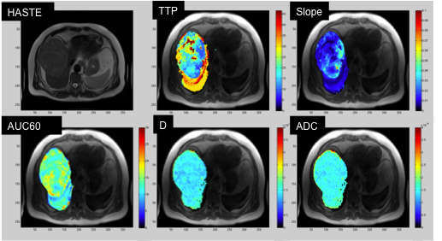
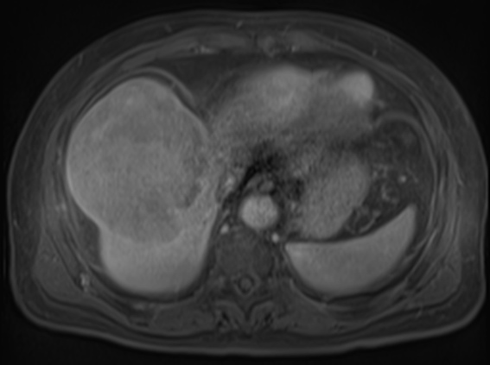
Evaluation of HCC Response to Systemic Therapy with Quantitative MRI (1 U01 CA172320-01)
Guido Jajmovich, Octavia Bane, Hadrien Dyvorne, Bachir Taouli; Icahn School of Medicine at Mount Sinai
Overall objective: Develop a quantitative multiparametric protocol combining measurements of MR diffusion, perfusion and hypoxia in hepatocellular carcinoma (HCC)
Objectives
Year 1
Develop a framework for quality control (QC) in functional MRI of the liver in patients with HCC
Determine reproducibility of diffusion, DCE-MRI and R2* metrics in HCC and liver parenchyma
Year 2
Develop a quantitative multiparametric scoring system combining measurements of MR diffusion, perfusion and hypoxia against histopathologic measures of tumor grade, cellularity, aggressiveness, angiogenesis and hypoxia in HCC.
Develop an advanced pathologic evaluation platform evaluating HCC tumor biology
Gain insight into intratumoral heterogeneity in MR metrics and pathology, and differentiate biological heterogeneity from image noise
Year 1 Summary Results
QC parameters being assessed: image quality, metrics variability, goodness of fit, quality of DCE-MRI curves, intra-patient test-retest, inter- and intra-observer variability, differences between 1.5T and 3T, assessment of pathologic variability.
Test-retest reproducibility in HCC
IVIM DWI: Mean CV (n=5) D (true diffusion coefficient) 19.8%, PF (perfusion fraction) 21.7%, D* (pseudodiffusion coefficient) 65.2%, and ADC 17.4%.
DCE-MRI: mean CV (n=12) Ktrans 38.2%, Ve 37.7%, Kep 52.7%
R2*: mean CV of R2* value with room air (n=8) 14.8%, under O2 (12.2%), carbogen (11.8%).
Multiparametric approach in HCC
Reference T2 HASTE, Time to Peak (TTP), slope, AUC60, D and ADC maps in a patient with a 14 cm HCC.
VIBE post-contrast R₂* room air (sec⁻¹) R₂* O₂ R₂* CO₂
HCC identified on post-contrast imaging (arrows) shows minimal response to O₂ (R₂* air 23.81 s⁻¹, R₂* O₂ 23.65 s⁻¹) and a minimal increase in R₂* with carbogen (R₂* CO₂ 25.22 s⁻¹).

