Slide 1
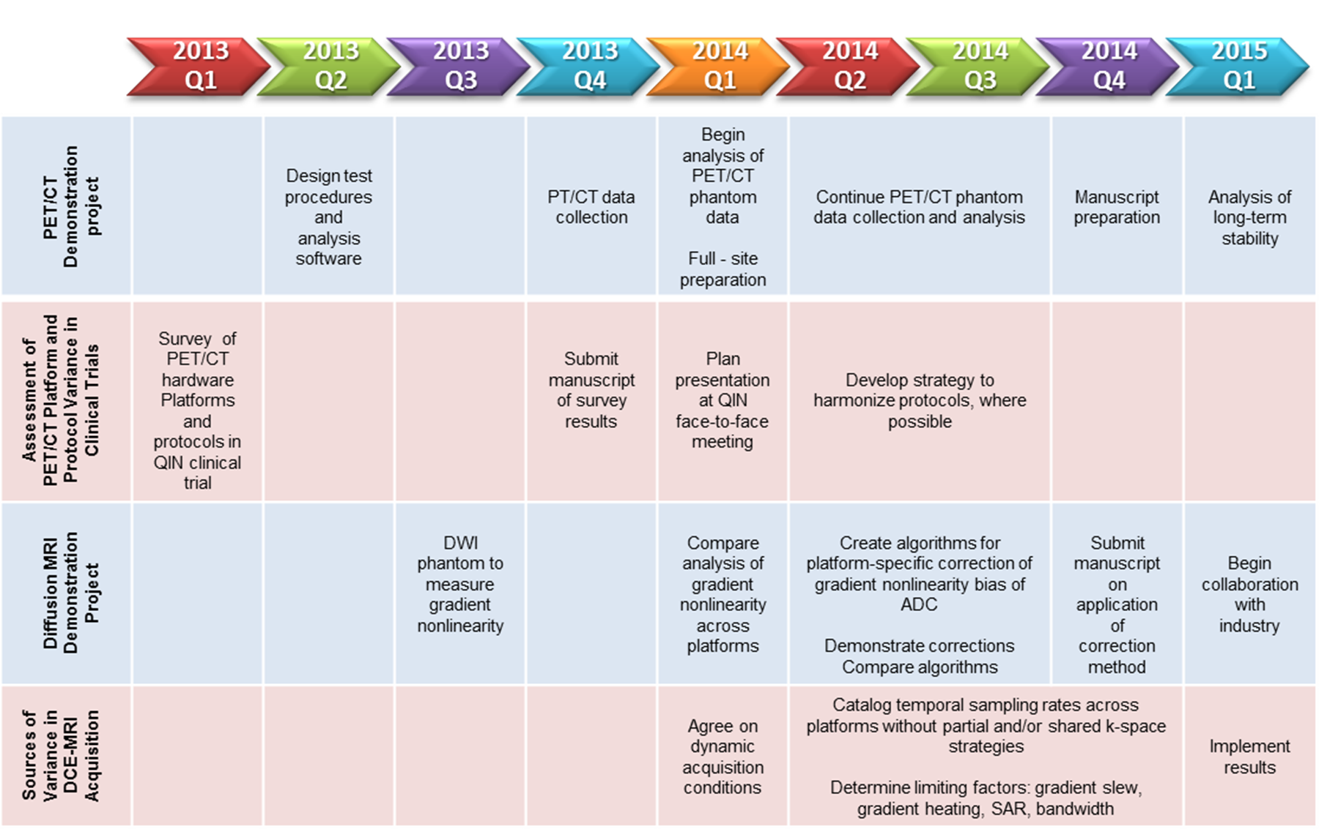
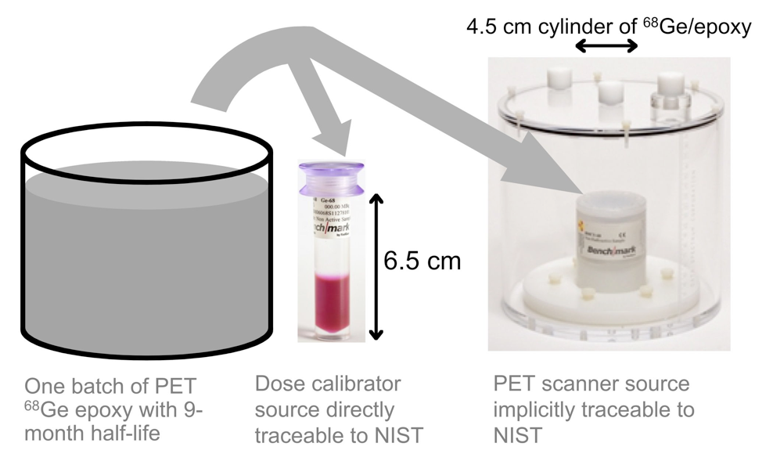
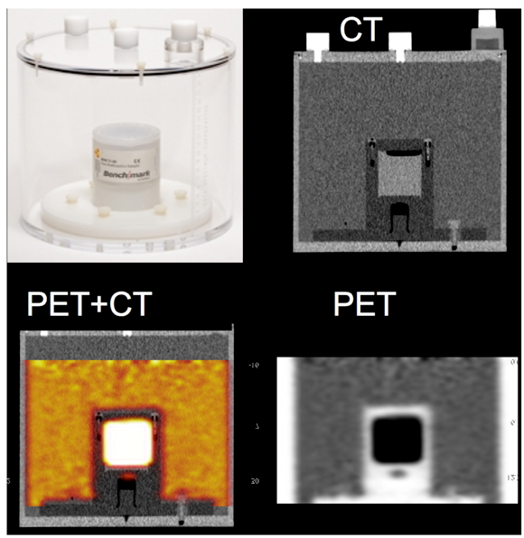
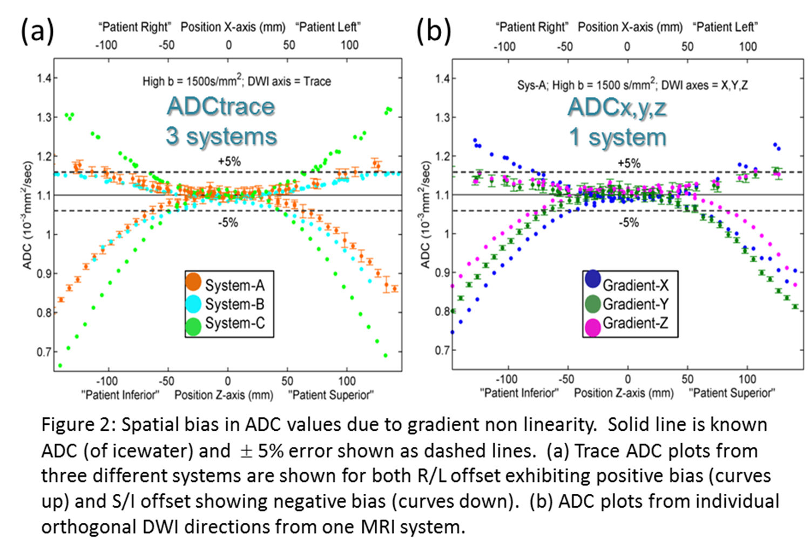
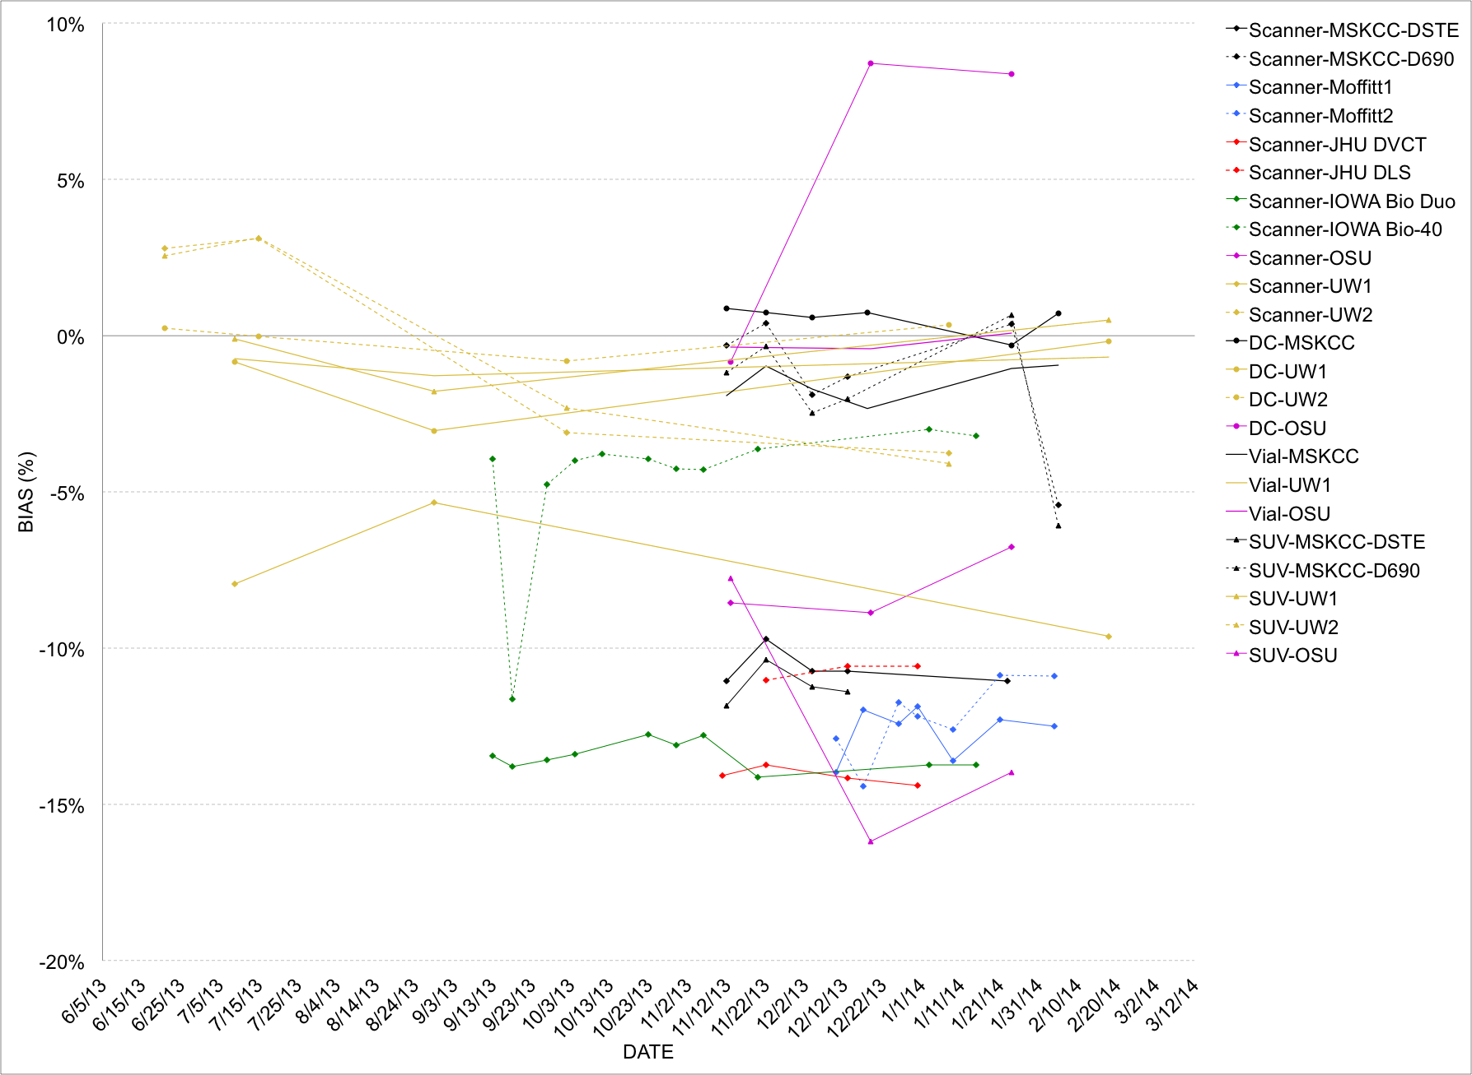
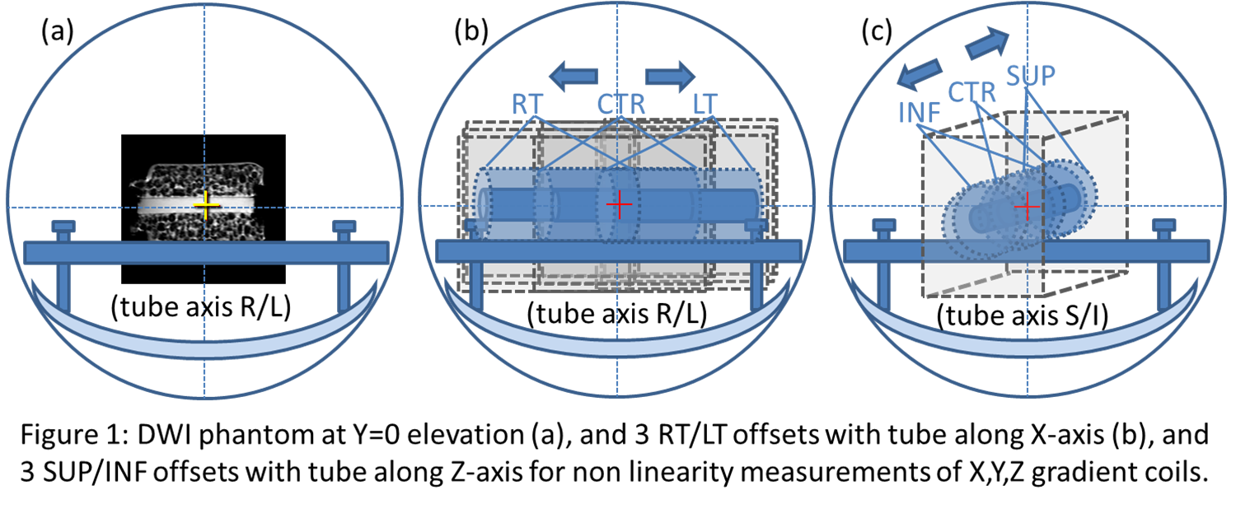
Data Acquisition Work Group
Co-Chairs Paul E. Kinahan and Thomas L. Chenevert
2013-14 DAWG Milestone Chart
Results
Circular ROIs in the center of the measurement tube as a function of offset from isocenter indicate that all MRI platforms exhibit ADC bias in excess of measurement error (defined as ROI stdev) for offsets greater than 40-50mm.
Bias vs location patterns resemble those predicted by spherical-harmonic description of gradient coil fields, although curvature varied with MRI manufacturer and model.
Bias plots are largely symmetric, although slight asymmetry due to interaction with local shim was observed.
Incremental bias offset due to interaction with the imaging gradients (eg. slice-selection) was also observed.
Discussion and Conclusions
The implemented protocol for multi-scanner bias evaluation provides a useful solution for empiric description of potential instrumental bias in multi-center clinical trials. The measurements confirm gradient nonlinearity as a significant source of ADC map bias on clinical scanners across vendor platform with some minor contributions from local shim and imaging cross-terms. The extent of bias is dependent on gradient coil design and diffusion gradient direction. These measures can form the basis for GNL bias removal algorithms.
Methods
Surveyed acquisition and processing protocols the QIN sites that participate in clinical trials using PET/CT imaging
Obtained access to ACRIN and ACRIN-CQIE acquisition and processing protocols
Tested and distributed NIST-traceable calibration sources for PET/CT to QIN sites
In process of collecting stability data for ~ 1 year at multiple QIN sites
Concept of the cross-calibration 'kit' using an NIST-traceable standard for a dose calibrator standard and a 4.5 cm PET/CT phantom
Images of the phantom
Diffusion MRI Demonstration Project:
Gradient Non Linearity
Dariya Malyarenko, David Newitt, Nola Hylton, Wei Huang, Alina Tudorica, Robert Mulkern, Fiona Fennessy, Karl Helmer, Michael Jacobs, Lori Arlinghaus, Thomas Yankeelov and Thomas Chenevert
Results
Initial calibration stability results (below) indicate site-specific variations, but these results are subject to verification
Purpose
To evaluate MRI gradient non linearity (GNL) bias in ADC measurements using an empiric procedure to characterize bias across diverse clinical MRI platforms
Methods
A 26cm “long-tube” ice-water DWI phantom and support stage were constructed to for ADC measurements along X-axis (right-left) and Z-axis (superior-inferior) at Y=0 elevation (anterior-posterior)
To extend GNL measurements over a 300mm wide X- and Z-range, the phantom was positioned at 3 right-left and 3 superior-inferior offsets
Three ortho-axes DWI were individually recorded for b=750 and 1500 s/mm²
GNL data were acquired at 7 QIN sites on 8 platforms (GE, Philips, and Siemens)
PET/CT Protocol variations and scanner calibration drift
Paul Kinahan, Darrin Byrd, Rebecca Christopfel, John Sunderland, Martin Lodge, Chip Laymon, Eduardo Moros and Sedek Nehmeh
Purpose
To address two of important parameters that effect single-center and multi-center PET/CT variability
Protocol variations
Scanner calibration drift.
Discussion and Conclusions
The survey of acquisition protocols has been completed and is undergoing analysis
The PET/CT calibration data acquisition project is underway and is already indicating different stability patterns between sites, although verification is still needed

