Slide 1
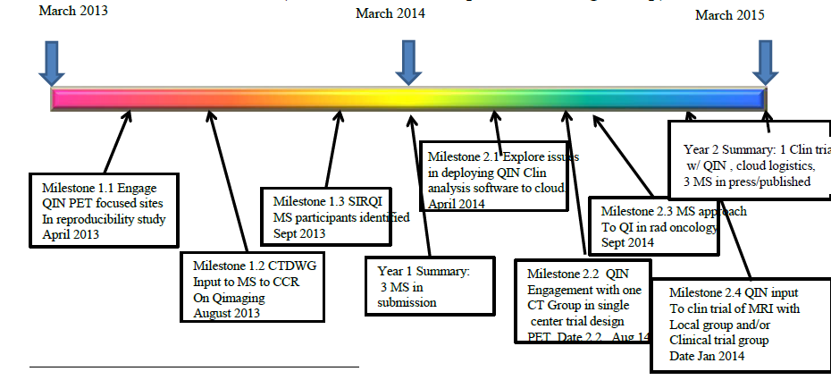
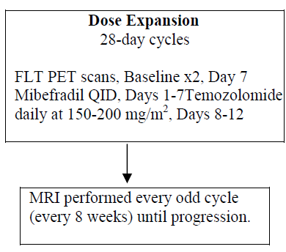
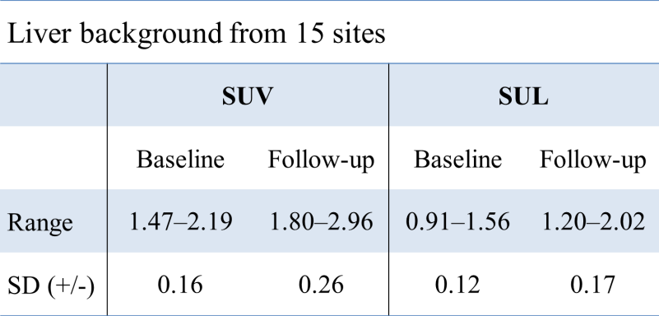
Clinical Trials Design and Development Working Group
The Russell H. Morgan Department of Radiology and Radiological Science, and
Sidney Kimmel Comprehensive Cancer Center,
Johns Hopkins University, Baltimore, MD, USA
*Richard L. Wahl, M.D. (chair), John Buatti, M.D. (co-chair, incoming chair), Brenda Kurland, Ph.D (incoming co-chair),
James M. Mountz, M.D., Ph.D., Daniel Rubin, M.D., Ph.D.,
Christopher Ryan, M.D, Edward Eikman, M.D., Elizabeth Gerstner, M.D, Frank S. Lieberman, M.D. E
Goals
Deliverable Time Line
Lessons/Opportunities/Conclusions
The overall goals of the CTDDWG are to:
Identify challenges and opportunities in clinical cancer imaging trial design and development, notably trials using quantitative imaging;
Identify and test potential best practices for clinical trial design, analysis and reporting;
Through collaborations with the other QIN working groups, facilitate introduction of QIN developed methods into clinical imaging trials;
Disseminate best clinical trial design and development methods through publications and guidelines;
Facilitate interactions with cooperative groups and other organizations interested in quantitative imaging by direct and continued engagement/cross-membership including introduction of quantitative imaging network methods into multicenter clinical trials and
Help export relevant and mature QIN methods to clinical practice settings as appropriate.
A small clinical trial has been designed between QIN site JHU, the U of Pittsburgh QIN, and the Adult Brain Tumor Consortium. In this trial, QIN methods and data/analysis sharing will be used to determine the role and performance of FLT PET in imaging cell cycle effects of mibefradil. A test-retest study will be included using FLT, to provide valuable data on reproducibility of the image analysis methods and the biology imaged in the study. This will be without intervening therapy being performed. The study schema is shown below. While only a 10 patient (30 scan) trial, the support from industry and the ABTC should make this a valuable exploratory undertaking in which QIN members are helping drive a key imaging component of a clinical trial of an innovative brain tumor therapy. The study is entitled:
A Phase I Open Label Safety Study to Evaluate the Pharmacokinetic Profile and Tolerance of Mibefradil Dose Finding in Subjects with Recurrent High-Grade Glioma Undergoing Standard, Repeated Temozolomide Treatment
Specific Projects
Specific Projects
Milestone 1.1: QIN inclusive Test-Retest study of PET/CT oncological quantification.
To determine what component of variability there is in the reader/workstation/lesion selection elements of quantitative assessments of treatment response
Sub-study: To determine the variability in measurement of FDG uptake in normal liver background in identical human PET studies analyzed by differing readers, software and performance sites.
In PERCIST 1.0 liver activity in a 3 cm sphere in the liver is used to assess noise, study comparability, and establish a patient-specific disease threshold.
Workstation software from 8 different vendors were used for the quantification. The standard uptake value (SUV) and SUV corrected for lean body mass (SUL) were measured using local standard approaches
A test case, both before and after therapy, from JHU Image Response Assessment Team (IRAT) Lab:
Liver measurements of the paired test case checked 30 paired cases of pre- and post-treatment FDG PET/CT studies distributed from the IRAT Lab; 2 experienced radiologists (nuclear medicine specialists) at each site asked to independently assess; Formatted reading forms to record the tumor and background measurements
QIN sites: JHU, Iowa, Pittsburgh, Stanford, U of Washiongton, H. Lee Moffitt and other non QIN US and international sites.
Progress toward these goals have been several fold including pilot QIN testing of reproducibility of FDG PET analyses among QIN sites, contributions to manuscripts and letters to JCO on the importance of incorporating imaging into clinical trials, Identification of publication goals including Standards in Reporting Quantitative Imaging (SIRQI) and a MS on QI in Radiation Oncology in the next year.
Additional tasks have been beginning to identify resources and barriers associated with placing QIN tools like “Auto PERCIST” in the “cloud”. QIN members have also worked to initiate small clinical trials including QIN sites, an example being a partly-intra QIN trial with FLT PET in brain tumor therapy assessment with a new treatment agent; this in an outreach effort with the Adult Brain Tumor Consortium. QIN related methods are also being considered in a large prospective trial of breast cancer neo-adjuvant therapy being developed with ACRIN-ECOG.
Thus, the CTDDWG is working on several fronts to translate best practices and technologies from the QIN to small scale and larger scale clinical trials, ultimately facilitating the most relevant quantitative methods entry to clinical practice.
SUV and SUL measurements of the normal liver derived from the same set of FDG PET/CT images showed generally similar, but not consistently the same, values. Variance is likely due to both human VOI selection methods and software differences. Relative % change is less affected than absolute change, and % change minimizes variance.
Milestone 1.2: CTDDWG contributions to CCR MS on Quantitative Imaging
Text contributions provided, ready for submission to CCR.
Contributions in related letter to editor, JCO by Mountz, status: in press
Milestone 1.3: Develop Standards in Reporting Quantitative Imaging MS
Status: In progress. Dr. Wahl has contacted authors of STARD MS to Assess process, several co-authors identified, linkage to data warehouse and Image archive a potentially critical element of the final product. This project has a parallel project on standardized reporting on which Dr. Eikman has developed sample reporting tools and processes.
Milestone 2.4: Explore Issues in deploying QIN Clinical Analysis software to the “cloud”
Status: Discussions have been ongoing. “Auto PERCIST” has been placed in a mini cloud and the software has been accessed by several QIN sites.
Milestone 2.2: QIN engagement with one clinical trials group in single center Trial design
Interactions with ECOG- ACRIN have been ongoing on a regular basis. Currently the QIN methods used in Auto PERCIST are being considered for inclusion in a prospective trial of breast cancer neoadjuvant therapy. While not yet complete, a pilot study from multiple sites has shown promise for the approach and we are optimistic the trial will move forward in the next year. There is active QIN engagement in this study design.
With new leadership coming on board for the QIN and the CTDDWG, an additional focus of the group will be on how to improve accrual to imaging trials. There is a concern that imaging trials accrue poorly and the CTDDWG, including Dr. Kurland, plan to focus on this additional aspect of imaging research as milestones are further refined for the next year’s activities.
While we have not yet achieved all our milestones, CTDDWG has made considerable progress toward moving QIN methods into more efficient and effective clinical trials, including advanced imaging.
.
Results:
Acknowledgements
We acknowledge the following collaborators for their contributions to the results above.
Joo Hyun O, M.D., Jeff Leal, BA, Radiological Society of North America (RSNA) and the Quantitative Imaging Biomarkers Alliance (QIBA), Image Response Assessment Team (IRAT) Laboratory, Johns Hopkins School of Medicine NCI P30CA006973; NIH/NCI 1U01CA140204-01A2; NIH HHSN268201000050C (13A)

