Slide 1

Program Overview
Tony Dickherber, Ph.D.
Program Director
Center for Strategic Scientific Initiatives (CSSI)
Office of the Director, National Cancer Institute (NCI)
National Institutes of Health (NIH)
April 2014

Slide 2


















National Institutes of Health (NIH): 27 Institutes and Centers
NHGRI
NIA
NIDA
NINDS
NIDCD
NIMH
NEI
NIAAA
CIT
NINR
NLM
NIDDK
NIH Campus – Bethesda, Maryland
FIC
CSR
NIBIB
NIMHD
NIDCR
NIEHS
NIGMS
NICHD
CC
NIAMS
NCATS
NCCAM
NIAID
NCI
NHLBI
NIH Budget ~ $30.8 Billion (FY12)
~82% for extramural support
~63,000 grants and contracts
NCI Budget ~ $ 5.07 Billion (FY12)
~ 76% for extramural support
~7,800 grants and contracts
Notes:
~4% contracts; ~25% training

Slide 3
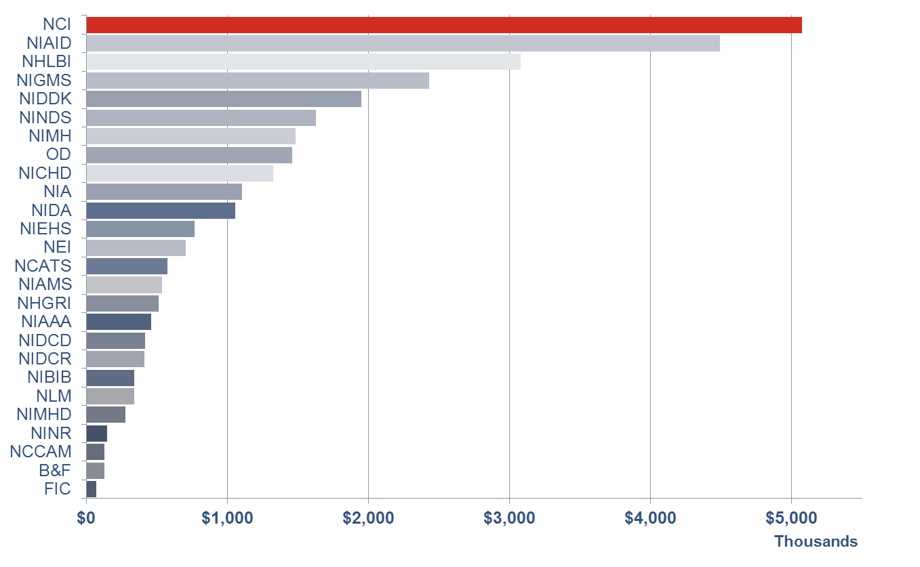
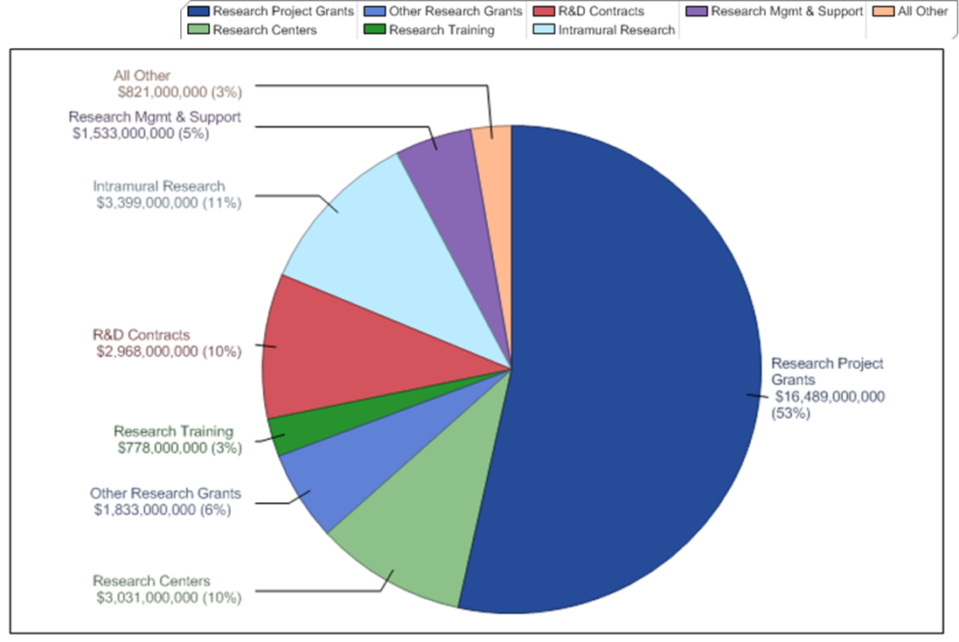
National Institutes of Health (NIH): 27 Institutes and Centers
NIH FY12 Appropriations Data Taken from http://www.nih.gov/about/almanac/appropriations/index.htm and http://report.nih.gov/nihdatabook/
Notes:
~4% contracts; ~25% training

Slide 4


National Cancer Institute Organization
National Cancer Institute
$5.07B
(FY12)
Director
Harold Varmus, MD
Office of the Director
Deputy Director
Douglas Lowy, MD
CSSI
~$190 M (~4%)
Center for Cancer Research
Division of Cancer Epidemiology and Genetics
Division of Cancer Treatment and Diagnosis
Division of Cancer Biology
Division of Cancer Control and Population Sciences
Division of Cancer Prevention
Division of Extramural Activities
Conducting – Intramural
Funding – Extramural

Slide 5









NCI Center for Strategic Scientific Initiatives (CSSI): Concept Shop
Director
Douglas Lowy, MD
~$190M (FY12)
Deputy Director
Jerry S.H. Lee, PhD
Mission
“…to create and uniquely implement exploratory programs focused on the development and integration of advanced technologies, trans-disciplinary approaches, infrastructures, and standards, to accelerate the creation and broad deployment of data, knowledge, and tools to empower the entire cancer research continuum in better understanding and leveraging knowledge of the cancer biology space for patient benefit…”
2003, 2007, 2011, 2013
2005, 2010
2008
2011
2004, 2008
2005, 2008
2010

Slide 6


























NCI Center for Strategic Scientific Initiatives (FY99 – FY13)
Pilot Launch
Expansion Launch
$3M
$10M
Pilot Launch
Expansion Launch
$11.7M
The Cancer Genome Atlas Program Office
$25M
Pilot Launch
Office of Cancer Clinical Proteomics Research
Pilot Launch
$8.7M
$13.1M
Center for Strategic Scientific Initiatives Established
Office of Biorepositories & Biospecimen Research
Pilot Launch
Pilot Launch
$10.5M
$60M
Office of Cancer Genomics
Restructure of NCI-wide SBIR/STTR mechanisms
Office of Physical Sciences Oncology
Pilot Launch
Pilot Launch
$30M
Renewal
Renewal
$10.5M
Pilot Launch
$10.5M
$10.5M
Center for
Bioinformatics
formed
$10.5M
Pilot Launch
Office of Latin American Cancer Program Development
$7.4M
$20M
Pilot Launch
Renewal
Office of Tech &
Industrial Relations
$15M
$30M
$3.9M
Pilot Launch
Office of Cancer Nanotechnology
$30.8M
FY99
FY00
FY01
FY02
FY03
FY04
FY05
FY06
FY07
FY08
FY09
FY10
FY11
FY12
FY13
Center for Biomedical Informatics and Information Technology
Spun Off to Coordinate Enterprise Phase of
SBIR Development Center
Spun Off to Coordinate NCI-wide SBIR/STTR awards
Center for Global Health
Spun Off to Coordinate NCI-wide international activities
Biorepositories & Biospecimen Research Branch
Spun Off to Coordinate NCI-wide biospecimen efforts
Center for Cancer Genomics
Spun Off to Coordinate NCI-wide genomics efforts
Office of Physical Sciences Oncology
Spun Off to join the Division of Cancer Biology
Data from NCI Factbooks (http://obf.cancer.gov/financial/factbook.htm)

Slide 7








Support Convergence and Innovation At Many Scales
Phase II
Early settlers
Team Explorers
Phase II
Phase II
Discoverers/
Pioneers
Basic
Applied
Translational
Clinical
Industry

Slide 8
Innovative Molecular Analysis Technologies (IMAT) Program
Program Mission:
  To support the development, maturation, and dissemination of novel and potentially transformative next-generation technologies through an approach of balanced but targeted innovation in support of clinical, laboratory, or epidemiological research on cancer.
Proof of Principle
Advanced Development
Testing & Validation
Scale Up
Technology Development Pipeline
Concept
Dissemination
R21
≤$500k over 3 years
direct cost support
Feasibility/Proof-of-principle study
Highly innovative technology
No preliminary data required
R33
Advanced development & validation phase
Demonstration of transformative utility
Requires proof of feasibility
≤$900k over 3 years
direct cost support
R43
R44
≤ $225k over 6m total cost support
≤ $1.5M over 2 years
total cost support
Development & (regulatory) validation
Manufacturing & marketing plan
Requires proof of feasibility and commercialization plan
Demonstration of transformative utility
Feasibility study
Clear commercial potential
Fast-Track

Slide 9
IMAT credits from the R21/R33 award history
Proteomics
Dynamic Range Enhancement Applied to Mass Spec (DREAMS)
Gateway ORF Cloning Tool
Multi-Dimensional Protein Identification Technology (MuDPIT)
Isotope-Coded Affinity Tags (ICAT)
Synchrotron Footprinting
Nanowire field effect transistors (NWFETs)
Deuterium exchange Mass Spec (DXMS)
Nucleic Acid Programmable Protein Array (NAPPA)
Genomics
Digital Optical Chemistry
Rolling Circle Amplification
Representational Oligonucleotide Microarray Analysis(ROMA)
Multi-photon Intravital Imaging (MPIVI)
Recombomice
Pyrophosphorolysis Activated Polymerization (PAP)
Pair-end Sequencing to screen structural rearrangements
Digital Transcriptome Subraction
Zinc Finger Nucleases for targeted double-strand breaks
COLD-PCR
Epigenomics
Differential Methylation Hybridization (DMH)
Chromatin Immunoprecipitation with next gen Sequencing (ChIP-Seq)
Clinical Diagnostics
Paramagnetic chemical exchange saturation transfer (ParaCEST)
Near IR Probes for in vivo diagnostics
MicroSOL IEF (Invitrogen as Zoom IEF Fractionator)
Microfluidic Genetic Analysis (MGA) chip
Oncomap
Mass Spec ImmunoAssays (MSIA) from Intrinsic Bioprobes
PhosphScan® kits from Cell Signaling Technology, Inc
Sample preparation
Magnetic Cell Sorting, now available from Ikotech
RainDance Oil Droplet Microfluidics
Cryopreservation followed by culturing of CML cells
NanoVelcro
Drug Screening or Delivery
  One Bead One Compound (OBOC)
  Genetically modified T-cells for acute lymphoblastic leukemia treatment
  PI 3K inhibitor screening platform from Echelon Biosciences (now Aeterna Zentaris)
  ONIX microfluidic perfusion cell toxicity screening system by CELLASIC Corp

Slide 10
IMAT credits from awards targeting Small Business Entities (R41-44)
Noteworthy IMAT-SBIR Awards:
GeneChip® CustomSeq® resequencing arrays from Affymetrix
BeadArray gene expression assay system from Illumina
BeadChip arrays, BeadLab and BeadStation enabling NGS from Illumina
PI 3K inhibitor screening platform from Echelon Biosciences (now Aeterna Zentaris)
ActivePipettes used in Rainmaker microarray dispenser from Engineering Arts
TRIO multspectral diagnostic imaging from CRi, now Perkin Elmer
Functionalization of Quantum Dots from Quantum Dot Corporation
Mass Spec ImmunoAssays (MSIA) from Intrinsic Bioprobes
Light Activation System from Syntrix, now SuperNova Life Sciences
PhosphScan® kits from Cell Signaling Technology, Inc
ONIX microfluidic perfusion cell toxicity screening system by CELLASIC Corp

Slide 11
Diversity of IMAT
Innovative Technologies for Molecular Analysis of Cancer (R21)
  Proof-of-concept
  Milestone driven (no biology)
Application of Emerging Technologies
for Cancer Research (R33)
  Validation
  Demonstration of impact on basic and/or clinical research

Slide 12
Unique Attributes of IMAT
Emphasis on innovative technology with transformative potential (i.e. high-risk, high-impact)
  Focus on technology development (NOT hypothesis-driven research)
Milestone-based applications (R21 only) that quantitatively assess the performance capacities of the technology (such as specificity, sensitivity, and speed) and characterize the improvement over state-of-the-art
100% investigator-initiated research grants

Slide 13
(Potential) Life Cycle of an IMAT Technology Development Project
Separate Application Process
Technology Dissemination via:
R21/Phase I
R33/Phase II
NCI Programs and Initiatives
Collaboration
Publication
Licensing
Commercialization
Mechanism:
Exploratory/pilot phase; requires innovative technology/approach; no preliminary data required
Mechanism:
Developmental/validation phase; requires significant feasibility data
Requirements:
Description of study
Relevance to cancer
Quantitative milestones
Truly novel tool/capability
Improvement over state-of-the-art
Requirements:
Plan for developing the technology to be useful to a category of cancer researchers or clinicians
Description of potential impact for the field
Description of completed milestones or evidence of technical feasibility
Technology Tools for Researchers:
Better – higher resolution, more detailed analysis, improved specificity/ selectivity/ sensitivity
Faster – faster processing, massively multiplexed
Cheaper – simpler or more robust design, field-ready

Slide 14
Active IMAT Funding Opportunities
Early‐Stage Innovative Molecular Analysis Technology Development for Cancer Research [R21] FOA#: RFA-CA-14-003 Budget: $500k/3yrs (direct cost cap)
Advanced Development and Validation of Emerging Molecular Analysis Technologies for Cancer Research [R33] FOA#: RFA-CA-14-004 Budget: $900k/3yrs (direct cost cap)
Innovative Technologies for Cancer-Relevant Biospecimen Sciences [R21] FOA#: RFA-CA-14-005 Budget: $500k/3yrs (direct cost cap)
Advanced Development and Validation of Emerging Technologies for Cancer-Relevant Biospecimen Sciences [R33] FOA#: RFA-CA-14-006 Budget: $900k/3yrs (direct cost cap)
Molecular/Cellular Analysis Tools
Sample QA/QC Tools
Notes:
We currently offer those phase I and II levels awards for two areas of technology development. The first is from our namesake, which is new technologies that offer novel capabilities for molecular or cellular analysis of cancer. The second is something of a front end enabler to that kind of research, and is described as Biospecimen Science technologies. As the first category is focused on the analytical capabilities themselves, the latter is focused on the quality of the analytes. So, technologies that would be within the scope of this solicitation focus on sample preparation, preservation, procurement or otherwise the ability to assess the quality and biological integrity of the molecules you wish to analyze.

Slide 15
IMAT Awards for Small Business
Molecular/Cellular Analysis Tools
Innovative Molecular Analysis Technology Development for Cancer Research and Clinical Care [FOA# PAR-13-327]
R43 Time: 6 months Budget: $150k (total cost cap)
R44 Time: 2 years Budget: $2M (total cost cap)
Sample QA/QC Tools

Slide 16
A Note on “Biospecimen Science”
Sample Quality Control (e.g., RNALater)
  Focus on preserving the biological integrity of the molecular and cellular targets to be assessed
  Spans the preanalytical time period from patient management variables, through sample procurement, immediate handling and preservation, and processing prior to analysis
Sample Quality Assessment (e.g., RIN)
  Focus on verifying the biological integrity of the molecular and cellular targets to be assessed

Slide 17
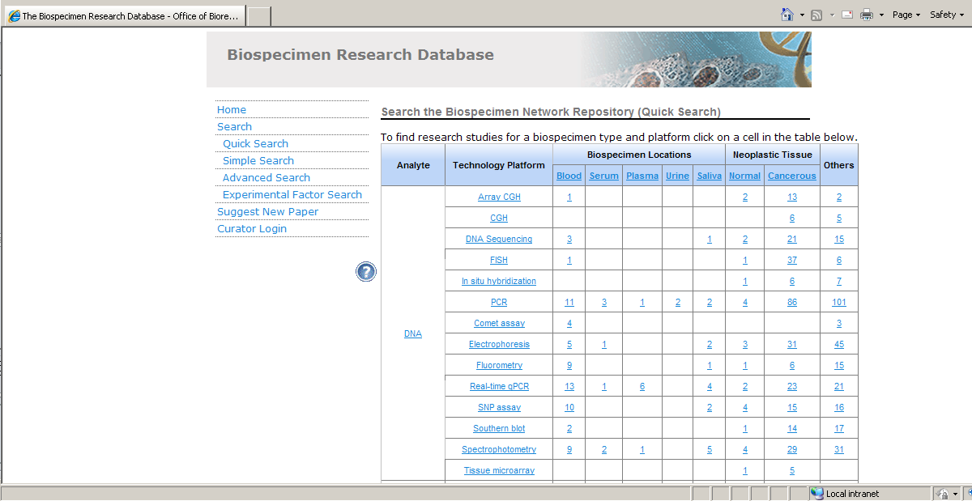
An Important Public Resource:
Biospecimen Research Database
http://brd.nci.nih.gov
Notes:
For just a bit more background on biospecimen science, one of the key challenges identified by a number of very high-profile groups around the time the NCI was contemplating the Center for Strategic Scientific Initiatives was the problem of wide ranging quality of samples being used for research and regulatory validation. We conducted a series of experiments in coordination with a network of similarly concerned investigators especially in the anatomic and clinical pathology community to confirm the merits of this concern. I have just one example of this concern in which investigators at Utah’s Intermountain Healthcare found that, even though they used a single standardized CLIA-approved laboratory for testing clinical samples from multiple hospitals to screen for an important breast cancer marker, they found the results were more likely to be negative just based on what day of the week the surgery was performed and the sample obtained. The issue is, essentially, that even when you take a biological sample from a patient, that is still live biology that responds to what is going on around it, and whether its taking a blood sample or removing a chunk of tissue from a person’s body, that is a significant change that the biology is likely to react to so how to either better prevent what we call preanalytical variables from running amuck or how to assess whether or not the molecular analytes we want to investigate or otherwise screen have sufficient biological integrity so as to provide useful information. The NCI has developed the Biospecimen Research Database for biospecimen science-relevant research, in which a team of experts curates the general biomedical literature for biospecimen science relevant studies and this is available to you all for either learning more for what is relevant to your own research or perhaps identify new opportunities for developing novel technological solutions. You

Slide 18
Non-responsiveness Criteria
Projects focused on a biological or clinical hypothesis for which the novelty resides in the biological or clinical question being pursued (i.e. traditional biological-hypothesis driven research);
Projects that propose to use existing technologies (for which proof of concept has already been obtained) that may be ready for the targeted applications without substantial further developmental efforts;
Projects that propose to develop only incremental technical advances to existing technologies projects that will have low potential for transforming cancer research;
Technologies for whole-body or in vivo imaging methods;
Projects involving clinical trials or toxicology studies;
Projects focused on biomarker discovery or biomarker validation;
Projects focused on development of specific contrast agents;
Projects focused on development of specific drugs or therapies;
Projects focused primarily on software/informatics solutions, database development, data mining, statistical tools, and computational/mathematical modeling (including those applicable to drug and/or patient responses) with the exception of projects which include software development for embedding in new devices or limited amounts of computational efforts as might be needed to develop new devices or methods;
Applications that may have appropriate scientific scope but do not include the required specific components (Statement of Impact and Quantitative Milestones) will also be considered non-responsive to this FOA and will not be reviewed.

Slide 19
R21 Milestones
Should be quantitative and scientifically justified
Critical components to include
  Numerical performance targets (what)
  Means by which they will be assessed (how)
Important review consideration:
  Means of judging the success of the aims
  Provide proof-of-principle for justifying further developmental effort
    e.g., under a future R33 project

Slide 20
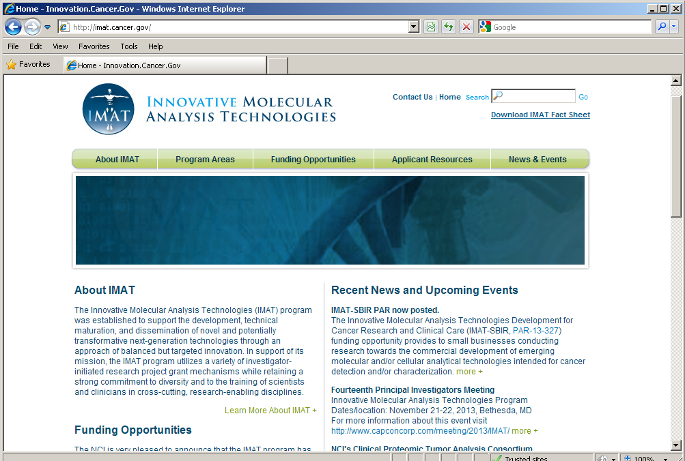
http://innovation.cancer.gov

Slide 21
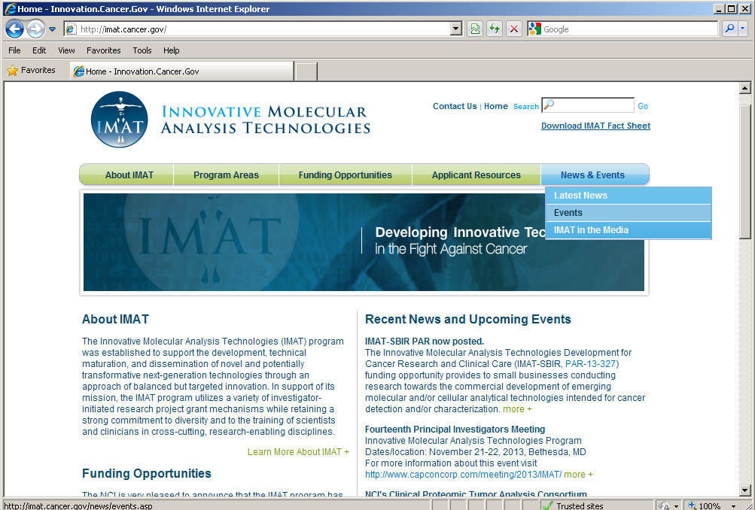
http://innovation.cancer.gov

Slide 22
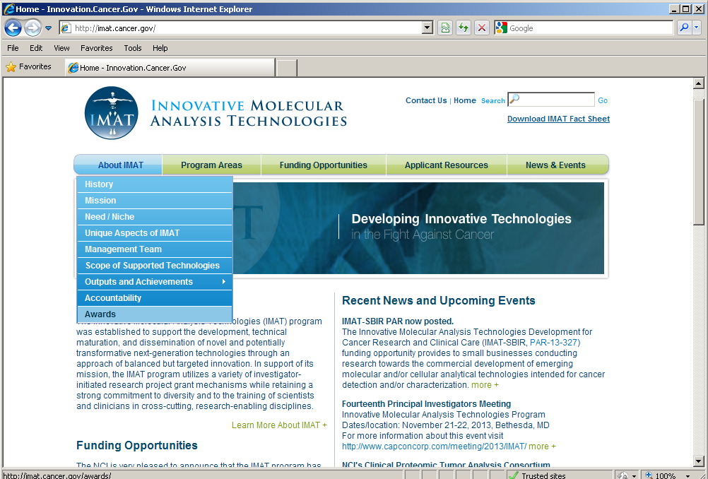
http://innovation.cancer.gov

Slide 23
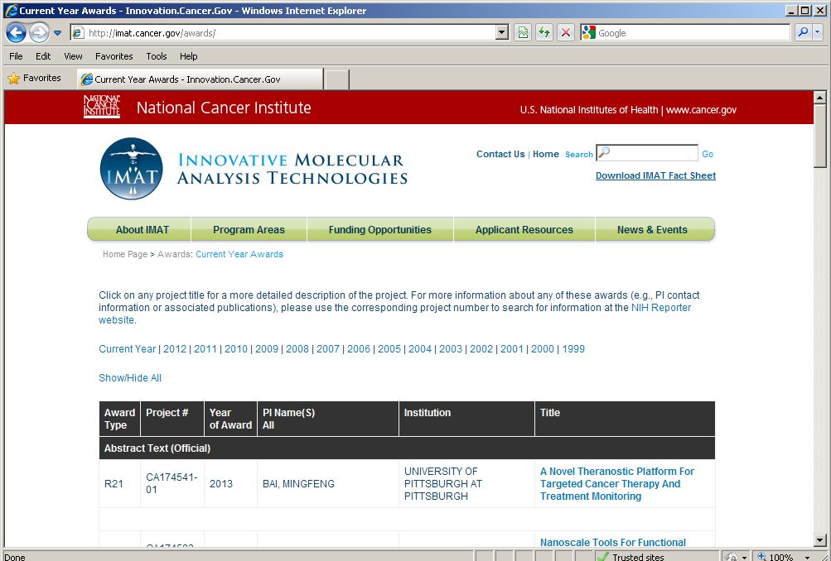
http://innovation.cancer.gov

Slide 24
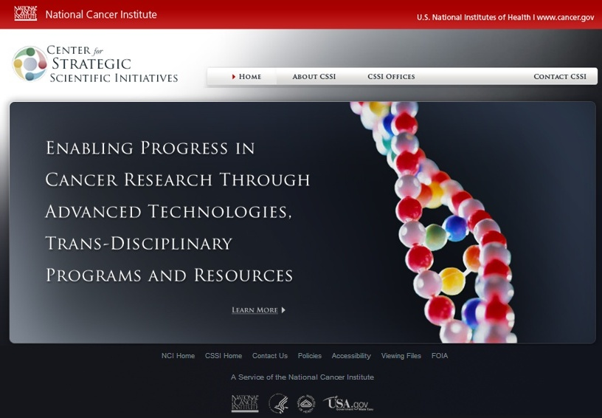
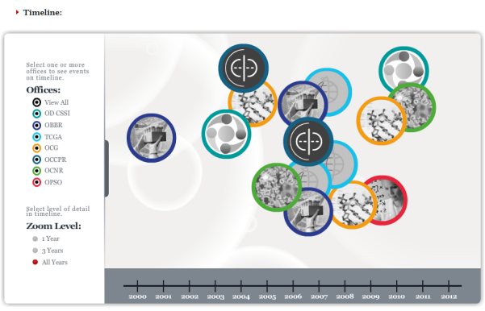
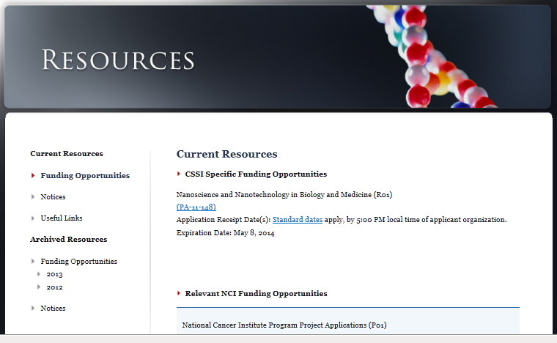
Learn More About Us…
http://cssi.cancer.gov
Tony Dickherber
anthony.dickherber@nih.gov
(301) 547 - 9980

