Slide 1
3D Slicer and QIICR as a resource for QIN
Andrey Fedorov, PhD and Ron Kikinis, MD
Brigham and Women’s Hospital/Harvard Medical School
Boston, MA
2014 QIN Face-to-face meeting, March 27-28, 2014
fedorov@bwh.harvard.edu

Slide 2
from QIN PAR-14-116
“Enhance the value of quantitative imaging (QI) in clinical trials for prediction and/or measurement of response to cancer therapies”
“emphasize the development, optimization and validation of state-of-the-art QI methods and software tools for potential implementation in single site phase 1 or 2 clinical trials”
“address the challenges of integrating existing and or new QI methods as required for multicenter phase 3 clinical trials”
“harmonization of image data collection, analysis, display and clinical workflow methods across imaging platforms, or testing their performance across different cancer sites”
“provide an improved means to have these advanced methods adopted into single site (i.e. phase 1-2) clinical trials, and further optimized or multi-site (phase 3) clinical trials”
“extend initial software tool development and optimization to analyze performance in the multisite clinical trial, where multiple platforms are used for data collection”
2

Slide 3
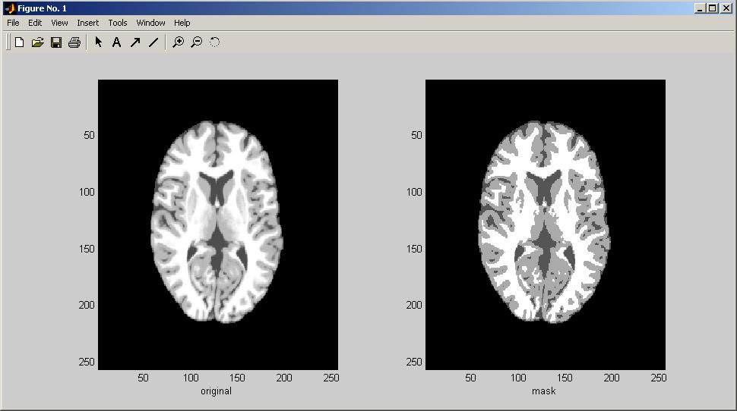
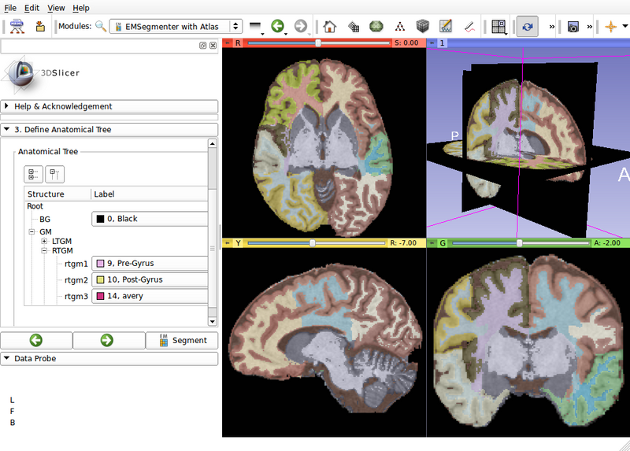
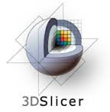
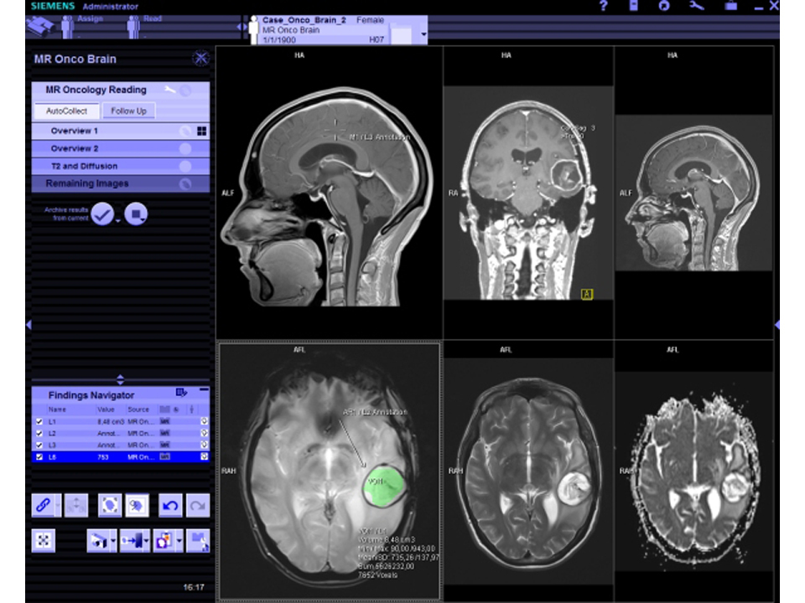
From Research prototypes
to Clinical tools
Questions and answers
Can it be done?
Research prototypes
Is it worth doing?
Clinical research tools
Standard of care
Commercially available “clinical devices” with regulatory approvals
3

Slide 4
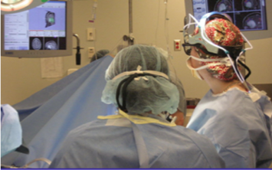
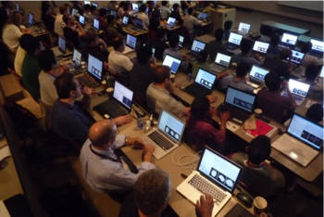
Easy to use, Easy to extend, for Research
3D Slicer: a cross platform system for translating innovative algorithms into tools for clinical research applications
What does a user expect ?
Easy Install and Upgrade
“Standard” Clinical Behavior
Advanced Functionality
Consistent Interface
Easily Deployable
Extensible and Reconfigurable
Rich Utility Libraries
What does a developer need ?
Easily Deployable
Extensible and Reconfigurable
Rich Utility Libraries
Stable Base
4

Slide 5
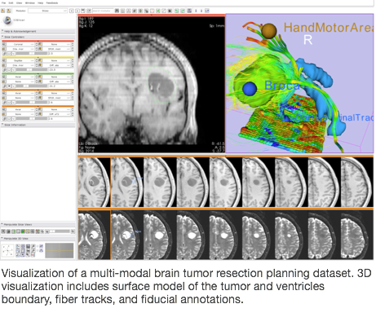
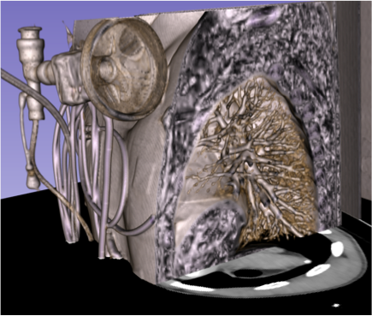
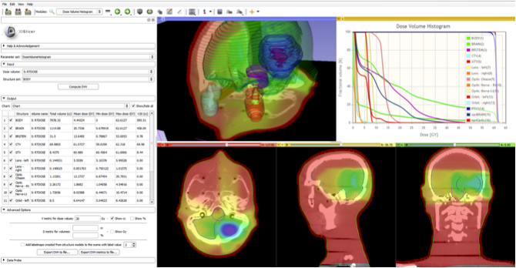
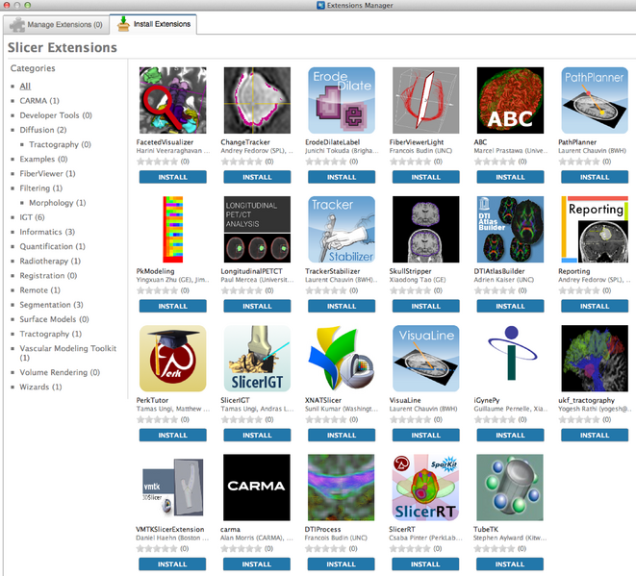
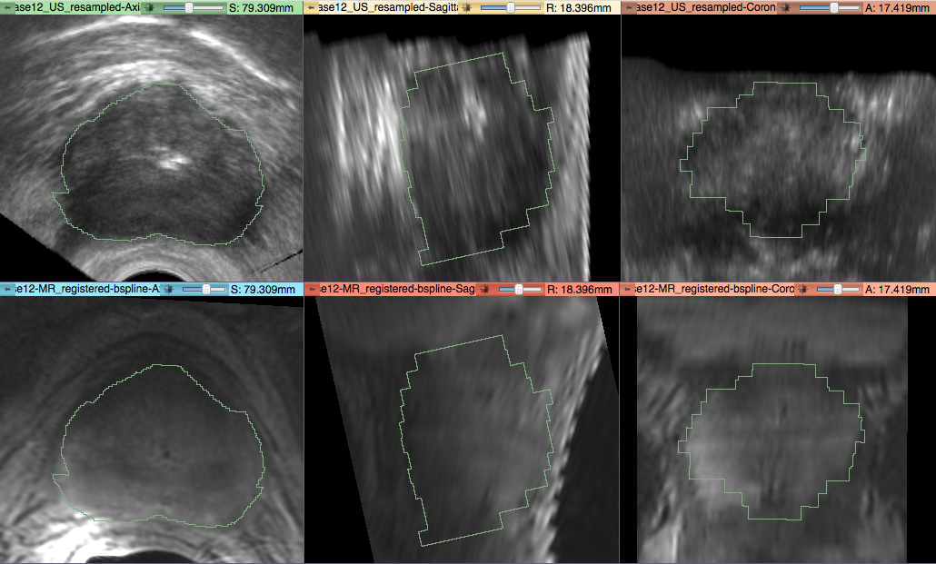
Slicer overview
Since circa 2000
Multi-modality visualization, Segmentation, Registration
Free open source
no reciprocity requirements
you choose what to share
Cross-platform
“One-click” installers for Windows, Mac and Linux
Support and training
Industry-strength engineering
Extensible
Community “App store”
Research software
not FDA approved
5

Slide 6
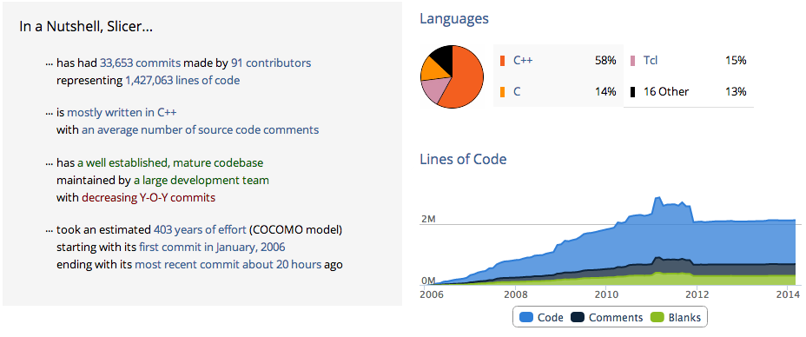
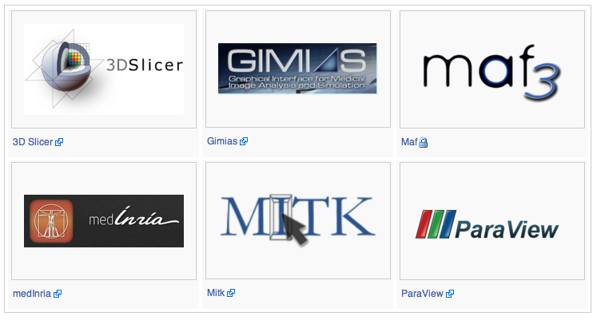
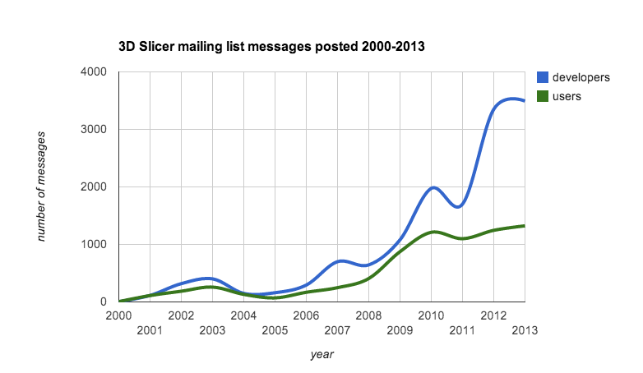
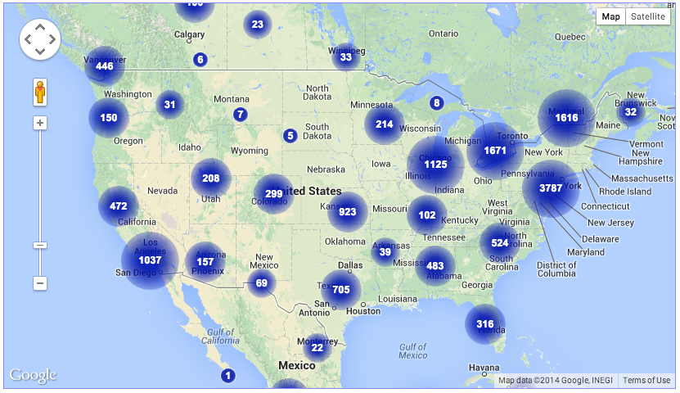
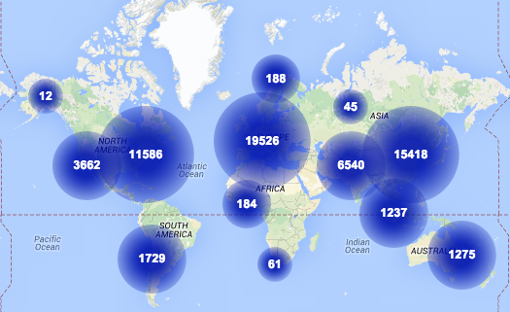
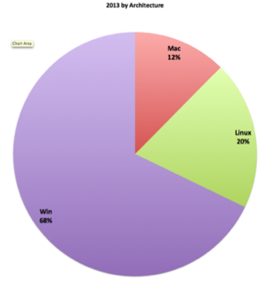
Slicer community at a glance
http://commontk.org
3D Slicer project analysis from Ohloh.net
http://www.ohloh.net/p/3376
Slicer version 4 re-architecture
and cleanup
Total number of 3D Slicer downloads in 2013: 61463
http://massmail.spl.harvard.edu/public-archives/slicer-users/
http://massmail.spl.harvard.edu/public-archives/slicer-devel/
6
http://download.slicer.org/stats
Notes:
since ~2000
user list participation
ohloh dev metrics
drop in # lines and submissions ~ 2011
cleanup + re-org the code into plugins - investment in software engn
international collaborations - CTK
CTK plugins - interoperability with other platform

Slide 7
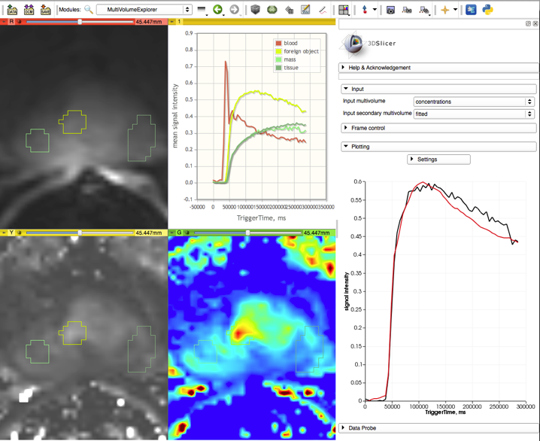
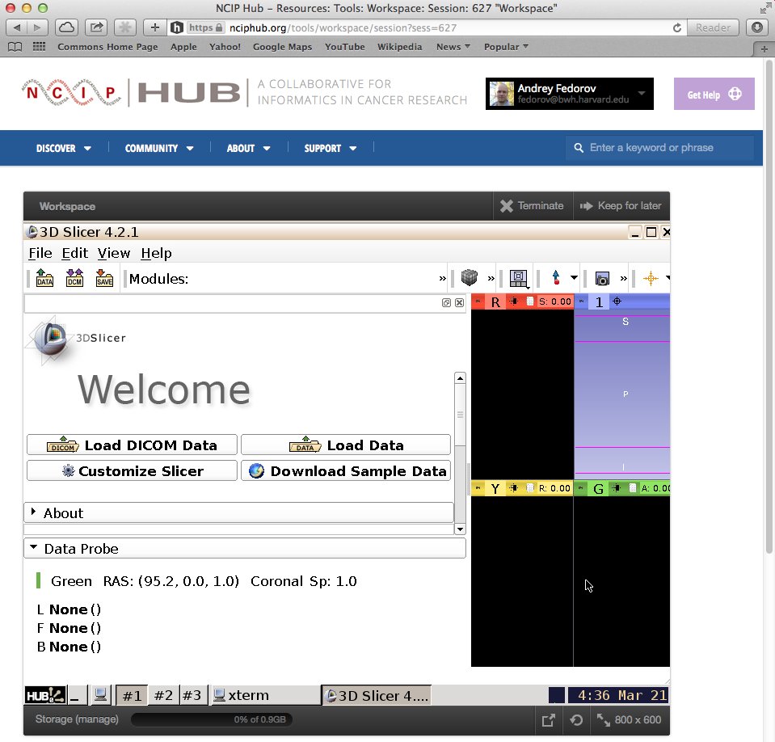
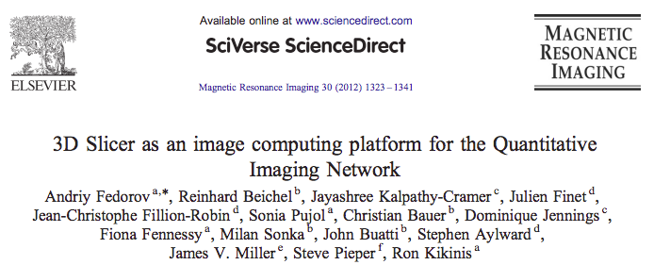
Slicer and QIN
QIN teams using Slicer in their research *
BWH, Iowa, MGH, Stanford, OHSU, Mayo
QIN “Grand Challenges”
Participated in DCE analysis, Intensity scaling, PET segmentation challenges
DICOM Segmentation object conversion tools
Slicer QIN paper
over 50 citations since published in 2012
Available on NCIP Hub (no GPU acceleration)
7
* Source: “QIN Matrix” summary spreadsheet, as of March 2014
Notes:
peer pressure

Slide 8
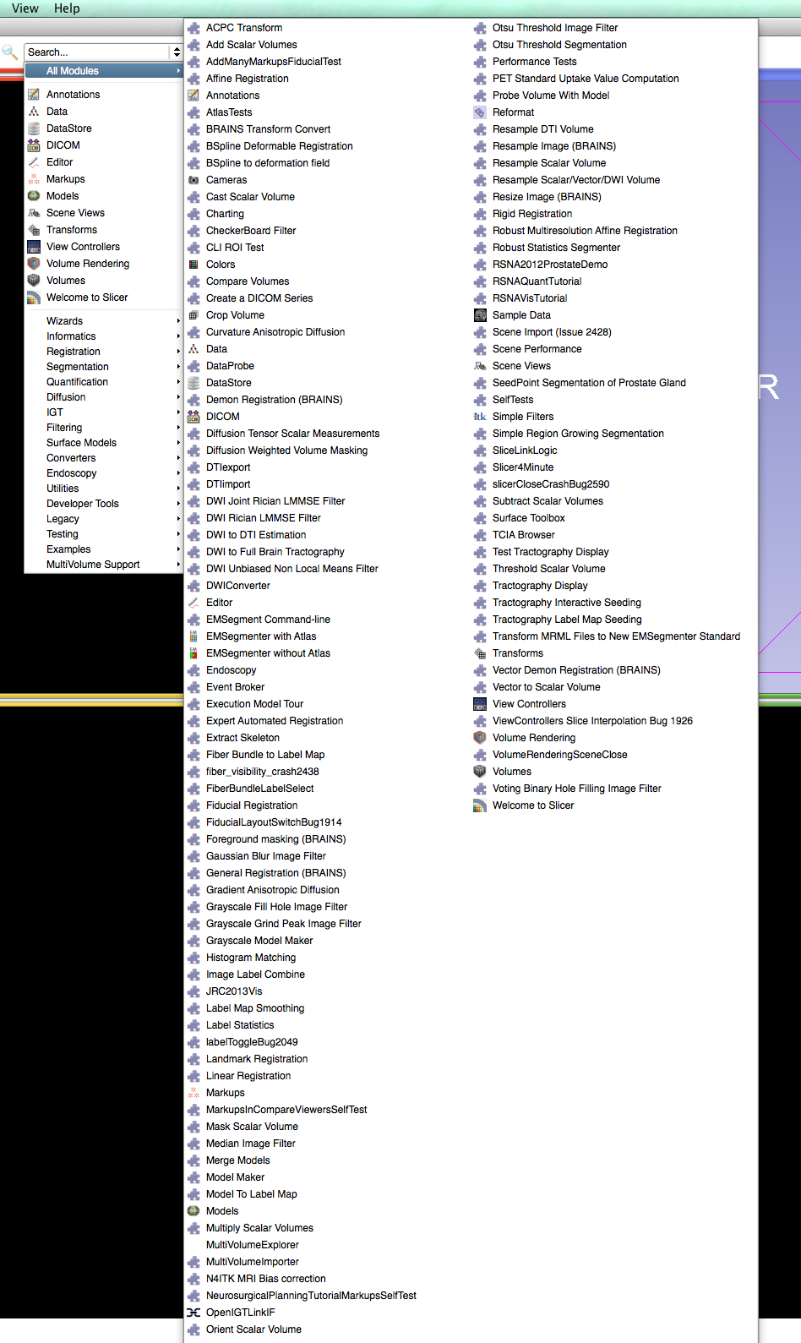
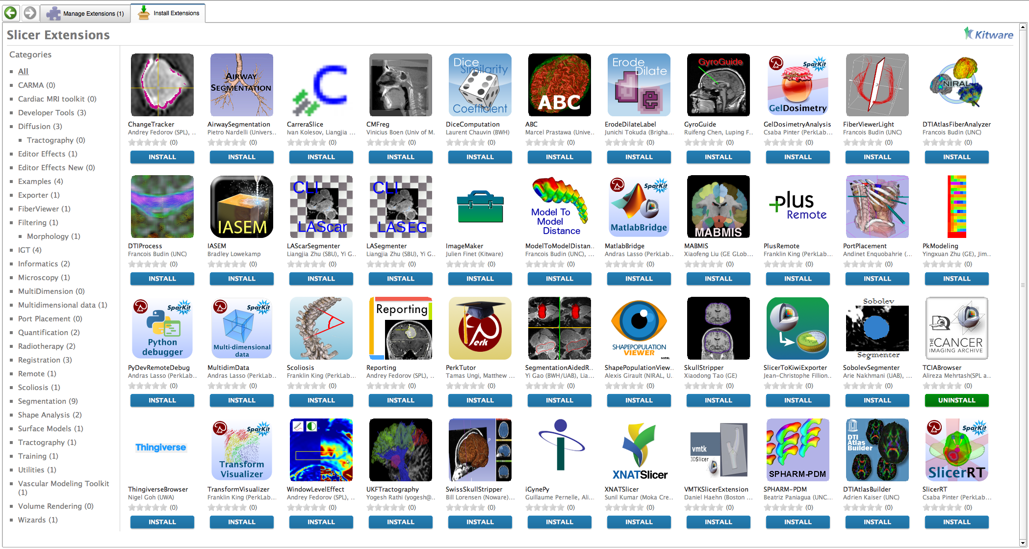
“Lessons learned” from Slicer user community
many algorithms, few end-to-end solutions
standards-based interoperability is limited
tools for longitudinal and quantitative analysis are needed
integration with community imaging archives is limited
8

Slide 9
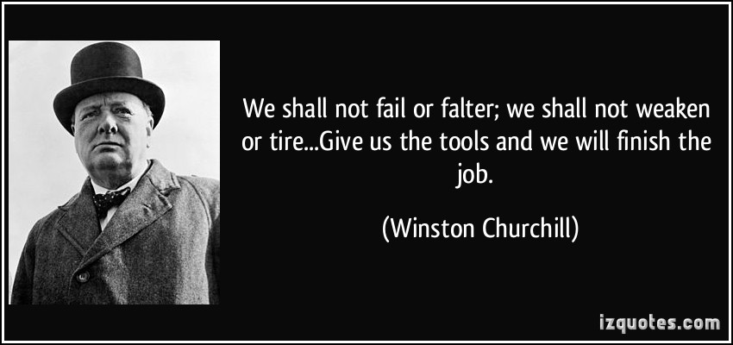
“Lessons learned” from QIN interactions
Individual sites are not tasked with the development of the platforms to facilitate sharing
Insufficient understanding of the capabilities and limitations of DICOM, limited support to encourage adoption of relevant parts of DICOM
Repositories of annotated image data are severely limited
9

Slide 10
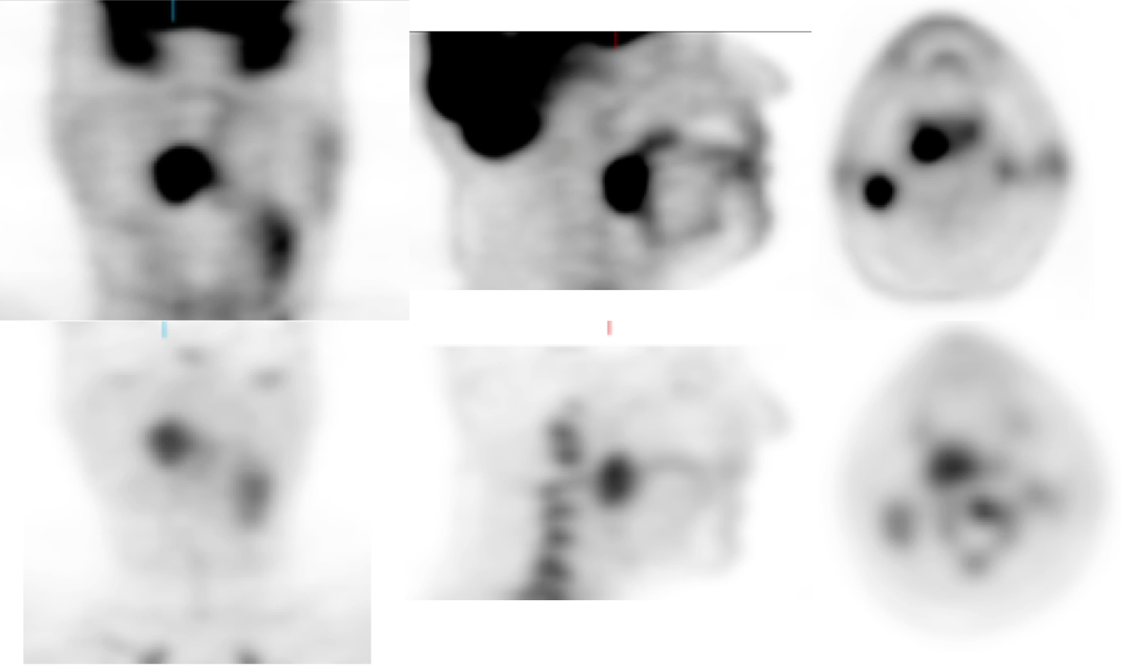
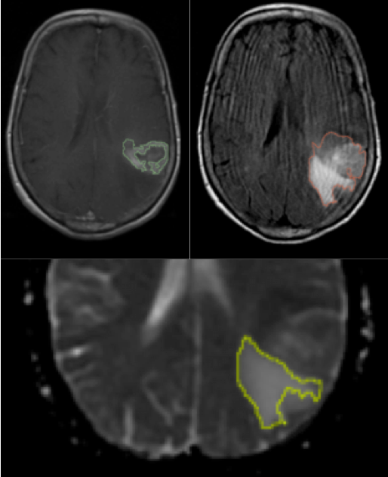
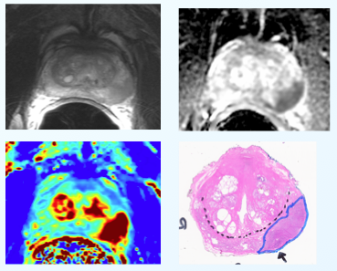
Quantitative Image Informatics for Cancer Research (QIICR)
U24 CA180918
http://qiicr.org
QIN Slicer “birds of a feather” U24
NCI ITCR PAR-12-287
Based on the needs of BWH, Iowa and MGH QIN projects:
identify image informatics needs
harmonize data sharing by using DICOM and implement supporting toolset
demonstrate software tool sharing
facilitate adoption of the toolset
Use DICOM as much as possible, propose improvements as needed
Free open source
MGH: glioblastoma
Iowa: head and neck cancer
BWH: prostate adenocarcinoma
10

Slide 11
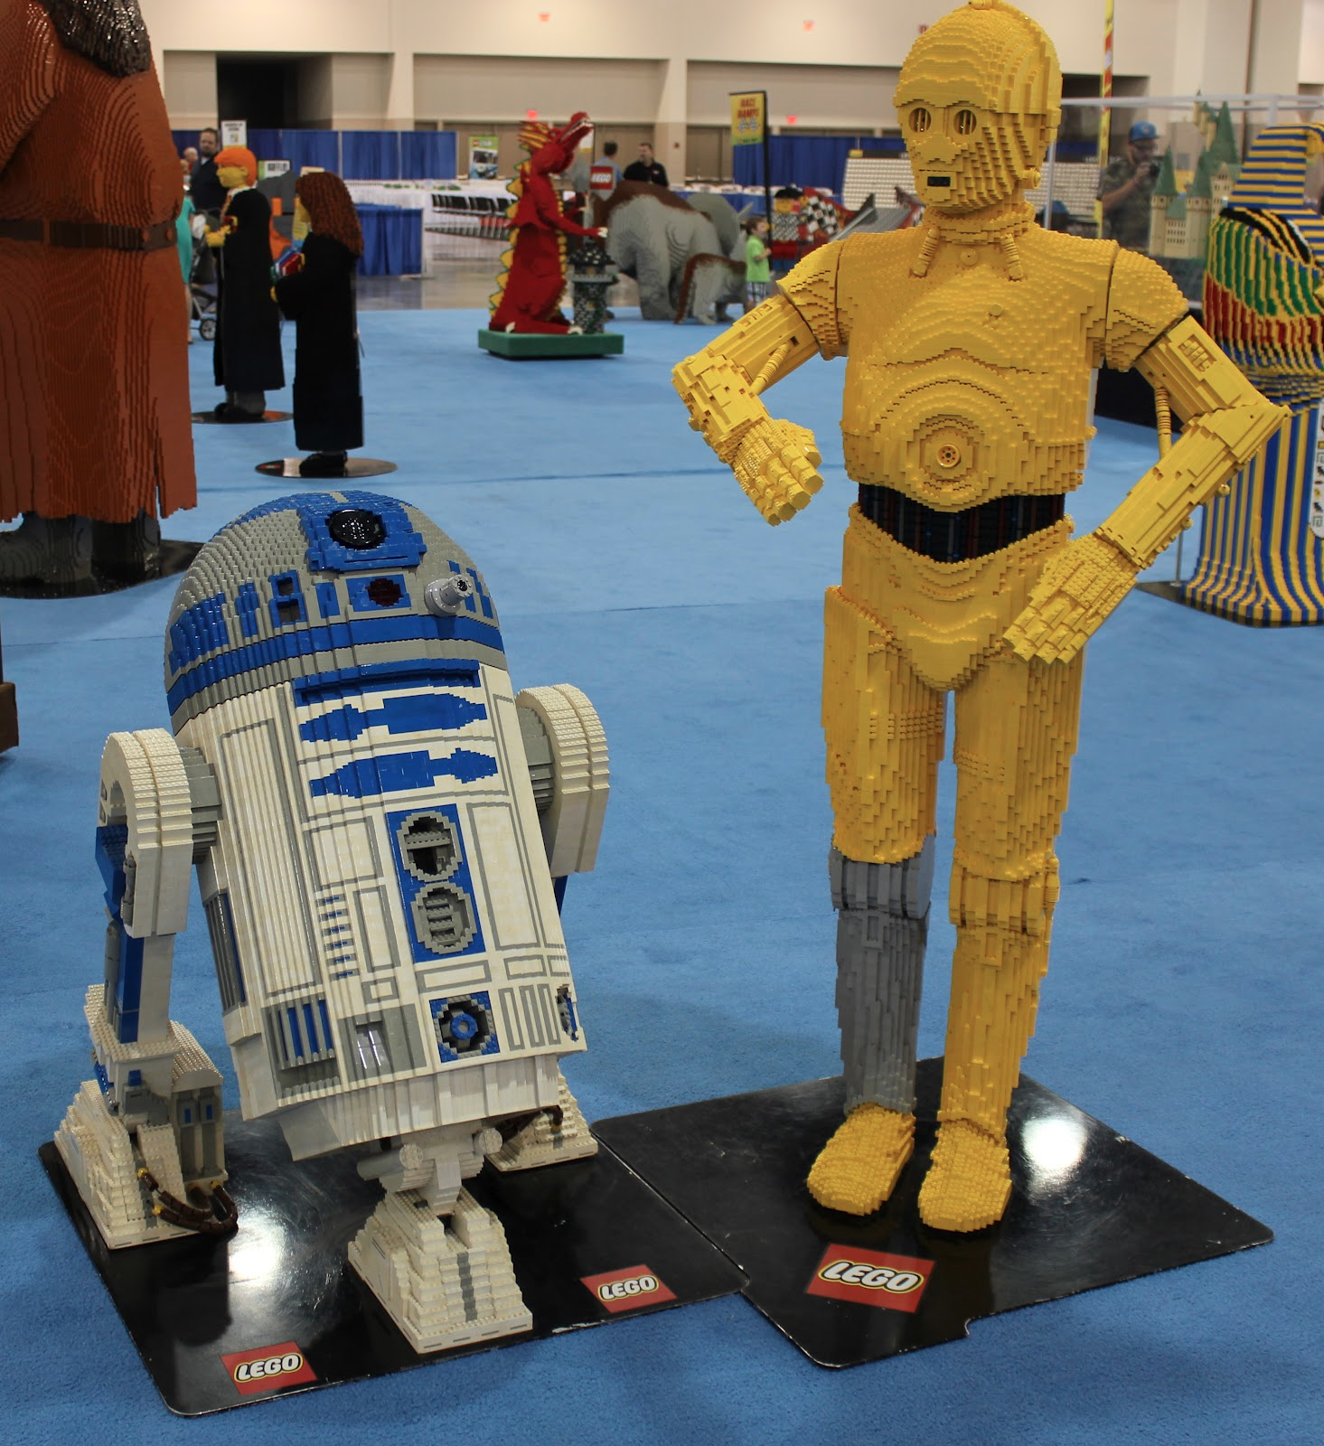
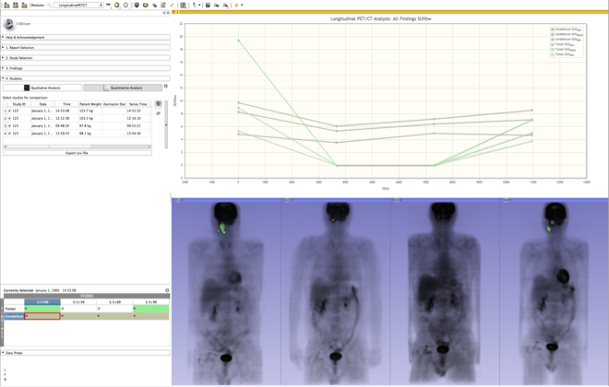
QIICR Aim 1: Solutions and tools
Standardize on 3D Slicer as the delivery platform
Implement missing “building blocks” as needed
segmentation
PK analysis
...
Integrate “building blocks” into end-to-end solutions
Standardize on DICOM for input images and output results serialization
WG interactions: try our tools, give us your feedback!
vs
Mercea P, Fedorov A, Pieper S, Beichel R, Park M-A, Hainer J, Kijewski MF, Horky L, Kikinis R, Dickhaus H. Quantification of longitudinal tumor changes using PET imaging in 3D Slicer. In Proc. of Computer Assisted Radiology and Surgery, 2013. Int J CARS 2013 (8) (Suppl 1):S285-S286.
Pohl K, Konukoglu E, Novellas S, Ayache N, Fedorov A, Wells WM, Talos IF, Golby A, Kikinis R, Black PM. A New Metric for Detecting Change in Slowly Evolving Brain Tumors: Validation in Meningioma Patients. Neurosurgery, 2011, 68(1 Suppl Operative), pp.225-233.
11

Slide 12
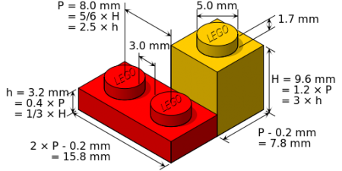
QIICR Aim 2: Interoperability
Standardize on DICOM for
image analysis results
parametric maps
measurements and quantitative indices
structured reports
terminologies
data provenance
clinical data
propose amendments as necessary
demonstrate applicability
improve toolkit support
facilitate adoption
WG interactions: focused presentations on the use of DICOM, feedback on broader applicability of use cases
David Clunie
http://dicom.offis.de/dcmtk
http://slicer.org
http://itk.org/
http://itk.org/
12

Slide 13
QIICR Aim 3: Sharing
Simplify interaction with public repositories to facilitate sharing of the analysis results:
focus on 2 most popular repositories:
NCI TCIA
XNAT Central
integrate developer API into 3D Slicer
provide user-level “data browsers”
support 2-way communication, when possible
WG interactions: try our tools, give us your feedback!
13

Slide 14
QIICR current progress and near-term plans
Talk to me in person for details and demos!
Aim 1: Solutions and tools
PET SUV and quantitative index extraction tools
improvements to DCE analysis tools
Slicer interface improvements to simplify user experience
Next 6-12 months: Slicer extensions to do PET and DCE MRI analysis (as required for QIICR QIN projects) and store all processing results in DICOM
Aim 2: Interoperability / DICOM
prototype DICOM implementations to explore capabilities of SR, SEG, RWVM objects
a number of DICOM correction proposals under development
improvements to DCMTK to support QIN use cases
Next 6-12 months: improve DICOM SEG support, support selected SR templates, floating point parametric maps, RWVM
Aim 3: Sharing
Slicer TCIABrowser extension released (google “slicer tciabrowser”)
TCIA image and TCGA clinical data access integrated via APIs
14

Slide 15
Summary
Our approach: Demonstrate by example
Improving infrastructure to facilitate method sharing and data harmonization
prioritize the BWH/MGH/Iowa QIN efforts
welcome feedback from other QIN stakeholders
DICOM is here to stay
learn and teach how it can help QIN
Leverage decades of prior open source contributions
maintain compatibility with existing platforms
learn lessons for the next generation of solutions
15

Slide 16
QIICR team
Leadership: Brigham and Women’s Hospital, Boston
Ron Kikinis, MD
Andrey Fedorov, PhD
Driving Biological Projects
Quantitative MRI of Glioblastoma response: Massachusetts General Hospital
Jayashree Kalpathy-Cramer, PhD
Elizabeth Gerstner, MD
Karl Helmer, PhD
Head and Neck cancer response assessment with PET/CT: University of Iowa
Reinhard Beichel, PhD
Milan Sonka, PhD
Quantitative MRI of prostate cancer: Brigham and Women's Hospital
Fiona Fennessy, MD, PhD
Andrey Fedorov, PhD
3D Slicer
3D Slicer lead architect: Steve Pieper, PhD - Isomics Inc., Cambridge
DICOM
Technical lead: David Clunie - PixelMed Publishing, LLC
DCMTK Development lead: Michael Onken - OFFIS and Open Connections, Germany
16

Slide 17
Where to learn more
3D Slicer
try it out: http://download.slicer.org
tutorials, documentation etc: http://slicer.org
QIICR
home page: http://qiicr.org
github QIICR organization: http://github.org/QIICR
NCIPHub QIICR group: https://nciphub.org/groups/qiicr
Contact me directly fedorov@bwh.harvard.edu
17

