Slide 1
BioInformatics and Data Sharing

Slide 2
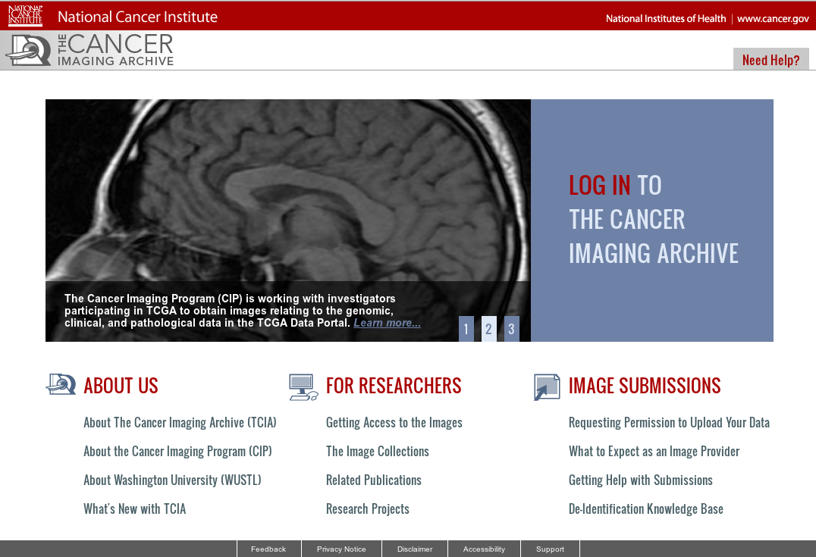
1. Data Sharing: Mechanism
QIN is strongly focused on data sharing (image and metadata)
http://www.cancerimagingarchive.net/
TCIA is preferred archive
CTP is preferred tool for De-ID and Xfer to TCIA for curation and sharing

Slide 3
1. Data Sharing: Format
Preferred format is DICOM
For images of course
For segmentation maps, DICOM-Seg
For contours, DICOM-RT
(DCE group is using Matlab & NRRD?)
Tools are available to convert

Slide 4
1. Data Sharing Status
12 data sets in TCIA currently

Slide 5
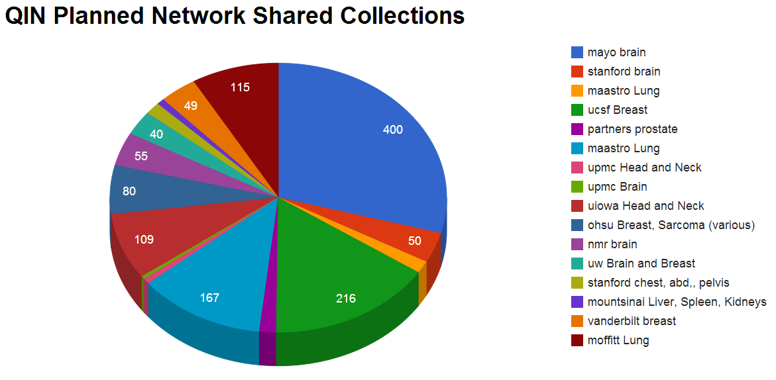
1. Data Sharing Status
[# subjects]
MR (13), CT (5), PET/CT (5), PET (2)

Slide 6
1. MetaData Sharing
While DICOM addresses image data, there is no good standard for clinical data—e.g. survival therapy, tumor type and grade
BIDS Breakout group: We wish to collect the type of information like that that is used by each QIN. Please be sure to send a person to at least 1 BIDS break out session with this information.

Slide 7
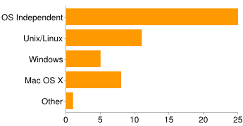
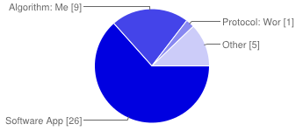
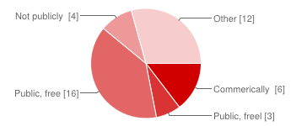
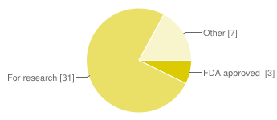
1. Tool Sharing
Type
Operating System
License
Maturity

Slide 8
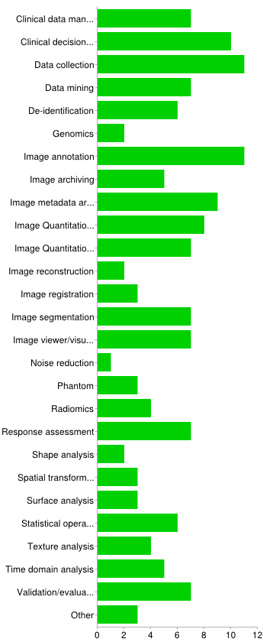
1. Tool Sharing
Spans all major modalities except ultrasound and X-ray
Predominantly vendor/hardware independent
Wide array of capabilities

Slide 9
1. Tool Sharing
Whitepaper is being considered that would
Characterize tool sharing today
Define best ways to encourage tool sharing
Define best ways to encourage joint tool development

Slide 10
2. Preferred Measures
Many segmentation measures have been used for grand challenge
“Weigh in” on preferred segmentation measures
Preferred measures for ‘soft’ segmentation
Preferred measures for non-geometric data

Slide 11
2. Preferred Measures
Preferred labels
DICOM-Seg has some and should be preferred
ID gaps in DICOM-Seg

Slide 12
2. Preferred Measures
Methods and tools for assessing other types of measures like textures are nearly absent. Small group is forming to address this need.

Slide 13
3. Infrastructure for Decision Support
Common need to have infrastructure to ease pain of deploying decision support for clinical trials

Slide 14
Next Year Activities: Data Sharing
Define use case for Segmentation Grand Challenge at MICCAI.
To include both image data and ROI metadata with tissue labels

Slide 15
Decision Support Use Case
Take TCGA data and simulate send from 2 or more ‘source sites’ using CTP to central site
Central site receives, IDs trial, and executes series of steps on the images
User(s) at each site view web page with ‘results’ of analysis
Likely task is segmentation of pre-op tumor, and perhaps CBV or ADC or T2 texture predicting grade or MGMT or 1p19q or ??
“Stretch Goal”

