Slide 1
DCE-MRI Data Analysis Challenge
W Huang, Xin Li, Y Chen, Xia Li, M-C Chang, M Oborski, D Malyarenko, M Muzi, G Jajamovich, A Fedorov, A Tudorica, S Gupta, C Laymon, K Marro, H Dyvorne, J Miller, D Barboriak, T Chenevert, T Yankeelov, J Mountz, P Kinahan, R Kikinis, B Taouli, F Fennessy, J Kalpathy-Cramer
OHSU, Vanderbilt Univ, Univ of Pitt, Univ of Mich, Univ of Wash, Mount Sinai, Brigham and Women’s Hospital, MGH, General Electric

Slide 2
Purpose
To evaluate variations in DCE-MRI assessment of cancer therapy response when different pharmacokinetic data analysis algorithms/software packages are used.
Methods
20 breast DCE-MRI data sets from 10 OHSU subjects shared: pre-therapy and after one cycle of neoadjuvant chemotherapy.
12 algorithms/software packages from 7 QIN sites: 6 Tofts model (TM), 4 extended TM (ETM), and 2 Shutter-Speed model (SSM).
Fixed inputs: tumor ROI definitions, AIF, and T₁₀.
QIBA digital reference object (DRO) simulated DCE-MRI data were used to validate TM algorithms.
Results from the 12 algorithms were correlated with pathologic response end points.

Slide 3
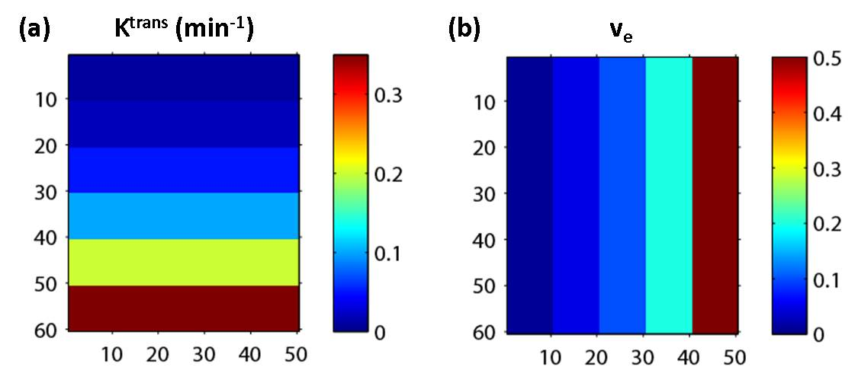
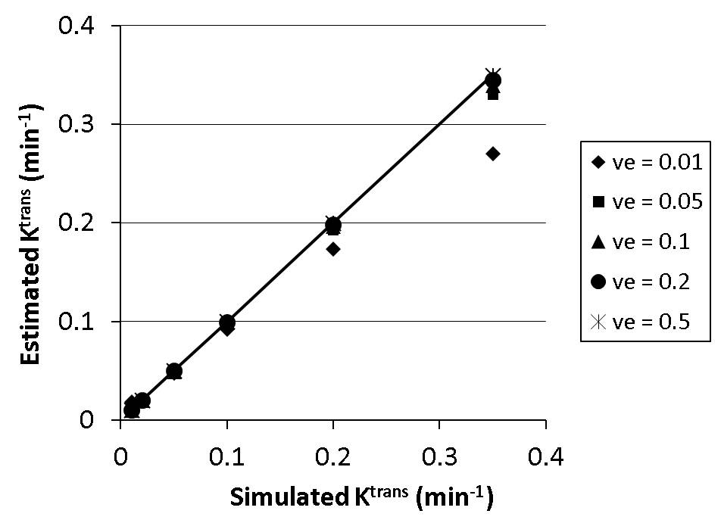
Results DRO Validation of Tofts Model Software Package

Slide 4
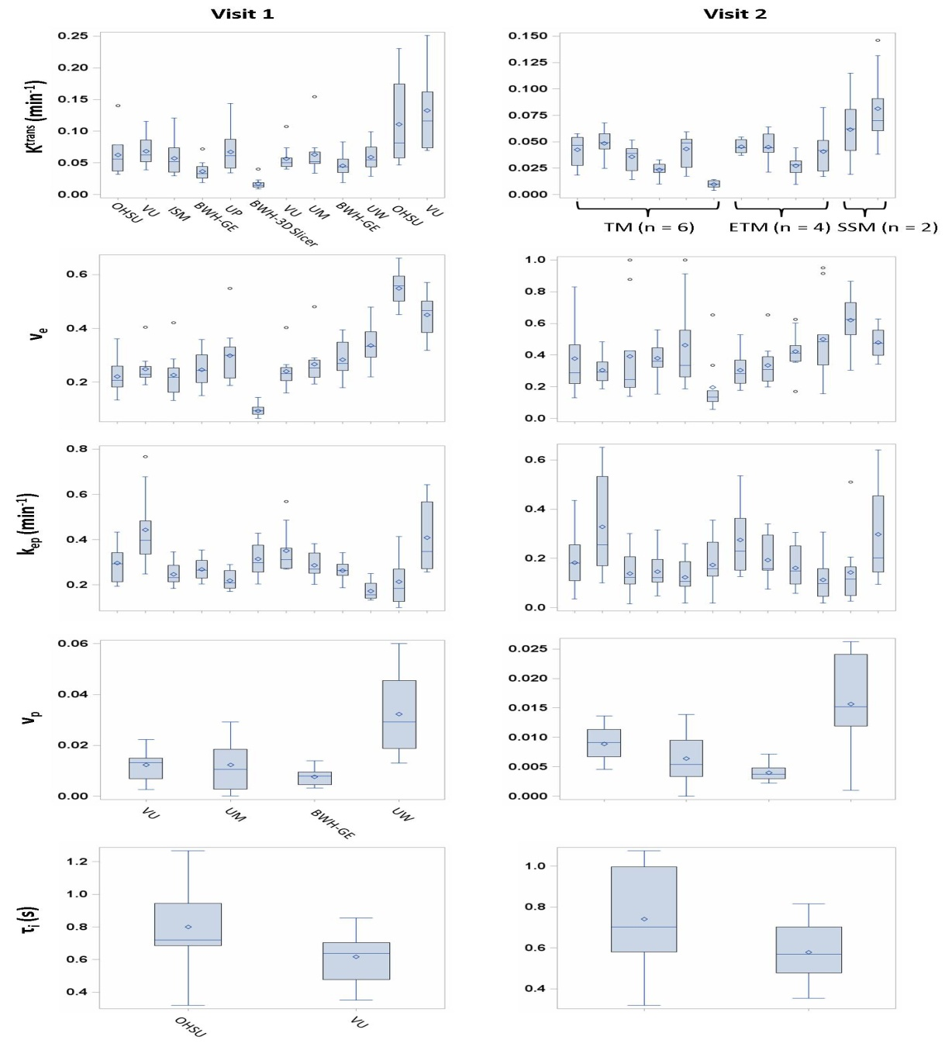
Results – human breast DCE-MRI data Variations among 12 software packages

Slide 5
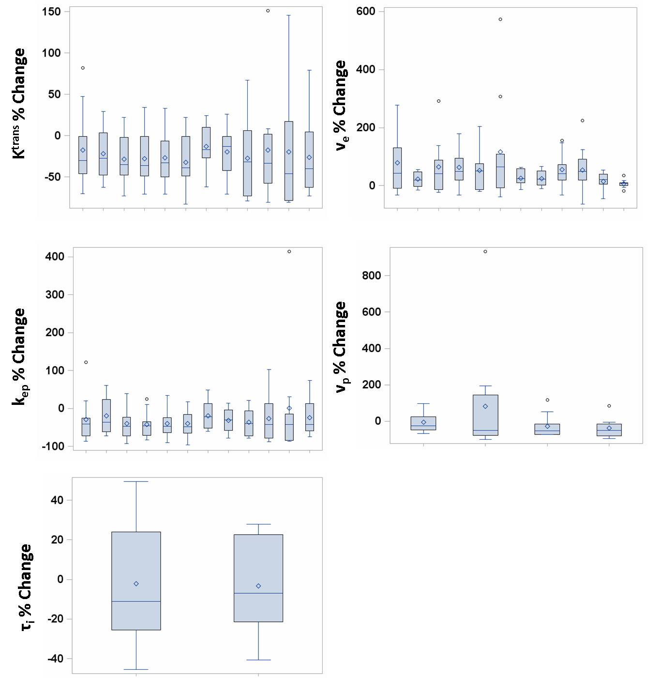
Results – human breast DCE-MRI data Variations among 12 software packages

Slide 6
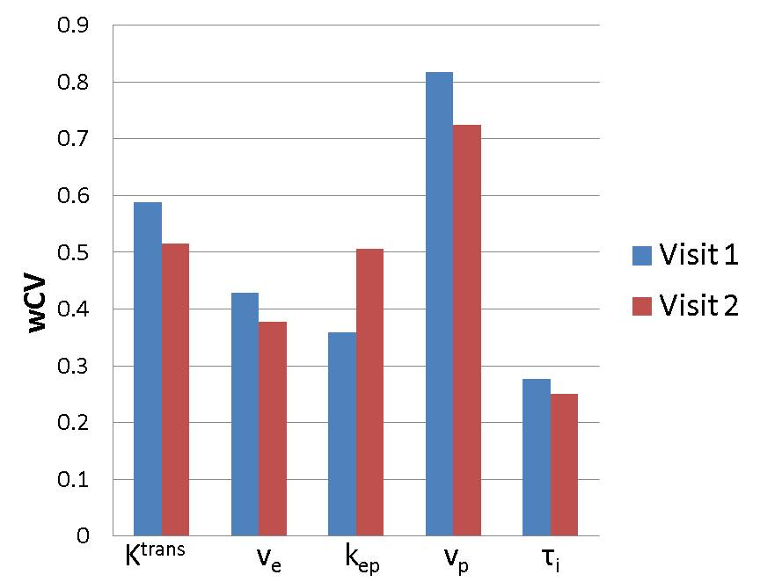
Results – human breast DCE-MRI data Variations among 12 software packages

Slide 7
Results – human breast DCE-MRI data Variations among 12 software packages

Slide 8
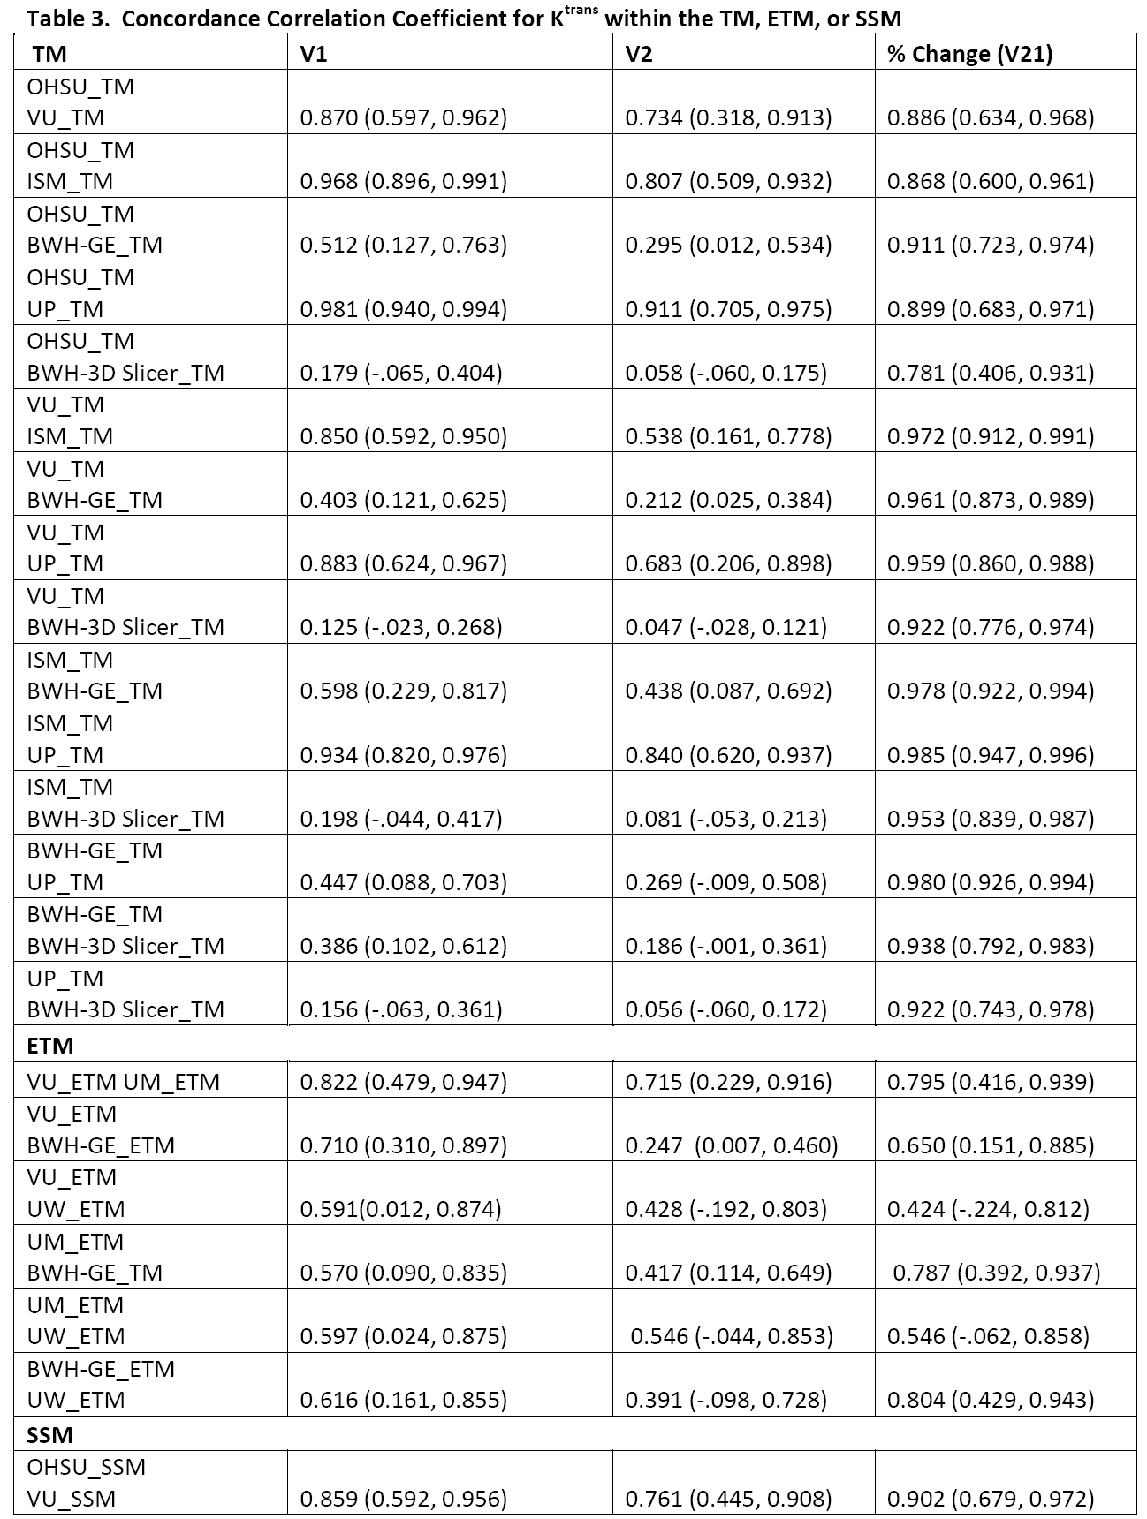
Results – human breast DCE-MRI data Concordance Analysis

Slide 9
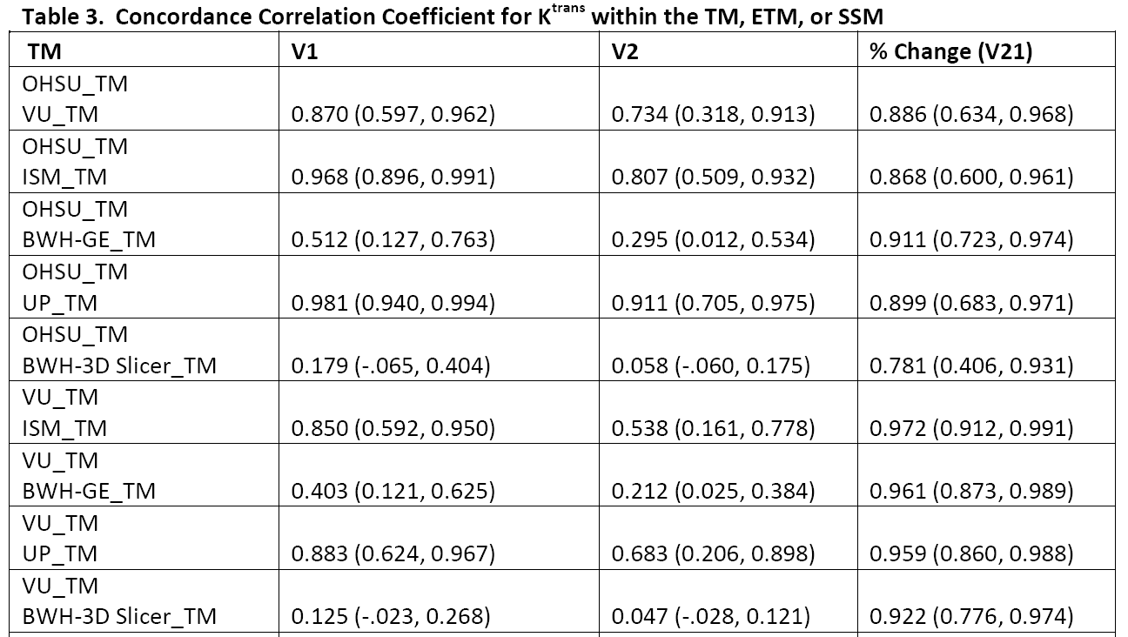
Results – human breast DCE-MRI data Concordance Analysis

Slide 10
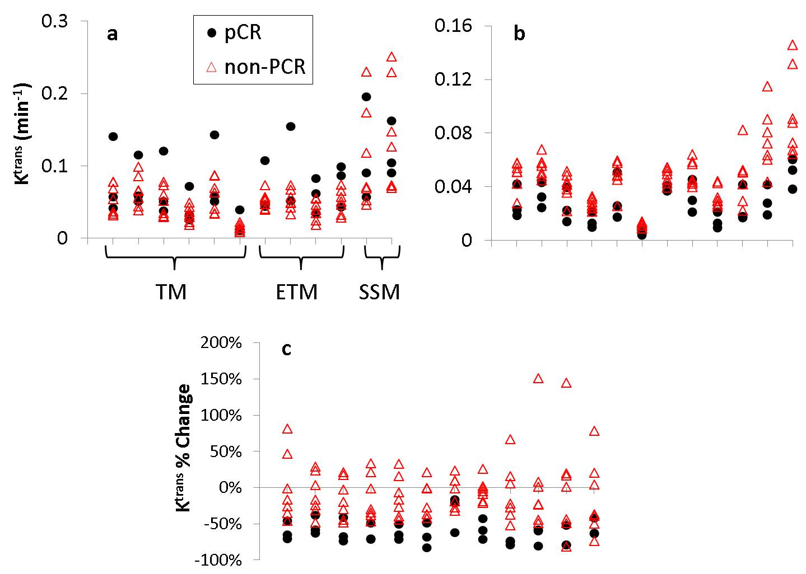
Results – human breast DCE-MRI data Early Prediction of Pathologic Response
V1
V2
V21

Slide 11
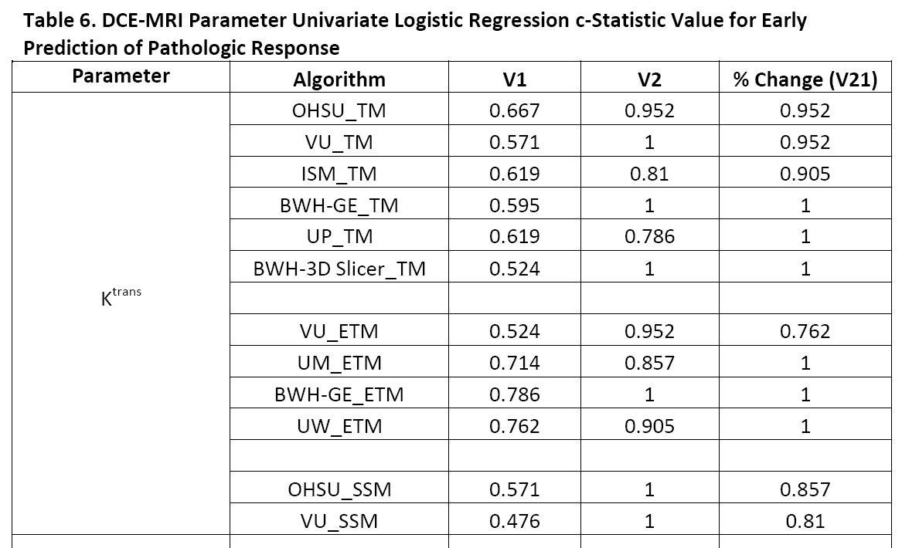
Results – human breast DCE-MRI data Early Prediction of Pathologic Response

Slide 12
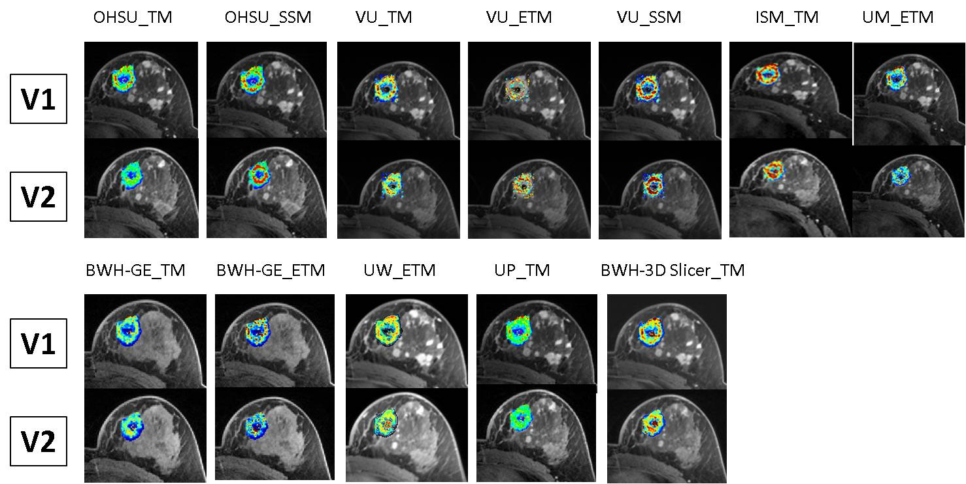
Results – human breast DCE-MRI data Early Prediction of Pathologic Response
Pathologic partial responder

Slide 13
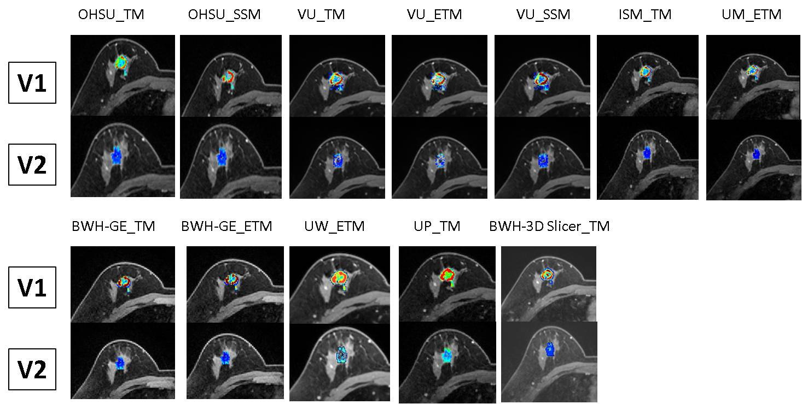
Results – human breast DCE-MRI data Early Prediction of Pathologic Response
Pathologic complete responder

Slide 14
Discussion and Conclusion
Considerable parameter variations were observed when shared breast DCE-MRI data sets were analyzed with different algorithms based on the TM, ETM, and SSM.
Variations are mostly systematic.
Nearly all algorithms provided good to excellent early prediction of breast cancer response to therapy using the K^{trans} and k_{ep} parameters after the first therapy cycle and their percent changes, suggesting that the utility of DCE-MRI for assessment of therapy response is not diminished by inter-algorithm systematic variations.

Slide 15
DCE Subgroup Challenge #2: Errors in Quantitative Image Analysis Due to Platform-Dependent Image Scaling
Thomas L. Chenevert1, Dariya I. Malyarenko1, David Newitt2, Xin Li3,
Mohan Jayatilake3, Alina Tudorica3, Andriy Fedorov4, Ron Kikinis4,Tiffany Ting Liu5, Mark Muzi6, Matthew J. Oborski7, Charles M. Laymon7, Xia Li8, Thomas Yankeelov8, Jayashree Kalpathy-Cramer9, James M. Mountz7, Paul E. Kinahan6, Daniel L. Rubin5, Fiona Fennessy4, Wei Huang3, Nola Hylton2, and Brian D. Ross1
1 University of Michigan, Ann Arbor, MI
2 University of California San Francisco, San Francisco, CA
3 Oregon Health and Science University, Portland, OR
4 Brigham and Women’s Hospital and Harvard Medical School, Boston, MA
5 Stanford University, Stanford, CA
6 University of Washington, Seattle, WA
7 University of Pittsburgh, Pittsburgh, PA
8 Vanderbilt University, Nashville, TN
9 Massachusetts General Hospital, Boston, MA

Slide 16
Introduction
QI built on premise that image intensity infers biology
Image scaling is numerical multiplication and shift of pixel intensities to best utilize digital storage bit-depth
Analysis SW must account for image scaling (if applied) prior to quantitative analyses
Objective:
Determine the ability of various QI analysis software tools to properly account for platform-specific image scaling

Slide 17
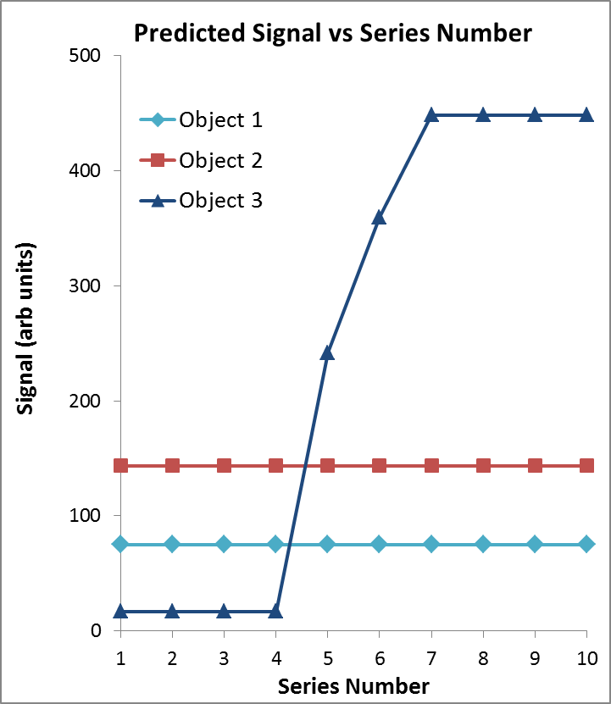
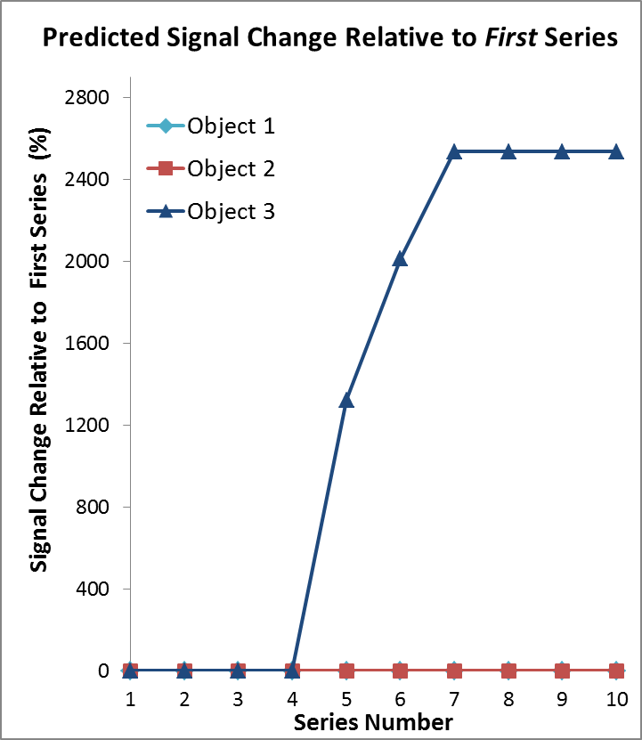
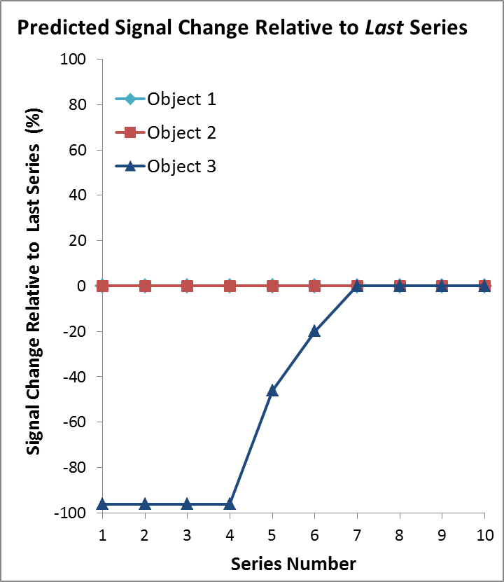
Methods
Phantom comprised constant signal “object 1” & “object 2”, and variable signal “object 3” scanned on 4 scanners: Philips3T; GE1.5T; Siemens3T; GE3T
Identical T1-weighted acquisition parameters were used across all scanners and hardware settings were held constant over 10 sequential series on each system
Variable “object 3” was 0% Gd for series 1, 2, 3, 4; increased Gd for series 5, 6, 7; then held constant at 2% Gd for series 8, 9 and 10. Objects 1 & 2 were unchanged for all series and hardware settings were constant across all series

Slide 18
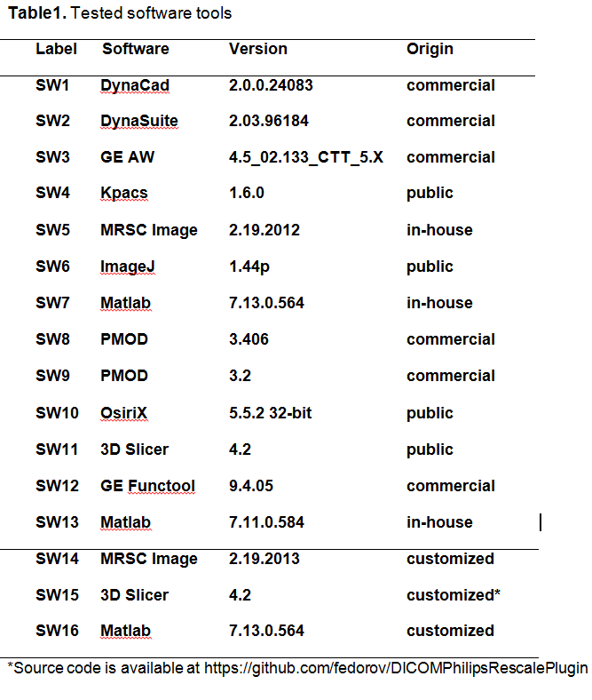
Methods
Thirteen software packages (“SW1” through “SW13”) available at QIN sites were used to measure SI vs series
Three packages, known to be naive to vendor-specific image scaling were subsequently customized per MRI vendor (Philips) instructions to account for intensity scaling
These modified packages were denoted “SW14, SW15, SW16”

Slide 19
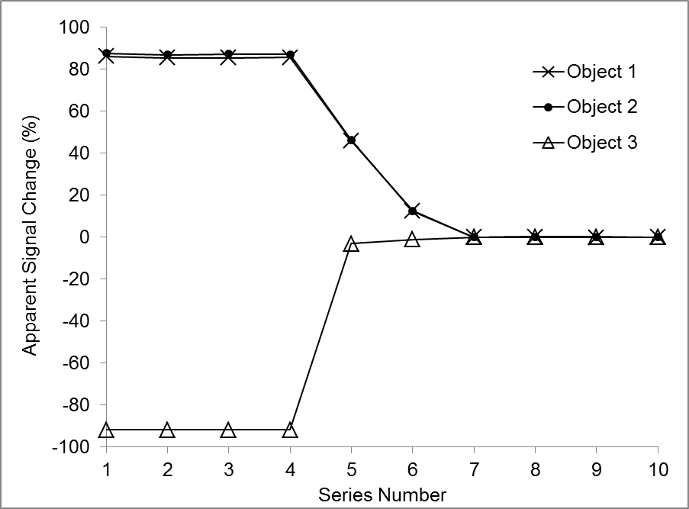
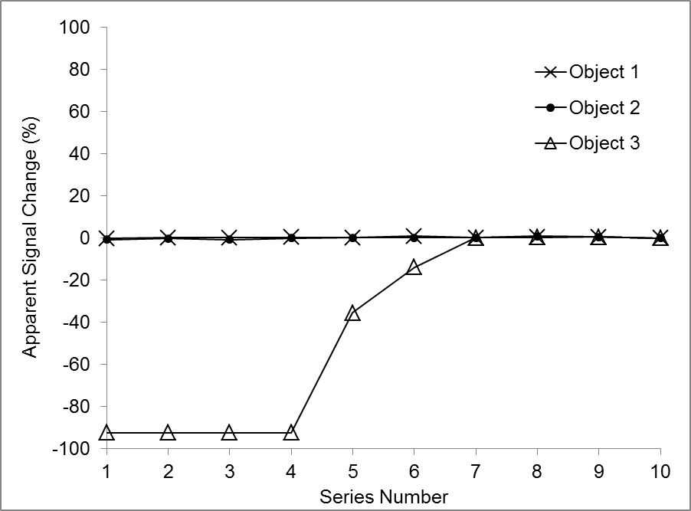
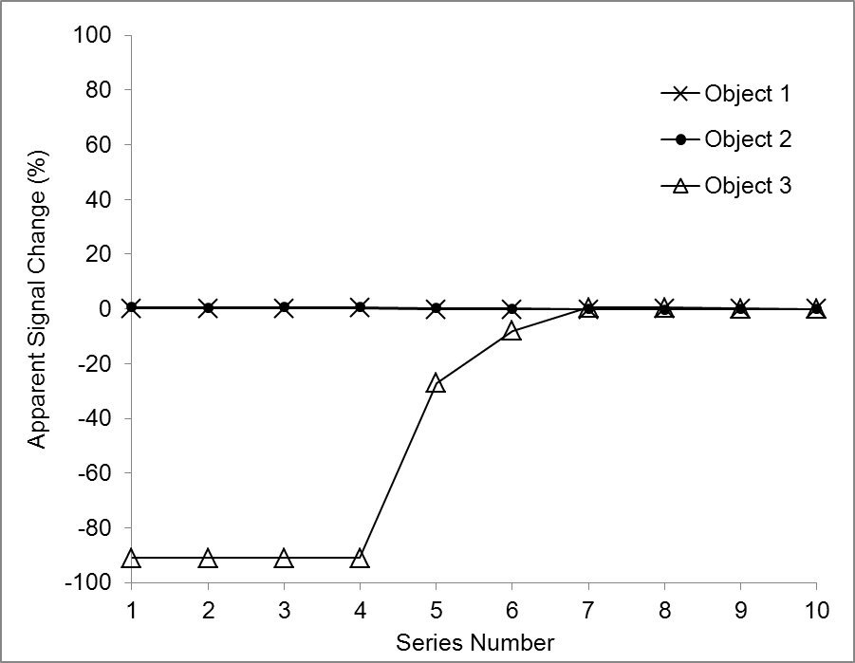
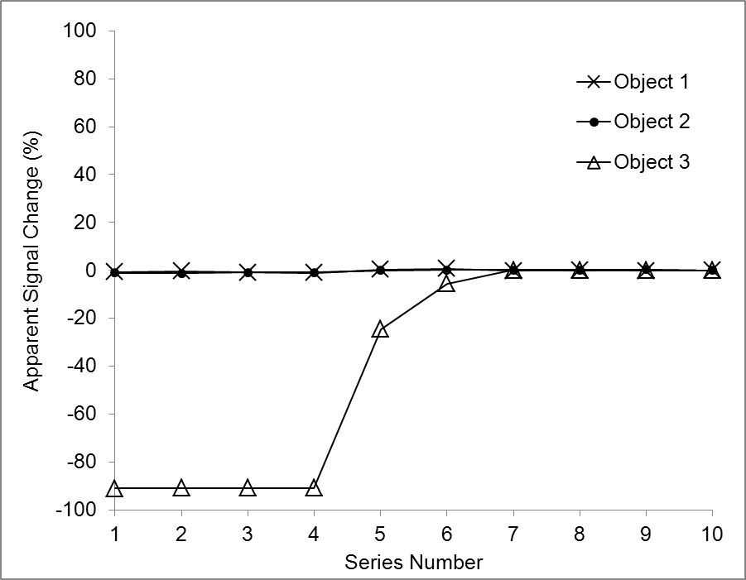
Results
One analysis package “SW7” applied to all image sources
Image Source: Philips 3T
Image Source: GE 1.5T
Image Source: Siemens 3T
Image Source: GE 3T

Slide 20
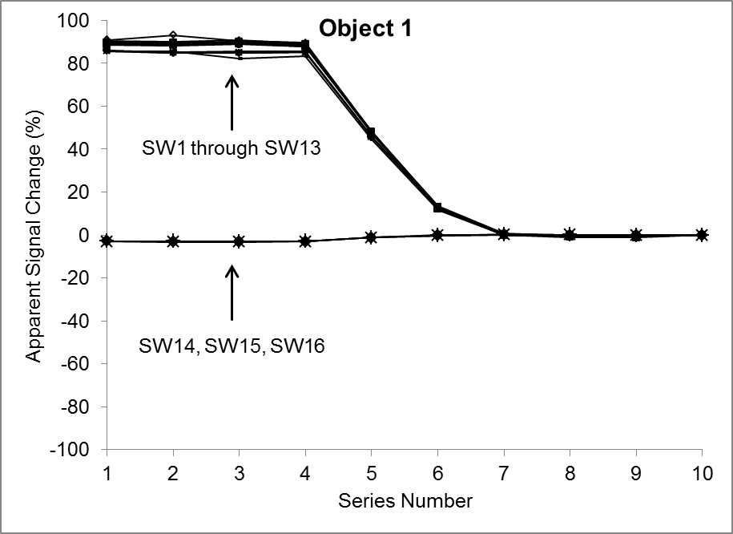
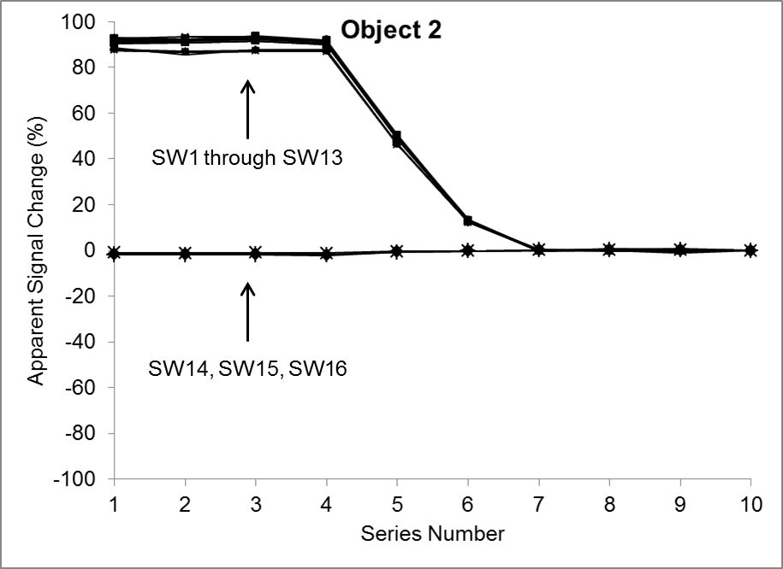
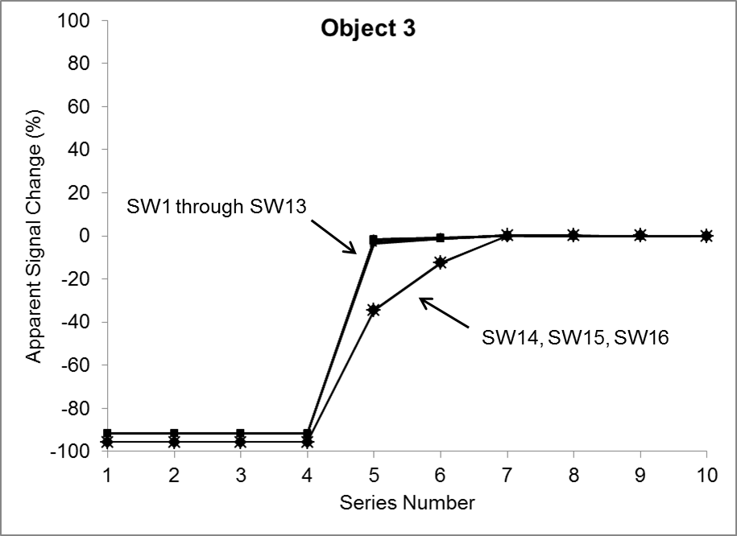
Results
All analysis packages applied to one image source “Philips 3T”
Caveats:
Variable image scaling happens on series-by-series and “image-type” basis
Single-series dynamic scans will all have the same scale factors, thus can be ignored if only relative signal change is measured
Unfortunately, essentially all T1-mapping require multiple series
Even pre-gd vs post-gd metrics span multiple series

Slide 21
Conclusion and Discussion
Many (most) QI analysis sw packages are naïve to Philips image scaling
Acquisition settings are often changed across multiple series (e.g. T1 via VFA), so the physics of true signal change may become indistinguishable from false change due to image scaling
This demonstration project provides a simple procedure to detect presence of image scaling, and the ability analysis SW to properly “inverse scale” images prior to quantitative analysis
QI sw packages should be certified for all image sources to which the analysis is applied
Why scale images at all?
Maintain or extend dynamic range – future work!

