Slide 1
PET/CT Working Group Update
Jayashree Kalpathy-Cramer
Sandy Napel

Slide 2
PET-CT Working Group
Sub-group of the Image Analysis and Performance Metrics (IAPMWG) consisting of teams working in the areas of CT and PET
Representation from
  BWH
  Columbia University
  Iowa
  MGH
  MSKCC
  Moffitt
  UPMC
  UW
  Stanford

Slide 3
CT Segmentation Challenge
Multi-site algorithm comparison
Task: CT-based lung nodule segmentation
Evaluate algorithm performance
  Bias, repeatability of volumes
  Overlap measures
  Understand sources of variability

Slide 4
Participants and Algorithms
CUMC: marker-controlled watershed and geometric active contours
Moffitt Cancer Center: multiple seed points with region growing. Ensemble segmentation obtained from the multiple grown regions.
Stanford University: 2.5 dimension region growing using adaptive thresholds initialized with statistics from a “seed circle” on a representative portion of the tumor

Slide 5
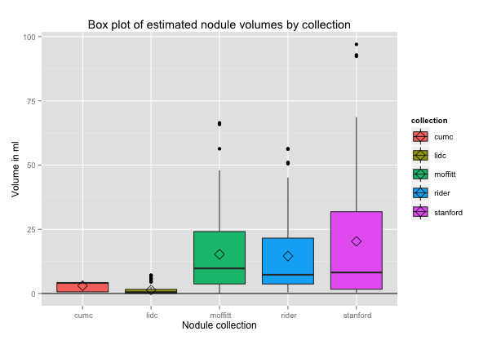
Data
52 nodules from 5 collections hosted in The Cancer Imaging Archive (TCIA)
  LIDC (10 studies with 1 nodule each)
  RIDER (10 studies with 1 nodule each)
  CUMC Phantom (single study, 12 nodules)
  Stanford (10 studies with 1 nodule each)
  Moffitt (10 studies with 1 nodule each)
Nodules volume by collection. Most nodules in the LIDC and phantom collection were small while others had a wide range of sizes

Slide 6
Distribution of volumes in collections
Nodules in the LIDC and phantom collection were small while other collections had a wide range of nodule sizes
Nodules volume by collection. Most nodules in the LIDC and phantom collection were small while others had a wide range of sizes
Nodules volume by collection. Most nodules in the LIDC and phantom collection were small while others had a wide range of sizes

Slide 7
Informatics
Created converters for a range of data formats (PNG, AIM, DICOM-SEG, DICOM-RT, .MAT, LIDC-XML)
Used TaCTICS to compute metrics
  C++ ITK libraries (20+ metrics)
  R statistics engine (statistical analysis and visualization)
Agreed to use DICOM-SEG or DICOM-RT for future segmentation challenges
Exploring use of NCIPHUB for future challenges

Slide 8
Evaluation
Ground truth: volume of nodules in phantom known
(Approximate truth): consensus segmentation obtained using submitted segmentations (STAPLE, thresholded probability map, majority vote)
Each group submitted at least 3 results for each algorithm
Bias: estimate volume of algorithms compared to known truth (based on phantom data)
Reproducibility: calculated using multiple segmentations submitted for each algorithm

Slide 9
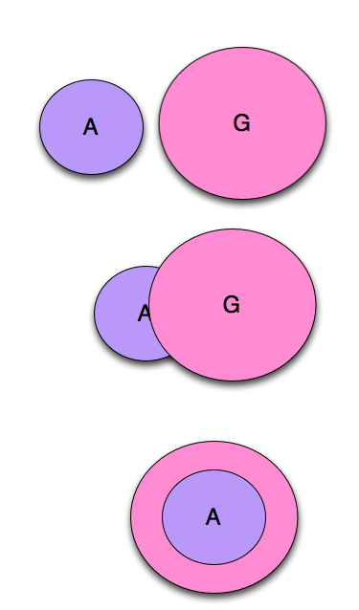
Volumetric difference
Volume differences: based on number of voxels in each volume
Does not take into account the spatial locations of the respective volumes
Not symmetric

Slide 10
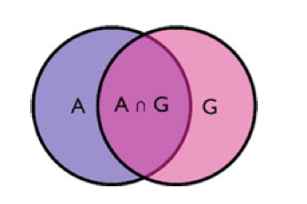
Dice coefficient
Dice (and Jaccard) coefficients most commonly used measures of spatial overlap for binary labels
  symmetric
    over or under-segmentation errors are weighted equally
Spatial overlap measures depend on the size and shape of the object as well as the voxel size relative to the object size

Slide 11
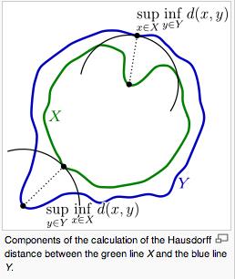
Hausdorff Distance
The Hausdorff Distance (HD) between A and G, h(A, G) is the maximum distance from any point in A to a point in G and is defined as

Slide 12
Distribution of Dice coefficients
Pairwise Dice coefficients were calculated between all segmentations for a given nodule
Intra-algorithm agreement was much higher than inter-algorithm agreement (p <0.05)

Slide 13
Dice coefficients by collection
All pairwise dice coefficients (all runs, all algorithms by nodule) by collection shows better agreement between algorithms on the phantom nodules (CUMC) than on clinical data

Slide 14
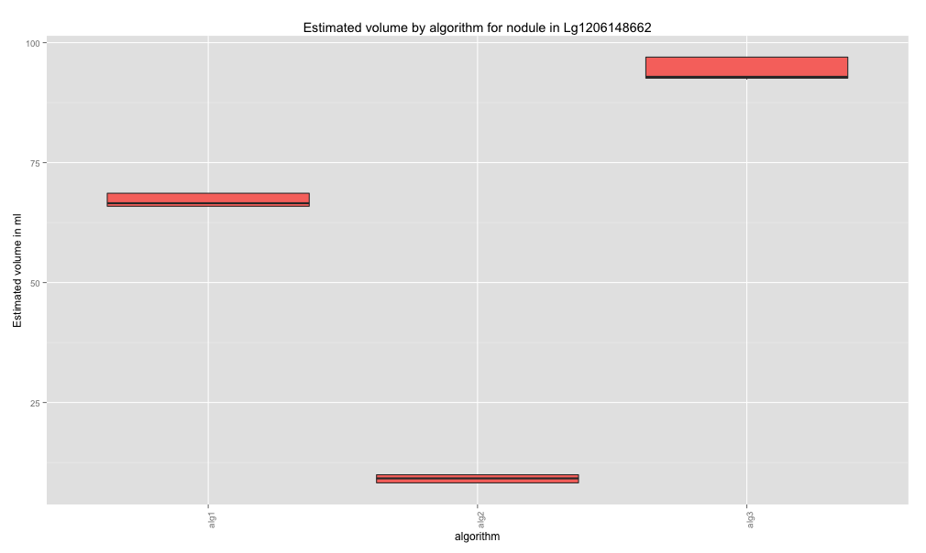
Exploring causes of variability
Dice coefficient (all algorithms, all runs) of nodules in Stanford collection (ordered by volume left to right)
Estimated volume varies significantly by algorithm

Slide 15
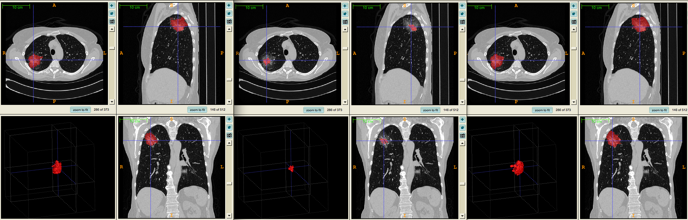
Exploring causes of variability
Some nodules (e.g., Lg from the Stanford collection) have high variability (typically heterogeneous)

Slide 16
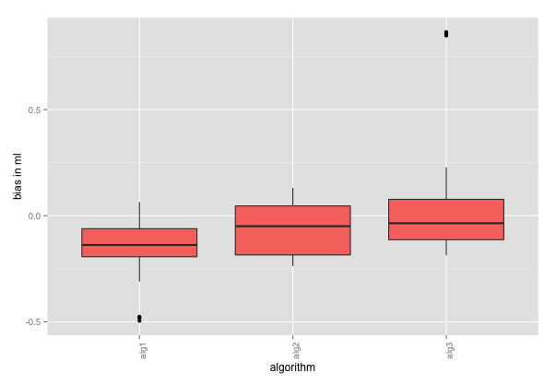
Estimating Bias in phantom data
Bias (estimated-true volume) for CUMC-phantom nodules shows a difference between algorithms (ANOVA with blocking, p <<0.05)

Slide 17
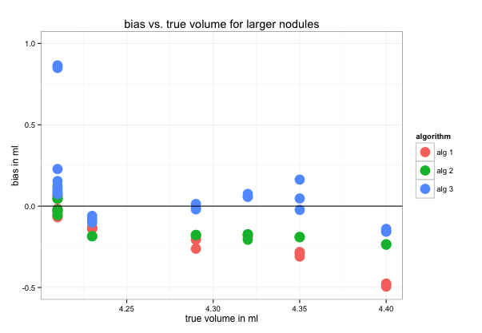
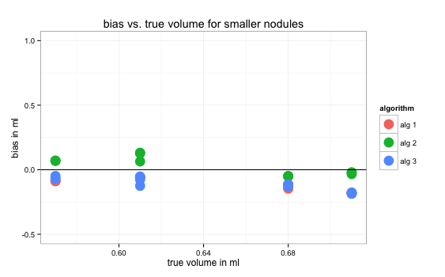
Bias in small and large nodules
Patterns of bias are different in large vs. small nodules

Slide 18
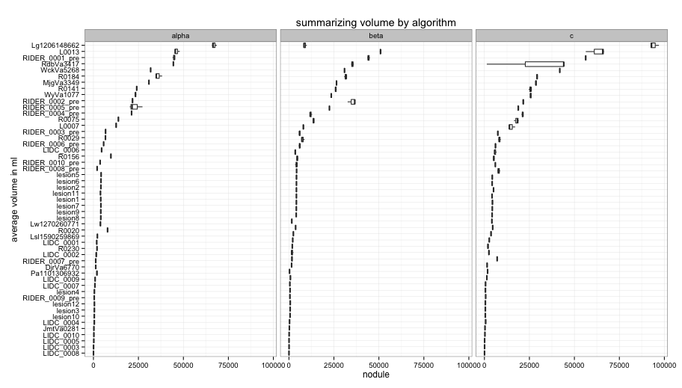
Reproducibility of algorithms
Algorithms are not perfectly deterministic (i.e different segmentations yield different volumes)
Notes:
Need to update graph with correct labels

Slide 19
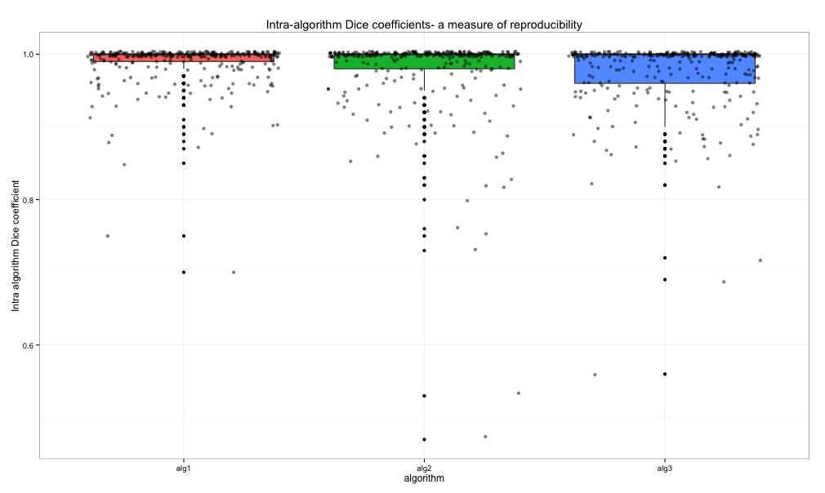
Reproducibility of algorithms
Dice coefficients between segmentations generated by a given algorithm vary between algorithms
Notes:
Need to update graph with correct labels

Slide 20
CT Segmentation: Future plans
Catalog of CT segmentation tools
Feature extraction project: Assess impact of segmentations on features (shape, texture, intensity) implemented at different QIN sites
  Comparison of features by implementation
  Comparison by feature type

Slide 21
PET Segmentation Challenge
Four (+?) phase challenge:
  software phantom (DRO)
  hardware phantom scanned at multiple sites
  segmenting clinical data
  correlating PET with outcomes
  dynamic PET (MSKCC)

Slide 22
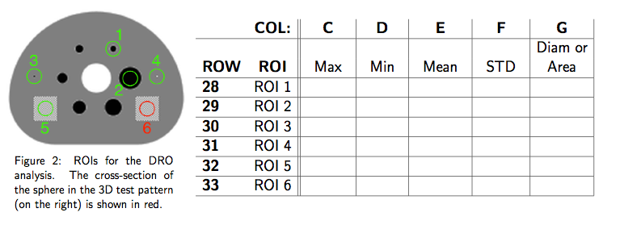
Digital Reference Object (DRO)
Generated by UW/QIBA
7 QIN sites participated
UW, Moffitt, Iowa, Stanford, Pittsburgh, CUMC, MSKCC
Software packages used included PMOD, Mirada Medical RTx, OSF tool, RT_Image, CuFusion, 3D Slicer, Osirix, Amide
After some effort, all sites were able to calculate the DRO SUV metrics correctly

Slide 23
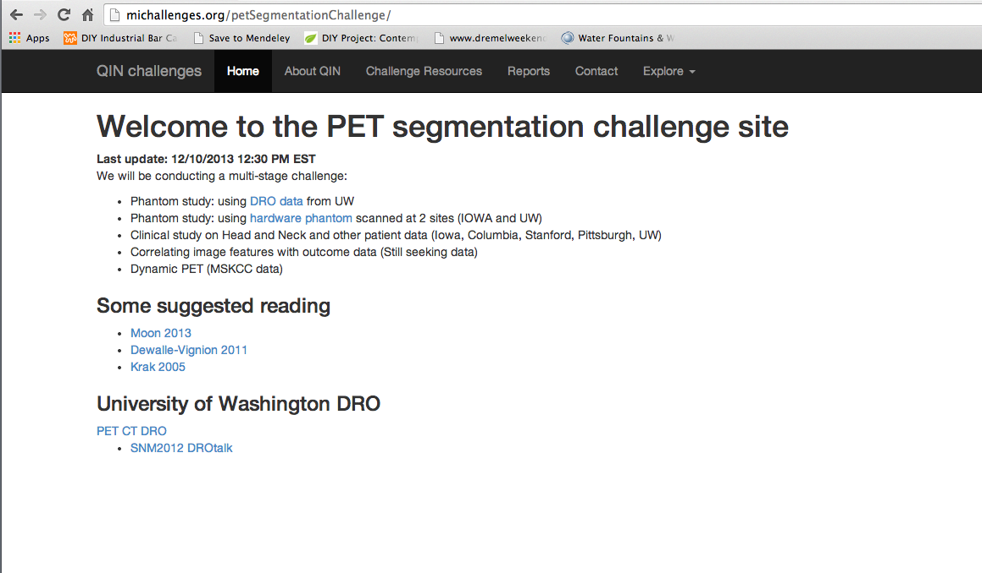
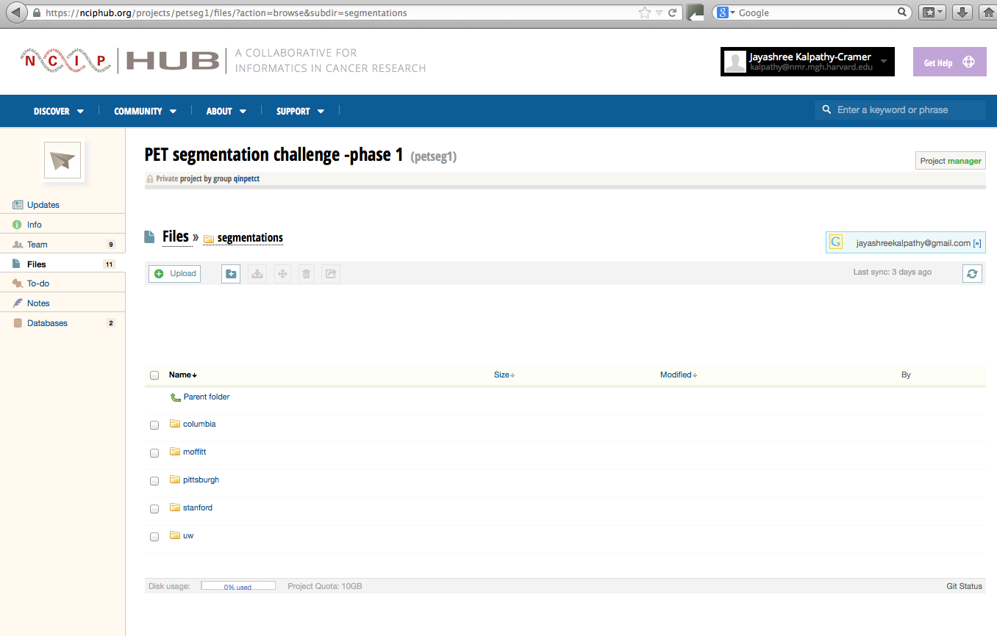
Informatics
Use michallenges.org to distribute data and post challenge rules
Exploring use of nciphub.org for challenges going forward
  PET segmentation challenge

Slide 24
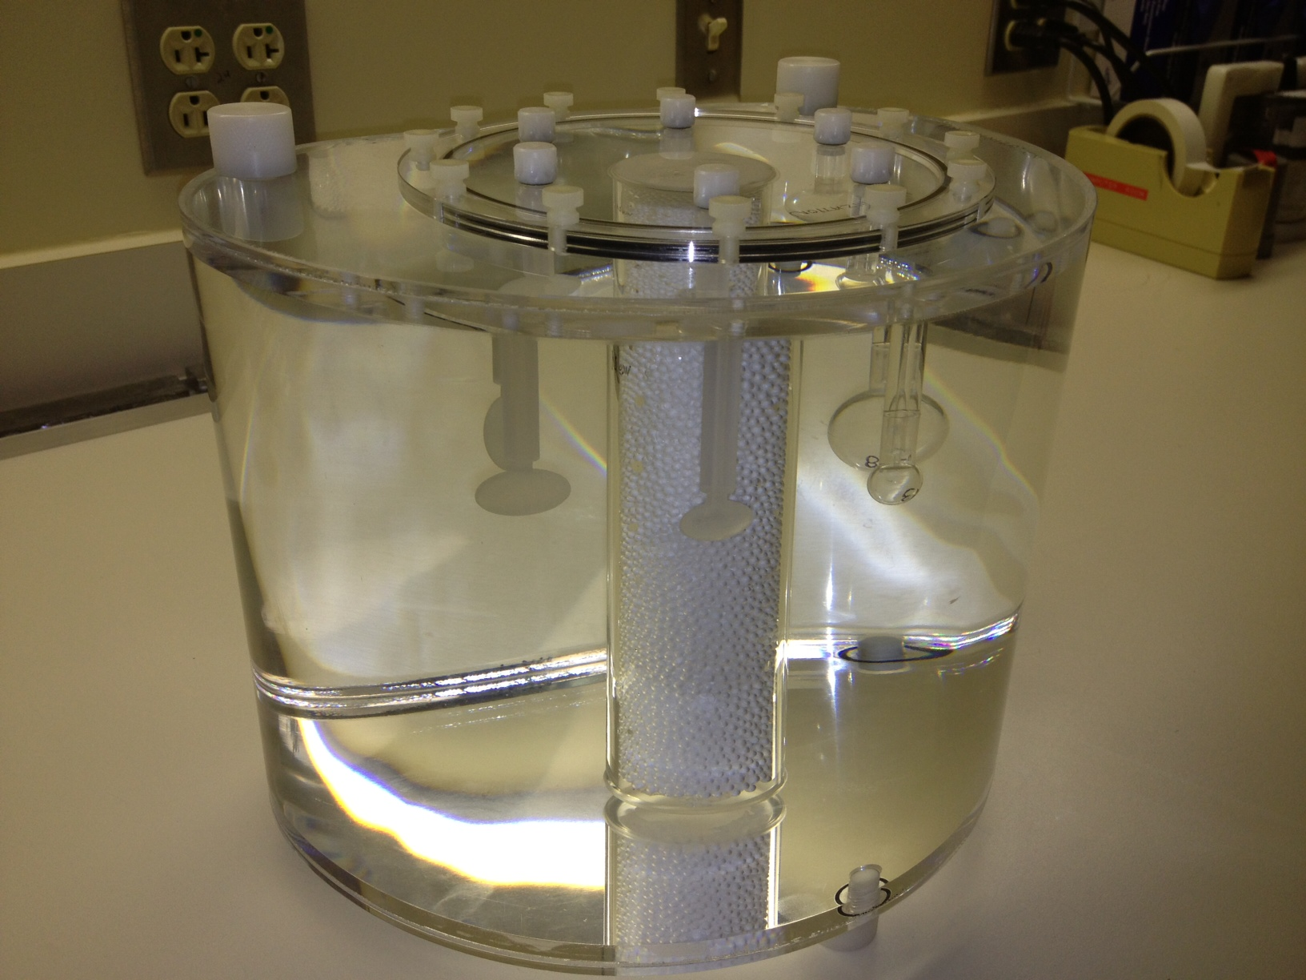
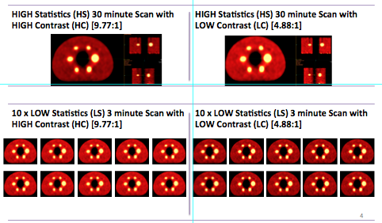
Hardware phantom
Phase II: Hardware phantom scanned at 2+ sites (UI, UW)
NEMA IEC Body Phantom Set™
Model PET/IEC-BODY/P
Four Image Sets per Site
Generate accurate volumetric segmentations of the objects in the phantom scans
Calculate the following indices for each of the objects: VOI volume, Max, PEAK & AVERAGE Concentration, Metabolic Tumor Volume

Slide 25
Future Plans
Leadership
  Sandy Napel: WG chair
  Karen Kurdzeil: WG co-chair
Milestones
  Tool Catalog
  PET segmentation challenges
  CT feature extraction challenges

