Slide 1
Data Acquisition Working Group
Tom Chenevert
Paul Kinahan
Yantian Zhang, NCI liaison
QIN annual meeting April 3-4, 2014

Slide 2
Charter
Identify, characterize, and ameliorate sources of variance and bias in image data acquisition, thereby enhancing the value of advanced oncologic quantitative imaging methods used in clinical trials
Work within the QIN and manufacturers to develop standardized system test procedures to enable objective assessment of quantitative imaging performance across sites and platforms
Formal interactions between QIN and other organizations will serve as a conduit to extend these procedures to benefit clinical trials employing quantitative imaging

Slide 3
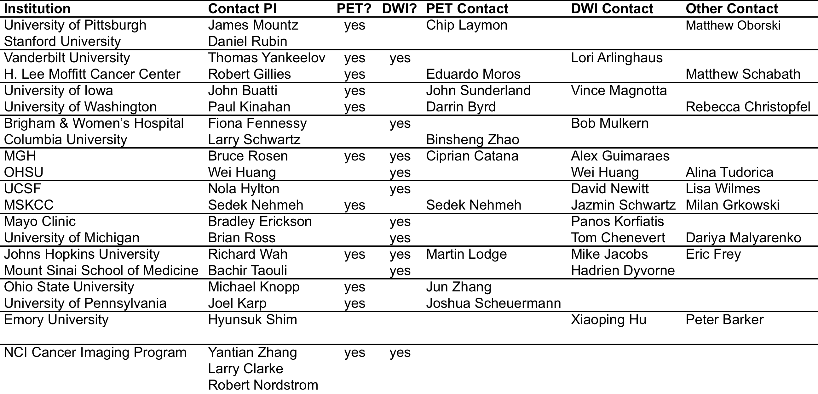
Membership
Driver to participate in WG – critical step
Research topics for multiple U01 groups

Slide 4
Milestones (October 2013)

Slide 5
Main goals
PET/CT Demonstration Project
  Multicenter data acquisition /processing survey
  Longitudinal multicenter scanner calibration and stability
MRI-DWI Demonstration Project
  Gradient Nonlinearity Bias in Multi-center Trials

Slide 6
Incoming co-chairs
John Sunderland, PhD - University of Iowa
Bachir Taouli, MD - Mt Sinai School of Medicine

Slide 7
PET/CT Demonstration Project
Data acquisition /processing survey
Longitudinal survey of multicenter scanner calibration and stability

Slide 8
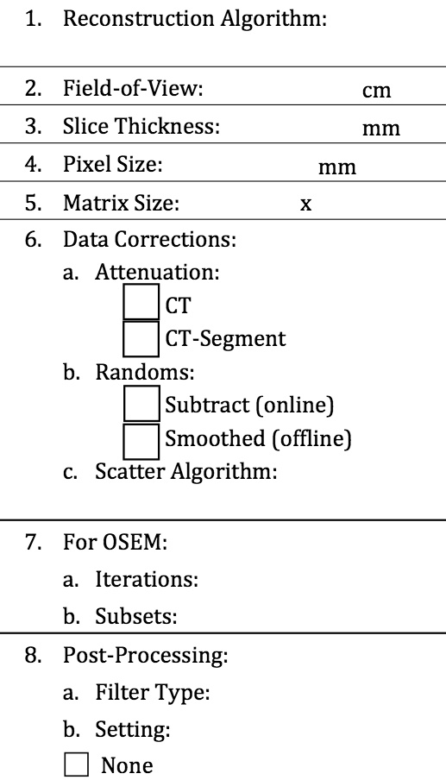
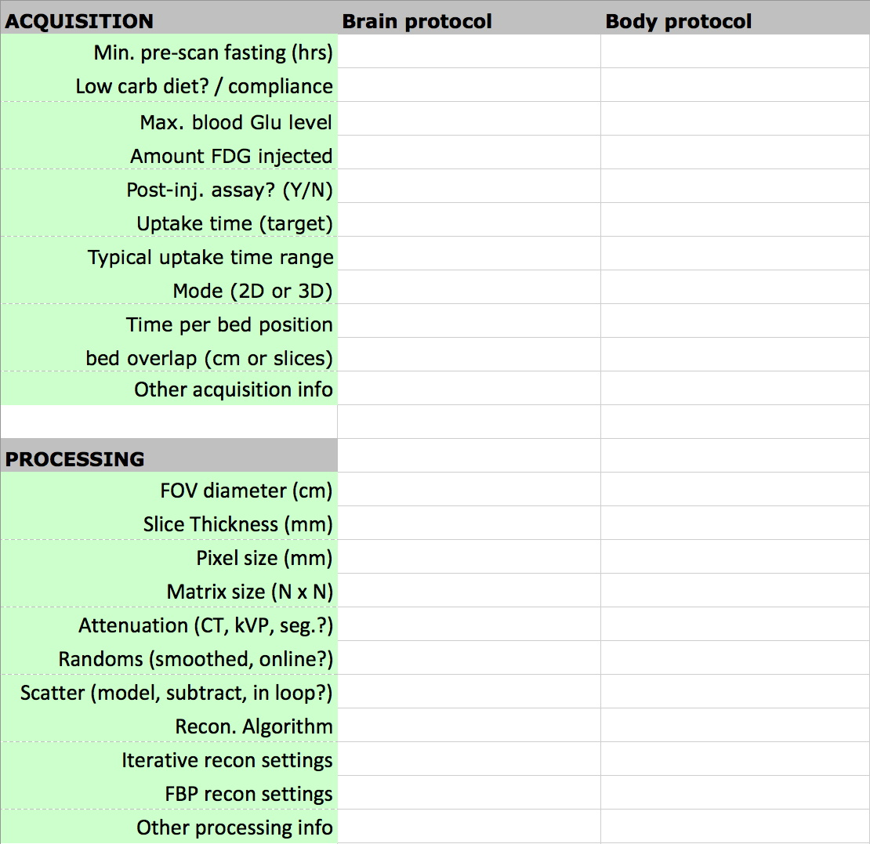
PET/CT Data Acquisition and Processing Survey
ACRIN CQIE survey (n = 65)
QIN survey (n = 8)
+ ACRIN Post CQIE sites (n = 25)

Slide 9
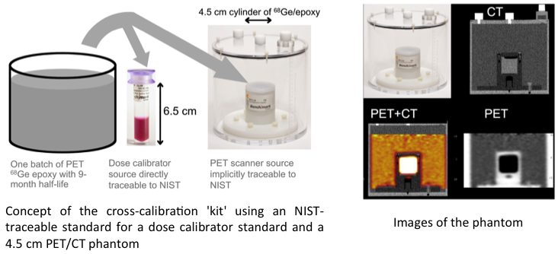
Longitudinal survey of multicenter scanner calibration and stability
Paul Kinahan, Darrin Byrd, Rebecca Christopfel, John Sunderland, Martin Lodge, Chip Laymon, Jun Zhang, Joshua Scheurmann, Cipriana Catana, Eduardo Moros, Sedek Nehmeh

Slide 10
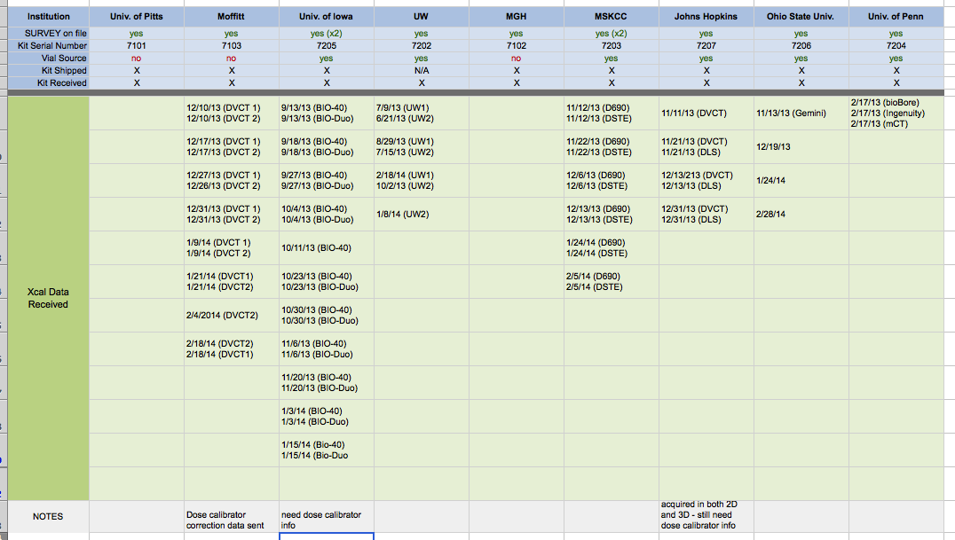
Data Accrual

Slide 11
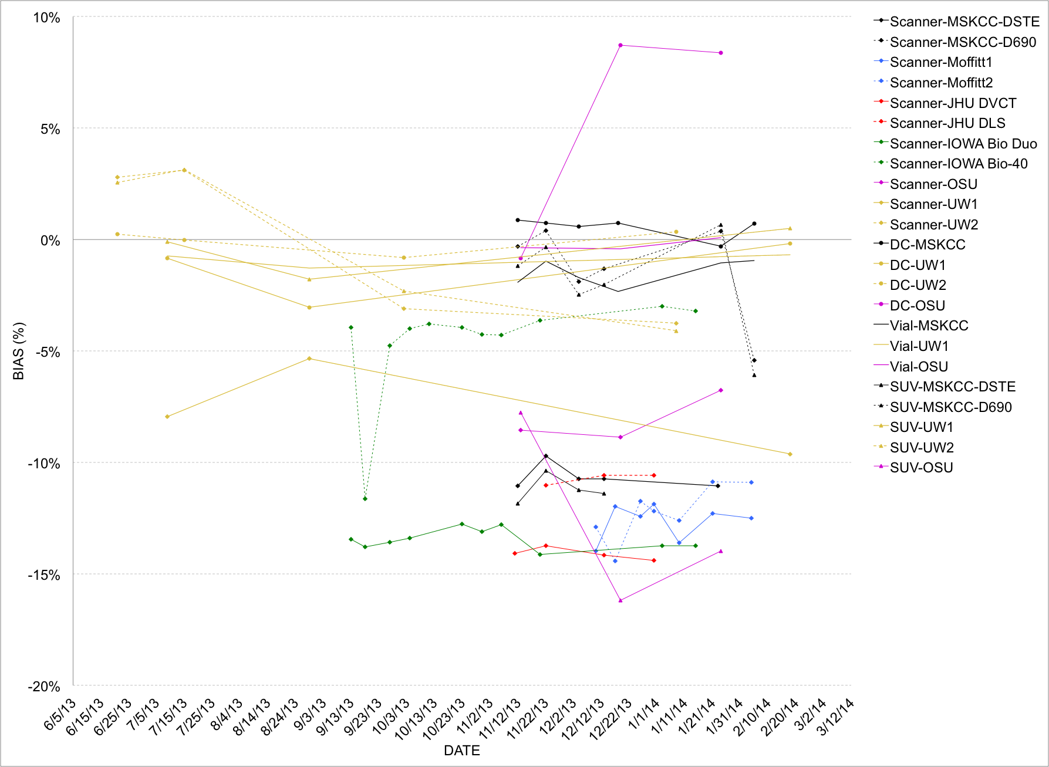
Early results

Slide 12
QIN DAWG Demonstration Project:
Gradient Nonlinearity Bias in Multi-center Trials
Dariya Malyarenko¹, David Newitt², Alina Tudorica³, Robert Mulkern⁴,
Karl G. Helmer⁵, Michael A. Jacobs⁶, Lori Arlinghaus⁷, Thomas Yankeelov⁷, Fiona Fennessy⁴, Wei Huang³, Nola Hylton², and Thomas L. Chenevert¹
¹University of Michigan Radiology, ²University of California San Francisco Radiology and Biomedical Imaging, ³Oregon Health and Science University, ⁴Dana Faber Harvard Cancer Center, ⁵Massachusetts General Hospital, ⁶John Hopkins University School of Medicine, ⁷Vanderbilt University Institute of Imaging Science

Slide 13
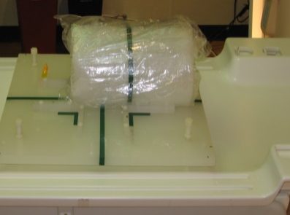
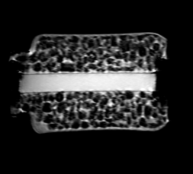
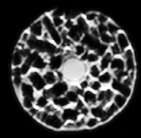

DAWG DWI Project Highlights:
Ice-water ADC as a function of R/L and S/I offsets (A/P ≈ 0)
DWI on G_{X},G_{Y},G_{Z} channels independently; ADC / ADC_{true}
Measurements sensitive to:
  Sequence class (single-echo vs double-echo)
  Cross-terms with imaging gradients
  Chronic gradients (i.e. shim)
  Gradient eddy currents
  Gradient non linearity 3x3 tensor, L
$l_{ij}^{}\left(r\right)=\frac{1}{\left\|G_{io}\right\|}\frac{∂B_{z}^{G_{i}}}{∂r_{j}}≠$ $δ_{ij}$
tube axis R/L
tube axis S/I
phantom & platform

Slide 14

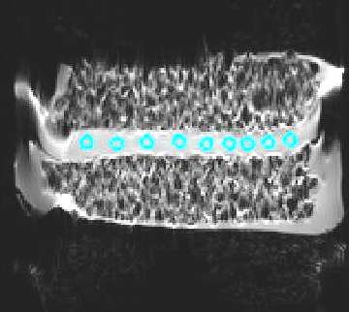


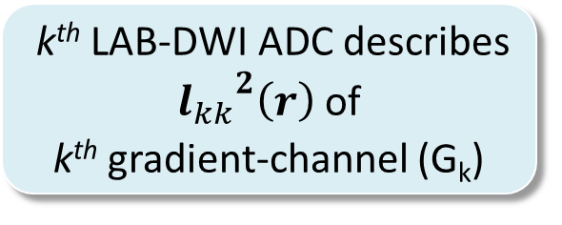
Method:
Isotropic ADC phantom: DWIx,y,z acquisition
RL offsets (+/-150mm)
SI offsets
(+/-150mm)
ADC measured from ROI_{d=10mm}
DWI axes = (G_{X}, G_{Y}, G_{Z})
k^{th} LAB-DWI ADC describes ${l_{kk}}_{}^{2}\left(r\right)$ of
k^{th} gradient-channel (G_{k})
ADC bias for individual gradient-channels
ADC_{ice-water} =
1.1.10⁻³mm²/s

Slide 15
Results:
ADC Bias Characterization in
Seven QIN centers
Nine MRI systems
Three MRI vendors
Two field strengths

Slide 16
Results:
Trace-DWI ADC on all 10 systems:
0.2
+5%
-5%
0.1
+5%
-5%
0
fractional bias
fractional bias
-0.1
-0.2
-0.3
-0.4
-0.5
R/L offset (mm)
-100
0
100
S/I offset (mm)
Observations:
Bias range: -60% (S/I) to +25% (R/L)
Offset-error at isocenter: +/-2%
Wide variance across platforms, though consistent within a platform
Median random error of ROI-ADC = 2.3%

Slide 17
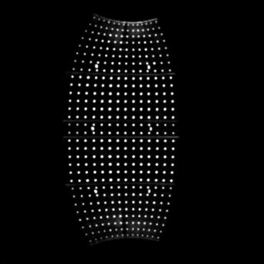
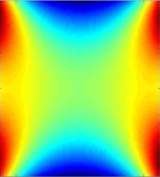
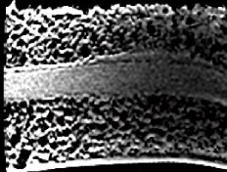
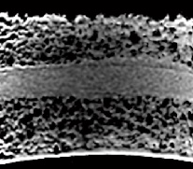
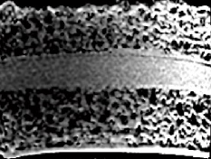
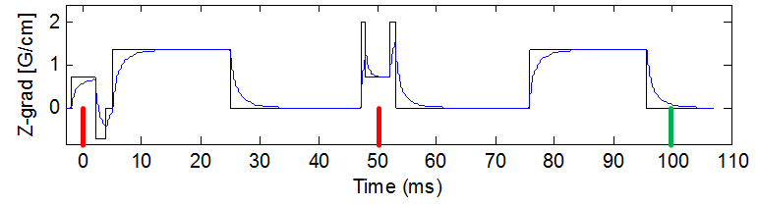
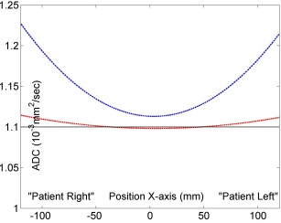
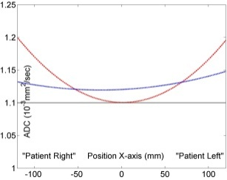
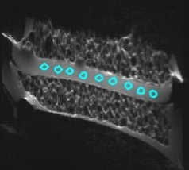
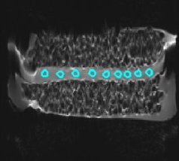
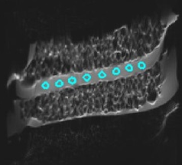
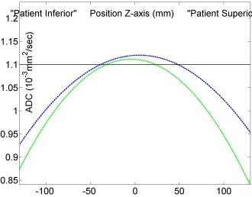
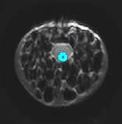
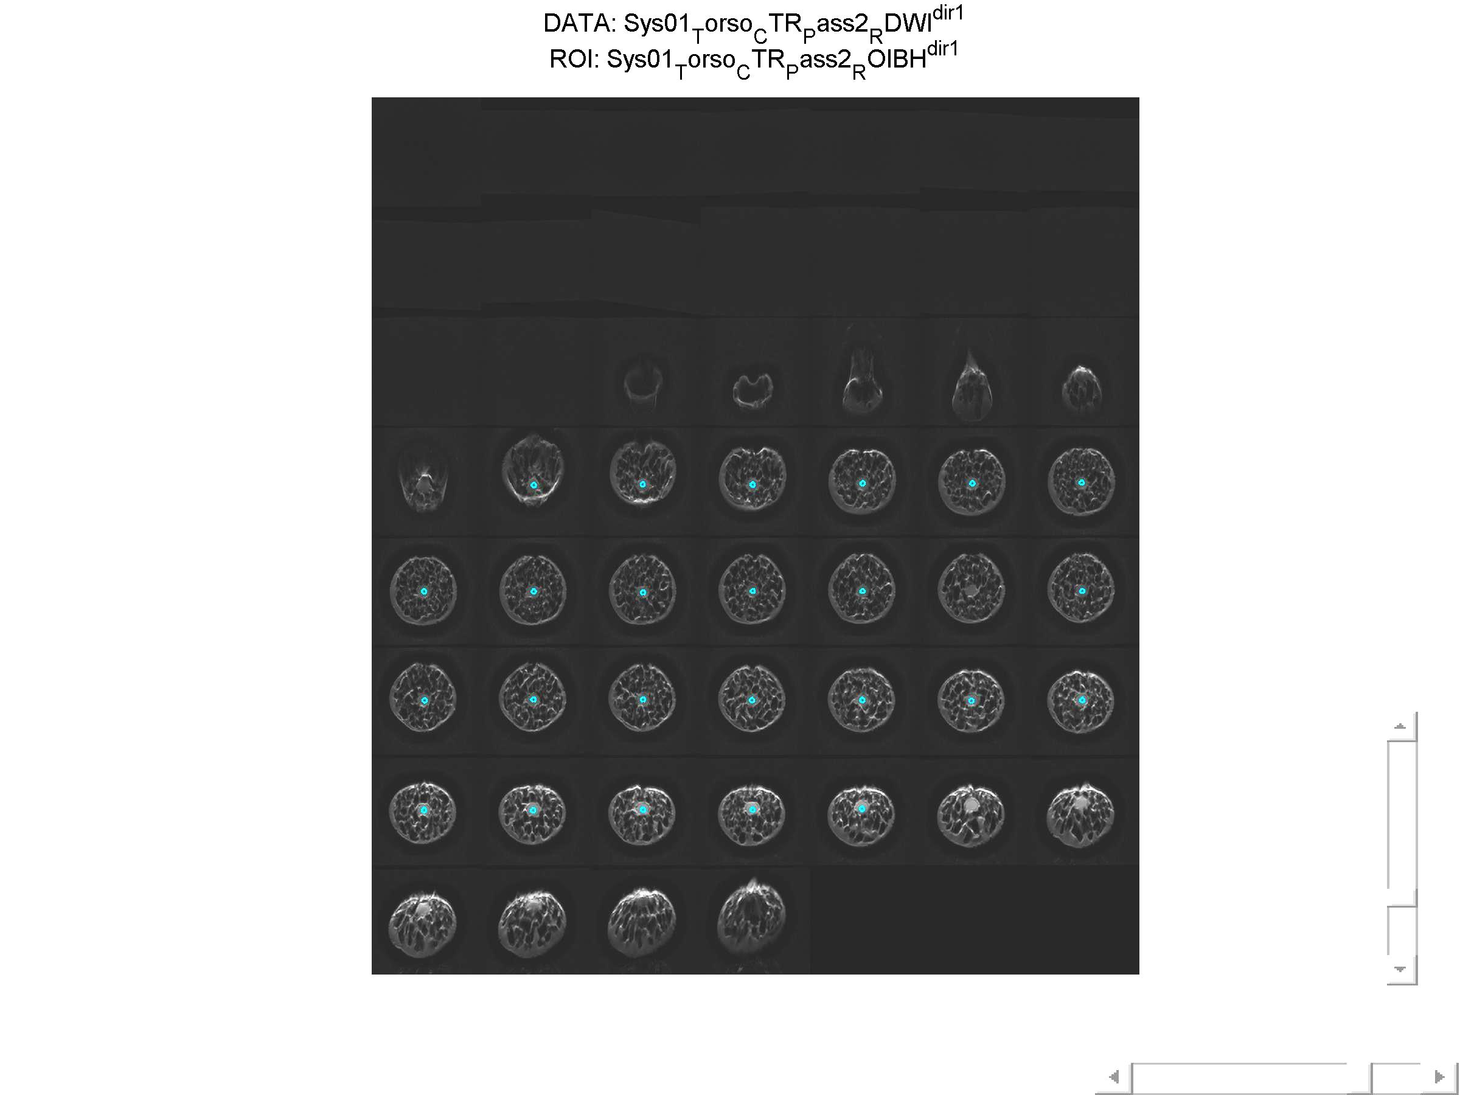
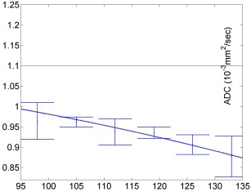
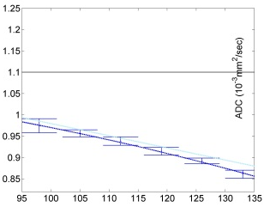
Analysis of Results:
Gradient-bias contributors: Manifestation on ADC:
nonuniform ADC
gradient (L)
nonlinearity
AP/RL
SI
imaging channel ADC “shift”
imaging
gradients
G_{X}-channel
(SAG)
G_{Z}-channel
(AX)
+5%
+5%
RL, mm
-5%
RL, mm
-5%
bias asymmetry at +/- offset
bkgnd gradients i.e. shim
+5%
AP “shift”
G_{X}
G_{Y}
-5%
SI, mm
uncertainty and asymmetry
eddy currents
image shift scale & shear
ADC-G_{X}
co-reg.
+5%
-5%
DWI-G_{X}
co-reg. to b=0
SI, mm
SI, mm

Slide 18
Conclusions:
Empiric evaluation of ADC bias is enabled in multi-center trials from DWI_{x,y,z} with an isotropic phantom of precisely known diffusion coefficient
Each gradient coil is characterized separately by R/L and S/I offset measurements
Nonlinearity, L(r), is the major source of ADC bias offcenter independent of MRI platform
Degree of nonlinearity varies substantially across platforms, though are consistent with a given platform
Small additional contribution of bias due to shim and imaging cross-terms

