Slide 1
ISA-TAB-Nano version 1.3 updates by the NCI Nano WG:
Sharon Gaheen, NCI-Leidos
Richard Marchese Robinson, Syngenta
Nina Jeliazkova, Ideaconsult Ltd.
Liz Hahn-Dantona, NCI-MSC

Slide 2
What is ISA-TAB-Nano?
A standard tab-delimited format for describing data related to:
Investigations
Materials (Nanomaterials)
Studies (Specimens)
Assays
Leverages and extends the Investigation/Study/Assay (ISA-TAB) format
Standard tab-delimited file format
Developed by the European Bioinformatics Institute (EBI) for representing a variety of assays and technology types
Example: MAGE-TAB
ISA-TAB-Nano supports ontology-based curation
Nanomaterials and concepts from the NanoParticle Ontology (NPO) as well as other ontologies

Slide 3
ISA-TAB Extensions for Nanotechnology
ISA-TAB Extension Field Name | ISA-TAB File | Purpose
Investigation Disease | Investigation | To capture and retrieve investigations associated with specific disease modalities such as cancer
Investigation Disease Term Accession Number | Investigation | To enable semantic interoperability for disease terms
Investigation Disease Term Source REF | Investigation | To enable semantic interoperability for disease terms
Investigation Outcome | Investigation | To enable researchers to review the outcomes of investigations for assessing the utility of the investigation in achieving scientific endpoints
MATERIAL | Investigation | Section header for the Material section. This section allows for the identification of materials used in the investigation and associated studies.
Material File Name | Investigation | The name of the ISA-TAB-Nano Material File, which lists information about the composition and characteristics of the nanomaterials or other small molecules. There can be only one file per cell.
Material Source Name | Investigation | A name of the nanomaterial or small molecule associated with the Material File. There can be only one Material Source Name per column.
Study Disease | Investigation | To capture and retrieve studies associated with specific disease modalities such as cancer
Study Disease Term Accession Number | Investigation | To enable semantic interoperability for disease terms
Study Disease Term Source REF | Investigation | To enable semantic interoperability for disease terms
Study Outcome | Investigation | To enable researchers to review the outcomes of studies for assessing the utility of the investigation in achieving scientific endpoints
Study Assay Measurement Name | Investigation | To capture the variables measured in an assay to support cross study analysis
Study Assay Measurement Name Term Accession Number | Investigation | To enable semantic interoperability for assay measurement names
Study Assay Measurement Name Term Source REF | Investigation | To enable semantic interoperability for assay measurement names
Measurement Value | Assay | To record the endpoint value of an assay measurement within the assay file
All Fields | Material | To describe nanomaterials and small molecules

Slide 4
Uses and Benefits
Address the data sharing challenges in nanomedicine
Provide a standard means for identifying nanomaterials and characterizations
Enable the submission and exchange of nanomaterial data to/from nanotechnology data resources ( e.g., NBI, caNanoLab, etc.)
Empower organizations to adopt standards for representing data in nanotechnology publications
Provide researchers with guidelines for representing nanomaterials and characterizations to achieve cross-material comparison

Slide 5
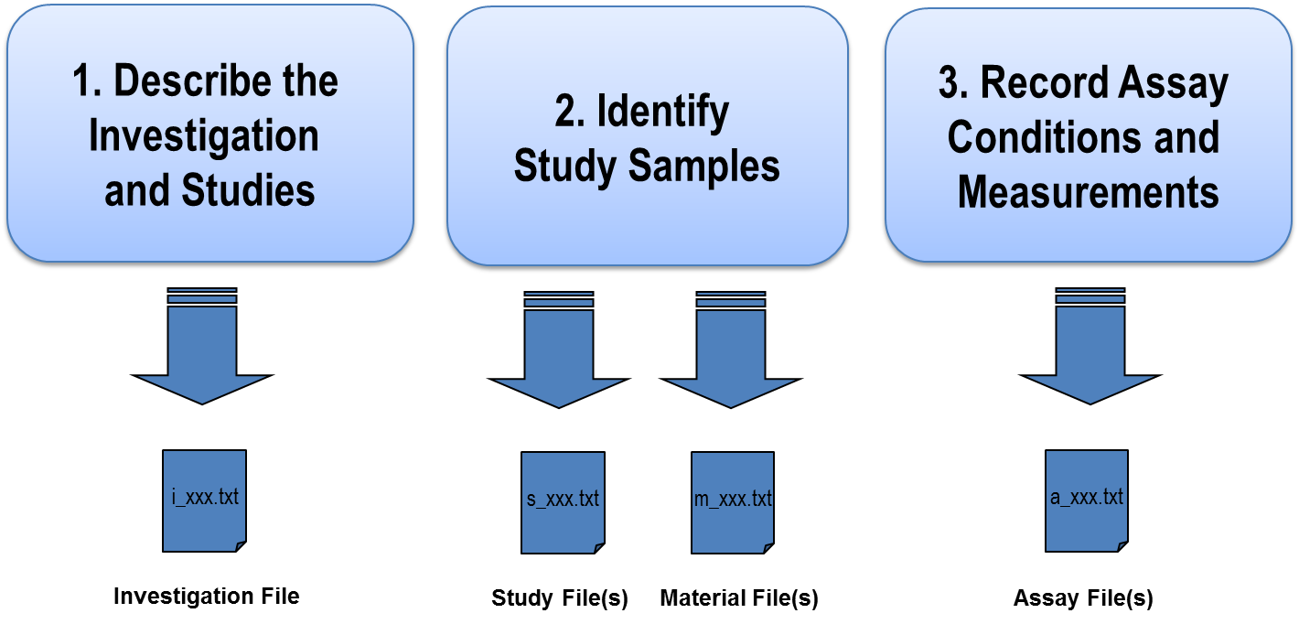
ISA-TAB-Nano Structure

Slide 6
Contacts and Links
National Cancer Institute (NCI) contacts:
Mervi.Heiskanen@nih.gov
Luisa.Russell@nih.gov
ISA-TAB-Nano Wiki: current and past versions, instructions and examples. https://wiki.nci.nih.gov/x/MwGGAg

