Slide 1
Cancer Genomics, Open Science and PMI: FAIR in NCI genomics thinking and projects
Warren Kibbe, PhD
NCI Center for Biomedical Informatics
@wakibbe
July 8th, 2016

Slide 2
Cancer Data Sharing, Open Source Software, Computation
Support open science
Support data reusability
Cancer Moonshot
Precision Medicine
Clinical Trials
Reduce the risk, improve early detection, outcomes and survivorship in cancer

Slide 3
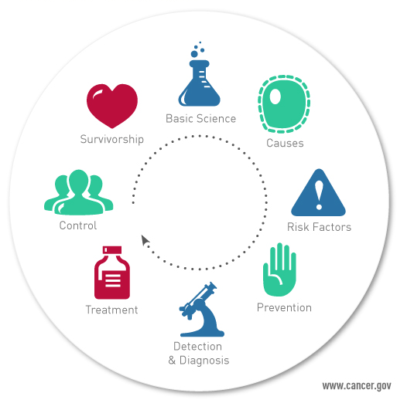
To develop the knowledge base that will lessen the burden of cancer in the United States and around the world.
NCI Mission
Notes:
Key message: The NCI coordinates the National Cancer Program, which conducts and supports research, training, health information dissemination, and other programs with respect to the cause, diagnosis, prevention, and treatment of cancer, rehabilitation from cancer, and the continuing care of cancer patients and the families of cancer patients.

Slide 4
US National Cancer Program

Slide 5
Why open science?

Slide 6
Why data sharing?

Slide 7
Open Science Assumption
Open sharing enhances reusability and reproducibility
Requires Open:
Data
Algorithms
Software
Annotations
Standards

Slide 8
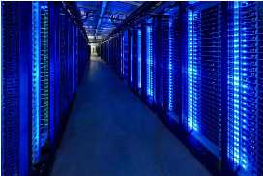
Changing the conversation around data sharing
NIH Data Commons
How do we find data, software, standards?
How can we make data, annotations, software, metadata accessible?
How do we reuse data standards
How do we make more data machine readable?

Slide 9
Data Commons
Data commons co-locate data, storage and computing infrastructure, and commonly used tools for analyzing and sharing data to create an interoperable resource for the research community.
*Robert L. Grossman, Allison Heath, Mark Murphy, Maria Patterson, A Case for Data Commons Towards Data Science as a Service, to appear. Source of image: Interior of one of Google’s Data Center, www.google.com/about/datacenters/.

Slide 10
FAIR – Making data Findable, Accessible, Attributable, Interoperable, Reusable, and provide Recognition
Force11 white paper
https://www.force11.org/group/fairgroup/fairprinciples

Slide 11
NIH Genomic Data Sharing Policy https://gds.nih.gov/ Went into effect January 25, 2015 NCI guidance: http://www.cancer.gov/grants-training/grants-management/nci-policies/genomic-data Requires public sharing of genomic data sets

Slide 12
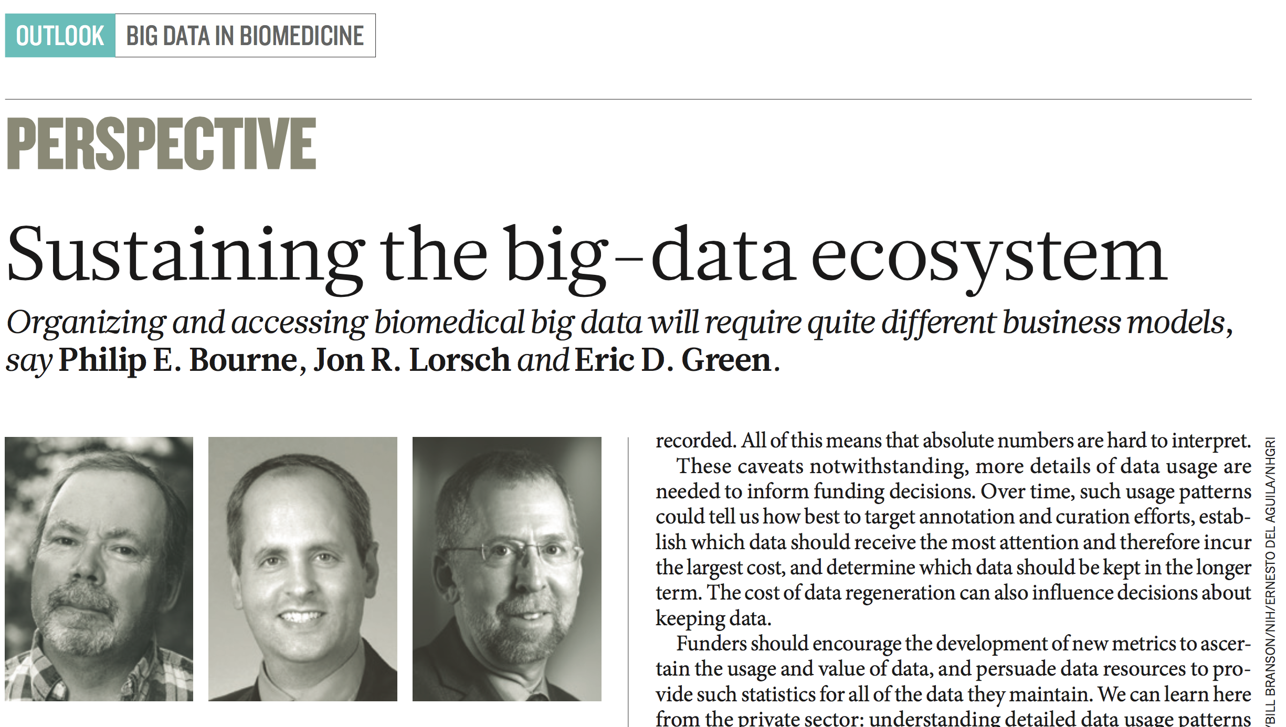
NIH and
Nature, November 2015

Slide 13
NEJM, January 2016

Slide 14
Science, March 2016

Slide 15
Vice President’s Cancer Initiative (aka Moonshot)
How do we enable meaningful, patient-centered and patient-level data sharing for cancer?

Slide 16
Moonshot Outline
Genomic Data Commons
Rethinking Clinical Trial Search
Development of Application Programming Interface (API) to NCI’s Clinical Trials Reporting Program, for use by:
NCI’s Cancer.gov website
Third party innovators providing clinical trial content to their communities
Vice President’s Moonshot Summit – June 29, 2016

Slide 17
Genomic Data Commons
Unified knowledge base that promotes sharing of genomic and clinical data between researchers and facilitates precision medicine in oncology
Contains standardized data from approximately 14,500 patients, derived from NCI programs, including:
The Cancer Genome Atlas (TCGA)
Therapeutically Applicable Research to Generate Effective Treatment (TARGET)
Cancer Genome Characterization Initiative (CGCI)
The Cancer Line Encyclopedia (CCLE)

Slide 18
Genomic Data Commons went live at ASCO June 6, 2016

Slide 19
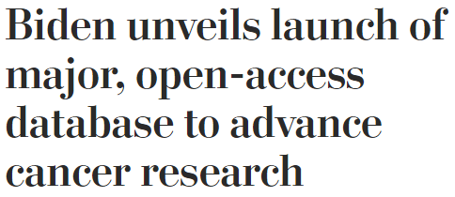
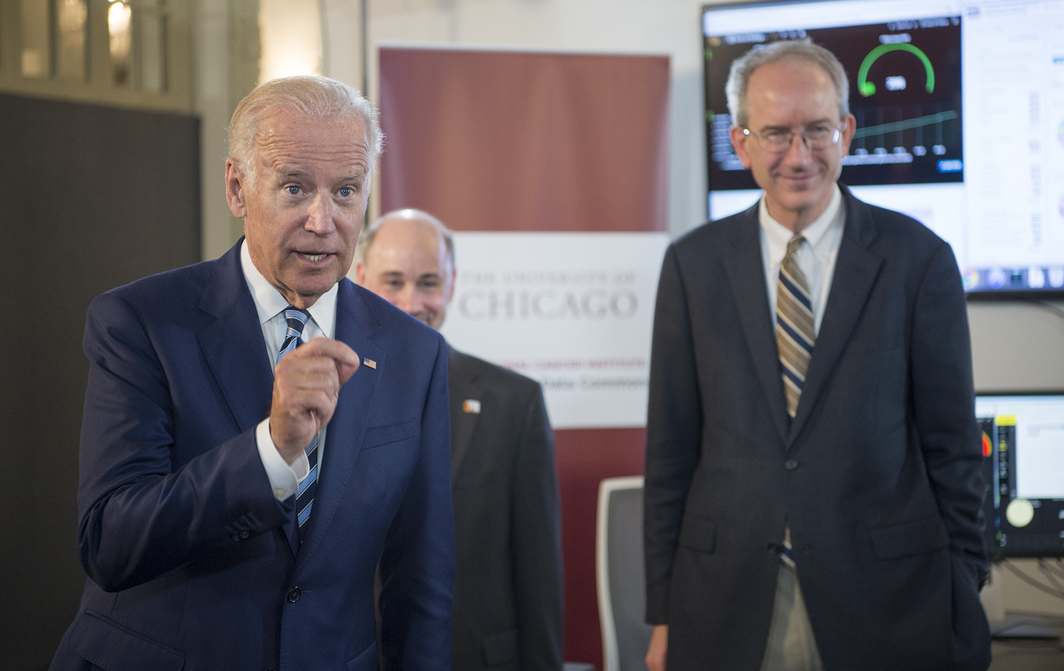
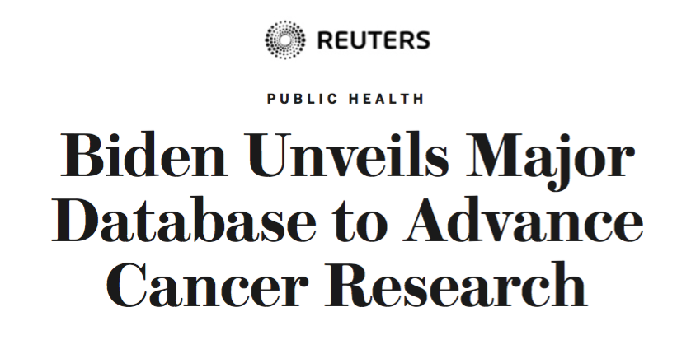

Slide 20
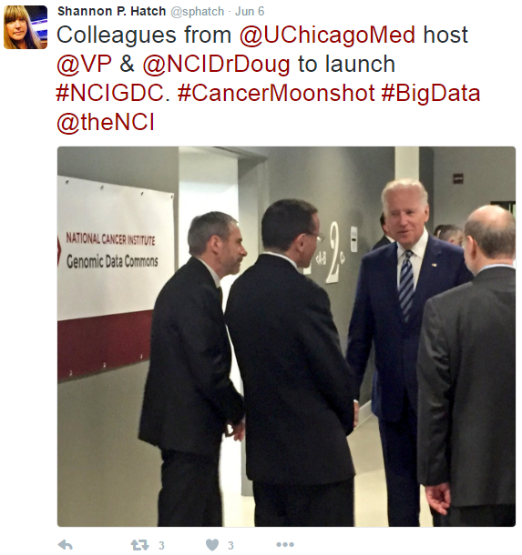
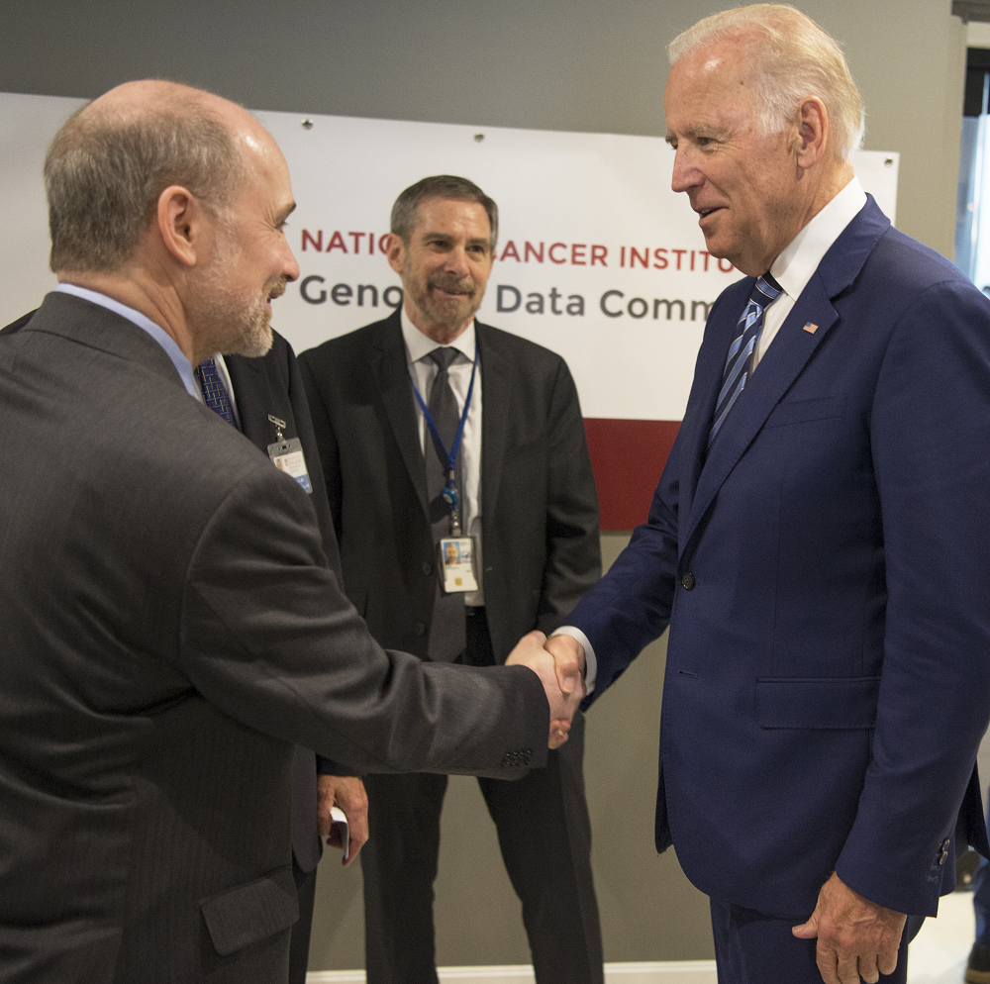
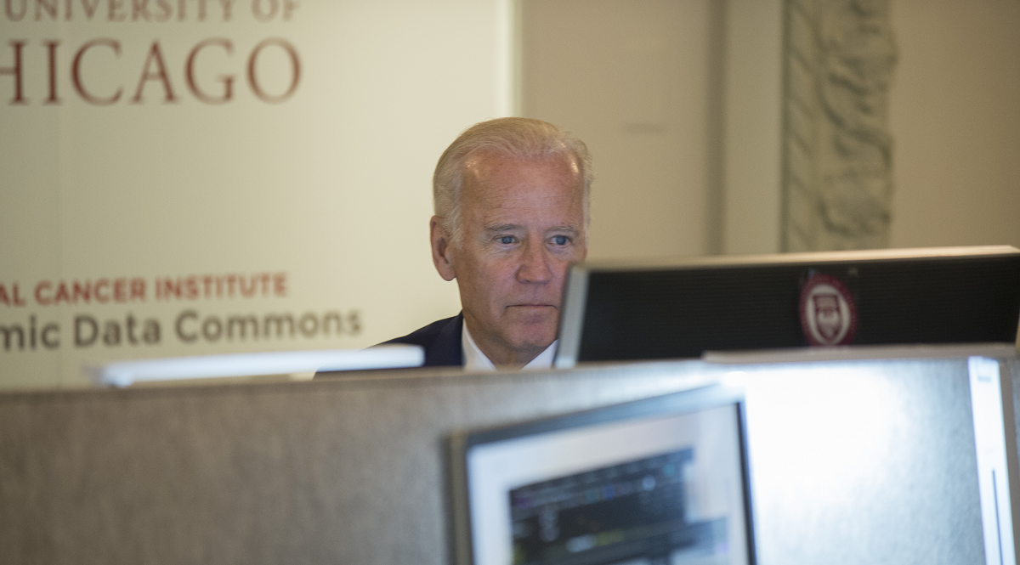
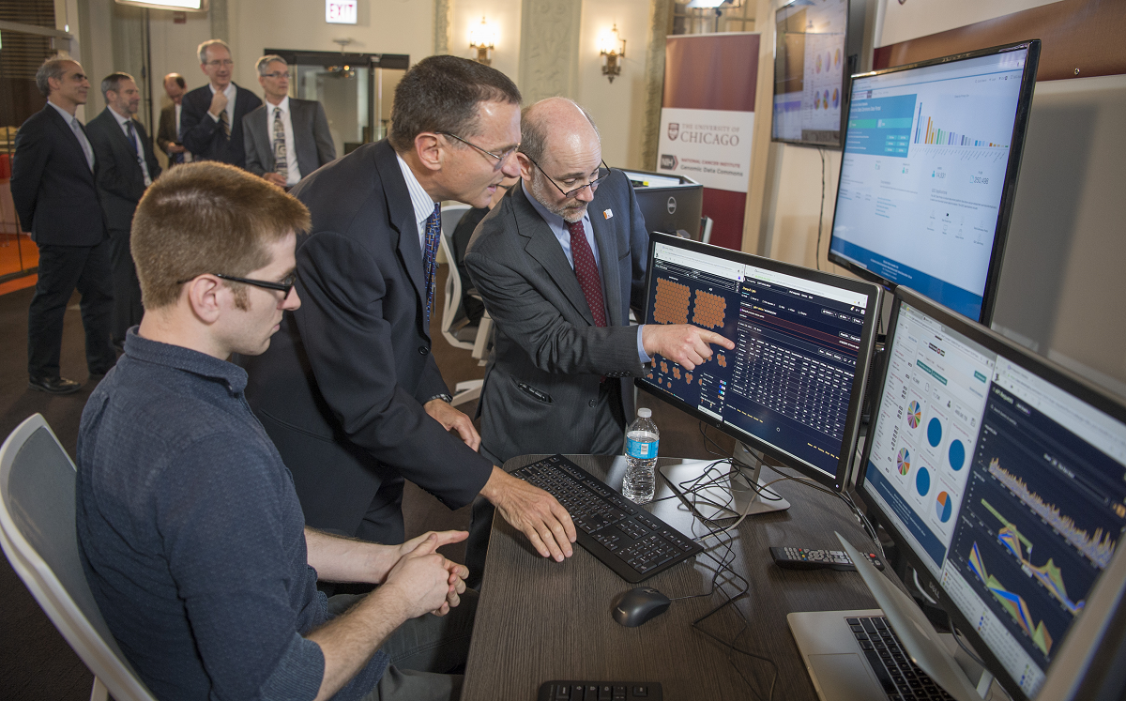
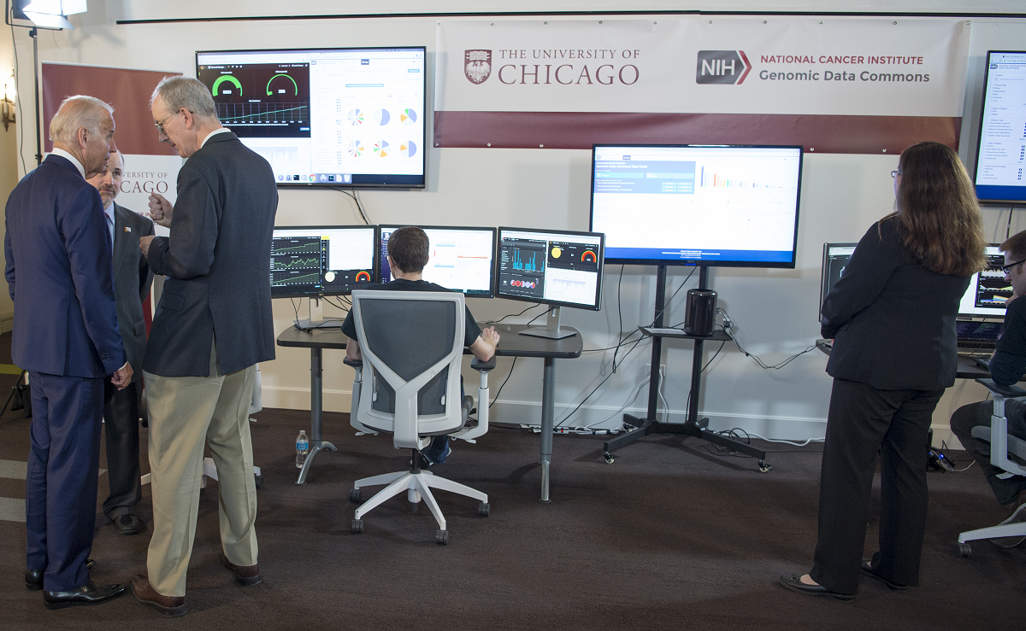

Slide 21
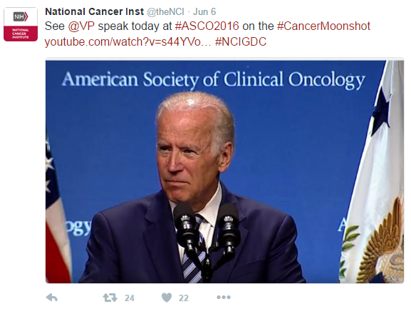
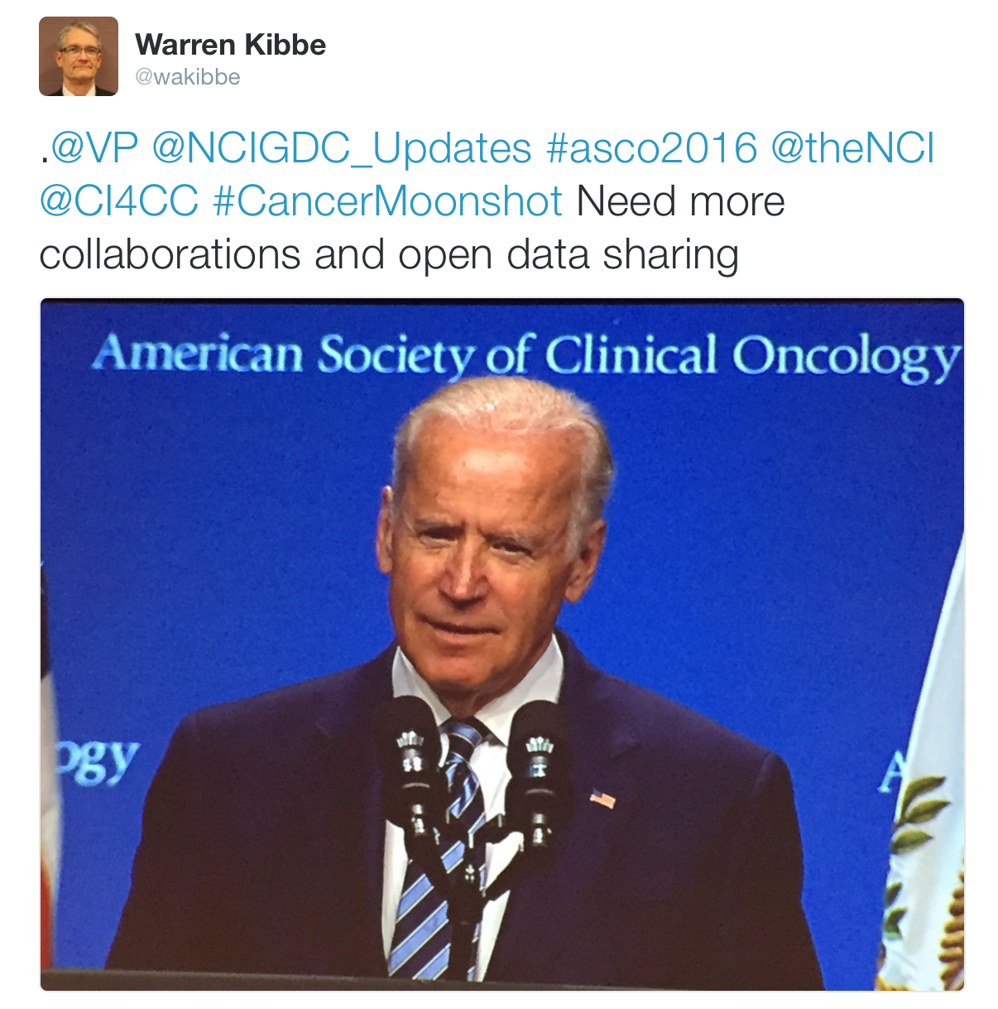
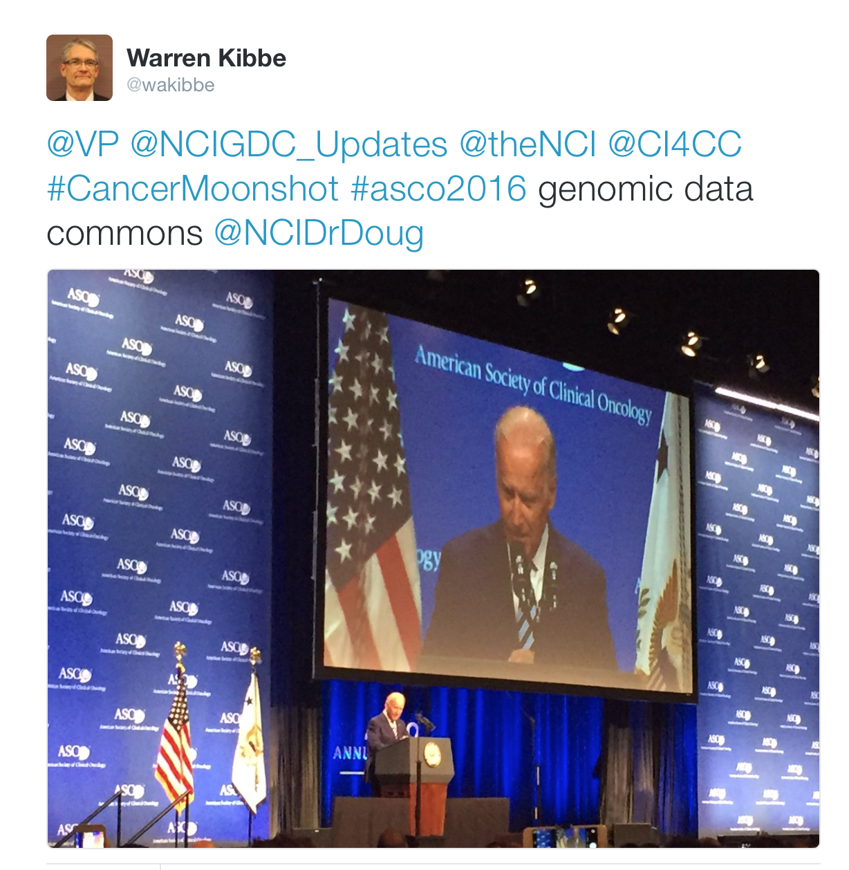

Slide 22
Vice President Biden’s Cancer Initiative January 2016
Federal Government Cancer Task Force – how can the federal agencies work together to:
Accelerate our understanding of cancer and its prevention, early detection, treatment, and cure
Improve patient access and care
Support greater access to new research, data, and computational capabilities
Encourage development of cancer treatments
Identify and address any unnecessary regulatory barriers and consider ways to expedite administrative reforms
Ensure optimal investment of federal resources
Identify opportunities to develop public–private partnerships and increase coordination of the federal government’s efforts with the private sector, as appropriate

Slide 23
Vice President Biden’s Cancer Initiative January 2016
Scientific Objectives of the Vice President’s Cancer Initiative Blue Ribbon Panel
Prevention and Cancer Vaccine Development
Early Cancer Detection
Cancer Immunotherapy and Combination Therapy
Genomic Analysis of Tumor and Surrounding Cells
Enhanced Data Sharing
Oncology Center of Excellence
Pediatric Cancer
Exceptional Scientific Opportunities in Cancer Research
http://www.cancer.gov/research/key-initiatives/moonshot-cancer-initiative/get-involved

Slide 24
Global Alliance for Genomics and Health
How do we foster open science, open software,
open data,
open access?

Slide 25
GA4GH
GenomicsAndHealth.org

Slide 26
GA4GH
Data Working Group

Slide 27
GA4GH
Data Working Group

Slide 28
GA4GH
GitHub

Slide 29
NCIP

Slide 30
NCIP
GitHub
147 repos

Slide 31
The Cancer Genomic Data Commons (GDC) is an existing effort to standardize and simplify submission of genomic data to NCI and follow the principles of FAIR – Findable, Accessible, Interoperable, Reusable.
The GDC is part of the NIH Big Data to Knowledge (BD2K) initiative and an example of the NIH Commons
Genomic Data Commons
Microattribution, nanopublications, tracking the use of data, annotation of data, use of algorithms, supports the data /software /metadata life cycle to provide credit and analyze impact of data, software, analytics, algorithm, curation and knowledge sharing
Notes:
The GDC is the Foundation of a Cancer Knowledge System

Slide 32
NCI Genomic Data Commons
The GDC will go live with approximately 4.1 PB of data.
This includes: 2.6 PB of legacy data;
and 1.5 PB of “harmonized” data.
577,878 files about 14194 cases (patients), in 42 cancer types, across 29 primary sites.
10 major data types, ranging from Raw Sequencing Data, Raw Microarray Data, to Copy Number Variation, Simple Nucleotide Variation and Gene Expression.
Data are derived from 17 different experimental strategies, with the major ones being RNA-Seq, WXS, WGS, miRNA-Seq, Genotyping Array and Expression Array.

Slide 33
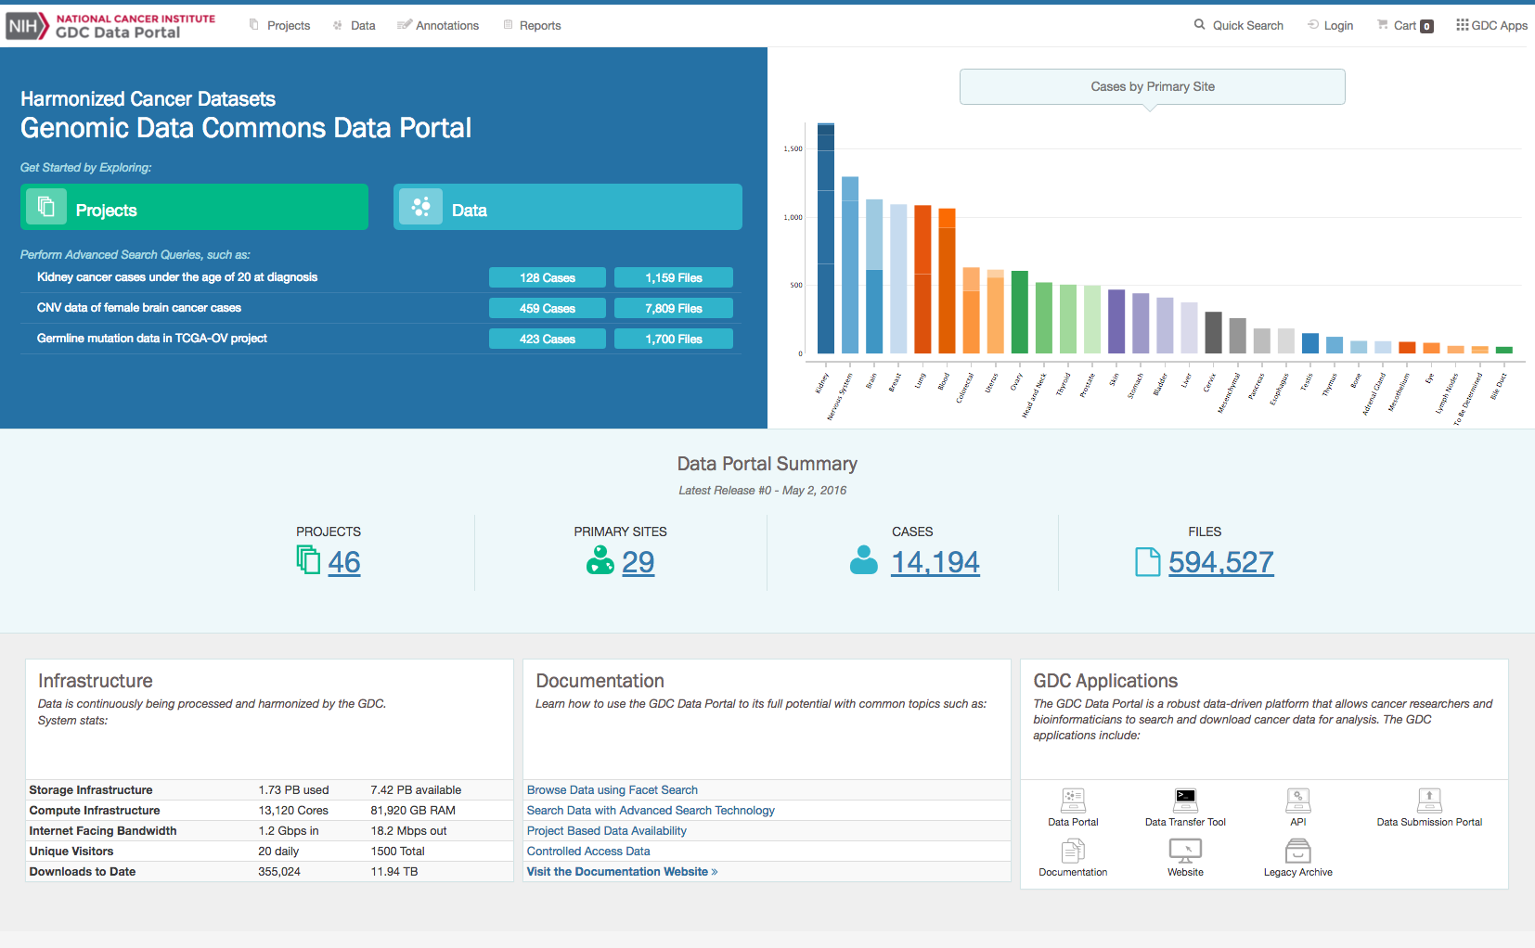
Genomic Data Commons Data Portal

Slide 34
The NCI Genomic Data Commons User Interface
Home Page

Slide 35
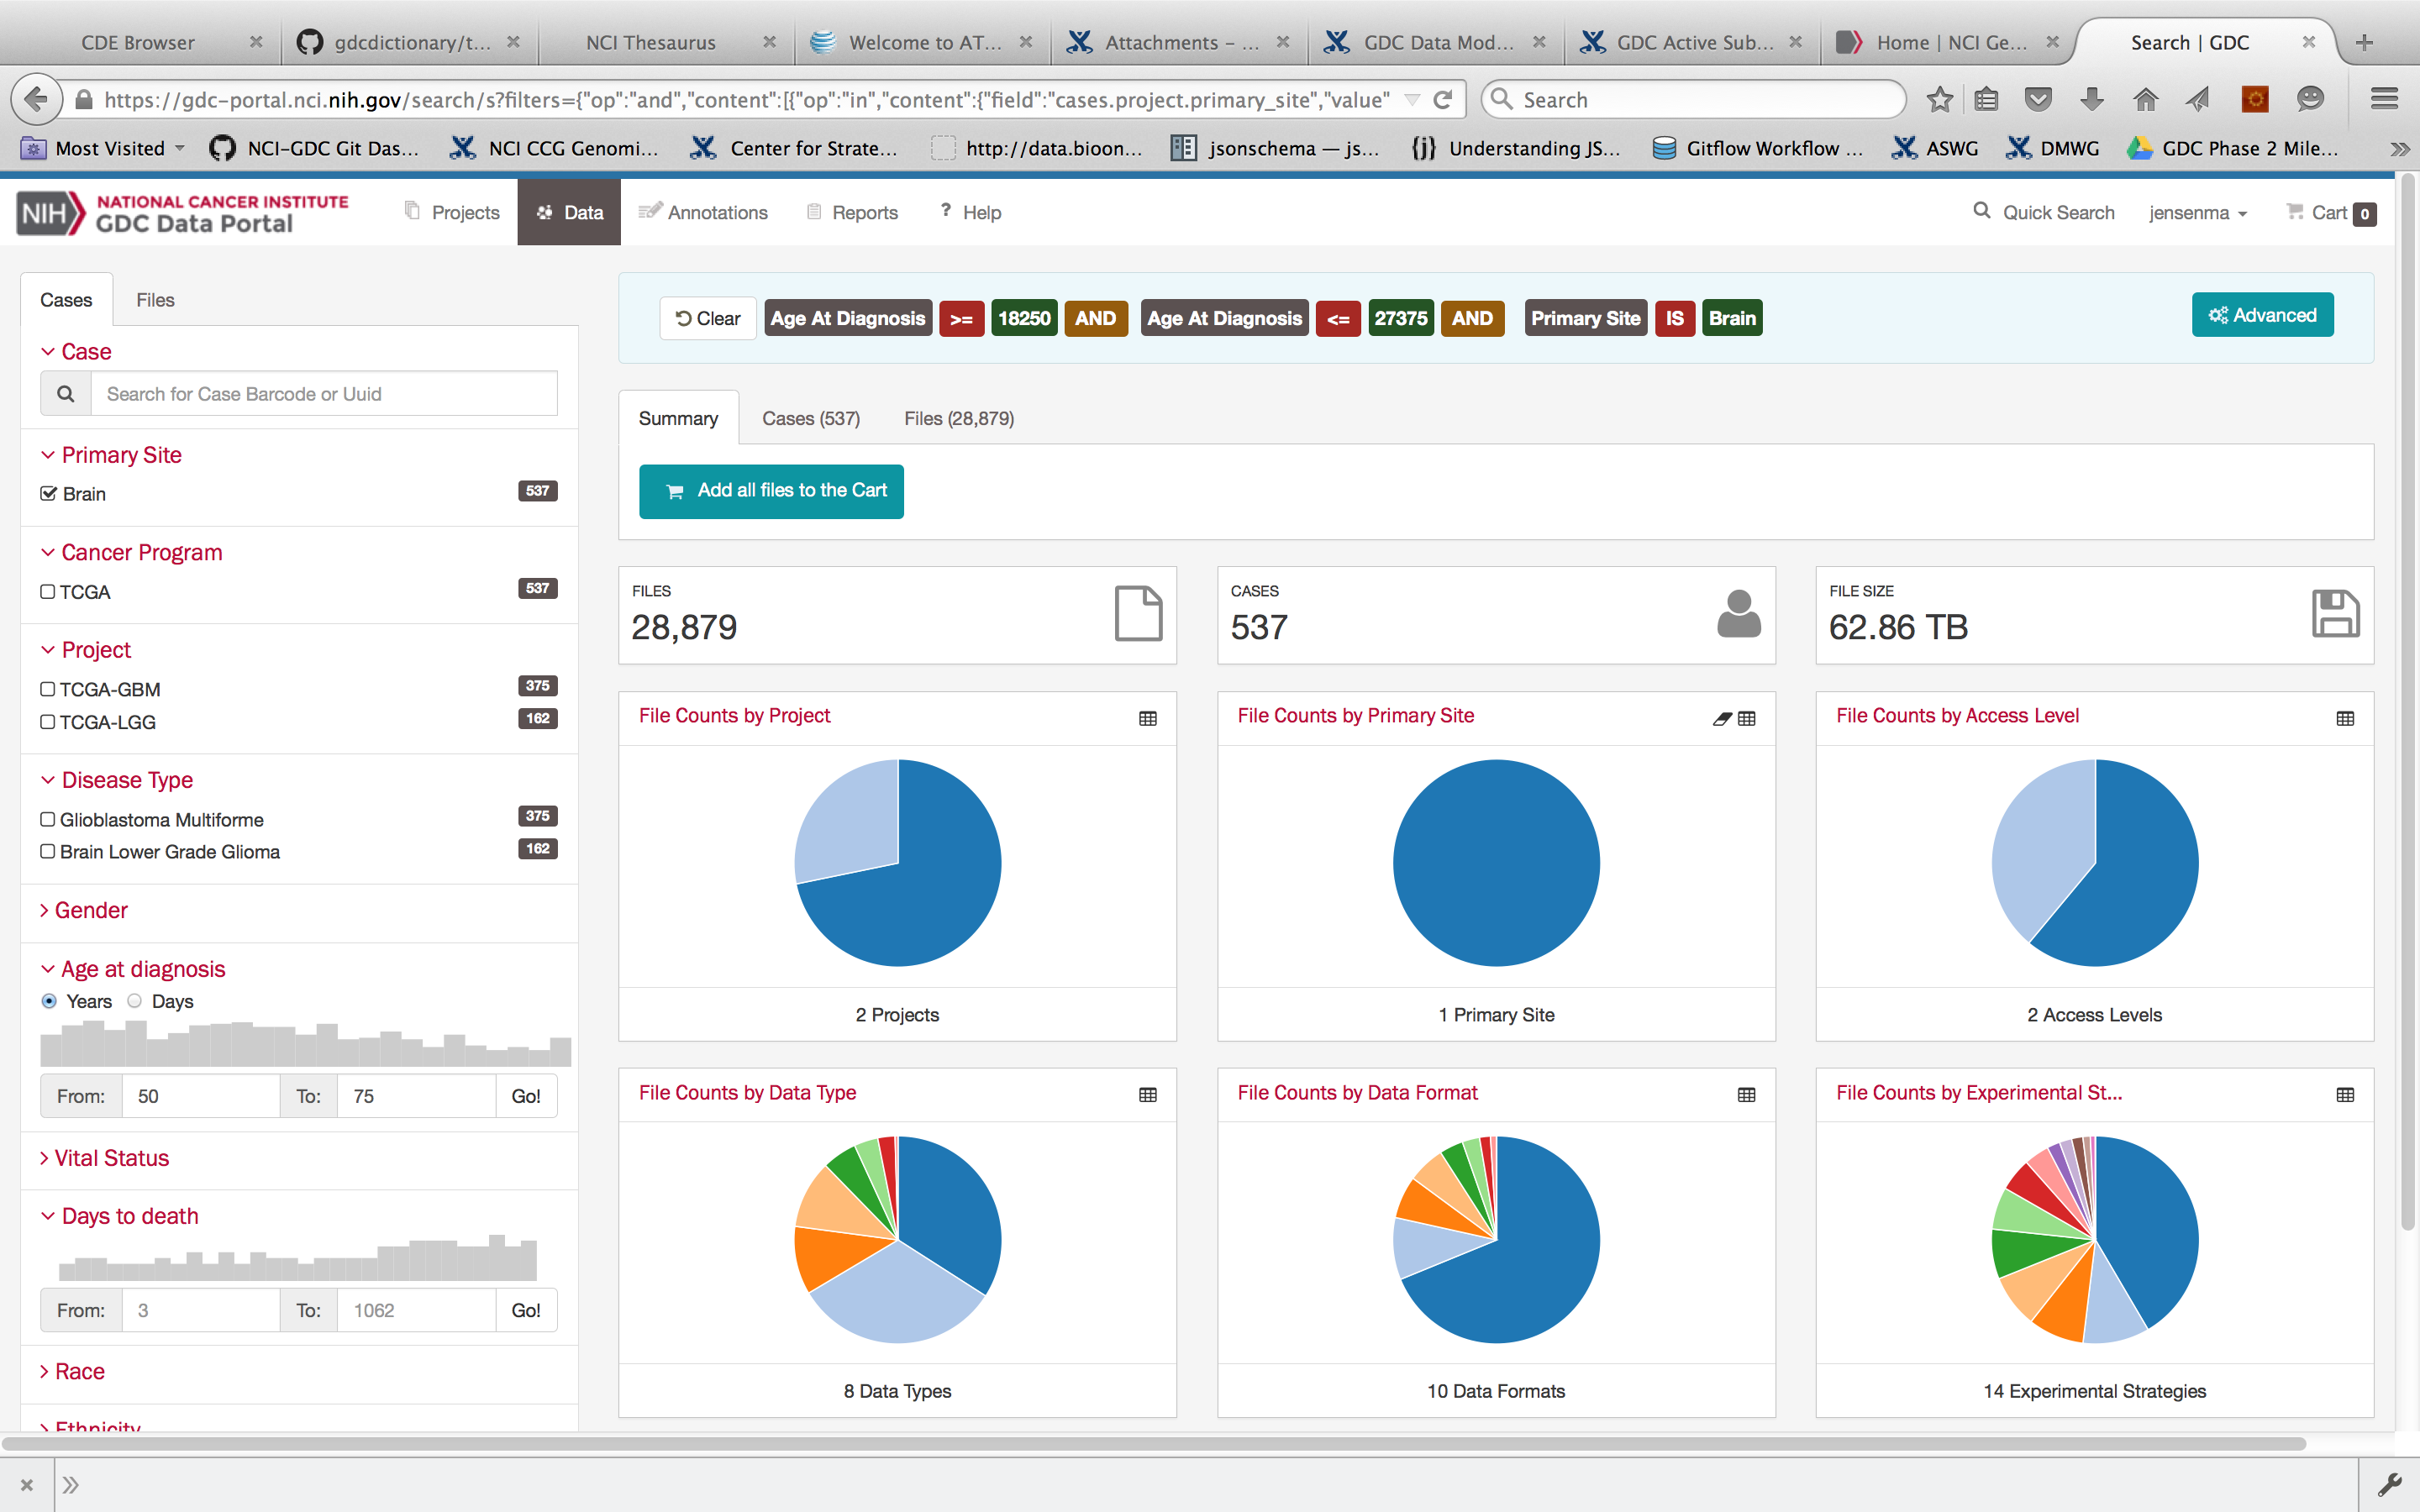
The NCI Genomic Data Commons User Interface
Sample Browser

Slide 36
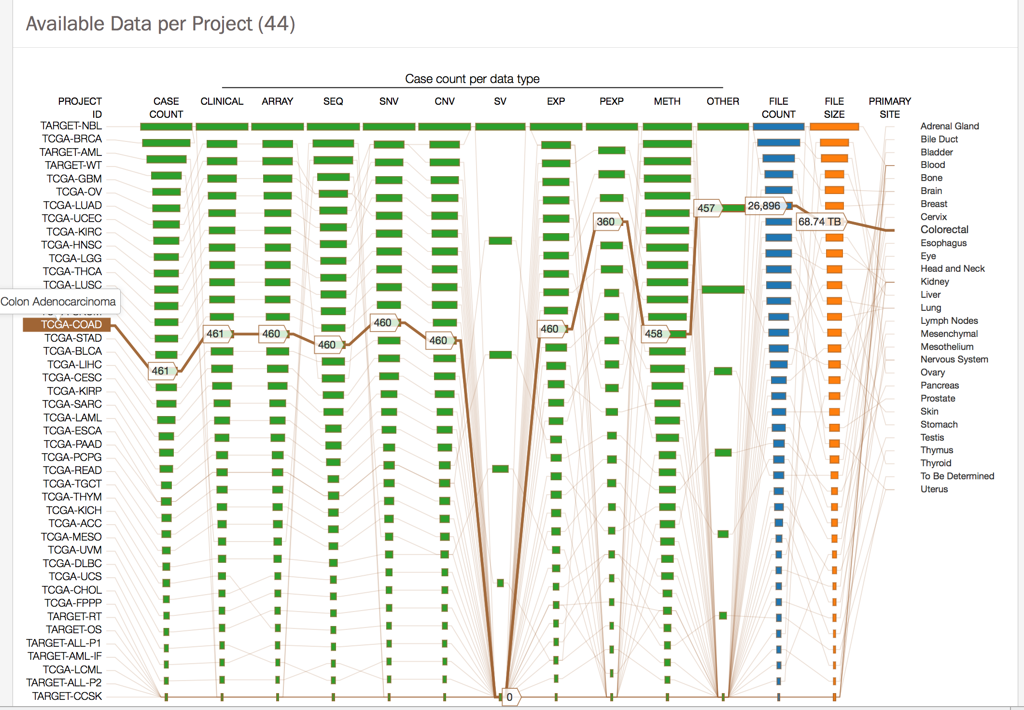
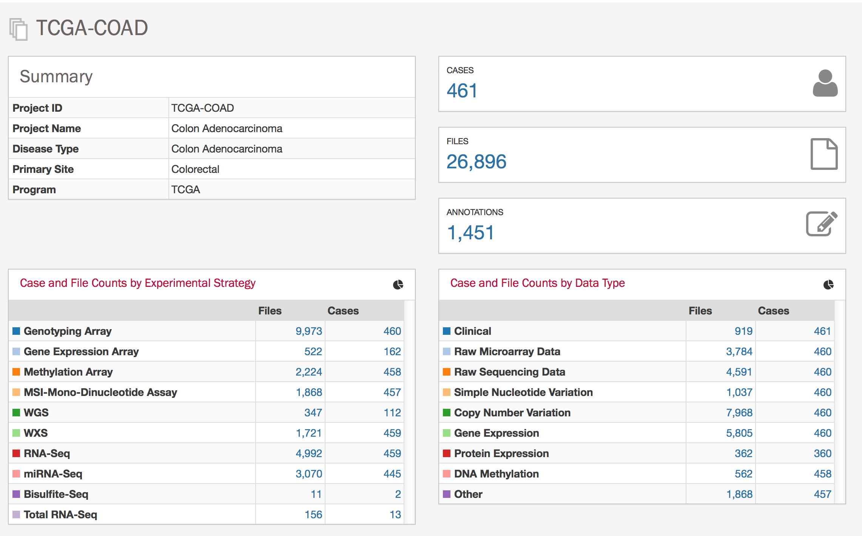
The NCI Genomic Data Commons User Interface
Sample Selection

Slide 37
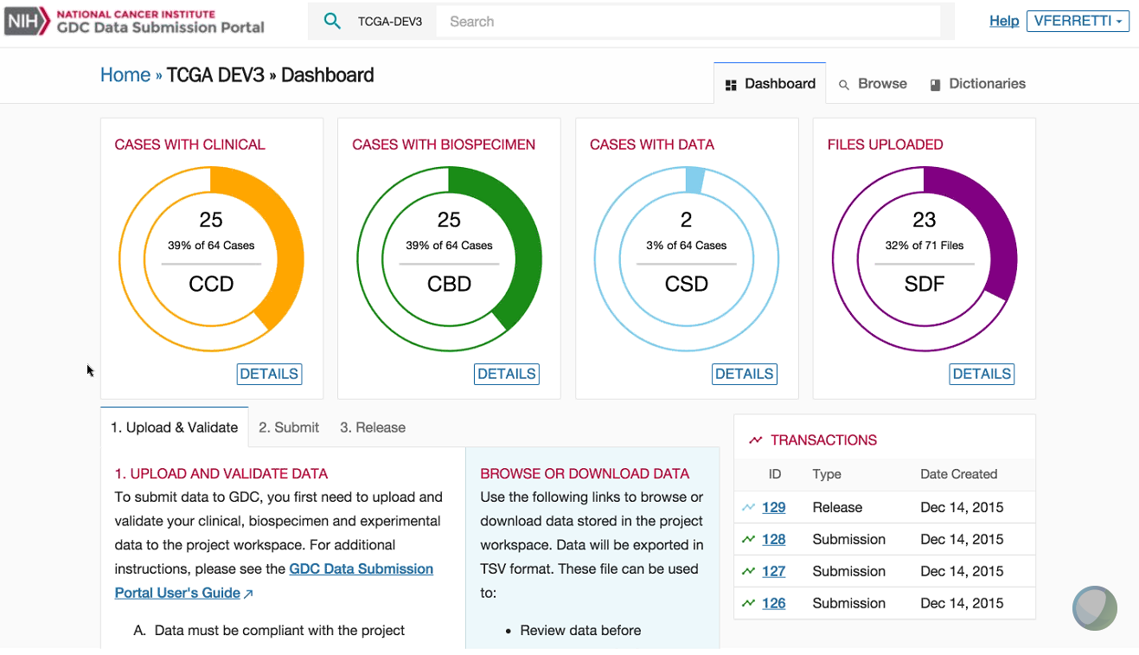
The NCI Genomic Data Commons User Interface
Data Submission Dashboard
Clinical data
Biospecimen data
Molecular data
Files uploaded

Slide 38
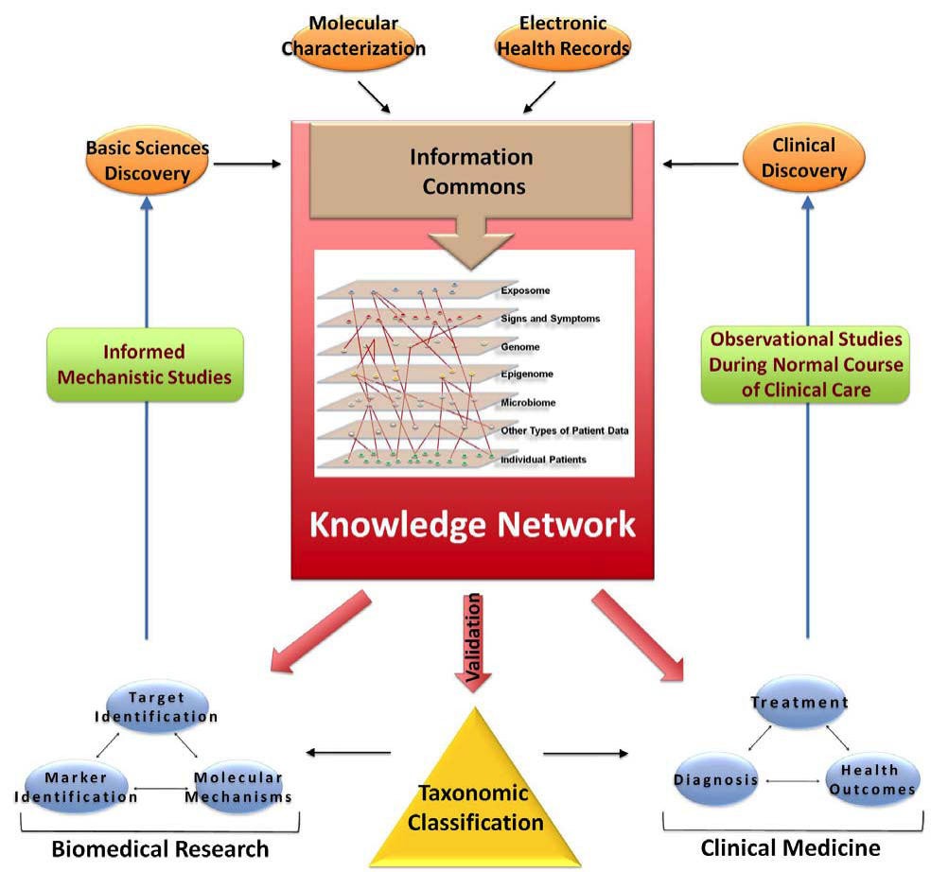
Development of the NCI Genomic Data Commons (GDC)
To Foster the Molecular Diagnosis and Treatment of Cancer
GDC
Bob Grossman PI
Univ. of Chicago
Ontario Inst. Cancer Res.
Leidos
Institute of Medicine
Towards Precision Medicine
2011

Slide 39
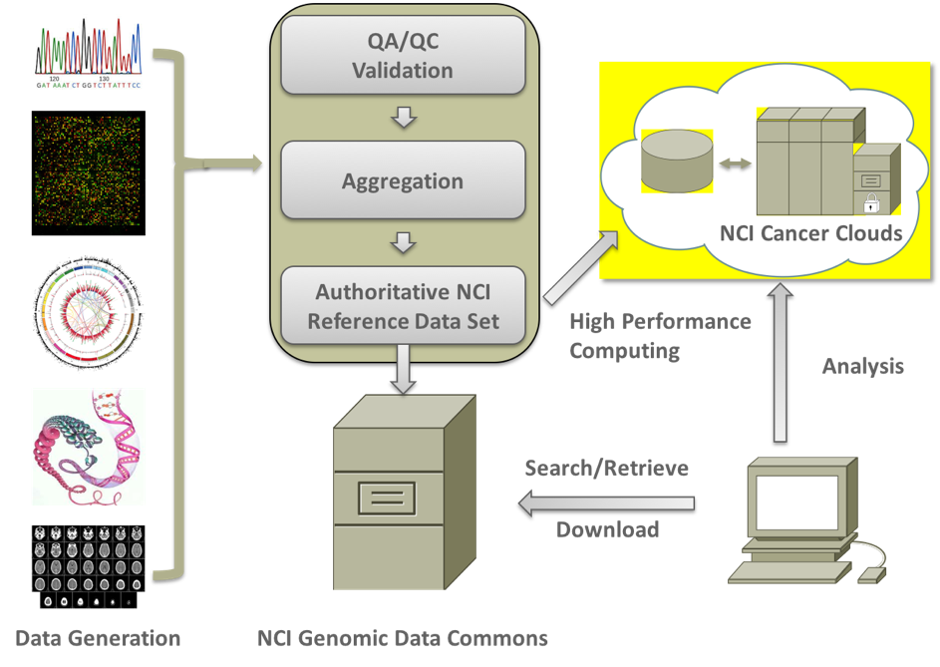
Support the Precision Medicine Initiative
The Genomic Data Commons and Cloud Pilots
Expand data model to include other data (e.g. imaging and proteomics)
Allow easy publication of persistent links to data, annotations, algorithms, tools, workflows
Measure usage and impact
Change incentives for public contributions
Notes:
Goal is to democratize access to NCI genomic and associated data
We are working towards having the Genomic data commons and the cloud pilots together create a cohesive model for large scale genomic data management and analysis

Slide 40
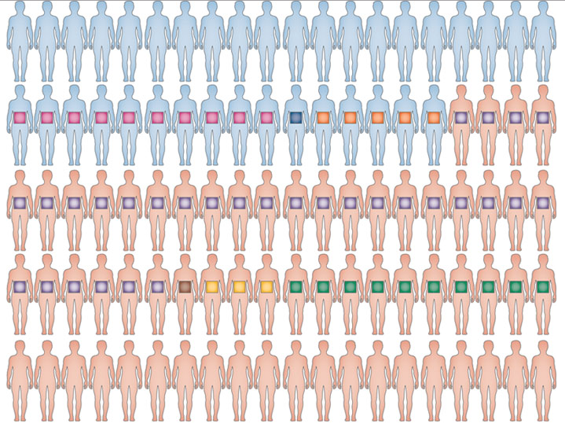
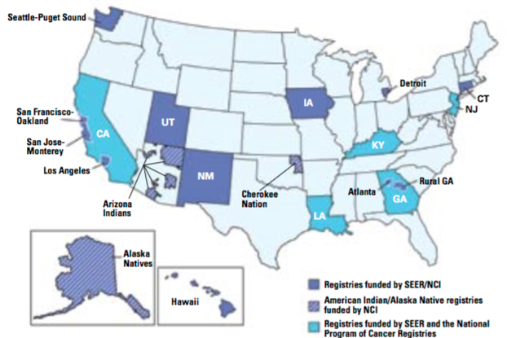
Cancer data ecosystem
Surveillance
Big Data
Implementation research
Patient engaged
Research
Discovery
Genomic research
Clinical trials with
genomic data
EHR, lab data, PROs,
smart devices,
decision support
Clinical Research
Observational studies
Well characterized genomic data sets
Cancer cohorts
Patient data
SEER
Genomic information
donor
Active research
participation
Learning from every
cancer patient

Slide 41
Genomic Commons Ecosystem
Submitters
New algorithms,
tools, visualization
API users
Web users
Broad Cloud
ISB Cloud
SBG Cloud
Compute
Analytics
Visualization
S3 API
GA4GH APIs
Data Validation
and
Harmonization
Genomic Data Commons

Slide 42
PMI – Oncology, the GDC and the Cloud Pilots Goals
Support precision medicine-focused clinical research
Enable researchers to deposit well-annotated (Interoperable) genomic data sets with the GDC
Provide a single source (and single dbGaP access request!) to Find and Access these data
Enable effective analysis and meta-analysis of these data without requiring local downloads – data Reuse
Understand Contributions, Assess value through usage, and give Attribution to all users

Slide 43
PMI – Oncology, the GDC and the Cloud Pilots Goals
Provide a data integration platform to allow multiple data types, multi-scalar data, temporal data from cancer models and patients through open APIs
Work with the Global Alliance for Genomics and Health (GA4GH) to define the next generation of secure, flexible, meaningful, interoperable, lightweight interfaces – open APIs
Engage the cancer research community in evaluating the open APIs for ease of use and effectiveness

Slide 44
Three Cancer Genomics Cloud Pilots
Broad Institute
Google Cloud
Firehose in the cloud
Institute for Systems Biology
Google Cloud
Interactive visualization and analysis
Seven Bridges Genomics
Amazon Web Services
> 30 public pipelines
http://firecloud.org
http://cgc.systemsbiology.net/
http://www.cancergenomicscloud.org
PI: Gad Getz
PI: Ilya Shmulevich
PI: Deniz Kural
Notes:
Now I’d like talk about the specifics of the three Cloud Pilot projects, which are being carried out by the Broad with Gaddy Getz as the PI, ISB with Ilya Smulevich as the PI, and SBG, with Deniz Kural as the PI. All three cloud pilots are implementing their systems on commercial clouds, with Broad and ISB using Google and Seven Bridges Genomics using Amazon. Each cloud pilot has a slightly different emphasis. Broad’s focus is on a system modeled after Firehose in the Cloud, ISB, on interactive visualization and analysis, and SBG on providing access to a large number of public tools and pipelines.
Now to say a few more words about each project

Slide 45
Cancer Genomics Project Teams
CGC Pilot Team Principal Investigators
Gad Getz, Ph.D - Broad Institute - http://firecloud.org
Ilya Shmulevich, Ph.D - ISB - http://cgc.systemsbiology.net/
Deniz Kural, Ph.D - Seven Bridges – http://www.cancergenomicscloud.org
NCI Project Officer & CORs
Anthony Kerlavage, Ph.D –Project Officer
Juli Klemm, Ph.D – COR, Broad Institute
Tanja Davidsen, Ph.D – COR, Institute for Systems Biology
Ishwar Chandramouliswaran, MS, MBA – COR, Seven Bridges Genomics
GDC Principal Investigator
Robert Grossman, Ph.D - University of Chicago
Center for Cancer Genomics Partners
JC Zenklusen, Ph.D.
Daniela Gerhard, Ph.D.
Zhining Wang, Ph.D.
Liming Yang, Ph.D.
Martin Ferguson, Ph.D.
NCI Leadership Team
Doug Lowy, M.D.
Lou Staudt, M.D., Ph.D.
Stephen Chanock, M.D.
George Komatsoulis, Ph.D.
Warren Kibbe, Ph.D.

Slide 46
Rethinking Cancer Clinical Trials Search for patients and providers

Slide 47
Rethinking Clinical Trials Search
Engaging the Presidential Innovation Fellows
Create an Application Programming Interface (API) for Clinical Trials
Create an example search interface based on the API
Create a twitter feed for all new clinical trials
Incorporation of these innovations into cancer.gov

Slide 48
Rethinking and Enhancing Clinical Trial Search: June, 2016
Initial Release of an API (Application Programming Interface) (API)^{1,} developed by the Presidential Innovation Fellows, for testing. This tool, found at https://clinicaltrialsapi.cancer.gov, makes publicly available trial registration information from the CTRP database, currently found on cancer.gov, assessable to third-party innovators so that they can build new digital tools tailored to the clinical trial search needs of their users.
Launch of @NCICancerTrials on Twitter and dissemination of clinical trial information via GovDelivery: https://public.govdelivery.com/accounts/USNIHNCI/subscriber/new
Changes the Cancer.gov Website to enhance clinical trial searching
¹A set of protocols designed to provide communication between a software application and a computer operating system or between applications.

Slide 49
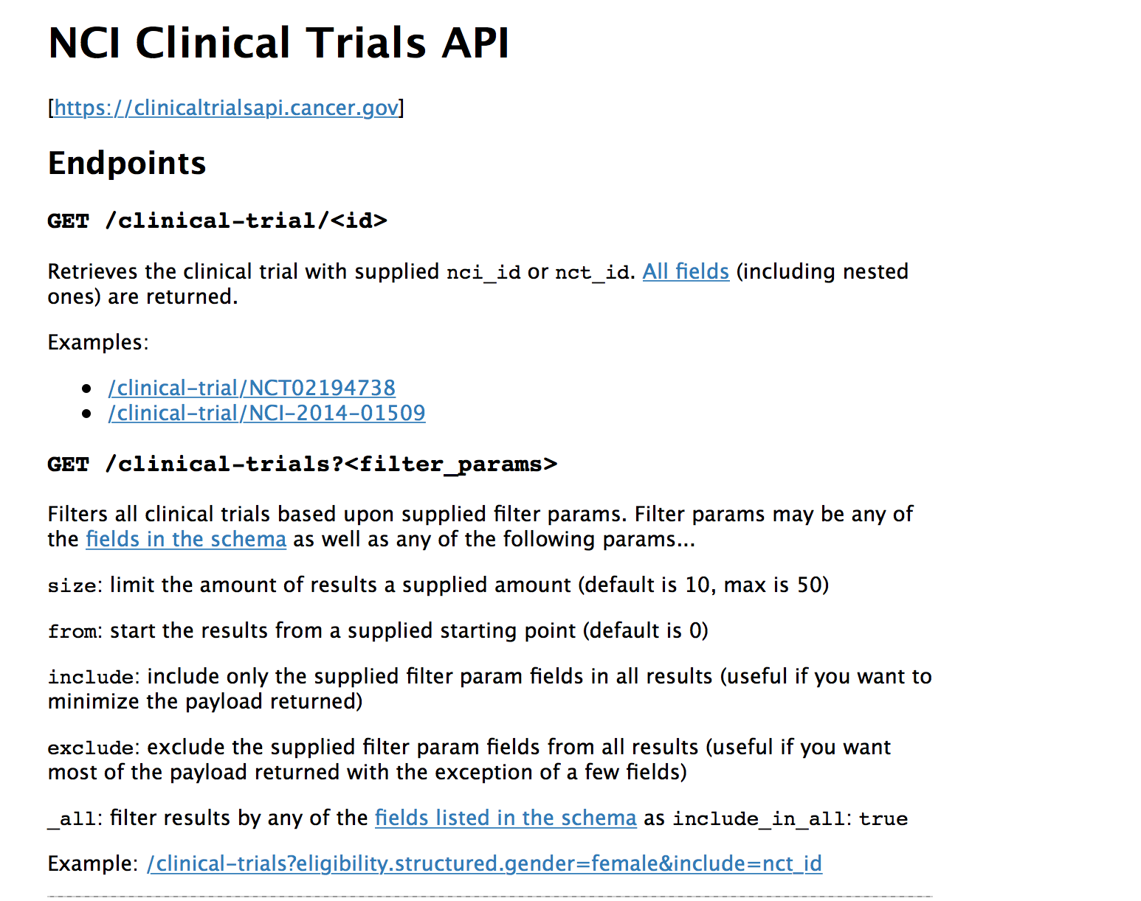
Clinical Trials Search API
https://clinicaltrialsapi.cancer.gov

Slide 50
https://clinicaltrialsapi.cancer.gov/clinical-trial/NCI-2014-01509

Slide 57
Cancer Moonshot Summit - Announcements on June 29th
NCI-pharma & Biotech Formulary
Applied Proteogenomics OrganizationaL Learning and Outcomes (APOLLO) NCI-DoD-VA
NCI – DOE partnership to incorporate computational science into cancer research
NIH Partnership for Accelerating Cancer Therapies (PACT) – collaboration with 12 biopharmaceutical companies
NCI, DOE, and GlaxoSmithKline public-private-partnership for using high performance computing in drug development

Slide 58
Cancer Moonshot Summit – Announcements on June 29th
Genomic Data Commons (https://gdc.nci.nih.gov) went live June 6th and is a data sharing point for clinical and basic science data generating genomic information
CTRP data:
NCI Clinical Trials Search https://trials.cancer.gov
NCI Clinical Trials API https://clinicaltrialsapi.cancer.gov

Slide 59
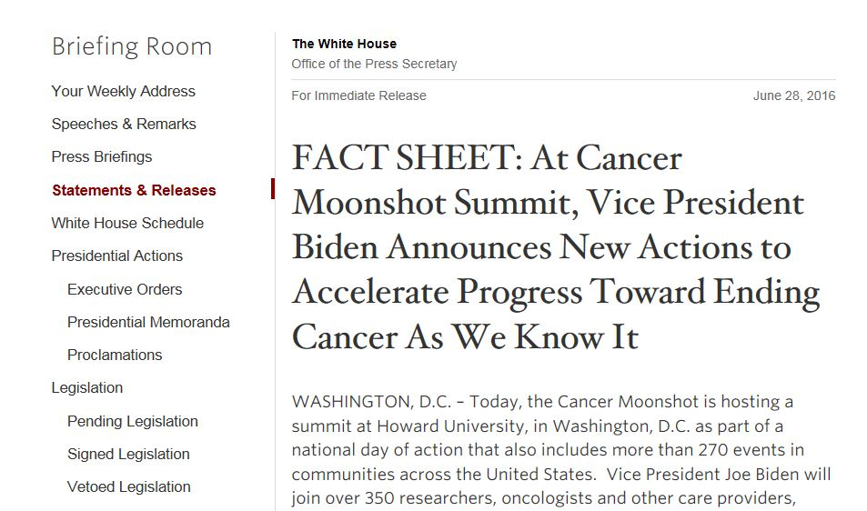

Slide 60
Thank you
Questions?
Warren A. Kibbe
warren.kibbe@nih.gov

Slide 62
Thank you
Questions?
Warren A. Kibbe
warren.kibbe@nih.gov

