Slide 1
NCIP Hub Resources
An introduction to using resources within NCIP Hub
Notes:
Good afternoon. Thank you for joining our webinar . My name is Lisa Mahoney and I work as an administrator of NCIP Hub. During today’s webinar, we be going through an overview of resources within NCIP Hub.

Slide 2
Outline
What is a resource?
Why and When to use a resource
How to upload a resource
Where to find more information
Questions?
Notes:
Here is the high level outline of the discussion.
First, we’ll go through what a resource is, next we’ll discuss and explain why and when to utilize a resource, then we’ll review briefly how to submit a resource, next we’ll give you a few options for assistance if you run into problems with your resources and finally we will open up for any questions you have.
Please also feel free to ask questions during the discussion if you need further clarification.
Let’s get started…

Slide 3
What are NCIP Hub Resources

Slide 4
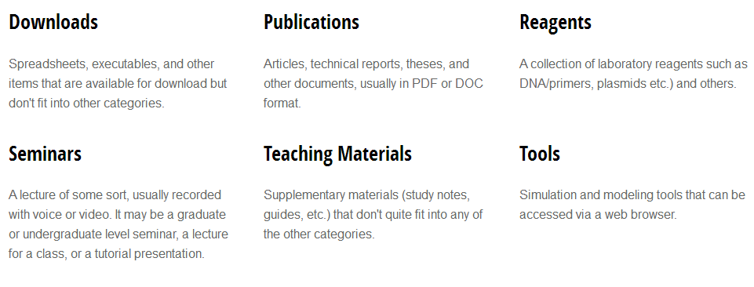
What are NCIP Hub Resources?
NCIP Hub resources are user submitted content grouped by category
Notes:
NCIP Hub resources are user submitted content grouped by category and can include video presentations, publications, simulation tools.
Any registered hub user can submit a resource.
However, resources must be relevant to the community and will undergo a short approval process to ensure all appropriate files and information are included.

Slide 5
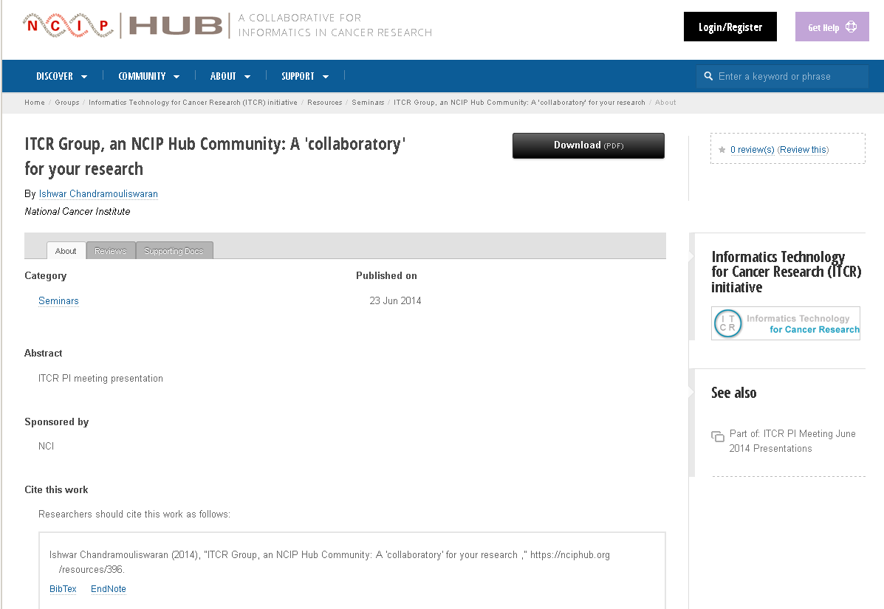
Resource Page
Title
Title
Authors
Reviews
Supporting
Documents
Related
Group
Abstract
Associated
Resource
Citation
Graphic Credit: Emily Kayser, Hubzero
Notes:
You can think of a resource as a digital publication.
When accessing a resource, like in other digital publications, you can find a lot of information about the resource on its individual resource page.
On a resource page, users see:
-Resource’s Title
- Authors and/or submitters
- The Abstract – which is a short description of the resource. This piece of information can be very helpful for other users when searching and accessing resources because it gives a brief preview of what to expect prior to downloading the actual resource.
And you will see a recommended Citation for the resource.
There are also tabs that contain more information such as user reviews of the resource and other supporting documents included with the resource.
I want to bring your attention to the review tab briefly. Because NCIP Hub is meant to encourage collaboration, the review functionality can be a useful tool in gathering feedback about a particular resource.
Finally, if the resource is related to a group or associated with other resources (for example within a series or a workshop) the associations will show on the right side.

Slide 6
Viewing the Resource
Notes:
When you are ready to access the resource, click the black box.
It is possible to attach more than one file to a single resource. When you do this, the first file uploaded will be accessible by clicking the black box. All files associated with a resource will be accessible from the “Supporting Documents” tab.

Slide 7
Why to use Resouces
When to use Resources
Notes:
With all the other modes of collaboration available on NCIP Hub, you may be asking why and when to use a resource.

Slide 8
Why to use resources
To share your own contributions
You are the author and get cited
You have permission of the author to share and give credit to the author
To increase visibility of your digital assets
Community provides input on your research to help accelerate
To demonstrate impact of the asset to the community
Usage metrics provides impact (DOI’s, citations)
To encourage collaboration
Notes:
Generally, resources are used when you want to share a contribution that you own. Reasons could be to preserve a work product at a certain point in time or to share preliminary data or work products with a research group. You do have the ability to share the work of another, however you must have permission to share the work and you must give the author credit.
Another reason to use a resource would be to increase visibility of your digital assets and allow the community to provide input on your research to help accelerate your work.
Yet another would be to demonstrate the impact your asset has on the community through usage metrics
Finally to serve toward resource sharing plans

Slide 9
When to use Resources
You have an individual contribution or white paper and want to share it with the community
You have a preliminary data set that you want to share with the larger community
You gave a presentation at a conference and want to share your slides with the community
You gave a presentation that was recorded and you want to share it with others who were not able to attend
You have a Tool/Linux based application you want to share with the community
Notes:
Examples include pdf of an article you published, word document of meeting minutes, PowerPoint slides from a presentation, video recording of a presentation
The common themes running through are collaboration and sharing.
As noted previously, you can upload more than one file to a resource. An example of when you may want to do this would be a presentation that was recorded but also has a slide deck to share. You are able to upload the video of the presentation with the slide deck for user reference.

Slide 10
Contributing New Resources

Slide 11
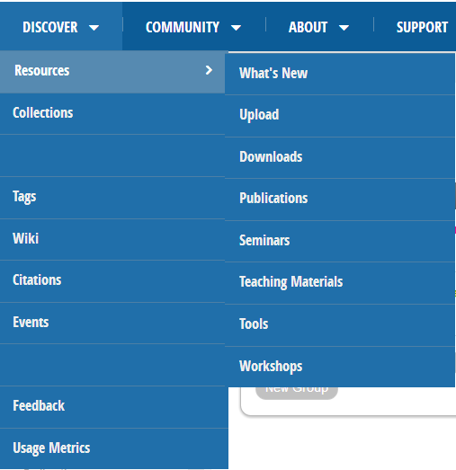
Create a New Resource: Getting Started
Creating resources within NCIP Hub is a simple step by step process!
Notes:
Creating a Resource
Who can create a resource?
All registered users can create a resource on the hub. They must be logged in.
To create a Resource
From the Resource page, click the “Get Started” button on the middle right of the page.

Slide 12
Create a New Resource: Select a Resource Type
Notes:
First, select the type of resource you want to submit.
There are a number of choices and each type is briefly described to help inform your choice.

Slide 13
Create a New Resource: Compose
Title
Abstract/Description
3. Additional uploads
4. Details
Notes:
Next compose the information that will be seen on the resource’s information page:
Give your new resource a title
Provide a short description/abstract. Although not required, this information is very helpful to include because it gives other users a preview to what they will be seeing with the resource.
Upload screenshots or graphics to include in your abstract. NOTE: You do not upload your resource here.
Provide other details you think will be helpful to users.

Slide 14
Note about “Additional Uploads”
Notes:
As noted previously, you do not upload your resource here. This is the place to upload a graphic that you want to show within your abstract.
To do so, choose a file by browsing and then click upload.

Slide 15
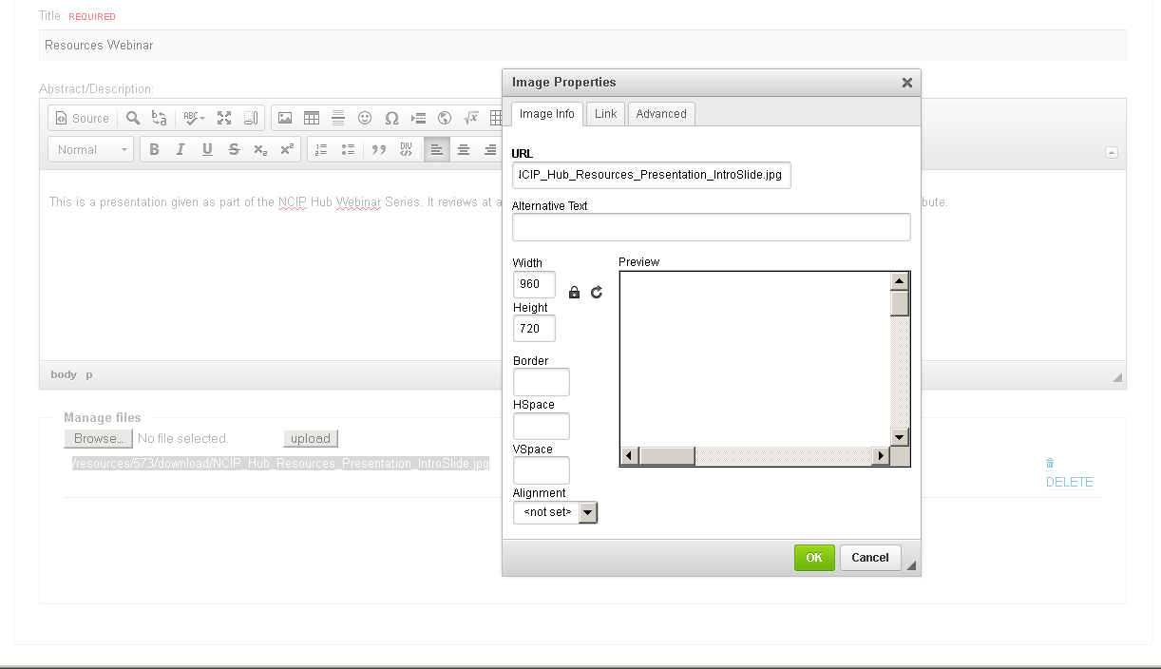
Note about “Additional Uploads” continued
Notes:
A URL will then appear here. Copy the URL and then use the image function of the ckEditor to add the image to the abstract.
In the ckEditor, Click in the text box where you want the image, and then click the image button.
Paste that URL into the "URL" text box, provide settings if you want to adjust the size, then press OK.

Slide 16
Note about “Additional Uploads” continued
Notes:
The image should appear.
You can resize the image from here too but using your mouse and the outline of the image.

Slide 17
Create a New Resource: Compose
Title
Abstract/Description
3. Additional uploads
4. Details
Notes:
When finished with uploading the image and the other tasks on the Compose screen (as seen in a previous slide), press “Next” at the bottom of the screen to move on.

Slide 18
Create a New Resource: Attach
Notes:
Here is where you upload your resource.
You can do this in one of two ways:
By clicking/dropping the file in the first box
Adding a link to where the file is stored

Slide 19
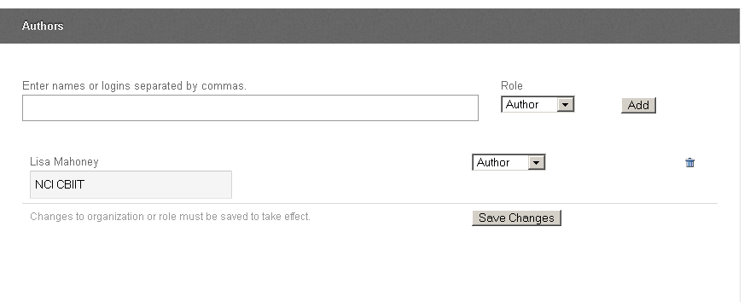
Create a Resource: Authors
Notes:
On the “Authors” Screen, you can choose for the resource to belong to a group, however this is optional and can be skipped.
If you choose to tie the resource to a group, first select the group name from the dropdown box, then select the access level.
Next, Enter the names of the resource authors. Click Add.
Your name will automatically be included as an author since you are uploading the resource from your account. You can remove your name by clicking on the trashcan icon. If you are not an author but want to receive credit for submitting the resource, simply click on “author” and select “submitter from the dropdown box. Be sure to add the author’s name so the proper person is credited.
When finished, be sure to save changes by clicking this box.

Slide 20
Create a Resource: Tags
Notes:
Next, add a tag to your resource. Tags help group your resource with similar material on NCIP Hub and aids in searching. If the tag you want to add already exists, it will appear in a dropdown as you begin to type. If a tag does not exist, simply type the entire word in the field and press enter…creating a new tag.

Slide 21
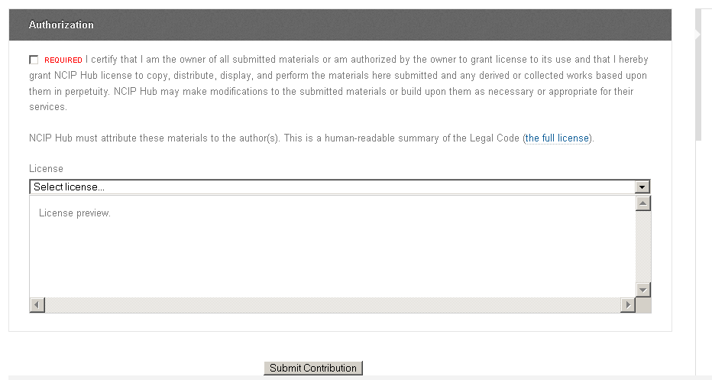
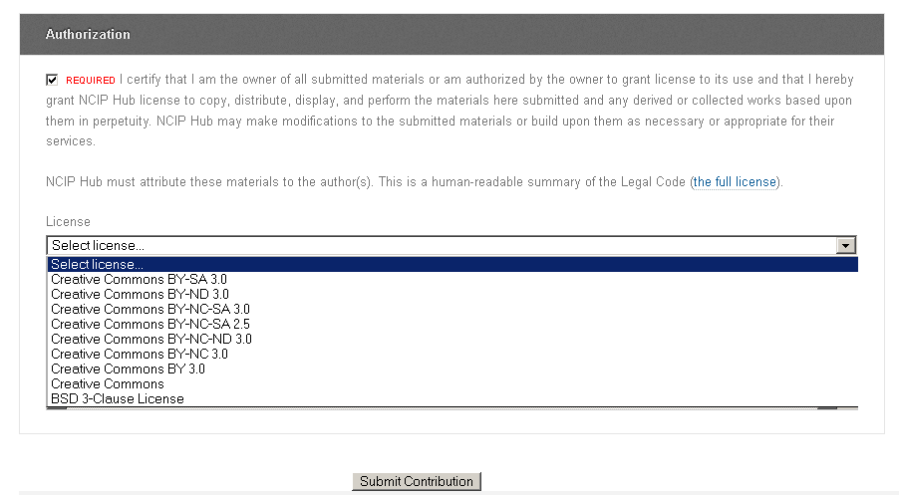
Create a Resource: Review and Submit
Notes:
On the next screen, click the box certifying that you are authorized to submit this resource. This is required to submit a resource.
Next, you can choose a license from the dropdown list. This step is optional and can be left blank if you want.
Then submit the contribution.

Slide 22
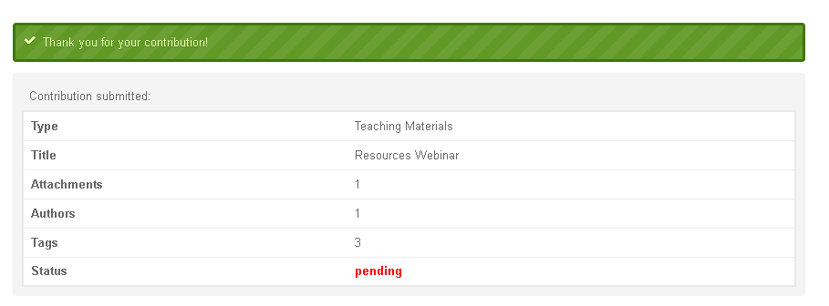
Create a Resource: Submitted
Notes:
After submitting, you will be taken to a confirmation screen. All resources will automatically go into “pending” status until an NCIP Hub administrator can review the resource to ensure all appropriate files and information are included. This approval generally occurs within 24 hours of uploading the resource.
Once approved, the resource is published according to the access settings you set.

Slide 23
Accessing Resources

Slide 24
Browsing your contributions
Notes:
After submitting your resource, it can be accessed in a number of ways:
Prior to being approved, resources you submitted are unplublished and appear in the “My Drafts” module on your personal dashboard. If you need to revise or update your submission in any way at this point, click on your resource to be taken back to the submission screens.
Once approved, the resource is listed in your contributions. This can also be accessed from your personal dashboard on the left side of the screen.
When wanting to revise a resource (either published or unpublished), you can navigate to different screens from the Resource menu…without having to click next through each screen. Note: that when a resource is unpublished, you will not be able to click on the “Review” option. Only after a resource is published can you skip directly to the Review screen.

Slide 25
Contributions
Notes:
Under contributions, all resources that I have published are listed. Notice that resources that I set as private show a small lock next to the title.

Slide 26
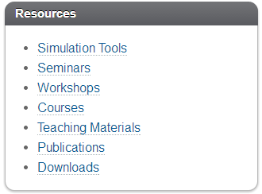
Browsing existing resources
From the Main Menu
Or from your
dashboard page…
Within the Resource page…
Notes:
You can also search and access resources that other users submitted to NCIP Hub.
To browse existing Resources:
From the Main menu, Click on Discover and select resources
From your Dashboard – The Resources Module
Your Resources Module displays the different categories of resources that you can access
From the Resource page users can perform a search or browse all available resources

Slide 27
How to get help
Help is available:
See our NCIP Hub Tutorials
Check out our User Group
Become a member if you are not already
See Question and Answers
Post a question to gather feedback from the user community
Read through questions already posted to learn more
Log a help ticket
Notes:
You always have support when using NCIP Hub.
If you run into a problem when submitting a resource or have general questions see our NCIP Hub Tutorials, check out the User Group page for announcements and discussions, see the Q&A page or log a help ticket.

Slide 28
QUESTIONS?

