Slide 1
Overview of the NCI Surveillance, Epidemiology, and End Results (SEER) Program
Paul Fearn, PhD, MBA
Chief, Surveillance Informatics Branch
Surveillance Research Program
Division of Cancer Control and Population Sciences
ITCR - May 4, 2018

Slide 2

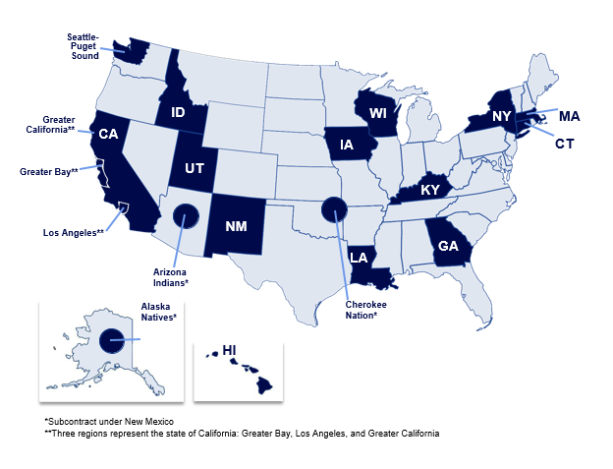
The SEER Program
Funded by NCI to support research on the diagnosis, treatment and outcomes of cancer since 1973
16 population-based registries now covering 34% of the US population
  Registries collect information on all cancer cases for residents of the state or region
  Representing racial and ethnic minorities
  Various geographic subgroups
~550,000 incident cases annually
  Approximately 85% of cases with
  real-time electronic pathology
  reporting from laboratories

Slide 3
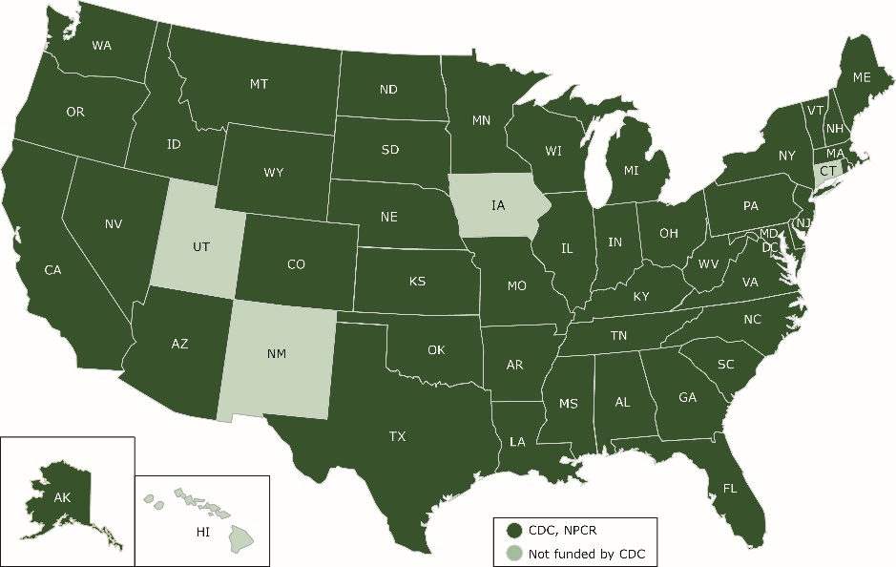

Federally Funded Programs
NCI SEER Registries
CDC NPCR Registries
https://seer.cancer.gov/report_to_nation/
https://www.cdc.gov/cancer/npcr/public-use/
https://seer.cancer.gov/data/
Notes:
SEER focus is research
CDC focus is public health

Slide 4

Cancer Registries – legal authority
Each state has a legal mandate for reporting of all cancer cases, treatment and outcomes to a state cancer registry
Patient Identifying Information (PII) is required to link disparate reporting sources for consolidation and longitudinal follow-up
  Surveillance reporting is HIPAA exempt
All health care providers are required to report including: hospitals, pathologists, other MDs (Oncologists/Radiation Oncologists), Pharmacists
  This includes path labs (such as genomic labs)
SEER registries establish “required” reporting of variables based on what SEER requires
  Opportunity to modify data collected
  3 SEER registries have written in their law permission to collect and use residual tumor tissue for research purposes
Public health reporting permits the collection of data on cancer patients to:
  understand trends in incidence, prevalence and survival (SEER & NPCR)
  use the data to better understand cancer care and outcomes – especially beyond the clinical trial setting (SEER)

Slide 5
Specific data gaps* being addressed with SEER initiatives
Detailed longitudinal treatment data
  First course of therapy collected but limited to generic categorization for systemic therapies (chemo/hormonal/targeted)
  No subsequent therapy collected
  No access to pharmacy-provided oral therapies
Lack of outcomes other than survival and cause of death
  Imperative to understand recurrence
Comprehensive genomic data characterizing the cancer
  Only 32 prognostic and predictive biomarkers currently collected
  More detailed/comprehensive genomic testing results are necessary to understand and characterize each cancer (both at diagnosis and subsequently)
*Note: these are gaps for all surveillance systems

Slide 6
SEER Big Data Challenges
Around 28% of US Population
High security and data confidentiality requirements
Big Data
Volume
Veracity
Variety
Velocity
Around 450,000 new cases per year
High data quality requirements
Around 80% of cases with electronic pathology reports
22-month delay in cancer reporting¹
Over 360 reporting laboratories
Heterogeneous data from acquisitions and linkages
¹ https://surveillance.cancer.gov/delay/
Notes:
Delay from end of diagnosis year to first reporting at NCI

Slide 7
Solutions in progress at SEER
Efficiently enhance completeness and expand the clinical data collected through
  Linkages to capture current and new data items
    Cost efficient
    Increased accuracy and timeliness (real time data feeds often possible)
  Developing tools for automation (NLP/machine learning)
    Reducing manual data processing
    Increasing consistency and potentially accuracy above human curation
  Leveraging these activities through collaborations with external partners both commercial and public
Expanding the SEER program infrastructure for supporting research
  Virtual SEER-Linked Biorepository (aka Virtual Tissue Repository)
  Virtual Pooled Registry (VPR)

Slide 8
Linkages - Radiation Therapy
Currently capture minimal data on radiation therapy is captured only for the initial course
Working with Elekta / Varian to capture selected structured data from their EMRs
  Increased detail
  Would automatically provide initial and subsequent courses of radiation
  Opportunity to identify treatment of recurrent disease
Pilot in process in NY
  Northwell hospitals have both Elekta and Varian
  Expanding to Seattle-based large Elekta practice
  Once successful can scale to broader SEER

Slide 9
Linkages – Systemic Therapy
Orally Administered Anti-neoplastics
Traditional Infusion Therapy
Different approaches
  Oral treatments provided at pharmacies
  Infusions often provided in the outpatient (community oncology practice) setting with limited access by registrars
Current status of linkages with pharmacy chain data
  Agreement signed with CVS and Walgreens to receive real time data for all anti-neoplastic therapies
    Pilot data received for Walgreens and CVS in Georgia

Slide 10
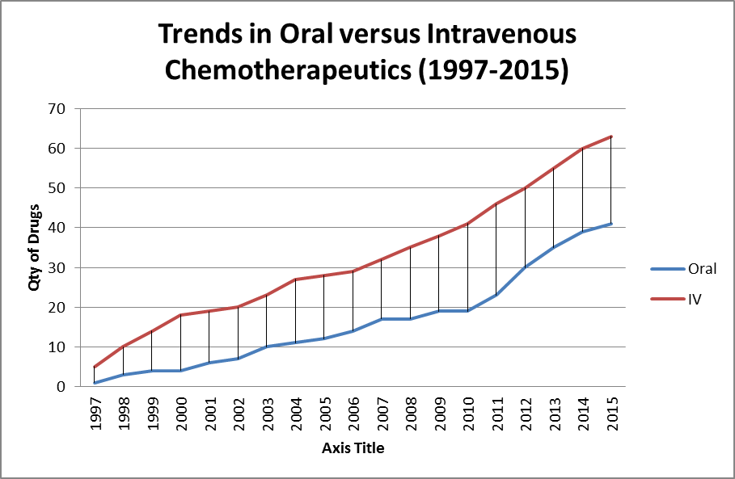
Linkages - large pharmacy chain central repositories for oral therapies
Capturing these data is critical
  Estimated 25%+ systemic Rx and growing with widening gap between traditional intravenous and oral agents (graph)
  No population-based information (clinical trials /case series data only)
Current status of linkages with pharmacy chain data
  Agreement signed with CVS and Walgreens to receive real time data for all anti-neoplastic therapies
    Pilot data received for Walgreens in Georgia
  In discussion with Walmart
  Rite Aid next targeted linkage
  These 4 represent >50-60% prescriptions

Slide 11
Linkages - Claims
Value of claims for treatment
  Standardized format and nomenclature from all providers (ANSI 837)
  High degree of accuracy and detail based on CPTs/HCPCs (billing codes) for treatment
  Longitudinal data permits assessment of initial and subsequent therapy
SEER- Medicare (ages 65+)
  Medicare Claims Data Linked to SEER since early 1990s
  >1600 publications
NCI Cancer “Moonshot” sponsored Claims Workshop in Sept 2017
  Brought together major US Health Insurance Companies : Humana, United (Optum), Aetna, Anthem, Blue Cross, AHIP*
  Purpose: seek expansion of linkage of claims from multiple insurers accomplished in Kentucky and Seattle to entire SEER program
  Status: working towards agreements with each commercial insurer for data exchange
*American Health Insurance Plans- includes HMOs

Slide 12
Linkages - Genetic and Genomic Labs
  Germline BRCA panels for Breast and Ovarian - 4 commercial labs* representing population testing in California and Georgia
    Completed for 2013-15 data
    Goal – link data across all SEER registries for all cancers with BRCA mutation panel testing
  Foundation Medicine
    Pilot in discussion to link panels with SEER data
  Multigene panels
    Breast
      Genomic Health Incorporated linkage - Oncotype DX 21 and 16 gene assay completed and repeating annually
    Prostate
      In discussions with commercial companies - GenomeDX, Myriad, GHI (Oncotype Dx Prostate)
      Currently unclear benefit of these tests- limited data but tests being used
      Linking with registry data and outcomes could provide guidance
    *Myriad, Ambry, Invitae, GeneDx

Slide 13
Capturing outcomes other than survival: Recurrence
Identifying patients with distant recurrent disease is critical with >16 million cancer survivors for whom we cannot describe the risk of recurrence
Identification of recurrence for the population is complex
It can be diagnosed via multiple methods which vary by:
  cancer site
  time to recurrence
  diagnosing physician type
    primary care, oncologist, radiation oncologist, radiologist etc.
  diagnostic method (biopsy, imaging, serology)
Accurate measurement of recurrence requires capture of multiple layered, combined data sources and new methods (NLP) to provide comprehensive capture of recurrence(s)

Slide 14
Progress Update: Developing systems to support NLP and machine learning
  DOE Partnership for Pilot 3 includes 4 registries, 4 DOE labs, NCI SRP and IMS
    IRB Approval - 3 registries
    DUAs- one registry/4 DOE labs (additional registries DUAs in progress)
      Data include: abstracts, path reports, radiology reports, claims, pharmacy data
      Participating registries include: Louisiana, Seattle, Kentucky; and Georgia
  4 participating DOE labs (ORNL, LANL, LLNL, ANL) with approved access to Louisiana data (2004-2017)
    Hackathon at ORNL in December 2017 for orientation of DOE labs in use of registry data; next one scheduled for September 2018.
Developed pipeline for scalable annotation of unstructured text
and validation of NLP algorithms
  Annotation proof-of-concept: 1,800 pathology reports annotated for ALK, EGFR
  Models initially targeting commonly-abstracted data elements (e.g., primary site, histology, behavior, grade, laterality), distant recurrence, and selected clinical biomarkers
  Schema for breast cancer distant recurrence and biomarkers (HER2, ER, PR) finalized and training materials under development
  Colorectal cancer distant recurrence and additional biomarkers (BRAF, KRAS, KI67, MSI) in the pipeline
  Validation of deep learning algorithms for 5 data elements in 2018
  Scale annotation to 10,000 documents per quarter to support deep learning

Slide 15
Progress Update: Unique value in DOE collaboration
Oak Ridge National Lab (ORNL) developed deep learning algorithms to automatically extract 5 key elements from the pathology report in real time
  Site, histology, behavior, grade and laterality
  Focus on ability to extract data with high degree of accuracy (>97%) where possible AND identify those instances requiring human review and adjudication
  Other algorithms developed have trouble with SEER scale (16 registries, >360 path labs), however
  Because of volume (450,000 cases per year) we can use deep learning to build the algorithms
  No other algorithms developed incorporate all cancer sites and histologies simultaneously
Los Alamos National Lab (LANL)
  Working to develop methods for “Uncertainty Quantification” (UQ) to be integrated with the deep learning algorithms
  Permits targeted manual review and curation where necessary to assure highest levels of accuracy for automation
Algorithms will be iteratively improved with registry participation

Slide 16
Results – Software Product for SEER and Surveillance Community
Return API tool to registries and community for integration into work flow and iterative improvement with human adjudication
Best performing models with UQ
  Identifies path reports in which human review necessary
  Packaged into an API in Docker container
Input:
  Path report text
Output:
  Predicted annotation
  Confidence estimate for prediction
Improve iteratively with registry feedback
…POST-OP DIAGNOSIS:
Cancer of cecum…
Deep Learning Model API
Path Report Input
{ 'primary_site':[‘C189’,0.94],
'laterality':[‘0’,.99], …}
Predicted annotation and UQ
Output

Slide 17
NCI-DOE Pilot 3 Scientific Outcomes since 10/2016
2 peer-reviewed publications
7 conference articles and posters
6 presentations
CBIIT Speaker Series on Jan 17, 2018
P Fearn, G.D. Tourassi, “Deep Learning Methods for Scalable Information Extraction From Path Reports: An Update from the NCI-DOE Pilot for Cancer Surveillance”, CBIIT Speaker Series, Jan 17, 2018.
Notes:
Peer-Reviewed Journal Publications:
J.X. Qiu, H.-Y. Yoon, P.A. Fearn, G.D. Tourassi, “Deep Learning for Automated Extraction of Primary Sites from Cancer Pathology Reports,” IEEE Journal of Biomedical and Health Informatics, 22(1): 244 - 251, 2018.
S. Gao, M.T. Young, J.X. Qiu, J.B. Christian, P.A. Fearn, G.D. Tourassi, A. Ramanathan, “Hierarchical Attention Networks for Information Extraction from Cancer Pathology Reports,” Journal of American Medical Informatics Association [accepted 10/2017].
Peer-Reviewed Conference Articles & Posters:
H.-J. Yoon, A. Ramanathan, G.D. Tourassi. "Multi-task Deep Neural Networks for Automated Extraction of Primary Site and Laterality Information from Cancer Pathology Reports." In INNS Conference on Big Data, pp. 195-204. Springer International Publishing, 2016.
H.-J. Yoon, L.W. Roberts, G.D. Tourassi, Automated histologic grading from free-text pathology reports using graph-of-words features and machine learning. 2017 IEEE International Conference on Biomedical and Health Informatics, Orlando, Florida, February 16-19, 2017 [Available in IEEE Xplore 04/2017] .
J. Boten, D. Rivera, M. Myneni, G.D. Tourassi, T. Bhattacharya, A.P. de Oliveira Sales, T. Brettin, P. Fearn, L. Penberthy, “Leveraging Large-Scale Computing for Population Information Integration,” AMIA 2017 Annual Symposium, November 4-8, 2017, Washington, DC.
G. Abastillas, S. Morris, J. Boten, T. Tumurchudur, K. Vora, P. Fearn, “Characterizing a Learning Curve for Annotating Data for Training and Validation of Natural Language Processing Systems,’ AMIA 2017 Annual Symposium, November 4-8, 2017, Washington, DC.
M. Alawad, H.-Y. Yoon, G.D. Tourassi, “Energy Efficient Stochastic-Based Deep Spiking Neural Networks for Sparse Datasets”. Presented at the IEEE Big Data Conference, Boston, MA, December 11-14, 2017.
H.-Y. Yoon, S. Robinson, J.B. Christian, J. Qiu, G.D. Tourassi, “Filter Pruning of Convolutional Neural Networks for Text Classiﬁcation: A Case Study of Cancer Pathology Report Comprehension”. Accepted for presentation at the 2018 IEEE International Conference on Biomedical and Health Informatics, Las Vegas, NV, March 4-7, 2018.
M. Alawad, H.-Y. Yoon, G.D. Tourassi, “Coarse-to-Fine Training of Convolutional Neural Networks for Automated Information Extraction from Cancer Pathology Reports”. Submitted to the 2018 IEEE International Conference on Biomedical and Health Informatics, Las Vegas, NV, March 4-7, 2018.
Invited Presentations:
L. Penberthy, G.D. Tourassi, “Population Information Integration, Analysis and Modeling”, Computational Approaches for Cancer Workshop, Supercomputing 2016, Salt Lake City, UT, November 13, 2016.
A. Ramanathan, “Exascale deep text comprehension tools for cancer surveillance”, GPU Tech Conference (GTC), San Jose, May 2017.
G.D. Tourassi, “Deep Learning Enabled National Cancer Surveillance to Support Precision Oncology”, 21st Century Cures: Southeast Conference, Knoxville, TN, June 1, 2017.
G.D. Tourassi, “Deep Learning Enabled National Cancer Surveillance to Support Precision Oncology”, ICSTI TACC Machine Learning Workshop, Washington, DC, October 26, 2017.
T. Bhattacharya, “Surveillance in an Era of Emerging Technology and Precision Medicine,” NAACCR 2017 Annual Symposium, June 16-23, 2017, Albuquerque, NM.
J. Boten, “The Development of the Clinical Document Annotation and Processing Pipeline to Facilitate the Integration of Natural Language Processing to Enhance Cancer Surveillance,” NAACCR 2017 Annual Symposium, June 22, 2017, Albuquerque, NM.
Educational Outreach:
G.D. Tourassi, “Advanced Deep Learning for NLP”, NCI NLP Workshop, Rockville, MD, December 8, 2016
A. Ramanathan, “Building deep text comprehension tools for cancer surveillance”, NCI-DOE Workshop on Cancer Deep Learning Environment (CANDLE), National Cancer Institute, Bethesda, MD, April 2017.
P Fearn, G.D. Tourassi, “Deep Learning Methods for Scalable Information Extraction From Path Reports: An Update from the NCI-DOE Pilot for Cancer Surveillance”, CBIIT Speaker Series, Jan 17, 2018.

Slide 18
NCI-DOE Pilot 3 Summary
Pilot 3 will advance cancer surveillance and use of registry data through
  Automating the most common 5 information extraction tasks for registries (ICD-O-3 coding for site, histology, grade, behavior and laterality)
  Increasing the longitudinal information available on each cancer patient (recurrence information)
  Enhancing the level of detailed data available in registries (biomarkers)
  Increasing the timeliness of important data components to support rapid case ascertainment for real time eligibility screening for studies (real-time data extraction linked to incoming treatment data)
The DOE Labs provide the computational resources and deep learning expertise to enable
  Application of computing resources and expertise at a level not possible with individual institutions
  Developing automation (NLP/deep learning) in a highly scalable, reliable, usable and reproducible process
Notes:
From … to …

Slide 19
Enhancing the SEER infrastructure to support recruitment into research studies
SEER registries already support study recruitment using real-time case ascertainment via electronic pathology reports
Centralizing this process through SEER*DMS to make it consistent, enabling recruitment across multiple registries
Efforts focus on
  Real-time longitudinal treatment data from linkages
  Automated real-time data extraction (via NLP and deep learning) from e-path and other unstructured text documents for tumor characteristics and
  Mapping queries between SEER and study criteria
Notes:
For context
Individual SEER registries already support case ascertainment through e-path reports, but there is some variation
Since all the SEER registries are now using the same data management system (DMS), we have the opportunity to make standardize and scale this opportunity across multiple registries
To do that we need to
start mapping data elements between SEER and study criteria
Extracting elements from unstructured text
Fill out the relevant details through linkages

Slide 20
SEER-Linked Virtual Bio-Repository Pilot Study
  7 registries funded for pilot of pancreas and breast
  Focus on “exceptional” survivors
    431 early stage node-negative breast cancer patients (< 2 yr survival)
    224 pancreatic adenoca long-term survivors (> 5 yr survival)
      PanCan partnership to support WGS for pancreatic cases and controls
    Matched controls for both sets of cancers (matched on a variety of relevant clinical characteristics)
  Purpose of Pilot
    Assess best practices across multiple registries
    Estimate costs of supporting a scaled system
    Assess availability of specimens
    Understand human subjects/consent as requirements
    In addition to primary objectives:
      Once completed pilot will provide a well annotated set of cancers with unusual outcomes plus tissue analysis
      Data will be available for researchers through dbGAP

Slide 21
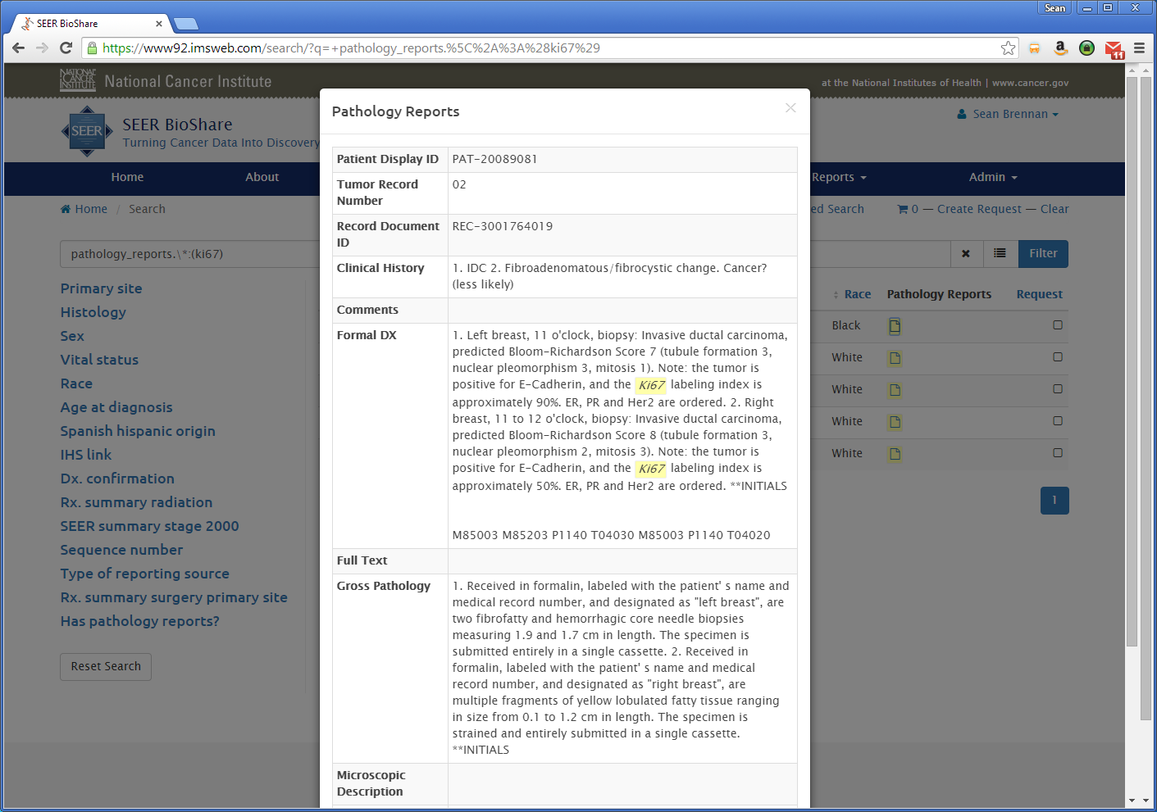
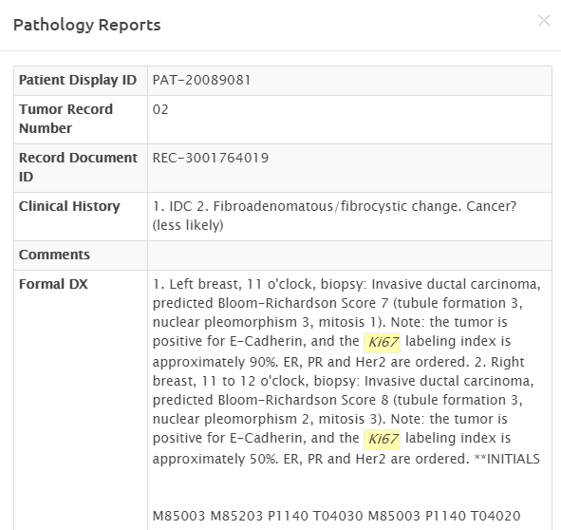
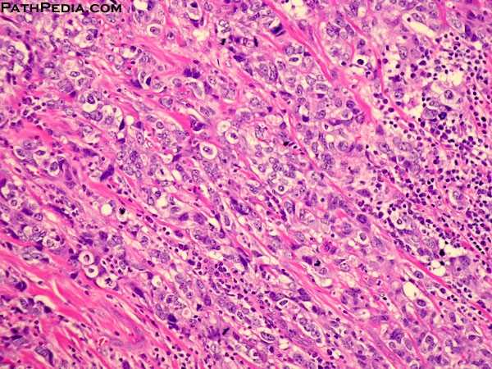
Plans to use IMS BSI for VTR Central resource for de-identified abstracts, path reports and path images - support investigator case selection
Ability to search de-identified path reports linked to abstracts
Static Images for QC
Whole Slide Images for digital pathology research

Slide 22
SEER-Linked Virtual Bio-Repository: Benefits
Population based – permitting comparison of subsets
Available across a broad spectrum of health care facilities/pathology labs (not just academic centers)
Access to rare cancers and exceptional outcomes
Linked to long term outcomes
Existing annotation with clinical and demographic data
Potential for custom annotation
Renewable with > 450,000 incident cases annually

Slide 23
Virtual Pooled Registry - Background
There is no nationwide registry that could be used to link with a cohort or clinical trial population
  The current infrastructure consists of 50+ central (state and regional) registries
  Linking for one cohort (Adventist Health) took approximately 3 years and required filling out 47 different IRB applications
The National Cancer Institute and other Federal organizations support linkages in follow-up to many studies including: cohorts, clinical trials and other epidemiologic research
  DCCPS alone provides support for follow up of >1.1 million participants in cohort studies
    Conservative cost for follow up estimated to be $2.2 to $8.8 million per year
  Other divisions support cohort studies, follow up of clinical trial patients etc.

Slide 24
Virtual Pooled Registry - Definition
What is it?
  Permits linkages of patients (cohorts, clinical trials, other research studies) to ALL registries across the US
  Maintains patient identifiers behind registry firewalls
  Permits access to appropriately approved investigators
Ultimate aims are to develop a system with:
  Automated linkage via an Honest Broker
  A Centralized and/or templated IRB
    Eliminating 50+ IRB applications and reviews
    CIRB will be for minimal risk human subjects research (in DCCPS/SRP)
  Rapid return of patient information on cancers, survival, cause of death, treatment etc. to the investigator
https://www.naaccr.org/about-vpr-cls/

Slide 25
Data analysis and visualization needs
Visualization and analytics to support linkages of cancer registry with longitudinal treatment data
  NAACCR formatted central cancer registry data elements
  Electronic pathology reports and values extracted and coded from reports
  Genomic testing data (e.g., Oncotype Dx scores)
  Longitudinal data (pharmacy, claims, radiation oncology)
  Longer term interest in mining and integration of EMR data, radiology notes, clinical visit notes
Clinical trial eligibility and real-time case ascertainment through SEER registries
SEER-Linked Virtual Bio-Repository
  Pathology imaging analytics
Simulation and predictive modeling (CISNET)

Slide 26
THANK YOU

