Slide 1
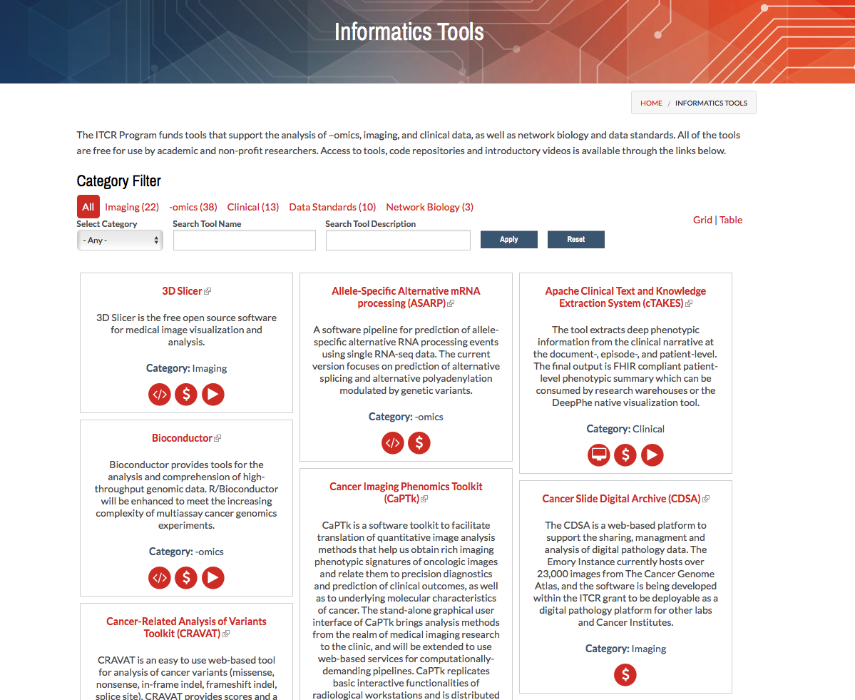
ITCR Explainer Videos
ITCR Training and Outreach Working Group has prepared guidelines for creating outreach and training videos.
The recommendation is all U24 projects and self-selected U01 & R21 projects will prepare a short 5-10 minute tool overview video.
Current status: 71 tools total, 29 videos.
Subtitles are required. When using the YouTube auto-generated closed captioning feature please use the edit function to correct any mistakes.
Use of NCI logo is not allowed.
Questions? Contact Mervi.Heiskanen@nih.gov
ITCR Website Featured Tools and Tool Catalog https://itcr.cancer.gov

Slide 2
ITCR Community News
E-mail news items to Mervi.Heiskanen@nih.gov
Software releases, publications, webinars…
Include recommended hashtag(s) for tweets from @NCI_NCIP account.
Thank you!
ITCR Website Latest News https://itcr.cancer.gov

