Slide 1
Network Analysis for a Data-Driven Approach to Cancer Care – Introduction CA231840 (U01)
Jeremy L. Warner MD, MS (PI)
ITCR Community Call
October 5th, 2018

Slide 2
Specific Aims
Aim 1: Produce a comprehensive ontology of chemotherapy regimen concepts.
Aim 2: Determine a treatment preference hierarchy based on information theoretic network analysis, and present the results to clinicians and cancer researchers.
Aim 3: Present preference hierarchy-modulated genomic treatment options.

Slide 3
Aim 1: Chemotherapy ontology
Systemic cancer treatment is context specific, with complex multidrug regimens in many cases.
We have been building a comprehensive, freely available website containing such information, HemOnc.org, since 2011.

Slide 4
862 pages with 39,521,841 characters of content

Slide 5
Chemo Regimen Data Dictionary
4 disease elements
14 regimen elements
13 drug elements
6 study elements
3 author elements
----
40 elements/regimen

Slide 6
Ontology as of 2018-09-26 (dev)
207,128 axioms (+20% since ITCR PI meeting)
29,031 individuals (drugs, regimens, authors, etc.)
1,316 distinct treatment regimens
3,425 references
23,438 authors
https://hemonc.org/wiki/Ontology
Malty et al. 2018 JCO CCI

Slide 7
Aim 2: Treatment preference hierarchy
Treatment scenario | No. of distinct regimens | No. of distinct pairwise comparisons | No. needed for full connectivity | Percentage of full connectivity
Untreated CLL/SLL | 40 | 34 | 780 | 4%
Adjuvant HER2+ breast cancer | 41 | 190 | 820 | 23%
Metastatic prostate cancer | 48 | 41 | 1,128 | 4%
Relapsed/refractory myeloma | 51 | 21 | 1,275 | 2%
These common treatment scenarios, which have many treatment options, including non-randomized evidence, are all characterized by sparse networks, with even the most connected by direct RCT comparisons (adjuvant HER2+ breast cancer) having less than 25% connectivity.

Slide 8
Preliminary results
ɸ = 178.9
ɸ = 277.9
First-line chronic myelogenous leukemia (CML)
Relapsed/refractory multiple myeloma
Warner et al. 2017 JCO CCI
See appendix for pictorial overview of methods

Slide 9
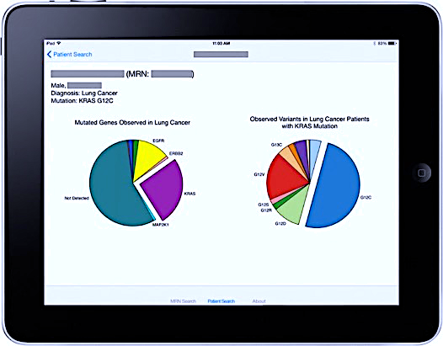
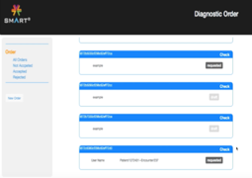
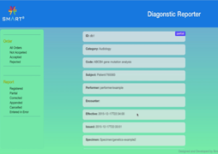
Getting the results into workflow
EHR/
Clinical
Systems
1
Order
Genetic Tests
3
Present & Contextualize
Genetic Test Results
SMART on FHIR
Clinico-Genomics Apps
Diagnostic Order App
Diagnostic Reporter App
FHIR®
Data
FHIR®
Data
Sequencing
Lab
SMART Precision Cancer Medicine App
2
Return
Genetic Test Results
Warner et al. 2016 Genome Med

Slide 10
Warner et al. 2016 JAMIA

Slide 11
Imatinib

Slide 12
Why we have a problem, part I
90%
78,813 variants
10%
Source: AACR GENIE public release 1

Slide 13
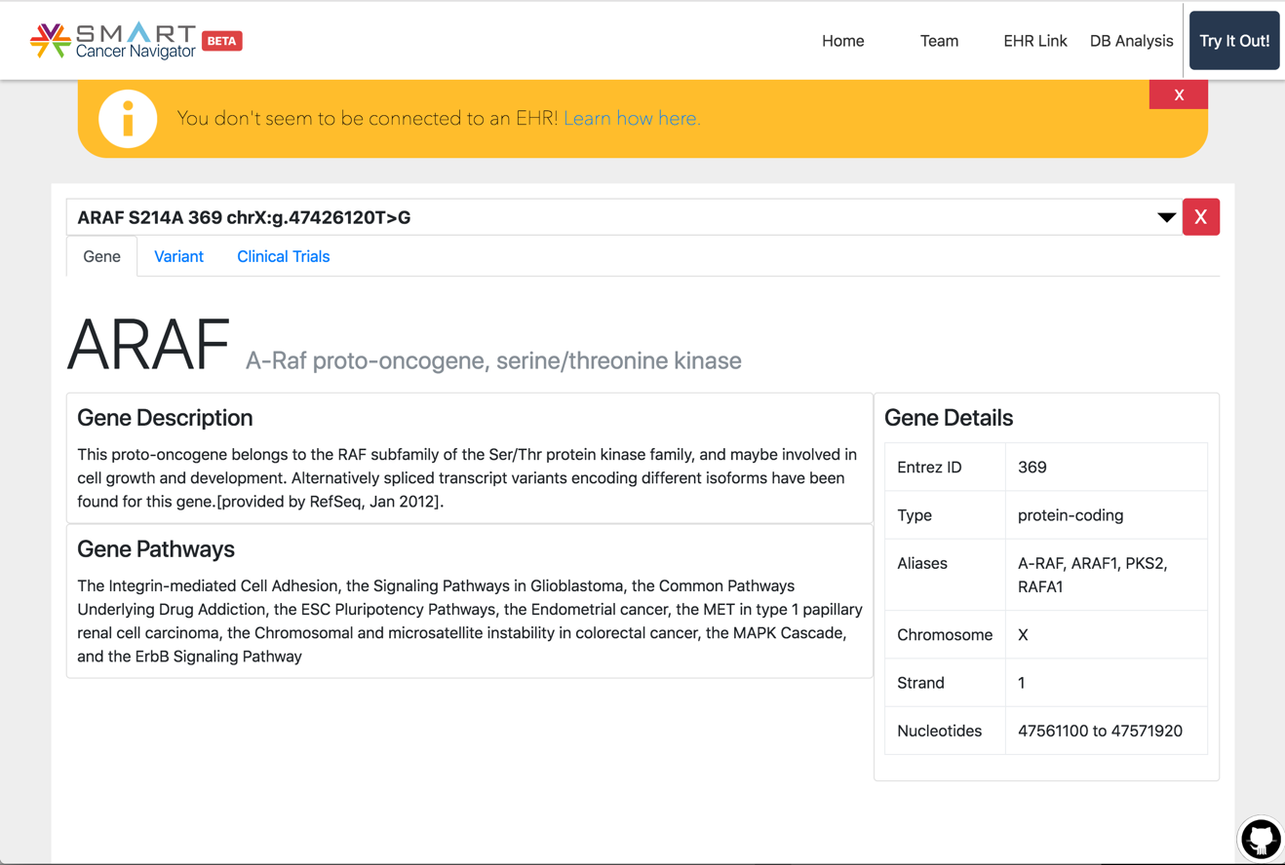
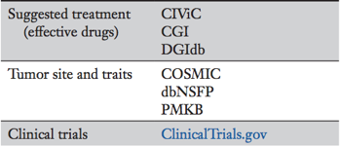
SMART Cancer Navigator
https://smart-cancer-navigator.github.io/app
Warner et al. 2018, JCO Precision Oncology

Slide 14
Why we have a problem, part II
Median “actionable” variant per patient:
4
Median VUS per patient:
7

Slide 15
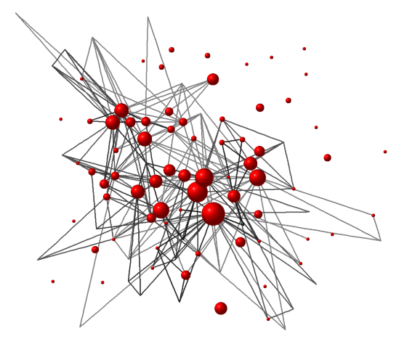
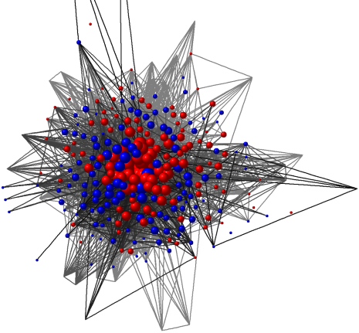
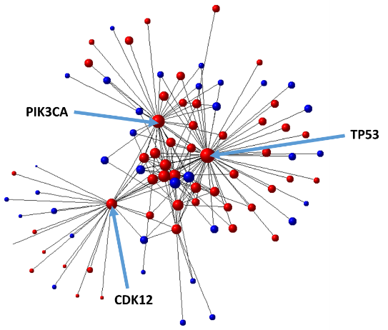
Uncovering signal through pruning
Breast cancer patients with NGS testing (N=148)
Rioth et al. 2016 ASCO Annual Meeting

Slide 16
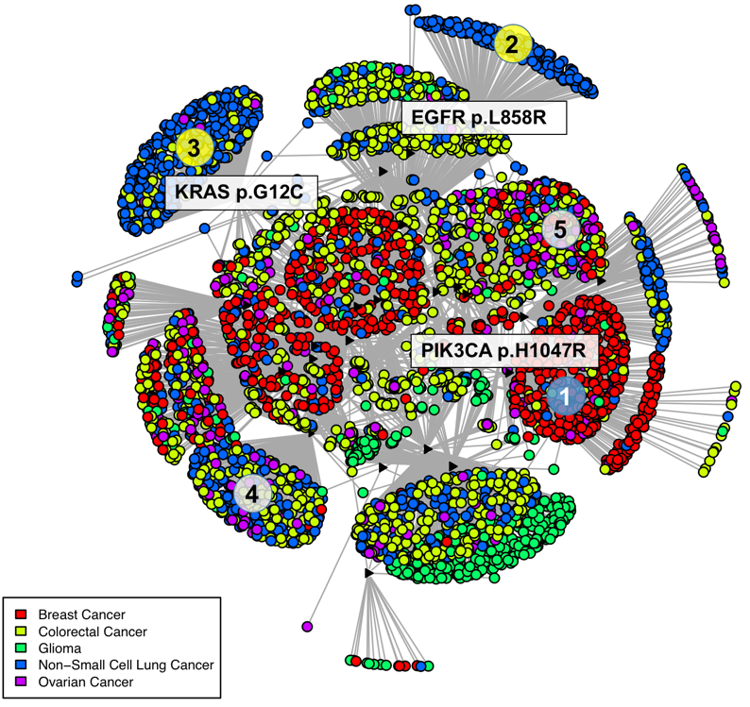
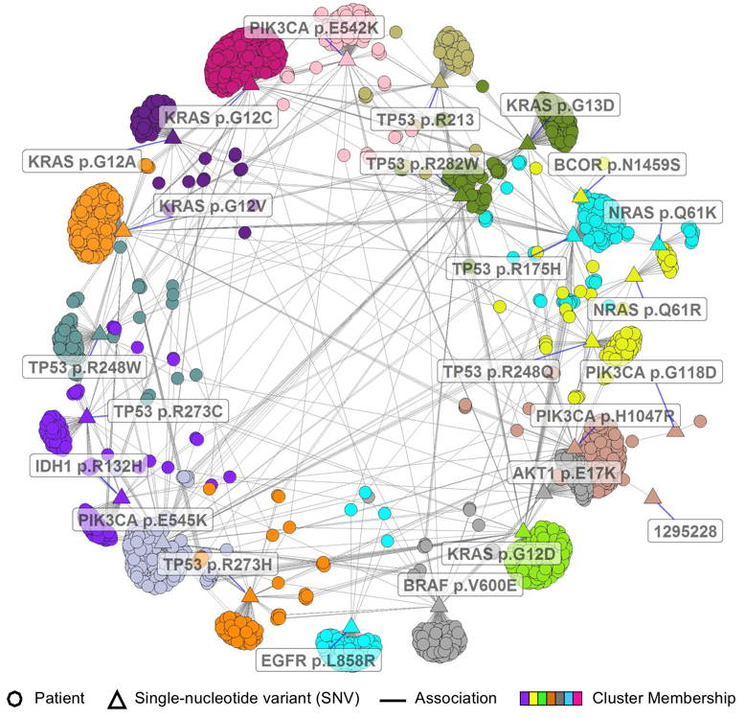
Uncovering signal through layout
Specimen grouping emphasized (Kamada-Kawai)
Variant relationships emphasized (ExplodeLayout)
Bhavnani et al. 2017 AMIA Joint Summits & 2018 AMIA Annual Meeting

Slide 17
Acknowledgements
HemOnc.org Ontology
Krysten Harvey
Sandeep Jain
Andrew Malty
Licensees
SMART PCM
Daniel Carbone
Ross Oreto
Lucy Wang
Heming Yao
Shilin Zhu
SMART Cancer Navigator
Monica Arniella
Makiah Bennett
Ishaan Prasad
Project Collaborators
Gil Alterovitz
Ed Ambinder
Suresh Bhavnani
Frank Cornell
Josh Denny
Aymen Elfiky
Andrey Fedorov
David Kreda
Subha Madhavan
Ken Mandl
Sam Rubinstein
Dan Stover
Hua Xu
Yaomin Xu
Peter Yang
BioVis
JAX CKB
HL7
VICC
ITCR
Juli Klemm
Ani Ganguly
Mervi Heiskanen
CA184407 (PI Savova)
CA194215 (MPI Warner/Yang/Xu)

Slide 18
Appendix

Slide 19
Project overview
The treatment of cancer has dramatically increased in complexity over the last several decades, with associated improvements in survival; however, cancer remains the second-leading cause of death in the United States and the leading cause of years of potential life lost. The very large number of treatment options will become even more complicated as cancer genomics is added to traditional clinical information, and cancer clinicians (oncologists) need new approaches to interpret, organize, and transform this data into knowledge-driven clinical decisions. We will develop new methods and software to analyze complex biological and treatment networks; the tools developed as a result of this work will be evaluated for breast cancer and multiple myeloma, and should be applicable to a wide variety of cancer types.

Slide 20
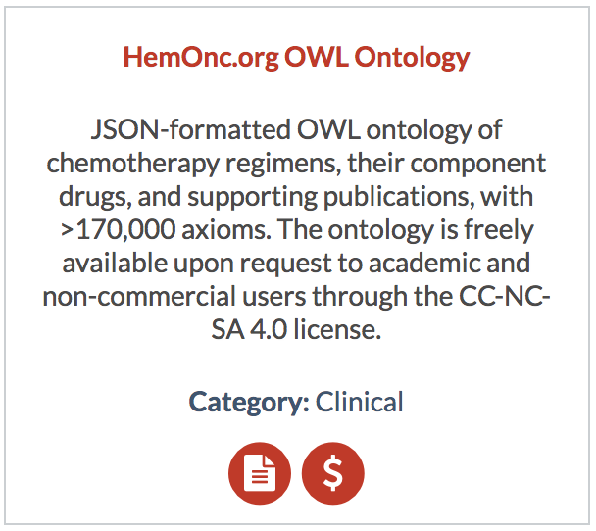
Ontology Licensees (by Institution)
Boston Children’s Hospital
Dana-Farber Cancer Institute
EMBL-EBI
Mayo Clinic
NCI SEER
Northwestern University
Odysseus Data Services Inc
OHDSI
UAMS
University of Illinois—Chicago College of Pharmacy
University of Pennsylvania
UT Health Science Center
Vanderbilt University
https://hemonc.org/wiki/Ontology
https://itcr.cancer.gov/informatics-tools

Slide 21
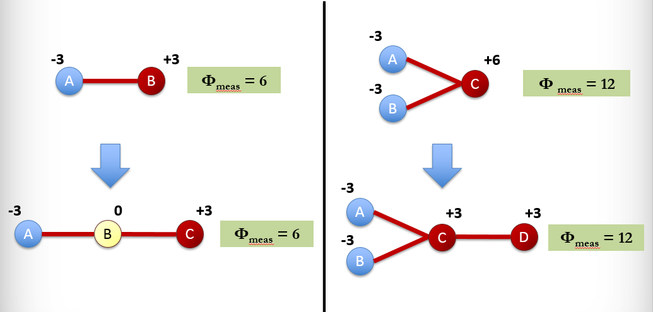
Network Power Analysis
Serial topology
Parallel topology
C > B > A
D > C > A, B
ɸ = network power = sum of all |node values|
Notes:
No value propagation (baseline analysis). On the left, a new node C is added to linear network A—B. C is superior to B, so gains relative value. B loses all value, and A is unaffected. On the right, a new node D is added to the branched network A—B—C. D is superior to C, so gains relative value. C loses some value; A & B are unaffected. Overall network power Φ does not change.

Slide 22
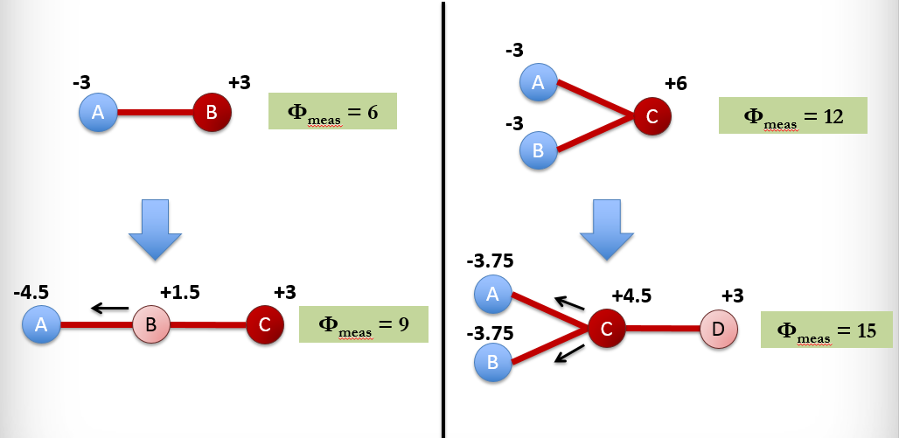
Value Propagation
Serial topology
Parallel topology
C > B > A
D > C > A, B
Notes:
Value propagation, without aging or refresh. On the left, a new node C is added to linear network A—B. C is superior to B, so gains relative value. B passes 50% of the anticipated value loss to A, such that B retains a slightly positive value, and A is more negatively valued. On the right, a new node D is added to the branched network A—B—C. D is superior to C, so gains relative value. C passes 25% of the anticipated value loss equally to A& B, such that C remains superiorly valued to D, due to its high starting value. Overall network power Φ increases.

Slide 23
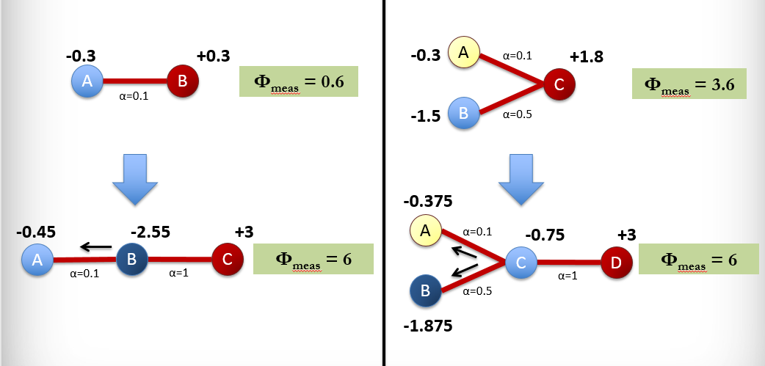
Value Propagation with Aging
Serial topology
Parallel topology
C > B > A
D > C > A, B
Notes:
Value propagation with aging, no refresh. On the left, a new node C is added to the aged linear network A—B. C is superior to B, so gains relative value. B passes 5% of the anticipated value loss to A, such that B remains negatively valued. On the right, a new node D is added to the aged branched network A—B—C. D is superior to C, so gains relative value. C passes 2.5% of the anticipated value loss to A and 12.5% to B, given that B is less aged than A. Overall network power Φ increases.

Slide 24
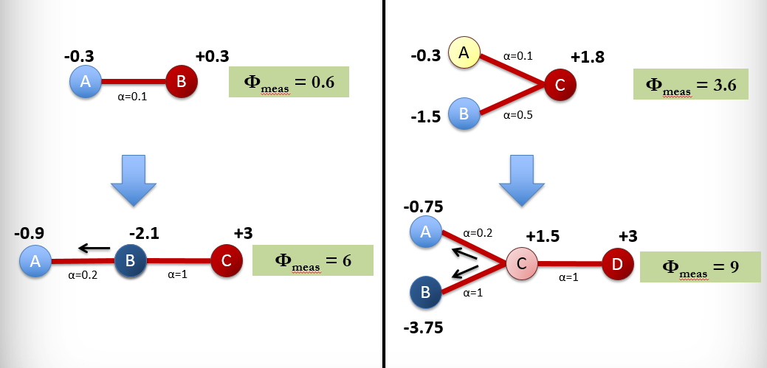
Value Prop. with Aging and Refresh
Serial topology
Parallel topology
C > B > A
D > C > A, B
Notes:
Value propagation with aging and refresh. On the left, a new node C is added to the aged linear network A—B. C is superior to B, so gains relative value. B passes 10% of the anticipated value loss to A, such that B remains negatively valued, but less so than in the situation where there is no refresh. On the right, a new node D is added to the aged branched network A—B—C. D is superior to C, so gains relative value. C passes 5% of the anticipated value loss to A and 25% to B, given that B is less aged than A. C remains superior to A or B, but is comparatively inferior to D. Overall network power Φ increases more for the branched network, given that two aged regimens are refreshed.

