Slide 1
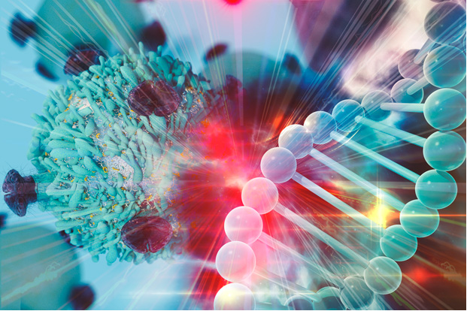
Cancer Challenge Area: Synthetic Data Nick Anderson, UC Davis Bill Richards, BWH/Harvard
Notes:
Unlike webinars which are focused on disseminating information, the purpose of µLabs is to

Slide 2
Access to Large-scale Clinical Data Sets
There is a scarcity of sharable high quality, high volume clinically-derived data sets available for research, education or validation purposes
Existing data sets are either deidentified - and require specific attestations for use, or are provided through interfaces that enforce deidentification and prevent access to low-level data
Making large-scale, information-rich deidentified clinical data sets available for sharing will continue to be limited by compliance and regulatory requirements, and require significant work
Current methods of deidentification or access management face new challenges when applied to very large and uniquely integrative data sets, such as concerns such as whether such methods “over-sanitize” data or introduce bias when applied at scale
Making broadly available large-scale data sets that include identifiable clinical data is currently challenging without changes to privacy law, or with development of new models of data access that supports oversight of secondary uses on sensitive data – and in health is not currently socially popular.

Slide 3
Synthetic Data: Overview
Synthetic data sets:
Statistically identically clinical derived data sets, considered not-relinkable to any patient, institution or community – determined to contain neither PHI or PII.
The idea:
Foster the development of high quality, statistically identical data sets and associated descriptive metadata and generation methods that can be broadly shared to support collaborative and reproducible analytic development and validation on large scale data
Why:
Expanding access to synthetic data sets generated in collaboration with a variety of clinical data domain expertise will democratize access to interdisciplinary experts, and accelerate options to access, test and share new methods and models.
Notes:
1

Slide 4
Challenge Area: Synthetic Data
Broad research questions:
Methods for reproducibly generating new and unlinkable synthetic data sets, rules and appropriate descriptive metadata from “reference” clinical data (1:1)
Methods for generating new and unlinkable synthetic datasets from clinical data “seeds” and permutation rules (1:many)
Methods for comparing new algorithms tested solely on synthetic data sets on “reference” clinically identifiable data sets (and visa versa) (1:1)
Methods for developing sets of uniquely distinguished and high-quality data sets for large “population simulation” studies (1:n-k)
Notes:
that push the limits of current cancer research computational practices and compel development of innovative computational technologies; and

Slide 5
Synthetic Data Discussion Questions
What are barriers to adoption and use of synthetic data sets?
What justifies synthetic data use over clinically extracted or prospectively collected data sets?
In what data areas is synthetic data generation most/least tractable?
What serves as a gold standards for the content of synthetic data set – the ability to test against the “reference” data?
Are there unexpected legal or other barriers to expecting “non-human subject” synthetic data sets to be shared?
What is unique about clinically derived data that prevents other key interest groups (basic sciences, engineering, computing, law) from participating?
What or whom might see funding value in these capabilities?
What additional key components or challenges would you add?
What is needed to move forward?
Notes:
that push the limits of current cancer research computational practices and compel development of innovative computational technologies; and

