Slide 1
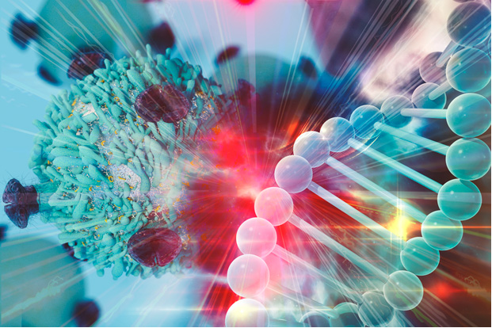
  Cancer Challenge Area:
  Hypothesis Generation Using Machine Learning
  Amber Simpson, Memorial Sloan Kettering Cancer Center
  Jeremy Goecks, Oregon Health & Science University
Notes:
Unlike webinars which are focused on disseminating information, the purpose of µLabs is to

Slide 2
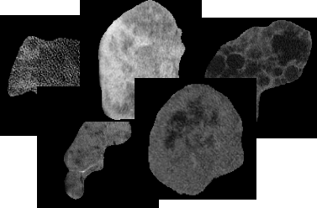
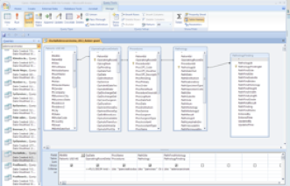
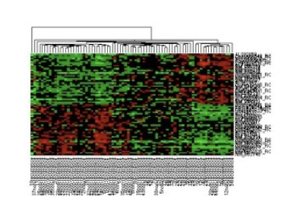
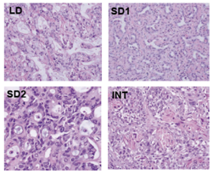
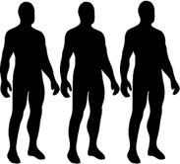
Hypothesis Generation Using Machine Learning: The Big Idea
Patient Data
  ML has the potential to efficiently guide hypothesis generation and experimental design for cancer clinical trials.
  ML has the potential reveal new relationships in large, complex data sets to guide cancer research and novel targeted therapies.
+
=
Pre-clinical Data
Notes:
that push the limits of current cancer research computational practices and compel development of innovative computational technologies; and

Slide 3
Hypothesis Generation Using Machine Learning: Overview
Patient Data
Multi-omic data are increasingly becoming available
Data mining techniques could be used to find novel patterns in data to generate hypothesis for evaluation in clinical trials
Transfer learning could be used to bridge the gap between pre-clinical and clinical data
+
=
Pre-clinical Data
Notes:
that push the limits of current cancer research computational practices and compel development of innovative computational technologies; and

Slide 4
Hypothesis Generation Using Machine Learning: Overview
Machine learning is not really used clinically - how do we change this?
Cancer data conundrum: researchers and clinicians are inundated with more information than they can handle, while, at the same time, there are sizeable gaps in the biological systems information that is required for research and clinical advance
ML is key to addressing both hurdles:
  ML can provide guidance to experimentalists on what to study and the sequence in which to attack questions.
  ML is a critical bridge between large, complex data sets and mining actionable meaning from the data. ML has the unique ability to discover and use algorithms to cluster observations (data), and to do so iteratively with experimentation, in an active learning process.
How do we influence patient management???
Notes:
that push the limits of current cancer research computational practices and compel development of innovative computational technologies; and

Slide 5
Hypothesis Generation Using ML
Discussion Questions
What is your most pressing concern? (What keeps you up at night?)
What do you know that we don’t?
What are the cross-cutting themes you would like to explore in-depth (biological, clinical & computational)?
What do we need to dive into greater depth?
What existing funding sources are you aware of that can support research in this area? Anticipated funding?
What additional key components or challenges would you add?
Which specialty areas / collaborators should be involved?
  What introductions are needed?
What is needed to move forward?
Notes:
that push the limits of current cancer research computational practices and compel development of innovative computational technologies; and

