Slide 1

So What Can We Do With
Nano Informatics? – Leveraging Decision Analytic Tools
Matthew E. Bates & Igor Linkov
Risk & Decision Science Team
Environmental Laboratory,
Engineer Research and Development Center,
US Army Corps of Engineers
Matthew.E.Bates@usace.army.mil
Jan 22, 2015 meeting Nanotechnology Working Group, National Cancer Informatics Program, National Cancer Institute

Slide 2
Engineer Research & Development Center
US Army / US Army Corps of Engineers
2500 Employees
Over 1000 engineers and scientists, 28% PhDs; 43% MS degrees,
$1B annual budget
Cold Regions Research
Engineering Laboratory
(Hanover, NH)
Risk & Decision Science Team (Boston, MA)
Research Laboratories
of the
Corps of Engineers
Geospatial Research Laboratory (Alexandria, VA)
Construction Engineering
Research Laboratory
(Champaign, IL)
Headquarters (Vicksburg, MS)
Coastal & Hydraulics Laboratory
Environmental Laboratory
Geotechnical & Structures Laboratory
Information Technology Laboratory
Laboratories
Field Offices

Slide 3
Risk and Decision Science Team
Mission: to improve decision-making and stakeholder engagement through application and development of risk and decision science techniques.
Execution: through risk assessment, technology-supported stakeholder engagement, decision modeling, portfolio optimization, life cycle assessment, and software development.
Results: help clients to describe relevant risks, identify and compare risk management alternatives, develop consensus among disparate stakeholder groups, and provide repeatable and transparent processes for future decisions.

Slide 4
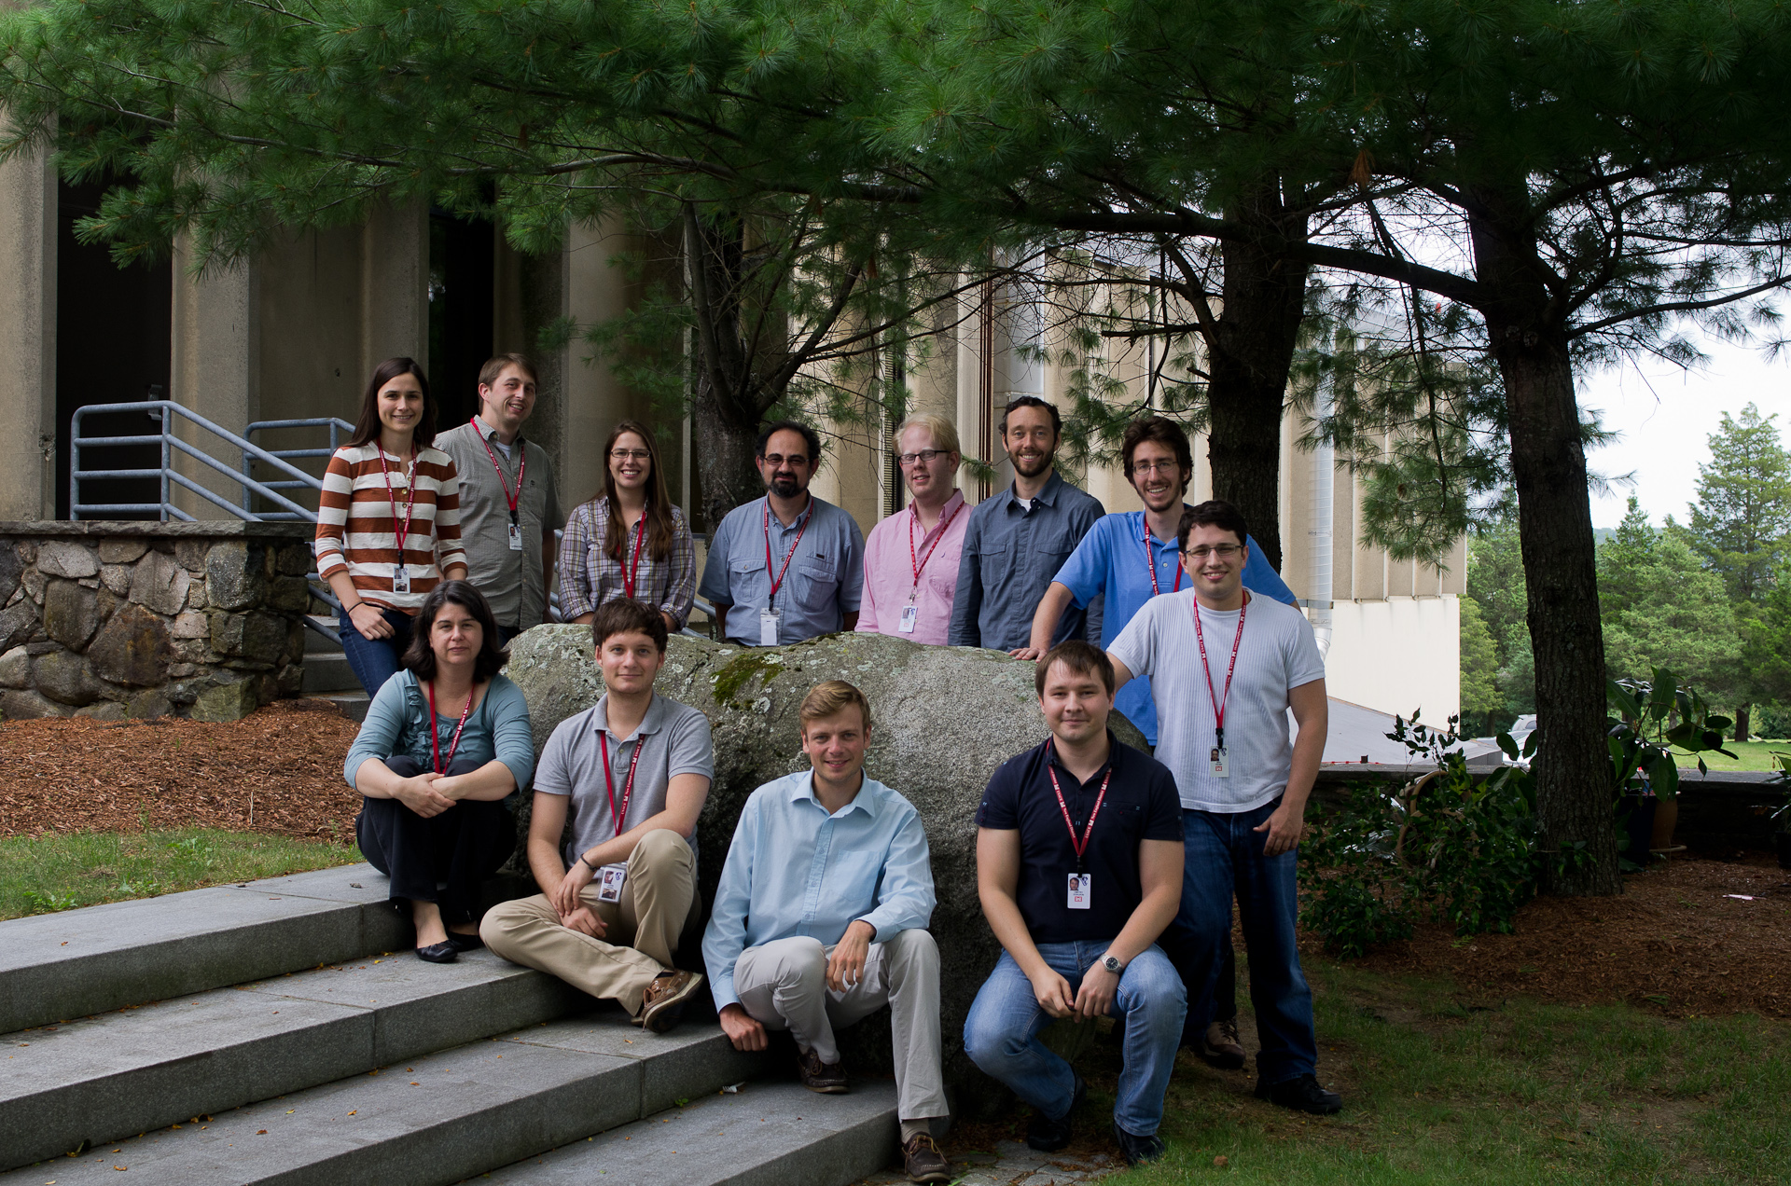
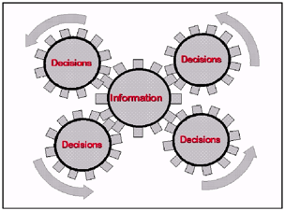
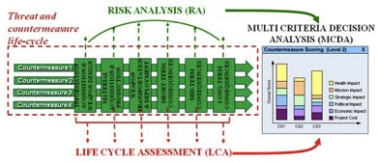
Risk and Decision Science Team
Capabilities
Over 15 risk, decision and environmental scientists developing solutions that support decisions across a broad govt needs.
State-of-the-science models and tools for structuring and conducting risk assessment, stakeholder engagement, resource prioritization, planning, and other emerging issues relevant to USACE, DoD, and Nation.
Current Programs
Cutting edge R&D for DoD as well as for DHS, DHHS, EPA, CPSC and others.
Applying Decision-Analytic tools to evaluate alternatives, integrate stakeholder values in product development, and prioritize research for a variety of technologies & industries.
Connecting Information and Decisions is our goal.
Integrating Risk Analysis, Life Cycle Assessment, and Multi-Criteria Decision Analysis models for the assessment of emerging materials & risks.
Notes:
Need to change bullet 2.3 to non-DoD agencies to non-DoD nano-focused orgs.

Slide 5
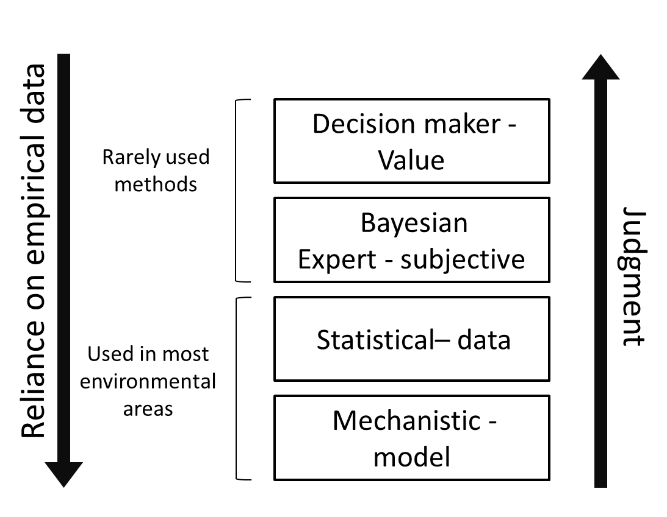
Differences in Types of Modeling
Decision Models
Data Mining
QSAR,
Exposure
PBPK,
Toxicity Models

Slide 6
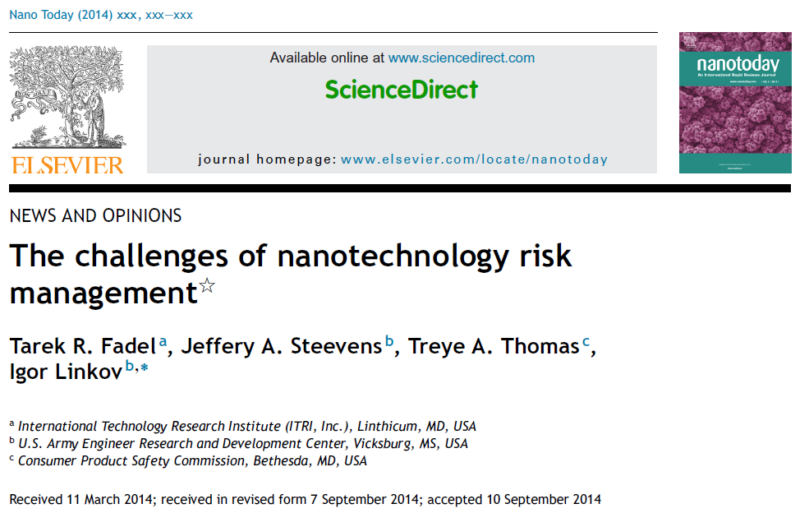

Slide 7
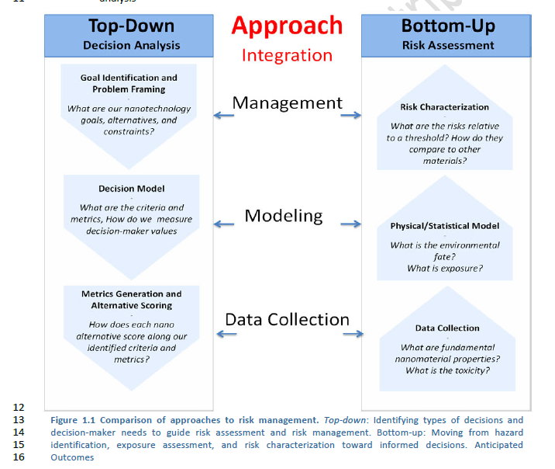
After Linkov, Anklam, Renn (2014)

Slide 8
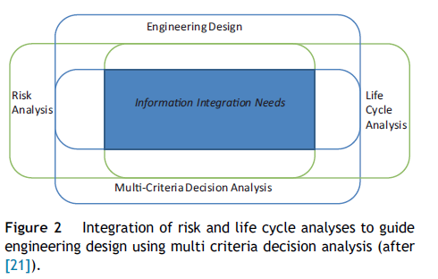
Information Integration Needs

Slide 9
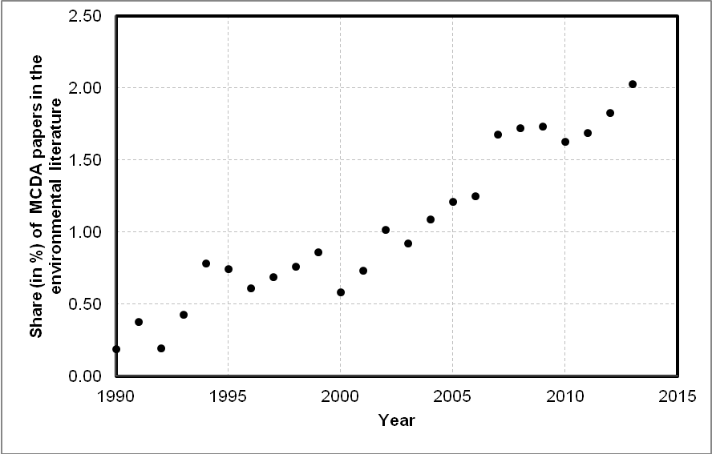
MCDA Use in Environmental Science
After Huang, Linkov 2011

Slide 10
Overview: DA Tools for Nano Informatics
Nano informatics opens new horizons in terms of data availability for risk assessment & mgmt.
In what ways can we make this data most useful in modeling and, ultimately, for decision making?
In this talk, we share perspectives from our team’s recent work with various decision analytic tools.

Slide 11
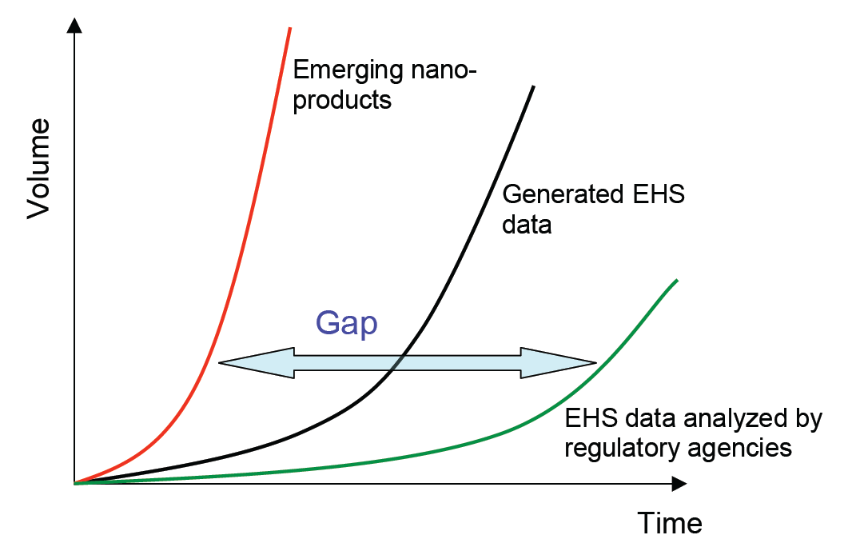
Motivation
No matter how sophisticated nano informatics become, a gap will always exist between new material introduction and risk characterization & mgmt.
Decision analytic tools can help fill these ever changing but ever present gaps.
From: Linkov et al., 2009

Slide 12
Motivation
How long before data availability leads to data overload?
Data visualization is good but, with voluminous data, it is better to have ways to quantitatively integrate information.
Where data is uncertain and/or conflicting, it is better yet to have tools that synthesize over all available information to aid decisions (while still preserving the underlying data attributes).

Slide 13
Top-Down
Decision Analysis
Integration
of
Approaches
Bottom-Up
Risk Assessment
Data Collection
-
What are fundamental properties/mechanisms associated with each alternative?
Goal Identification and Problem Framing
-
What are the goals, alternatives, and constraints?
Management
Decision Model
-
What are the criteria and metrics, How do we measure decision-maker values
Physical/Statistical Model
-
What is the hazard?
What is exposure?
Modeling
Metrics Generation and Alternative Scoring
-
How does each alternative score along our identified criteria and metrics?
Risk Characterization
-
What are the risks relative to a threshold? How do they compare to other alternatives?
Data Collection
Informatics can be the language for integrating these
two approaches towards generating & using information.

Slide 14
Which Decision Analytic Tools
Can Be Helpful With Nano Informatics?
Multi-Criteria Decision Analysis (MCDA) as a risk screening tool and to include costs/benefits.
Value of Information (VoI) analysis to include uncertainty and prioritize research.
Weight of Evidence (WoE) to make sense of conflicting data.
Life Cycle Assessment (LCA) to include a temporal component & broader impacts.
\\

Slide 15
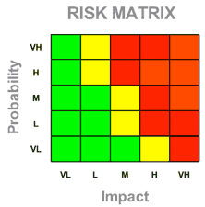
Decision Analysis for Risk Screening
More sophisticated or mechanistic nano hazard & exposure tools are currently being developed.
Nevertheless, a need for screening tools exists.
MCDA provides a transparent and data driven way to aggregate & interpret material properties and expert judgments for relative ranking.
E.g., nano hazard & control banding tools:
CB Nanotool, NanoSafer, Swiss Precautionary Matrix, ANSES CB Tool, Stoffenmanager Nano, etc…

Slide 16
MCDA Risk Screening Example
CB NanoTool 2.0 Hazard Banding
Hazard band (H/M/L ) based on a sum of individual scores estimated from physiochemical property data
Parent-material scores also included as relevant
Three or four possible hazard scores based on property ranges
Property | Score
Surface reactivity | 0-10
Particle shape | 0-10
Particle diameter | 0-10
Solubility | 5-10
Carcinogenicity | 0-6
Reproductive tox | 0-6
Property | Score
Mutagenicity | 0-6
Dermal tox | 0-6
Asthmagen | 0-6
Toxicity of parent material | 0-10
Carcinogencity of parent material | 0-4
Property | Score
Reprodoctive Tox of parent material | 0-4
Mutagenicity of parent material | 0-4
Dermal tox of parent material | 0-4
Asthmagen of parent material | 0-4
(Zalk et al 2009; Paik et al 2008)

Slide 17
Next Steps for MCDA &
Nano Informatics?
Can hazard/control banding tools can be specialized for each agency’s mission?
Can we tailor integration of these data & tools to identify the best materials for each new product?
Can we link structured nano data with these tools for rapid, real time screening?
Can we use MCDA to incorporate cost and benefit information with EHS data for rapid risk-cost-benefit screening evaluations?

Slide 18
Value of Information to
Prioritize Research
Nano risk estimates are uncertain and risk management strategies should build on this.
Given limited research opportunity, which uncertainties matter most understanding risk?
How do I know when I know enough?
VoI can assess the impacts of uncertainty on risk classification to prioritizes nano research.

Slide 19
VoI with Multiple Types of Criteria
Product Development
Material yield
Costs
Energy usage
LCA & Environ risk
From: Linkov, Bates et al. 2012, Nature Nano

Slide 20
Next Steps for VoI &
Nano Informatics
Can we automatically characterize uncertainty based on data aggregated by nano informatics?
Can we give researchers tools to link this uncertainty to their organizational missions and objectives, giving them a way to prioritize their research? (Either automatically updated or user driven.)
Can funding agencies use these types of tools to fund balanced & goal oriented research portfolios?
Can cost & benefit uncertainties be included too?

Slide 21
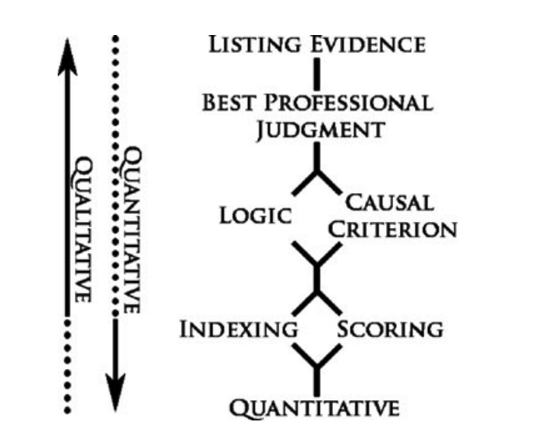
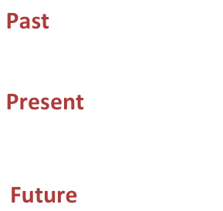
Weight of Evidence to Make Sense of Conflicting Information
Helpful when data do not converge.
Interprets data in light of data quality, etc.
WoE Review – Linkov et. al

Slide 22
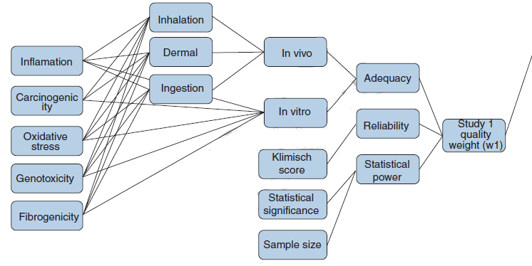
Weight of Evidence
Provides a way to fuse information that incorporates differences in data quality.
Nano WoE - Hristozov et al 2013

Slide 23
Next Steps for WoE &
Nano Informatics
Can nano informatics efforts & databases also collect & quantify study metadata (e.g., related to data quality, relevance, and resolution)?
Can we give researchers tools to help synthesize information based on these WoE parameters?
Can these tools be included in publicly available nanoinformatics efforts to help industry make informed interpretations of scientific knowledge (something many practitioners may struggle with)?

Slide 24
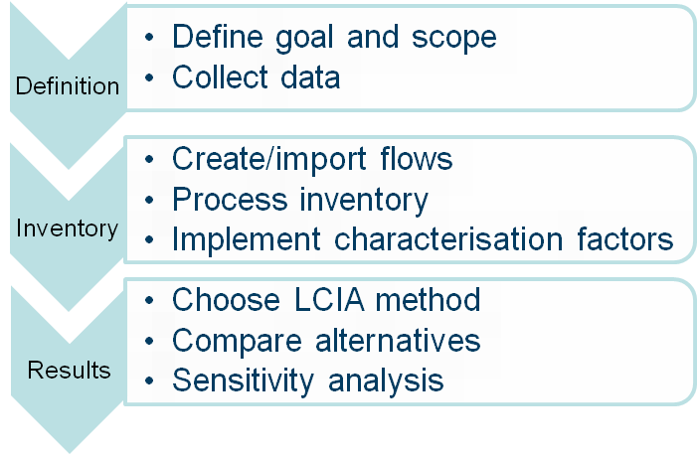
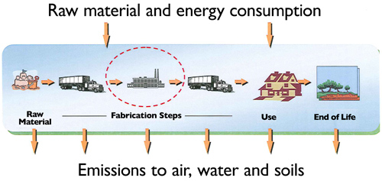
Life Cycle Assessment
LCA addresses potential health & environmental impacts throughout a product's life cycle.
From raw material acquisition through production, use, end-of-life treatment, recycling and final disposal.
Source: ISO 14040 (2006)

Slide 25
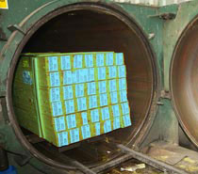

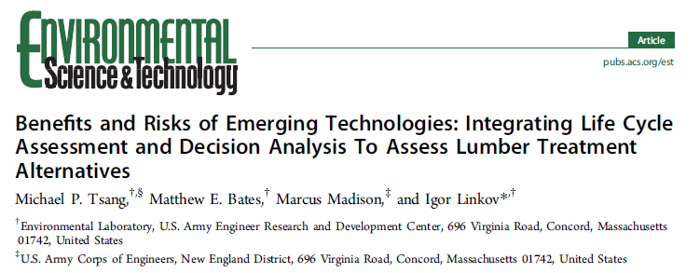
Recent LCA Case Study
  Evaluate DOD lumber treatment alternatives:
  Micronized copper quaternary (MCQ)*
  Alkaline copper quaternary (ACQ)
  Waterborne copper naphthenate (CN)
  Oil-borne copper naphthenate (CN_{o})
  Water-borne copper quinolate (CQ)
  Waterborne zinc naphthenate (ZN)
*Incorporates nanosized particles of copper salts
Photo: http://www.timberlink.co.uk/treatment/

Slide 26
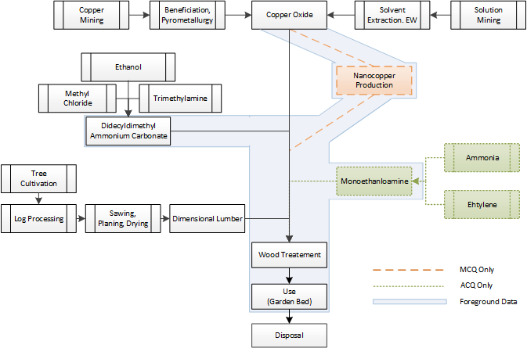
LCA Identifies Impacts Through All Steps
Process Flow Diagram for MCQ & ACQ

Slide 27
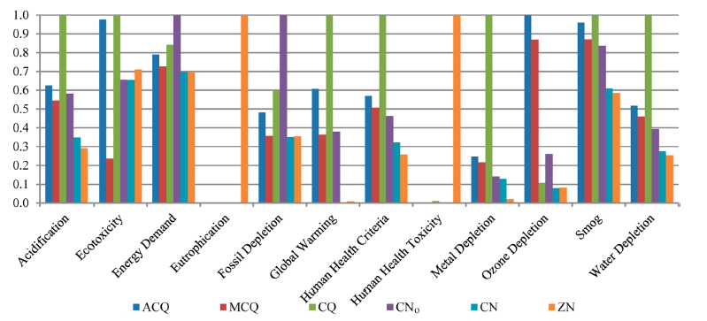
Normalized (unweighted) LCA Results
Typical LCA Impact Results
How can we use informatics to make this nano specific?

Slide 28
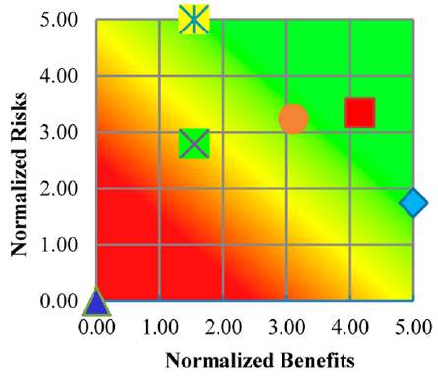
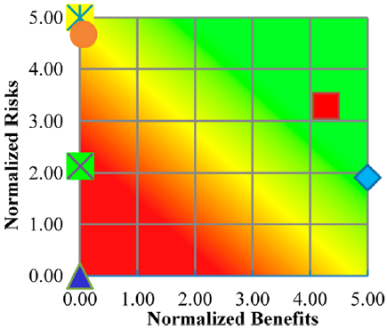
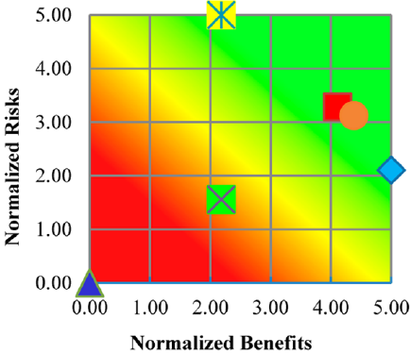
Combined Risk/Benefit Results
LCA Results in Context of MCDA Tradeoffs
Balanced Weights Environmental Perspective Military Perspective
*

Slide 29
Next Steps for LCA &
Nano Informatics?
Can we combine LCA data with nano informatics for better life cycle risk assessment?
With sufficient data from nano informatics, can we add nano-specific risk modules to LCA?
Do we also need to develop new nano-specific LCA impact categories?
Can we use Anticipatory LCA to design better nanomaterials and nano products?

Slide 30
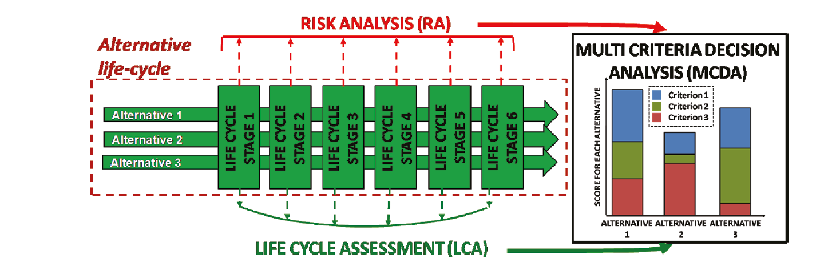

Conclusion – Integration of DA Tools
VoI
WoE
Seager & Linkov, 2011
Nano Informatics will present opportunities to solve complex nano problems using a diverse decision analytic toolkit

Slide 31
References
Linkov, I., Bates, M.E., Canis, L.J., Seager, T.P., and Keisler J.M. (2011). A Decision-directed Approach for Prioritizing Research into the Impact of Nanomaterials on the Environment and Human Health. Nature Nanotechnology 6:784-787.
Linkov, I., Bates, M., Trump, B., Seager, TP, Chappell, M., Keisler, J. (2013). For Nanotechnology Decisions, Use Decision Analysis. NanoToday 8: 5-10.
Mohan, M, Trump, B.D., Bates, M., Monica, J., and Linkov, I. (2012). Integrating Legal Liabilities in Nanomanufacturing Risk Management. Environmental Science and Technology 46:7955-62.
Linkov, I., Steevens, J. (2009). Nanotechnology: Risks and Benefits. Springer, Amsterdam.
Hristozov, D., Zabeo, A., Foran, C., Critto, A., Marcomini, A., Linkov, I. (2014). A weight of evidence approach for hazard screening of engineered nanomaterials. Nanotoxicology 8:78-87.
Linkov, I., Tkachuk, A., Canis, L., Mohan, M., Keisler, J. (2012) Risk Informed Decision Framework for Integrated Evaluation of Countermeasures against CBRN Threats. Journal of Homeland Security and Emergency Management. 9: 1547-7355.
Grieger K.D., Linkov, I., Foss Hansen, S., Baun, A. (2012). Environmental risk analysis for nanomaterials: Review and evaluation of frameworks. Nanotoxicology 6:196–212.
Valverde, J.L., Linkov, I. (2011). Nanotechnology: Risk Assessment And Risk Management Perspectives. Nanotechnology: Law and Business 8:25-47.
Linkov, I., Seager, T. (2011). Coupling Multi-Criteria Decision Analysis, Life Cycle Assessment and Risk Assessment for Emerging Threats. Environmental Science and Technology 45:5068–5074.
Canis, L., Seager, T., and Linkov, I. (2010). Application of Stochastic Multiattribute Analysis to Assessment of Single Walled Carbon Nanotube Synthesis Processes. Environmental Science and Technology 44: 8704–8711.
Linkov, I., Satterstrom, F.K., Monica, J.C., Jr., Foss Hansen, S. and Davis, T.A. (2009). Nano Risk Governance: Current Developments and Future Perspectives. Nanotechnology: Law and Business 6:203-220.
Tervonen, T., Linkov, I. Figueira, J., Steevens, J., Chappell, M., Merad, M. (2009). Risk-based Classification System of Nanomaterials. J. of Nanoparticle Research 11:757-766.
Seager, T., Linkov, I. (2008). Coupling Multi-Criteria Decision Analysis and Life Cycle Assessment For Nanomaterials. J. of Industrial Ecology 12:282-285
Rajagopalan, G., Bouchard, D, Gu, A., Linkov, I., Mackay, C., Sellers, K. (2008). Effects of Nanoparticles on the Wastewater Treatment Industry. Technical Practice Update. Water Environment Federation.

