Slide 1
The HUBzero Platform for Scientific Collaboration
Michael McLennan
Director, HUBzero® Platform for Scientific Collaboration
Purdue University

Slide 2

What is HUBzero?
Open source software platform
used for building
“Science Gateways”
“Collaboratories”
“Hubs”

Slide 3
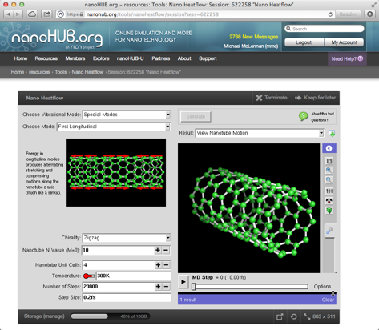
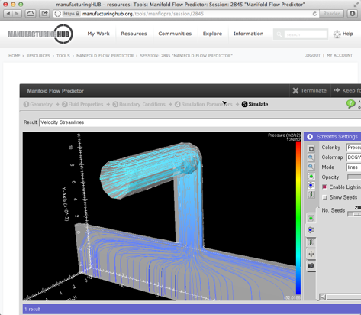
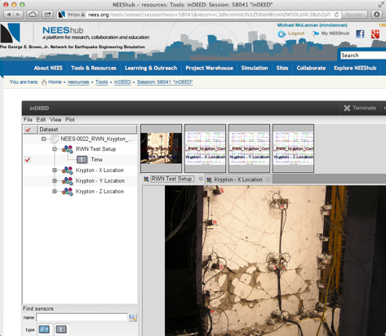
HUBzero: Simulation/Modeling Tools
Powerful research codes
Uploaded by researchers in the community
Run on cloud/grid/cluster resources
Integrated visualization

Slide 4
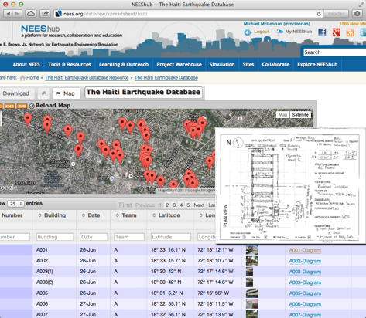
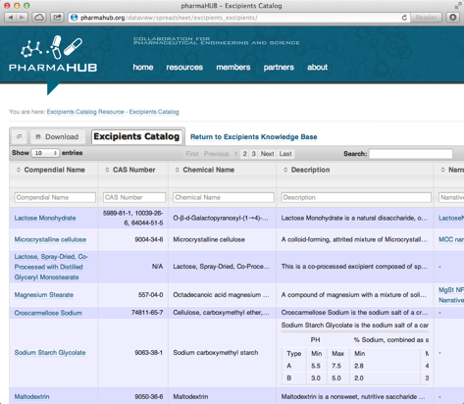
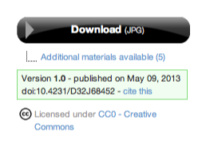
HUBzero: Databases and Digital Assets
Databases and digital publications
Uploaded by researchers in the community
Digital Object Identifiers and license options
Data ↔ tools for analysis

Slide 5




HUBzero: Group/Project Collaboration
Research
Education
Hub
Private groups/projects for collaboration
Messages, wikis, blogs, calendars
Data repository with versioning

Slide 6

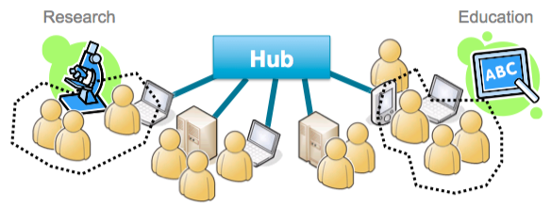
Platform for Scientific Collaboration
Computational Tools
Databases / Publications
Group/Project Collaboration

Slide 7
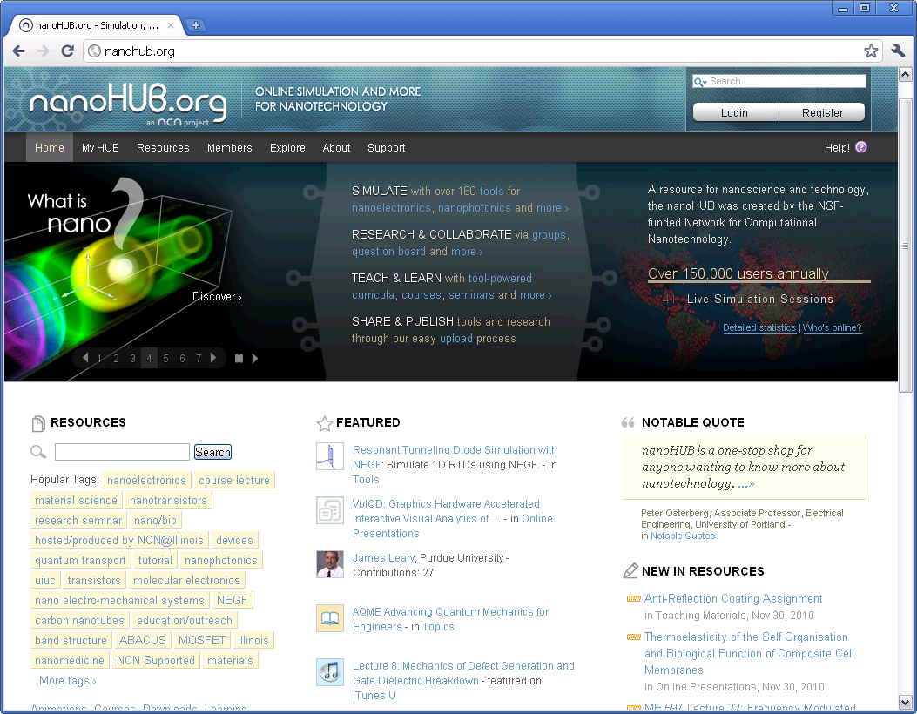

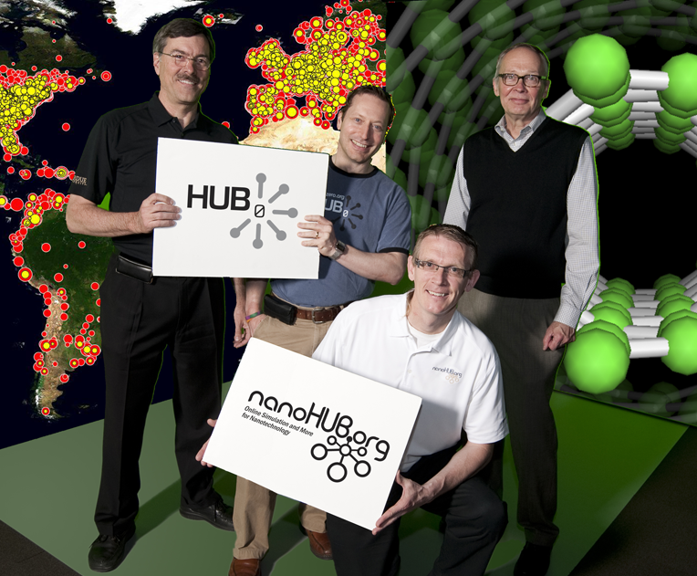
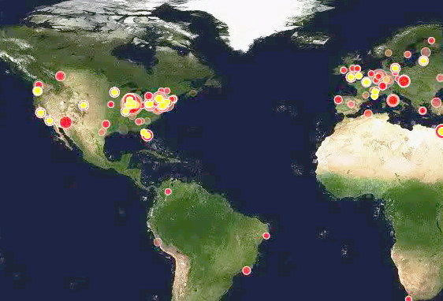
Started with nanoHUB.org
Network for
Computational
Nanotechnology
Established in 2002
Awards
EEC-0228390
EEC-0634750
OCI-0438246
OCI-0721680
540,063 Visitors
258,791 Users
276 Simulation Tools
4,312 Resources
1,032 Citations
14,000 Students at 185 Insitutions

Slide 8



























Who’s Using HUBzero?
Supporting Purdue’s largest research projects:
NEES: NSF $105M - earthquake engr data (Ramirez)
NCN: NSF $18M - nanotechnology (Klimeck/Lundstrom)
C3Bio: DoE EFRC $20M - biofuels (McCann)
PRISM: DoE $17M - mems devices (Murthy/Strachan)
Supporting Purdue infrastructure
Purdue University Research Repository (PURR) – data mgmt
PurdueNExT / nanoHUB-U – online education
Supporting many other Purdue Projects
Outside Institutions

Slide 9




50+ Hubs for many disciplines
visitors users
554,223 266,292 nanoHUB.org
249,187 69,232 nees.org
58,690 28,972 GlobalHUB.org
36,660 23,143 pharmaHUB.org
35,807 12,380 vhub.org
44,478 3,539 HABRIcentral.org
17,037 3,923 cceHUB.org 16,211 5,523 ciHUB.org
13,592 4,278 StemEdHub.org
12,198 2,185 iemhub.org
14,184 2,129 C3Bio.org 7,501 1,272 cleerHUB.org
~1,000,000
visitors total

Slide 10


Global community
27
Non-profit organization
Independent owner of HUBzero code
Promotes dissemination and outreach
Sponsors HUBbub Conference
Coordinates software contributions
Foundation, LLC

Slide 11

HUBzero User Conference
Plenary Talks ◆ Hands-On Training ◆ Hub Case Studies
September 5-6, 2013, Sheraton Indianapolis City Centre Hotel, Indianapolis, Indiana

Slide 12
More information
Michael McLennan
Director, HUBzero® Project
mmclennan@purdue.edu
http://hubzero.org/pressroom
Simulation/modeling tools
Data management
Collaboration and social networking
Analytics to measure impact

