Slide 1
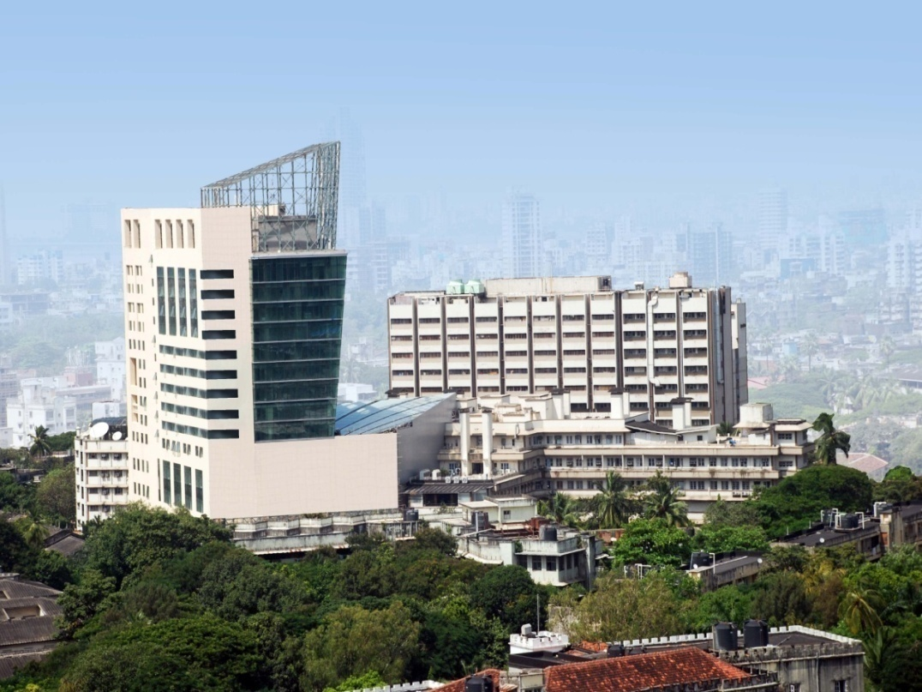
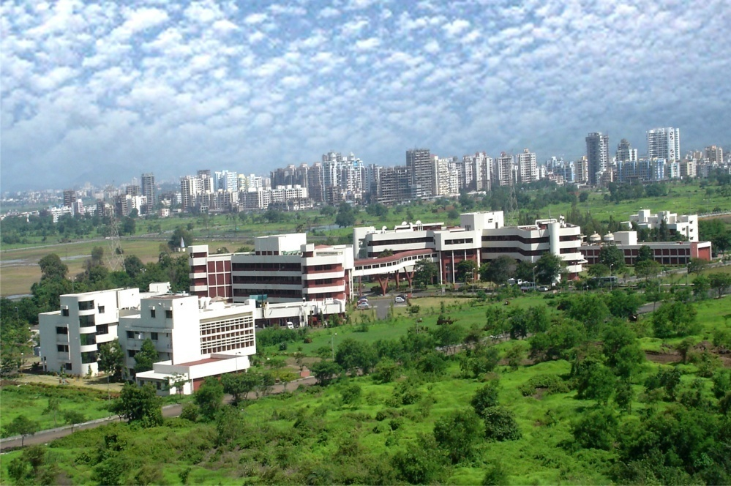
TATA MEMORIAL CENTRE
Tata Memorial Hospital (TMH)
Advanced Centre for Treatment, Research & Education in Cancer (ACTREC)
Centre for Cancer Epidemiology
(CCE)

Slide 2
HISTORY
TMH Commissioned by the House of TATAs | 1941
CRI Commissioned | 1952
TMH handed over to Ministry of Health | 1957
TMH transferred under administrative control of DAE | 1962
Tata Memorial Centre (TMC) – TMH and CRI | 1966
ACTREC – CRI moves to new campus | 2002
ACTREC – CRC inaugurated | 2005
PACS installed in TMH | 2006
Homi Bhabha Block | 2011
ACTREC studies integrated with TMH PACS | 2013

Slide 3
Mission
The mission of the Tata Memorial Centre is to provide comprehensive cancer care to one and all through our motto of excellence in service, education and research.
Vision
As the premier cancer center in the country, we will provide leadership for guiding the national policy and strategy for cancer care by
Promoting outstanding service through evidence based practice of oncology
Emphasis on research which is affordable, innovative and relevant to the needs of the country
Committed to providing education in cancer for students, trainees, professionals, employees and the public.

Slide 4
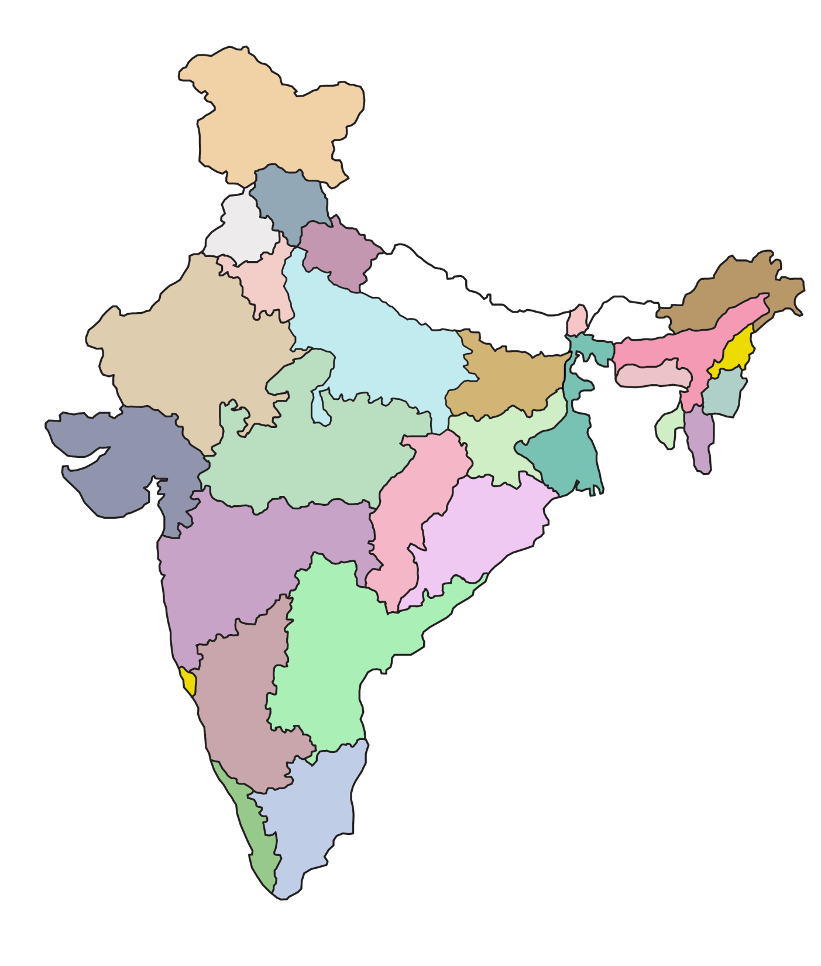
New Case File Registrations
State-wise Distribution
Jammu & Kashmir
175
Himachal Pradesh
10
Haryana
70
Chandigarh
20
Punjab
89
Uttaranchal
82
Delhi
94
Arunachal Pradesh
41
Sikkim
10
Rajasthan
672
Uttar Pradesh
4630
Assam 720
Nagaland
22
Bihar
2694
Meghalaya
27
Manipur
244
Daman & Diu 11
Gujarat
485
Jharkhand
1120
Madhya Pradesh
2018
W. Bengal
3643
Tripura
139
Mizoram
47
Dadra & Nagar Haveli 19
Orissa
1029
Maharashtra (excl. Mumbai)
15030
Chhattisgarh
492
Mumbai
5383
Andhra Pradesh
201
Total - 62162
Preventive - 5739
Referals- 16444
Patients - 35199
Karnataka
275
Goa
199
Tamil Nadu
59
Andaman & Nicobar 3
Kerala
86
Pondicherry 3

Slide 5
ANNUAL WORK LOAD (2013)
New Registrations 62162
Admissions (660) 23446
Bed Occupancy 91.3%
ALOS 6.9 days
Day Care 70081

Slide 6
The National Cancer Grid
Srinagar
Shimla
Chandigarh
Rohtak
New Delhi
Bikaner
Lucknow
Jaipur
Guwahati
Gwalior
Allahabad
Silchar
Satna
Aizawl
Ahmedabad
Kolkata
Nagpur
Cuttack
Mumbai
Hyderabad
Bengaluru
Kancheepuram
Vellore
Chennai
Thalassery
Pondicherry
Kochi
Coimbatore
Thiruvananthapuram

Slide 7
National Cancer Grid
Development of a cooperative cancer management network – standard treatment guidelines and expertise transfer
41 major cancer centres across the country
Patient care: Ensure that patients have access to the same standard of cancer care regardless of geographic location or socio economic status
Exchange of specific expertise between centres
Degree / fellowship courses
Focused training – eg, microvascular surgery, BMT, IGRT etc.
Collaborative research – the “National Cancer Research Initiative”
Clinical, translational and basic research
Multicentric studies

Slide 8
Department of Radiodiagnosis
Equipment –
Two 16 slice CT scanners
Two MR scanners – 1.5 T and 3T
Four US and color Doppler machines; One equipped with Elastography
12 Consultant Radiologists and 3 Radiation Safety Officers

Slide 9
Quantification in CT/ MRI/ US
RECIST
CT
Contrast Enhanced CT
Dynamic Contrast Enhanced CT (Functional CT or Perfusion CT)
MRI
Dynamic contrast enhanced MRI
Perfusion MRI
Magnetic resonance spectroscopy (MRS)
Diffusion weighted imaging (DWI)
Diffusion tensor imaging (DTI)
Functional imaging
US
Contrast enhanced US
Elastography

Slide 10
Department of Nuclear Medicine & Molecular Imaging
64 slice CT /Time of Flight PET scanner
16 slice CT/time of flight PET scanner
Low energy CT /SPECT scanner
Uptake Probe system
Radio guided surgical probe
Breast Specific Gamma Camera
( Cadmium Telluride Twin detector systems-(earlier))
( cadmium Iodide Single detector system& Biopsy grid ( soon))
Radiopharmaceuticals available:
PET
18F-FDG, 18F –Fluoride, 18F –MIZO, 18F-FLT
68Gallium- DOTANOC PSMA, Citrate, MAA
Nuclear Medicine:
99mTc- EC,ECD,DTPA,MAG3,MAA,MIBI, TETROFOSMIN,MEBROFININ,MDP,HEDP, HYNIC-TOC, nanocolloid, S-colloid,
153Samarium EDTMP
177Lu EDTMP, DOTA-NOC
90Y- Microspheres
131I –NaI, MIBG
3 Nuclear Physicians:
1 Radiologist ( all cross trained) & 6 NM technologists

Slide 11
Quantification in PET/CT
Department of Nuclear Medicine & Molecular Imaging
Quantification with SPECT/CT( NM)
GFR,renal clearance
Split Renal function
Renal transit time/perfusion
Gastric emptying Time
MUGA- multigated acquisition
Shunt analysis
Pre therapy and post therapy uptakes/dosimetry
Salivary function quantification
Retention studies
Myocardial perfusion – wall motion, regional ejection fraction, bull’s eye analysis
PERCIST criteria
SUV ( body wt /lean body mass)
SUV Max,mean
SUV based volume estimation ( using cutoff)
Glycolytic volume
Glycolytic index
CT: Perfusion Blood flow, Blood volume, capillary permeability & Mean transit Time
CT: RECIST 1.1
CT based bone mineral densitometry ( Z & T scores)
Qualitative Assessment -Deauville's Criteria

Slide 12
Imaging procedures done at TMC annually
Department of Radiodiagnosis
Sr. No | PROCEDURES | 2013 | 2012
1 | CONVENTIONAL RADIOGRAPHY | 56326 | 55832
2 | INTERVENTIONAL PROCEDURES | 3078 | 2019
3 | MAMMOGRAPHY | 9957 | 9369
4 | ULTRASOUND / COLOUR DOPPLER | 36274 | 35127
5 | C.T. SCAN (No. of Patients / Reports) | 20668 | 15571
6 | M. R.I. SCAN (No. of Patients / Reports) | 3994 | 3894
Procedures in Nuclear Medicine Department 2013
Whole body PET/CT: 11,211 ( includes 6100 PET-CECT)
SPECT/CT ( Gen Nuclear medicine ): 5191

Slide 13
Neuro Oncology Group in TMC
Patient accrual in clinical trials
1 year data (1st July 2009 - 30th June 2010)
Diagnosis | No of patients registered in the clinic | No of patients accrued in clinical trials | Patients in clinical trials
High Grade Gliomas | 192 | 51 | 26.5 %
Benign Brain Tumours | 131 | 42 | 32 %
Medulloblastoma / PNET | 46 | 21 | 45.5%

Slide 14
Breast Oncology Group in TMC
Patient accrual in clinical trials
Total Ca breast patients registered - 3857
Patients on trial - 670 (17%)

Slide 15
Proposal for a multi-tiered partnership
Review imaging data generated at various institutions, with a focus on comparable data that all partners are working on
Evolve common analytic methods that may then be suitable for joint publication(s)
Develop an exchange program whereby we may visit each other’s institutions to exchange ideas and learn the commonalities as well as the differences in approach to imaging cancer
Collaborate on jointly developing imaging protocols that are focused on prospectively providing evidence for the role of cancer imaging

Slide 16
Thank You

