Slide 1
Rationale for Creating an International Forum and NCI Funding Opportunities
Larry Clarke PhD, FAAPM, FISMRM
Branch Chief: Imaging Technology
Cancer Imaging Program (CIP)
Division of Cancer Treatment and Diagnosis (DCTD)
National Cancer Institute (NCI)
March 27 – 28, 2014
Notes:
Introductory comments.
The topic here is the creation of research networks and their value to cancer research.
We, in the Cancer Imaging Program, are administering several research networks.
I will speak briefly about two of them today: The Network for Translational research or NTR, and the Quantitative Imaging network, or QIN.

Slide 2
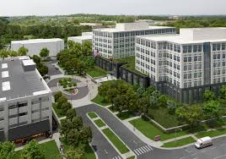
Welcome to NCI New Facility
2014

Slide 3
Plan of Presentation
Background to Planned Forum
International Imaging Workshop I CIHR, CR UK, NCI) ( July 2011)
NCI Imaging-genomics workshop ( June 2103)
Clinical Quantitative Imaging (QI) Standards Initiatives
QIN: Model for open science to promote clinical imaging standards
Grand Challenges: Clinical Decision Support/IGI and IGDD
Outreach to International Scientific societies:
Preclinical, co-clinical and digital pathology imaging
Mouse Models of Human Cancer (MCHC). Best practices
Exploratory pre clinical imaging standards
Research Resources for QI and correlation with genomics
Challenges and goals for an international forum for QI best practices

Slide 4
International Imaging Workshop Canada CIHR, CR UK, NCI, London July 2011
Quantitative Imaging Workshop Goals:
Science: Linking ‘omics’ to patient care
Scope: Screening, Diagnosis, Therapy and IGDD
Funders: Leveraging Resources/Networks/ Open Science Strategies
Deliverables: NCI -CIHR Funding Plan
Support for Two QIN Teams from Canada ( 2014-2015)
Active Dialogue with CR UK: Data and Tool Sharing ( 2014)
Exploring other Countries: EU Framework, India, China
Notes:
One of the values of networking not yet mentioned is the opportunity to connect with other networks. Program staff members at CIP are working with research networks of other countries (UK and Canada) to create opportunities for consensus building and resource sharing on a global scale.

Slide 5
NCI: Imaging-Genomics Workshop(June 2013)
Leverage next generation of the TCGA project
Explore new imaging methods to improve correlation with genomic signatures
Explore advanced computation and modeling methods that are operator independent
Explore use of cloud computing methods
Explore the need to scale up TCIA- as an international resources to meet these goals

Slide 6
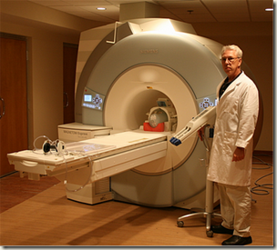
QIN “Open Science’ Network: 21 Teams (U01) Development and Performance Assessment of Quantitative Imaging Methods for Prediction or Response to Therapy
TCIA Imaging Archive:
Annotated image databases
with metadata
Link to a
Clinical Trial
Development
Clinical trial
Tools
Tool
Validation
QIN
A QIN Member
Goal: Standardized Imaging Tools
Consensus on data collection/analysis

Slide 7
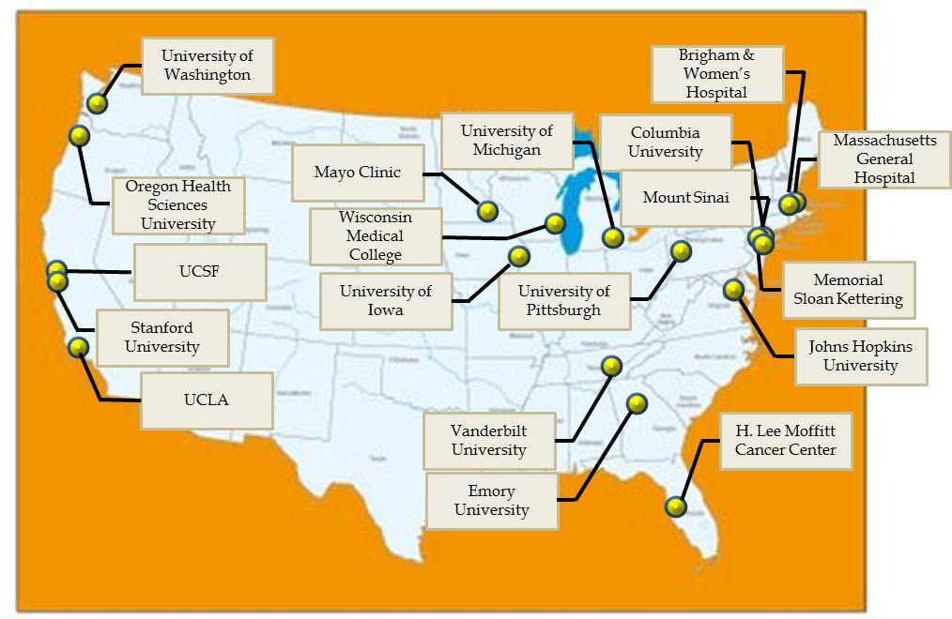
The Current QIN Teams

Slide 8
Goals for new QIN PAR-14-116 2014-2019
Enhance the value of quantitative imaging in clinical trials to predict or measure response to therapy.
Develop, optimize & validate quantitative imaging methods and software tools for a single clinical trial site
Address the challenge of integrating existing or new methods and tools into multi-site multi -platform clinical trials.

Slide 9
Two research strategies including research infrastructure
Inclusion in multisite trials
Harmonization across platforms
Clinical acceptance
Validation from multisite trials
Tool optimization
Tool development
Tool validation
Modifying clinical trials
(Not part of QIN)
Integration into multisite
Multi platform clinical trials.
Validated quantitative imaging
Methods single clinical site.
Research Infrastructure

Slide 10
PAR-14-116 QIN U01 Details
Renewal applications are permitted
Single Site or multi-site trials (data collections)
Domestic and foreign applications encouraged
Industry participation encouraged
Budget remains capped at $500k direct costs (5 years)
Itemized budget for WG’s, data and tool sharing
Research Strategy: Different Emphasis
Need not to be strong in all areas
QI methods
Selection of clinical trials
Imaging Modalities
Research Infrastructure

Slide 11
NCI-MICCAI 2013 Scientific Society Outreach to Promote Imaging Standards
Automatic Segmentation of Prostate Structures (ASPS):
Neurovascular Bundle & Seminal Vesicles
2. Automatic Segmentation of GBM components (BRATS):
Core, Edema, Enhancing and non-Enhancing regions
http://cancerimagingarchive.net/
Or
http://www.miccai2013.org/
Other Societies
RSNA (QIBA)
AAPM
SPIE

Slide 12
Mouse Models Preclinical Imaging Standards For Co-Clinical Trials

Slide 13
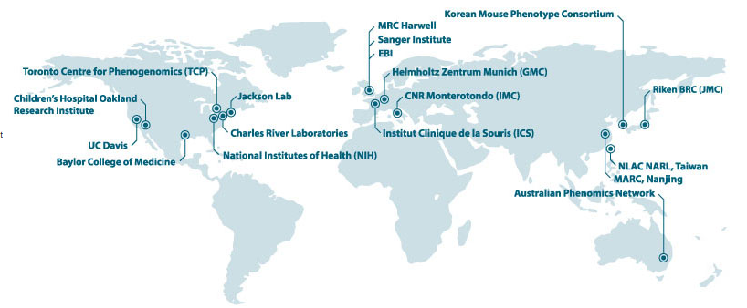
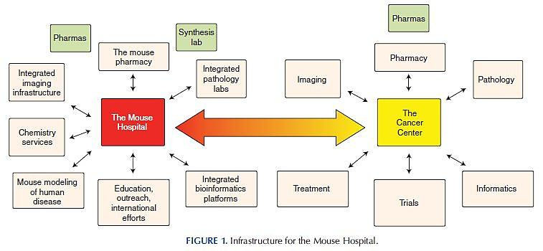
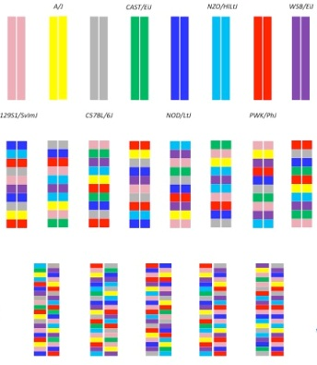
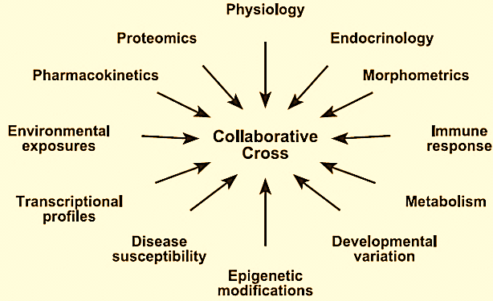
The International Mouse Phenotyping Consortium
System Genetics in Mice: International Population Resources
Inbred Founder Strains
The Mouse Hospital Concept
CC
Collaborative Cross Diversity Outbred Mice
DOM

Slide 14
Research Resources

Slide 15
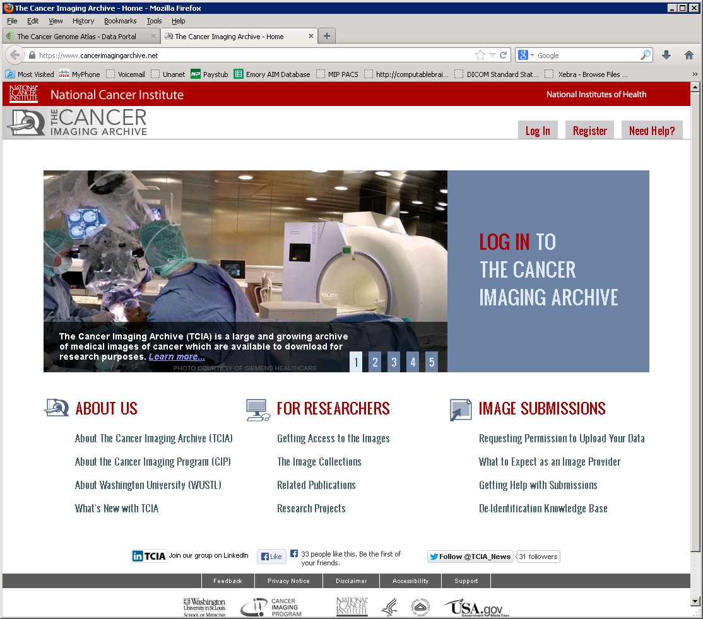
NCI: The Cancer Imaging Archive (TCIA) International Research Resource
Linked to The Cancer Genome Atlas-(TCGA)
TCIA-Imaging Genomic Correlation
TCIA: National CT Lung Screening Trial Data (NLST)
Quantitative Imaging Network Data (QIN)

Slide 16
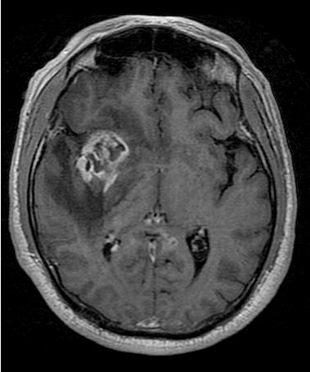
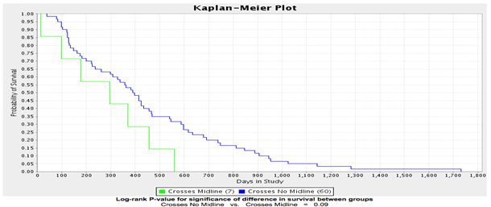
TCGA-TCIA: Correlative Studies
Image Annotation Data
Genomic &
Clinical
Analytic Results
Image
+
+
=
Goal: Improved models for understanding survival and additional potential biomarkers to follow for response.

Slide 17
NCI Center For Bioinformatics and IT (CBIIT) Imaging WG: New Contract (2013-2014)
Research Themes:
QI and Imaging-Genomics Correlation
Scope: Clinical (QIN), Co-Clinical, Digital Pathology
Development of interoperability standards for image, meta data and software tools
Pilot Challenges: Image processing methods
Data Sharing- TCIA, Tool Sharing: HUB Zero
Pilot Efforts: Cloud Computing (HUB Zero)

Slide 18
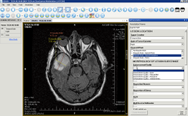
Center For Bioinformatics and IT (CBIIT) RFI: Pilot: Data Analysis in the Cloud Potential Pilot Project Imaging Sciences? Long Term: : NIH BIG DATA Project?
Moving the data to the tools and algorithms
Moving the tools and algorithms to the data

Slide 19
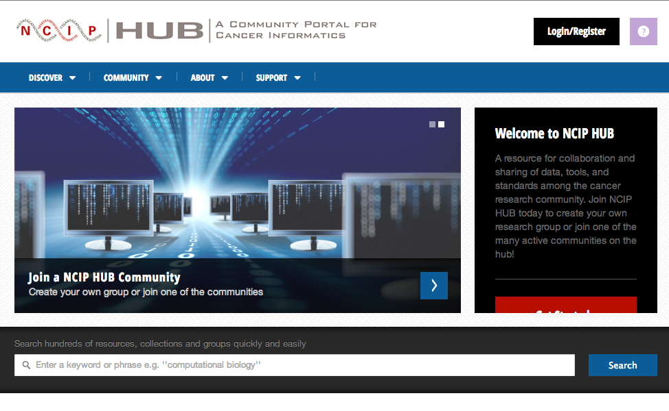
NCI Center for Bioinformatics and IT (CBIIT) HUB ZERO Collaborative Tools Sharing Imaging –Genomics-Proteomics…

Slide 20
International Funding Opportunities

Slide 21
Academic -Industry Partnerships (R01) NCI PAR 11-169
Strong emphasis on translational research
Bi -directional research between academic & industrial sites
Development and validation of imaging platforms:
Human and Pre-Clinical imaging
Early Detection, diagnosis, IGI, therapy response
Development of research resources
Imaging phantoms, software tools , imaging archives
Multiple PI’s: Includes Industry, and/or International
Hub and Spoke Model ( QIN U01-R01)

Slide 22
Informatics Technology for Cancer Research (ITCR) Initiatives : (R01, U01, U24’s)
Supports cancer research-driven informatics/ software development; including imaging
Software requirements:
Provide flexible and scalable software support throughout development life cycles
Includes software prototyping, enhancement, maintenance
Must include plans for data sharing and software sharing
Scope covers either basic or clinical research
Includes pre-clinical of clinical decision support tools

Slide 23
NIH BIG DATA: Funding Opportunities
PA-14-154: Early Stage Development of Technologies in Biomedical Computing, Informatics, and Big Data Science (R43/R44) http://grants.nih.gov/grants/guide/pa-files/PA-14-154.html
PA-14-155): Early Stage Development of Technologies in Biomedical Computing, Informatics, and Big Data Science (R01) http://grants.nih.gov/grants/guide/pa-files/PA-14-155.html PA-14-156: Extended Development, Hardening and Dissemination of Technologies in Biomedical Computing, Informatics and Big Data Science (R01) http://grants.nih.gov/grants/guide/pa-files/PA-14-156.html PA-14-157: Early Stage Development of Technologies in Biomedical Computing, Informatics, and Big Data Science (R41/R42) http://grants.nih.gov/grants/guide/pa-files/PA-14-157.html

Slide 24
Challenges and goals for an International forum for QI best practices

Slide 25
Potential Areas of Common Interest
Clinical decision support systems:
Clinical and Preclinical
QI for prediction and/or measurement of response to therapy
QI correlation with genomics signatures for prediction of response to therapy
Sharing research resources
Image and Meta data-archives, metrology tools

Slide 26
International Forum for Quantitative Imaging (proposed)
International Forum for Quantitative Imaging
Research
Networks
Canada
CIHR
US
QIN & other
U01, R01, U24
Programs
NIH
UK
CR-UK
Other
Fun ding agencies
Other
EU framework
Associate
Members
Canadian
Researchers
US
India, China
UK Researchers
Other

Slide 27
Challenges: International Forum
Actively participate in promoting “best practices” in imaging sciences and quantitative imaging standards for data collection and analysis
Explore joint collaboration across clinical, pre clinical and digital pathology
Actively participate in efforts to correlate imaging with genomic signatures and other molecular assays
Societies: Clinical: Collaborate on “Grand Challenges”
Societies: Pre Clinical: Develop a new consortium; promote “Grand Challenges” such as WMIC, other

