Slide 1
Automatic information extraction from free-text pathology reports using multi-task convolutional neural networks
Hong-Jun Yoon
Biomedical Sciences, Engineering and Computing Group
Computer Sciences and Engineering Division
Notes:
I heard the purpose of the meeting is to learn in depth of NLP techniques and studies, so I would focus on the detail of the CNN for NLP, how it works, what it learned, how it is programmed, what are the limitations, and how we can improve.

Slide 2
Joint Design of Advanced Computing Solutions for Cancer (JDACS4C)
Notes:
The JDACS4C consists of two parts; on the left side is focusing on scientific aspect, and the right is on engineering and implementation. Several of DOE laboratories are participating in, and each laboratory leads the pilot study. ANL is leading the Cellular level study, LLNL is doing Molecular level, and our laboratory is leading research efforts on population level studies. CANDLE is for research and engineering works of implementing the pilot works on DOE operated exascale machines.

Slide 3
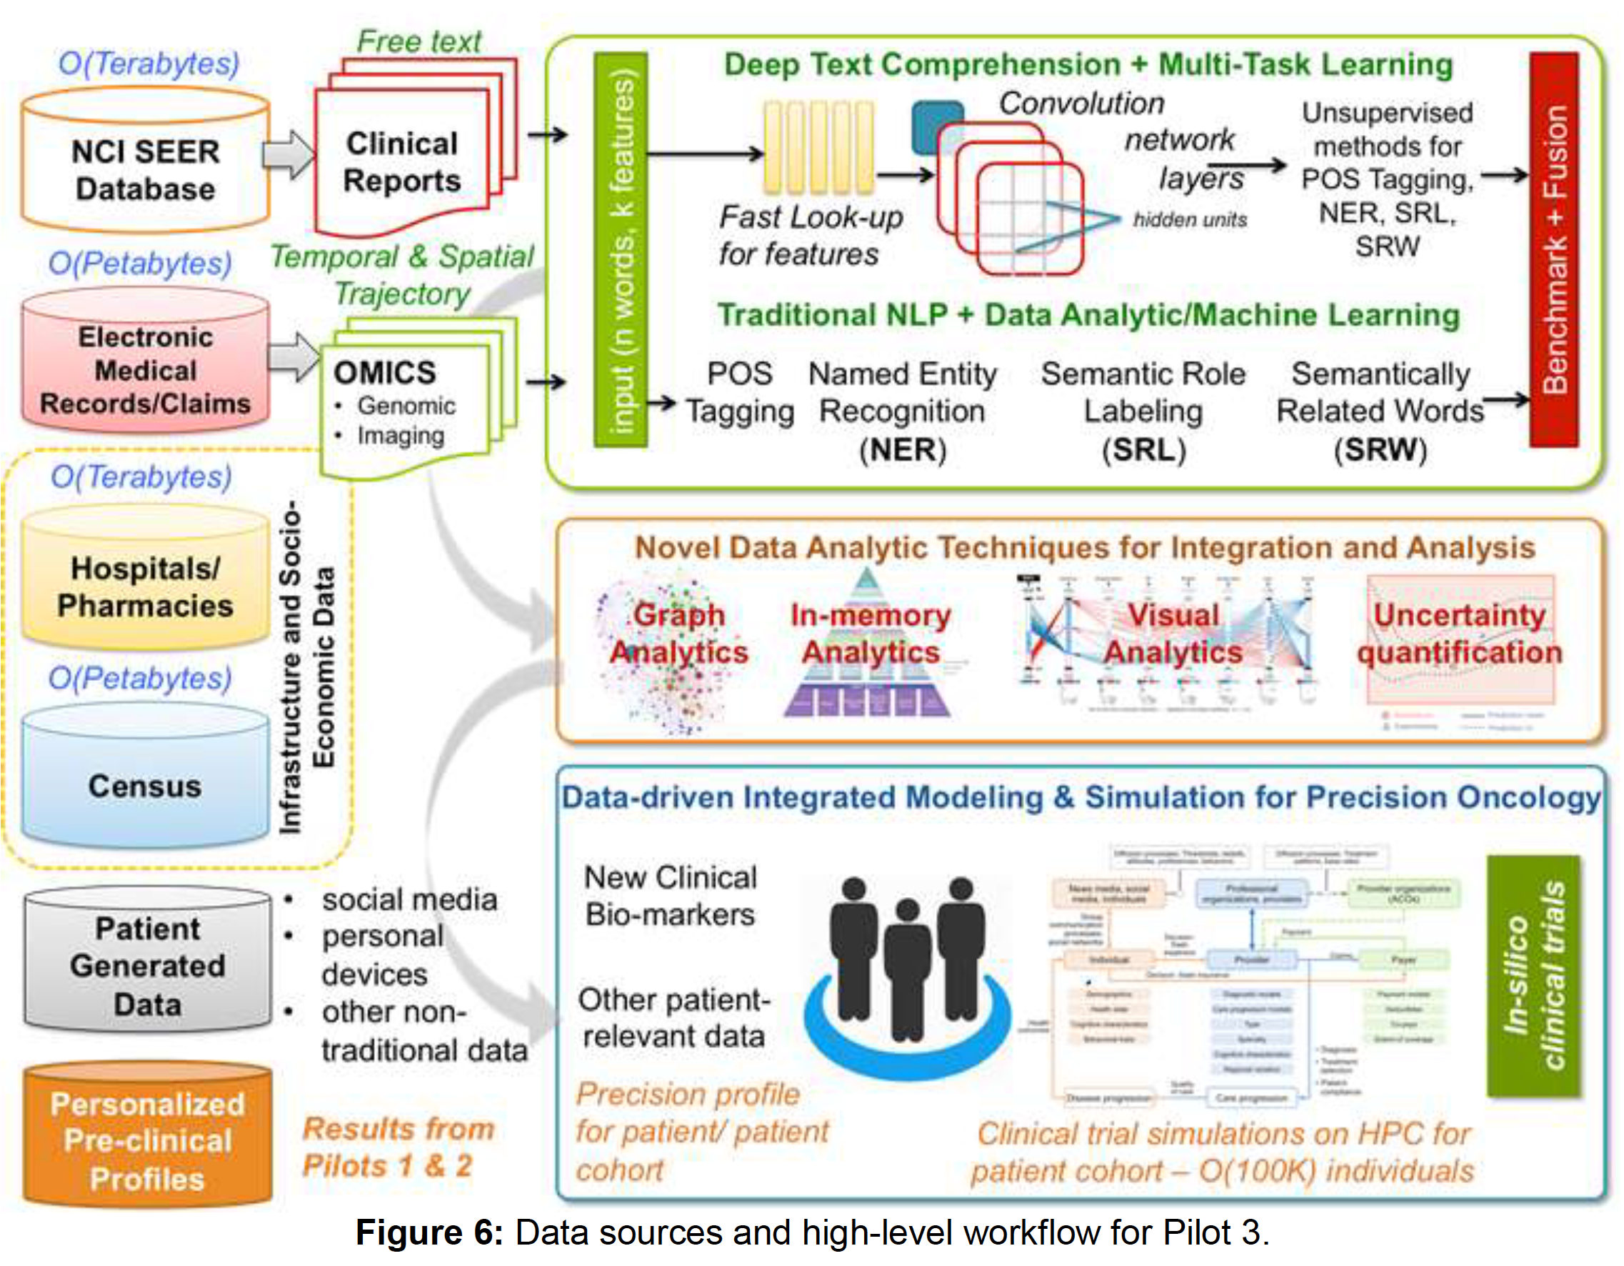
Pilot 3 - Population Level Pilot for Population Information Integration, Analysis and Modeling
Notes:
ORNL is doing research on population level information integration and modeling. Which means, we need to extract and collect information from multi-modality data, including natural language text. That we named Aim 1. Aim 2 is composing a statistical model and applying various types of analytics, let’s say graph analytics, visual analytics, and so on. Then we will suggest a new model and perform simulations to generate a new hypothesis.

Slide 4
Deep Text Comprehension
NEED
Abstracting structured data from free-text pathology reports is critical for the national cancer surveillance program
CHALLENGE
Manual abstraction is time-consuming, costly, and not scalable
GOAL
Develop a scalable framework for automated information extraction from pathology reports
Notes:
As a part of Aim 1 effort, we are developing a model that extracts information and compose a structured data from free-text pathology reports. Right now the reading and abstracting is done manually, which is very time-consuming, error prone, costly. So, developing a scalable framework for automated information extraction would be really beneficial to the national cancer surveillance program, which I know there is a there-year backlog, and right now only a few portion of the reports being read and make estimation based on that.

Slide 5
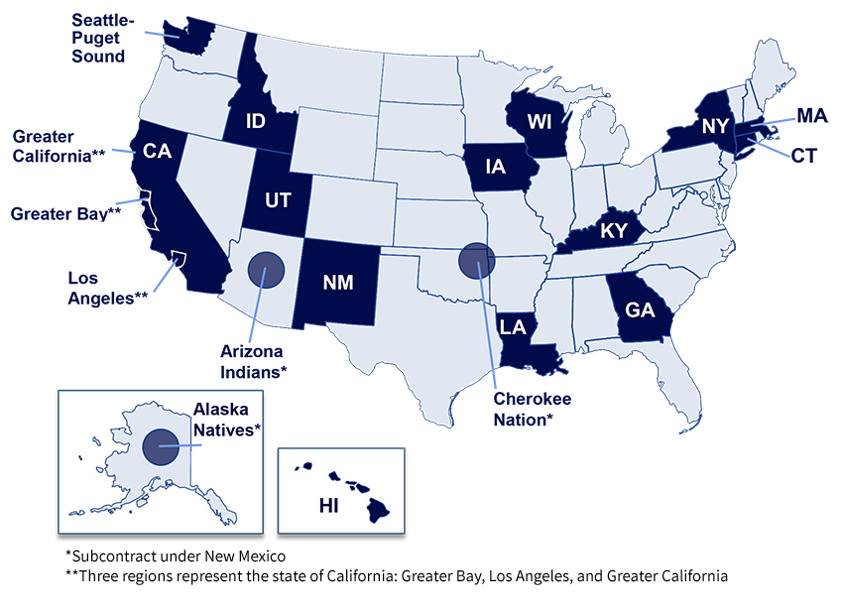
Data Sources
NCI Surveillance, Epidemiology, and End Results (SEER) Program
Since 1973
450,000+ cases / year
1/3 US population
Notes:
What we are doing is setting up a data use agreement with SEER registries, transfer cancer pathology reports from them, and store them to the PHI enclave, we called Knowledge Discovery Infrastructure (KDI). So, we secure the data access only to the trained designated researchers. Provide GPU DevBoxes to play with. Also, we make a tokenized data file export to the Summit supercomputer, so we can perform hyperparameter optimization, new algorithm development, etc on the ORNL supercomputer facility.

Slide 6
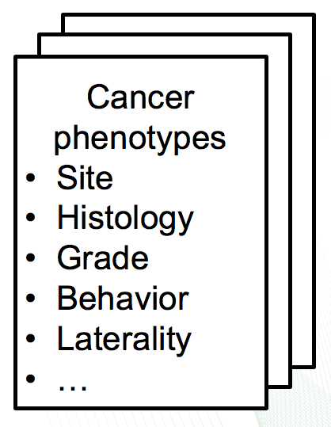
Cancer Phenotyping
Automated information extraction
Replace manual or rule-based approaches
Scalable training of solutions
Deploy API to SEER registries
Notes:
So, what we need for this project to extract those FIVE cancer phenotypes such as site, histology, behavior, laterality and grade. One may suggest some kind of authentic NLP, Part of Speech, Named Entity Recognition, and perform a kind of topic modeling. But, the task we need to do does not require that much of detail. So, we need fast, easy, and that works type of solution.

Slide 7
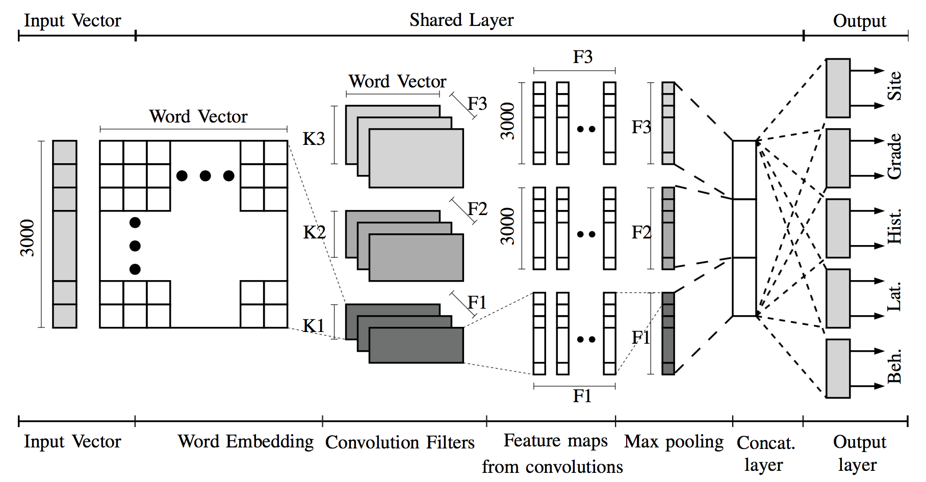
Multi-Task Convolutional Neural Networks for Cancer Pathology Reports
Notes:
So, what we did was applying CNN for natural language processing, aka Yoon Kim’s CNN. It is word-based model, so the first part is converting words into vector forms, called word vector or word embedding. Then, we apply 1D convolution to the word embedding matrix. On the right end, we add multi-task fully connected layer on. The multi-task learning mechanism is the way that the latent feature representations in word embedding layer and 1d convolution layer being more generalizable, so that we can expect the higher clinical task performance. Which is the following.

Slide 8
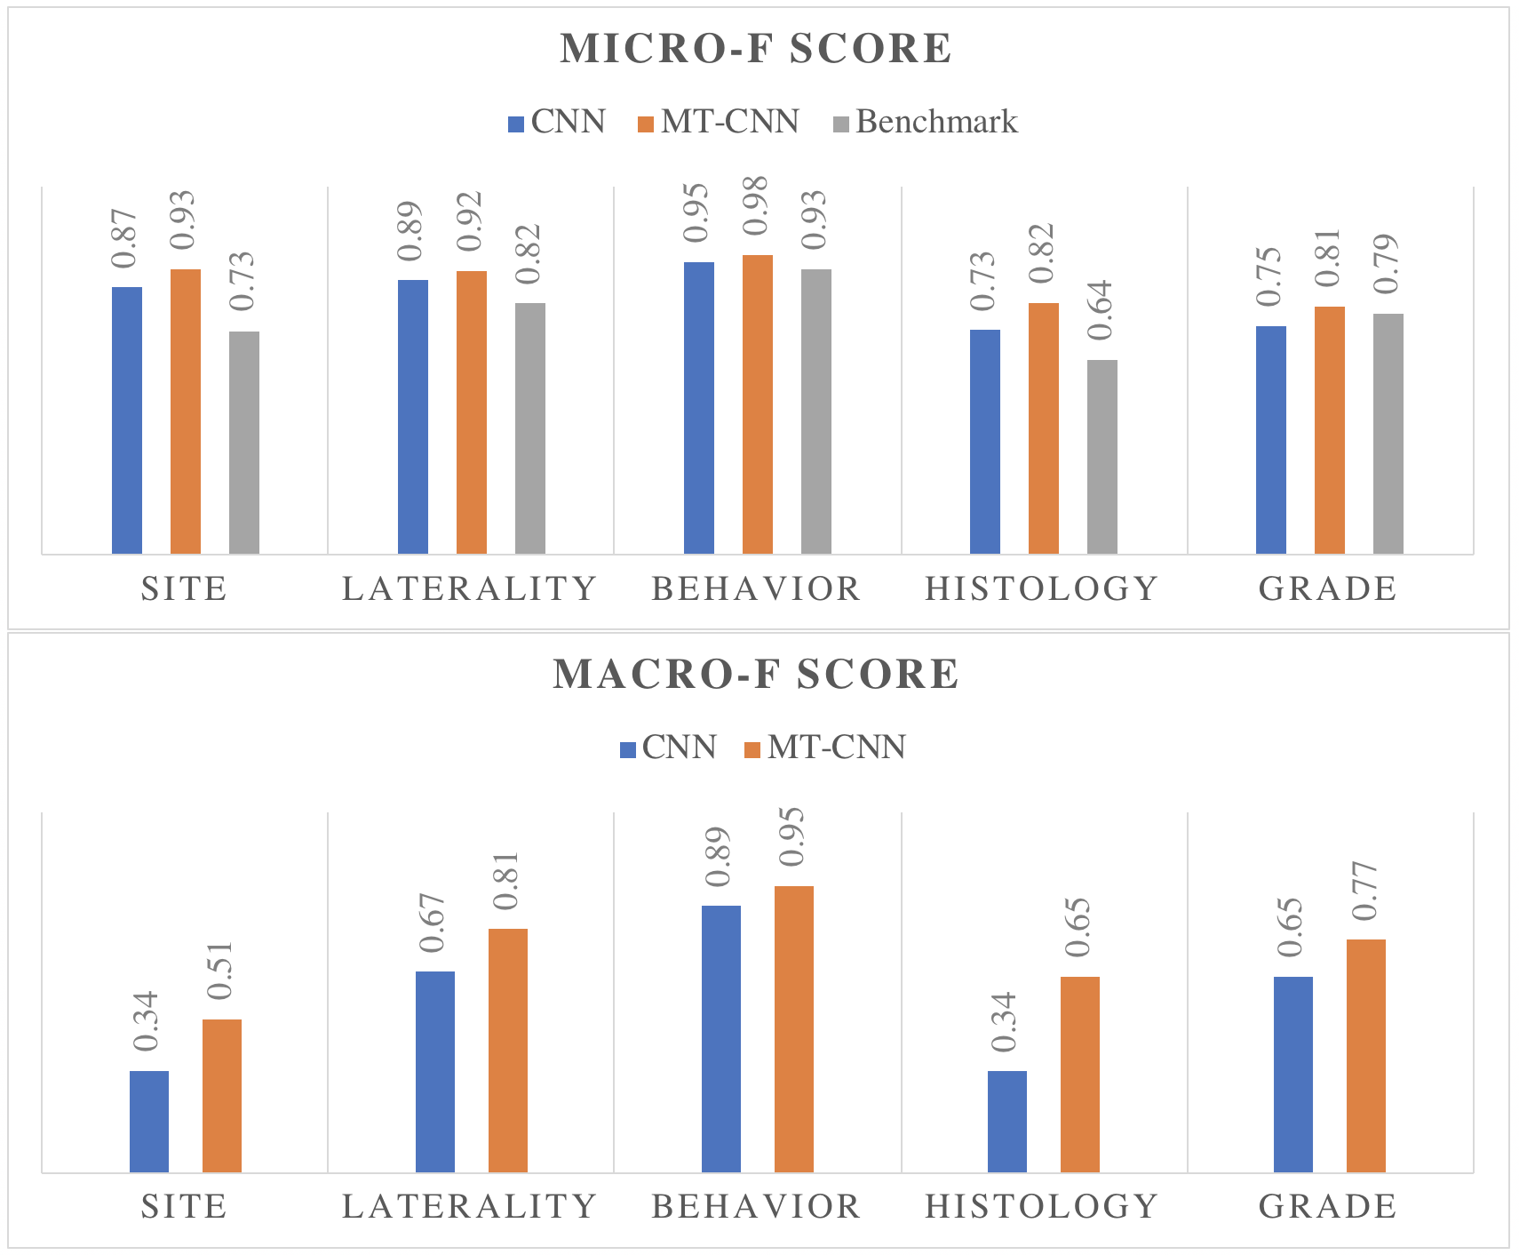
Performance Metrics
Notes:
So, this is the bar charts comparing between multi-task versus single-task learning mechanism. We applied the same CNN models, but made substantial differences between single-task and multi-task. So, the multi-task learning works. This is because there are 300 class labels to histology, and 70 classes to primary cancer sites. And it is very unbalanced.

Slide 9
Follow-up Research Activities
Data parallelism
Uncertainty quantification
Abstention / novelty detection
Hyper-parameter optimization
Convolutional filter pruning
Publications
Yoon, H. J., Alawad, M., Christian, J. B., Hinkle, J., Ramanathan, A., & Tourassi, G. D. (2018, November). HPC-based Hyperparameter Search of MT-CNN for Information Extraction from Cancer Pathology Reports. In CAFCW 2018, HPC 2018.
Yoon, H. J., Robinson, S., Christian, J. B., Qiu, J. X., & Tourassi, G. D. (2018, March). Filter pruning of Convolutional Neural Networks for text classification: A case study of cancer pathology report comprehension. In Biomedical & Health Informatics (BHI), 2018 IEEE EMBS International Conference on (pp. 345-348). IEEE.
Yoon, H. J., Qiu, J. X., Christian, J. B., Hinkle, J., Alamudun, F., & Tourassi, G. D. (2019, April). Selective Information Extraction Strategies for Cancer Pathology Reports with Convolutional Neural Networks. Submitted to INNS 2019.
Qiu, J. X., Yoon, H. J., Srivastava, K., Watson, T. P., Christian, J. B., Ramanathan, A., ... & Tourassi, G. D. (2018). Scalable deep text comprehension for Cancer surveillance on high-performance computing. BMC bioinformatics, 19(18), 488.
Notes:
Those are the to-do list of our research, which of some already in the middle of doing, and some of them made very promising results. Especially, we published papers on convolutional filter pruning and novelty detection. Asynchronous data parallelism was also performed successfully. Hyper-parameter optimization is done with ECP CANDLE.

Slide 10
Implementations / codes
ECP CANDLE Benchmarks
Pilot 3 Benchmark 3 (P3B3) – MT-CNN
GitHub repository https://github.com/ECP-CANDLE/Benchmarks.git
JDACS4C
NCI CBIIT Sandbox
pilot3_MT-CNN_ORNL
GitHub repository https://github.com/CBIIT/pilot3_MT-CNN_ORNL.git

Slide 11
MT-CNN models for text classification
Phrase-level features
Transformation
Word-level features
Notes:
Now, I want to explain more in details of the MT-CNN model. How the model learns natural languages and expressions.
The MT-CNN model learns patterns in three layers. First, it learns in word embedding layer, in this layer it captures word-level features, the second layer learns key phrases, a combination of words. Lastly the fully connected layer transforms the latent feature space into linearly separable decision space.

Slide 12
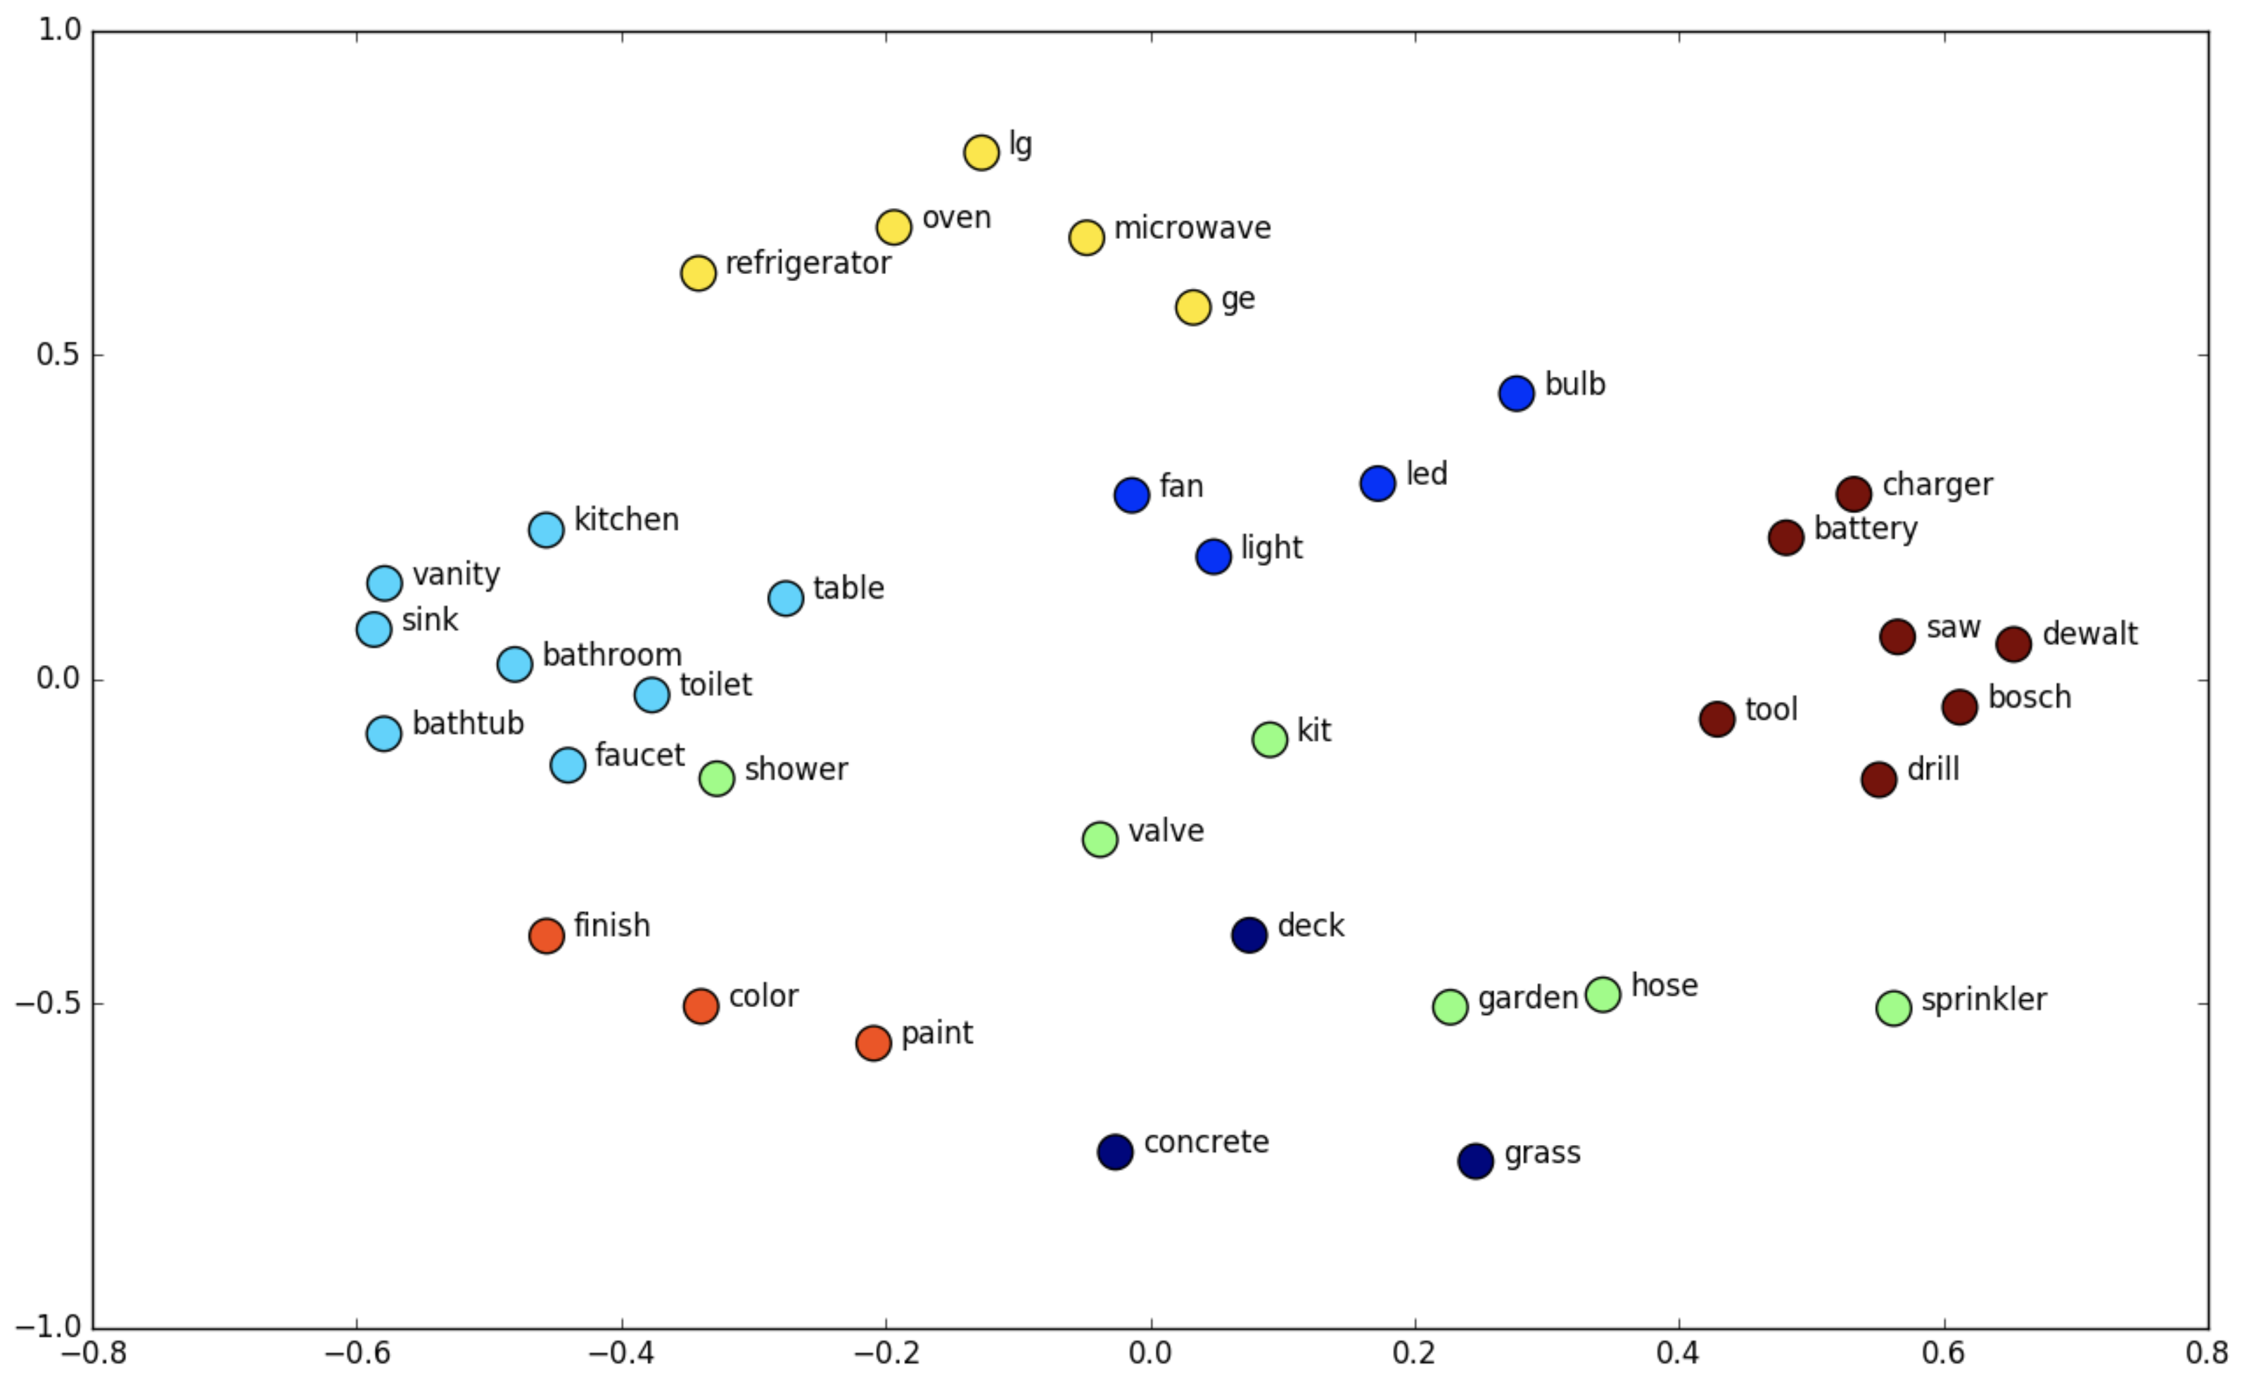
Word embedding
Carry syntactic and semantic meaning
Notes:
Let’s start with the word embedding layer. Word embedding is a translation of words to vector representation. Similarity and relationships between words are modeled by the cosine distance between vectors. What we expect from the word embedding layer is such vector representation can carry syntactic and semantic meaning of the words and vocabularies.

Slide 13
Word embedding training
Word embedding matrices
Pre-trained
Homebrew
word2vec
GloVe
FastText
Randomly initialized word embedding
Let DL training determines its best WE representation
Notes:
Two ways we can train the word embedding layer. First, we can use the external word embedding training algorithms and software packages. We can train word embedding matrices with our data corpus using the word2vec, GloVe, or FastText algorithm. Or, we may train them from the larger, richer data corpus. For example, PubMed. It has vast amount of medical terms and concepts on, so we may expect it can capture more generalizable features than our data corpus itself. Or, we can adopt the pre-trained word embeddings out there. Let’s say Wikipedia word embeddings.
Another way is random initial. Let stochastic gradient algorithm determines the optimal word embedding representation.

Slide 14
Convolution – physical significance
Notes:
The second layer of learning is the 1-d convolution layer. Let’s review the convolution briefly. Assume that we have an input signal in red, and a filter weights in blue. The convolution process is the sum of multiplication between the signal and weights. The point where we received the maximum response, that is the place where the signal is close to the filter weights.

Slide 15
1D convolution
Feature maps
Notes:
Let’s apply it to our 1-d convolution case. We are performing convolution process between the input, which is the word embedding matrix, and the convolution filter weights. The convolution filter is being trained to identify what are the key phrases to classify which document belongs to which class, and so on.
So, convolution filter size means we are trying to identify n-gram features with.

Slide 16
Global max-pooling
May lost temporal information
Notes:
Then we apply global max-pooling to the convolution filter output, which means, we ignore spatial component, but we just care if the n-gram, pattern exists or not. The following fully connected layer and softmax layer will determine the class association of the epath reports.

Slide 17
Demo

Slide 18
Advantages
Prompt inference – less than 0.1 secs / case
Can read massive volume of data in a snap
No need special hardware (GPU)
Multi-task learning
Generalized features
Yield higher accuracy
Simple and intuitive
Easy to apply advanced features – UQ, Abstention, Novelty detection
Privacy aware training, distributed training, etc.
Notes:
We all recognized there are several weaknesses and defects on the model, however, it works quite decently. And, there are several advantages we can hardly deny. Number one is, it is fast. The inference time is less than 0.1 seconds. Actually, much less than that. And, it spits out five decisions at the same time. And, the accuracy score is pretty decent.
Because the structure of the model is very simple and intuitive, we can easily add bells and whistles to it. UQ, Abstention, Novelty detection, etc. We are also researching on privacy aware training and distributed training along with it.

Slide 19
Need improvements
Ambiguity on tasks
Colon / rectal, leukemia / lymphoma, Ill-defined types, unknown types
Variability / variety of expressions, typos, word orders
Severely imbalanced, underrepresented rare cancer types
Class weights
Ignorance of temporal components
Negation
Where is the Gold Standard?
Notes:
And, I don’t want to hide our weaknesses.
CTC = Cancer/Tumor/Case

Slide 20
Summary
Convolutional neural networks
For Natural Language Classification
Word-based
Multi-task learning mechanism
Shared feature representation, additive task-specific layers
Generalized features, higher scores
Achieved decent scores with high speed
Cost effective

Slide 21
Thank you!
For the further / follow-up inquiries: please contact Hong-Jun Yoon (yoonh@ornl.gov)
Questions?

