Slide 1
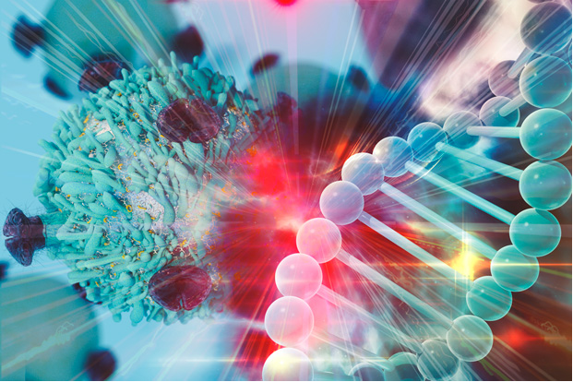
Cancer Challenge Area: Digital Twin Tina Hernandez-Boussard, Stanford University Paul Macklin, Indiana University Tanveer Syeda-Mahmood, IBM Research Ilya Shmulevich, Institute for Systems Biology
Notes:
Unlike webinars which are focused on disseminating information, the purpose of µLabs is to

Slide 2
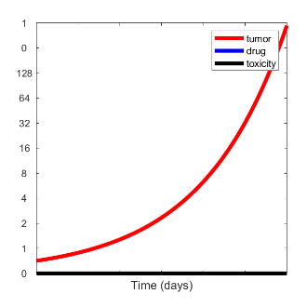
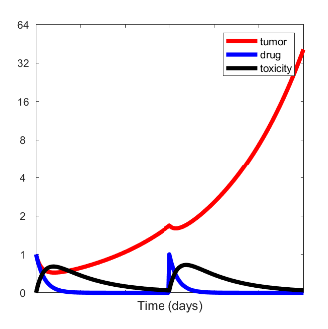
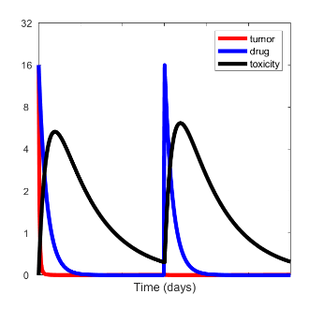
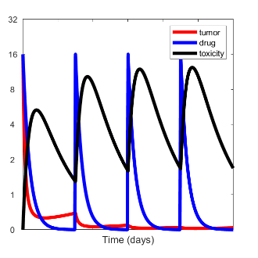
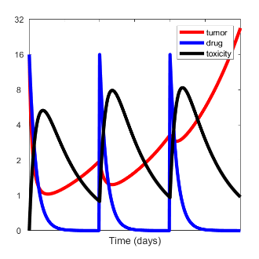
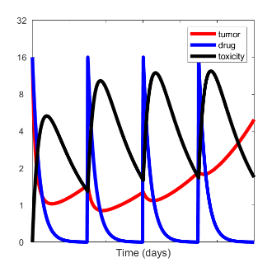
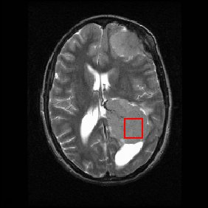
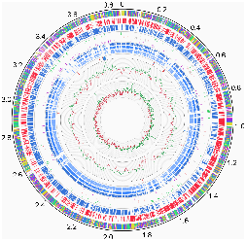
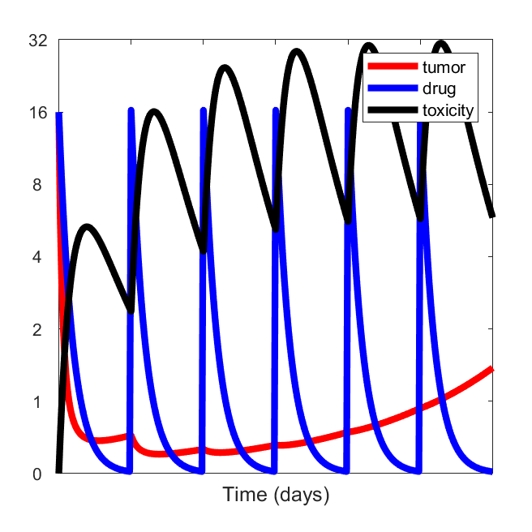
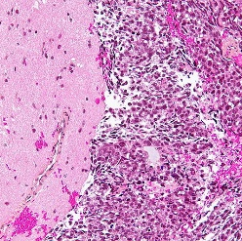
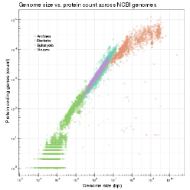
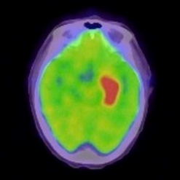
Digital Twin: The big idea
Treatment Exploration
Patient and oncologist discuss goals and preferences
Clinicians build a "digital twin"
Clinicians use HPC to simulate all treatment options on the virtual twin
Patient and clinician explore risks, benefits, side effects
They choose a plan and predict progress using their digital twin
Patient Data
digital twin
Treatment Consultation
Notes:
that push the limits of current cancer research computational practices and compel development of innovative computational technologies; and

Slide 3
What would this enable?
Model personalized benefit from different treatment modalities
Incorporate genetic, environment, and social factors to predict individual trajectory
Predict outcomes and side-effects throughout patients’ health trajectories
Advance patient-valued care
Virtual clinical trials
Synthetic controls
Expand generalizability
Population Estimates
Notes:
that push the limits of current cancer research computational practices and compel development of innovative computational technologies; and
Not just looking at point in time but can predict where the patient will be with each treatment modality

Slide 4
What are the barriers?
Analytics:
Multiscale analysis and coupling of data
Integration of dynamical models with AI
HPC-driven healthcare informatics:
Simulation and virtual evaluation of care pathways
Assess novel therapies simulated data to guide clinical assertions, inform clinical guidelines and develop health policies
Data Sandboxes and platforms:
Assembly of coordinated data across scales per patient
Development of data commons to support the analysis
Multi-scale analysis of cancer
Notes:
that push the limits of current cancer research computational practices and compel development of innovative computational technologies; and

Slide 5
What help is needed?
Analytics, simulation and modeling:
Multimodal analytics
AI research in causal reasoning and pathways
Multiscale data and model standards
Uncertainty quantification
Data Commons:
Unified data and model shares
Data visualization
Patient data ingestions
Validation efforts
Scale out and test
Regulatory:
Licensing, regulatory, and funding landscape
Open source and open data where possible!
Integration with socioeconomics
Notes:
that push the limits of current cancer research computational practices and compel development of innovative computational technologies; and

Slide 6
Digital Twin Discussion Questions
Do you think this vision is realistic and feasible in our time frames?
Would you like add any additional perspective on this vision?
What do you see as the main challenges in achieving this vision?
What existing funding sources are there to support research in this area?
Which specialty areas/collaborators should be involved?
What do you see the role of academia versus industry in addressing this vision?
In what ways can you help expand/realize this vision?
What are the cross-cutting themes you would like to explore in-depth (biological, clinical & computational)?
What do we need to dive into greater depth in the breakout?
Notes:
that push the limits of current cancer research computational practices and compel development of innovative computational technologies; and

